Slide 1
Public Workshop
Discussion of Updates to the new Electronic Certification Database for On-Road Heavy-Duty Engines, Vehicles, and Powertrains and for
Off-Road Compression-Ignition Engines
September 29, 2021

Slide 2
Public Workshop - September 29, 2021
Discussion of Updates to the new Electronic Certification Database for
On-Road Heavy-Duty Engines, Vehicles, and Powertrains and for
Off-Road Compression-Ignition Engines
Agenda
9:05 Welcome
9:10 Presentation of an Overview the E-Cert Project
9:30 Walkthrough on Using E-Cert Data Requirements Document
10:10 Walkthrough of Engine and Vehicle Applications
10:40 Break
10:50 Walkthrough of GHG Vehicle Applications
11:20 Walkthrough of Hybrids and Electrics Applications
11:50 Conclusion

Slide 3
Public Workshop - September 29, 2021
Discussion of Updates to the new Electronic Certification Database for
On-Road Heavy-Duty Engines, Vehicles, and Powertrains and for
Off-Road Compression-Ignition Engines
Overview of the E-Cert Project
What is E-Cert ?
E-Cert is a database designed to accept applications for engines, vehicles, and powertrains including test configurations, emissions testing data, durability program data, emission control systems and other basic components of design, models, and other relevant information.

Slide 4
Public Workshop - September 29, 2021
Discussion of Updates to the new Electronic Certification Database for
On-Road Heavy-Duty Engines, Vehicles, and Powertrains and for
Off-Road Compression-Ignition Engines
Overview of the E-Cert Project
What are the E-Cert project objectives ?
Standardize the application templates
Reduce common errors committed by manufacturers and CARB staff
Eliminate need for CARB staff to manually copy application data
Streamline verification of numerical values in applications
Streamline comparison of different applications
Align data requested with updated regulations and policies
Develop database capable of storing historical and future data
Improve speed and quality of replies to internal or public data requests
Revamp public Executive Orders webpages using E-Cert data

Slide 5
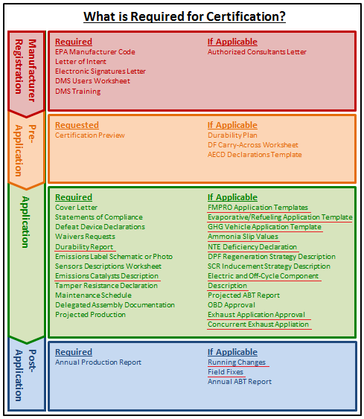
Public Workshop - September 29, 2021
Discussion of Updates to the new Electronic Certification Database for
On-Road Heavy-Duty Engines, Vehicles, and Powertrains and for
Off-Road Compression-Ignition Engines
Overview of the E-Cert Project
How does E-Cert fit in overall certification ?
There are four primary phases of certification: Registration, Pre-Application, Application, and Post-Application.
E-Cert is used during the Application and
Post-Application phases.
E-Cert stores applications in a database and the document management system stores documents in an online filing system.

Slide 6
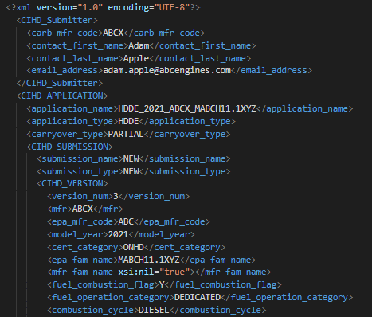
Public Workshop - September 29, 2021
Discussion of Updates to the new Electronic Certification Database for
On-Road Heavy-Duty Engines, Vehicles, and Powertrains and for
Off-Road Compression-Ignition Engines
Overview the E-Cert Project
How are applications into E-Cert created?
Each application is a single, complete XML data file, and may be created in anyway possible that produces a correct application
CARB will provide a web tool that manufacturers may voluntarily use to create XML data files.

Slide 7
Public Workshop - September 29, 2021
Discussion of Updates to the new Electronic Certification Database for
On-Road Heavy-Duty Engines, Vehicles, and Powertrains and for
Off-Road Compression-Ignition Engines
Overview of the E-Cert Project
How are applications into E-Cert submitted ?
Each application…
must be submitted sequentially, i.e. each file is an update of the most recent previous file – no “leapfrogging”.
will be reviewed in the order it is received. For example, Running change #2 will not be reviewed until Running Change #1 is fully reviewed.
Carryover applications…
are assumed to carryover from the most recently submitted version of the source application that was submitted before the carryover application.
are reviewed only after this version of the source application is approved.

Slide 8
Public Workshop - September 29, 2021
Discussion of Updates to the new Electronic Certification Database for
On-Road Heavy-Duty Engines, Vehicles, and Powertrains and for
Off-Road Compression-Ignition Engines
Overview of the E-Cert Project
How are applications into E-Cert reviewed?
Each application will be reviewed using the current process of review by staff, peers, and management before a final decision is made.
Assigned staff will monitor the information submitted to E-Cert and the document management system to ensure all required information is received.
Certification review timeframes will be based on submissions to both E-Cert and the document management system.

Slide 9
Public Workshop - September 29, 2021
Discussion of Updates to the new Electronic Certification Database for
On-Road Heavy-Duty Engines, Vehicles, and Powertrains and for
Off-Road Compression-Ignition Engines
Overview of the E-Cert Project
What applications will be submitted to E-Cert ?
Engines | Vehicles
Medium-duty diesel and Otto * | Medium-duty diesel and Otto *
Heavy-duty diesel and Otto | Heavy-duty diesel and Otto †
Off-road compression-ignition | Heavy-duty GHG vehicle families ‡
Flexibility (“TPEM”) Ʇ | Heavy-duty Zero Emission Powertrain families
* Certified using the heavy-duty engine test procedures | † Includes hybrid vehicles and powertrains
Ʇ Included for historical purposes | ‡ Includes fuel cell and electric vehicles
Applications for Aero Devices, exempt (N-Series) engines, and fuel-fired heaters are not included.

Slide 10
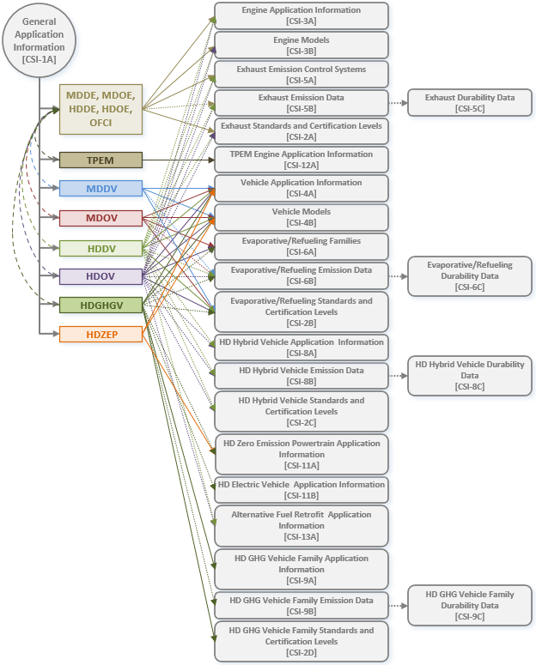
Public Workshop - September 29, 2021
Discussion of Updates to the new Electronic Certification Database for
On-Road Heavy-Duty Engines, Vehicles, and Powertrains and for
Off-Road Compression-Ignition Engines
Overview of the E-Cert Project
What information is submitted into E-Cert?
All applications include some information which is also included in some other category.
To minimize repetition, most tables in the database are used by multiple application categories.
E-Cert will expect specific blocks of data based on the application category and other field values.
E-Cert documentation explains the rules that the system will use to check each application. These rules mimic current review procedures used by staff.

Slide 11
Public Workshop - September 29, 2021
Discussion of Updates to the new Electronic Certification Database for
On-Road Heavy-Duty Engines, Vehicles, and Powertrains and for
Off-Road Compression-Ignition Engines
Overview of the E-Cert Project
Where are we in the E-Cert project timeline ?
2008 – Initial E-Cert effort
2009-2014 – Suspended due to other priorities
2014-2017 – Internal development of data requirements with expanded scope
August 2017 – Workshop to introduce expanded data requirements
October 2017-October 2018 – Workgroup meetings
October 2018-February 2019 – Comment period
2019-2021 – Internal development of E-Cert database and updates of data requirements
September 2021 – Workshop to update data requirements
October 2021-June 2022 – Comment period and further internal development
June 2022 – Workshop to describe submission process
July 2022 – Voluntary testing by manufacturers
October 2022 – Official Launch

Slide 12
Public Workshop - September 29, 2021
Discussion of Updates to the new Electronic Certification Database for
On-Road Heavy-Duty Engines, Vehicles, and Powertrains and for
Off-Road Compression-Ignition Engines
Overview of the E-Cert Project
Questions
and
Answers

