Slide 1

Draft 2024 Funding Guidelines for Agencies that Administer California Climate Investments
July 11, 2024
Notes:
[Raina] Good afternoon everyone and thank you for joining us for this afternoon’s workshop, where we’ll be covering updates to the Funding Guidelines for Agencies that Administer California Climate Investments.

Slide 2

Live Spanish Interpretation
In your meeting/webinar controls, click Interpretation.
Click the language that you would like to hear.
To hear the interpreted language only, click
Mute Original Audio.
Notes:
[Raina] Before we dive into the workshop presentation, I’ll cover some logistics.
First, I’ll note that this workshop is being recorded.
Interpretation services will be provided today in Spanish.
There will be a button labeled "Interpretation" on the Zoom screen.
When it appears click on that interpretation button and select the language you’d like to hear the meeting in.
To hear the interpreted language only, click Mute Original Audio. Now, we’ll hear a message from our interpreters about interpretation services.
[Pause to let interpreter make this announcement in Spanish]

Slide 3
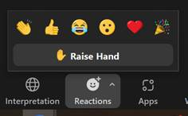

How to Participate
*9
Raise Hand via Zoom Webinar
Select the “Reactions” button, then the Raise Hand option.
The host will be notified that you've raised your hand.
Click Lower Hand to lower it.
Raise Hand via phone:
Dial *9 to raise and lower your hand
Type your comments or questions into the Q&A Box
Notes:
[Raina] Throughout the workshop today, we invite you to submit your written questions using the Zoom Q&A feature.
We recommend taking a moment to ensure your participant name on zoom is your preferred name. This will help us call on you during the Q&A. You’re welcome to add your organization to your name as well.
Later on in the workshop, we’ll also invite those interested in making a verbal comment to use the Raise Hand feature.
If you’re joining on the phone, dial *9 to raise and lower your hand.
My colleague Sierra will help facilitate today’s Q&A sessions and let you know when it’s your turn to speak.

Slide 4

Technical Support
Contact GGRFProgram@arb.ca.gov
Notes:
If you run into any technical issues, please email us at GGRFProgram@arb.ca.gov and we will do our best to assist you.

Slide 5
Workshop Agenda
California Climate Investments Overview
Funding Guidelines Background
Draft Key Changes
Resource Portal Tour
Open Comment
Next steps
Notes:
[Raina] Now that we have gone over the logistics, let’s give today’s speakers an opportunity to introduce themselves.
My name is Raina Ryan, and I will be going over the updates in the draft Funding Guidelines today and assisting with the public comment.
Hi everyone. My name is Kristyn, and I will be providing some background on California Climate Investments today.
Hi everyone. My name is Nicole, and I will be walking everyone through a tour of our new web companion, the Resource Portal today.
Hi everyone. My name is Jamie Tipton, and I will be assisting with the public comment portion of today’s workshop.
Hi everyone. My name is Sierra Maciorowski, and I will be assisting with Q&A and polling.
[Raina] Thank everyone for introducing yourselves! Here is our agenda. We will start with an overview of the California Climate Investments and build on that with background on the Funding Guidelines, which is the topic of today’s discussion. After that, we will dive into the updates in the 2024 draft Funding Guidelines. Once we have a had a chance to go over key elements of the draft, we will provide a tour of our new supplemental web tool, the Resource Portal. Then, we will open the floor for public comment and discussion before wrapping up with next steps.
Now, I will pass the mic to Sierra for a poll question.

Slide 6
Poll: What type of organization do you represent?
Community-based organization/nonprofit
Tribal government or tribal member
Local, regional or state government
California Climate Investments program administrator
California Climate Investments grant applicant
Workforce development or training organization
Business or consultant
Public attendee
Other
Notes:
[Sierra] We’d like to get a sense of who’s joining us today, so we invite you to respond to this poll question.
[Read poll options, share poll results and summarize takeaways from the poll] Sierra is going to launch the poll.
We see we have a fairly diverse set of organizations here today. We appreciate the varied perspectives everyone will have to give.
Thank you all for participating. Now we are going to transition Kristyn, who will provide a brief overview of California Climate Investments.

Slide 7
California Climate Investments Overview
Notes:
[Kristyn] Before we launch into the updates, I will give an overview of what California Climate Investments are, how it works, and how programs and projects are benefiting Californians.
California Climate Investments put billions of dollars of Cap-and-Trade proceeds to work in communities across the state - all with the goal of reducing climate pollution, benefiting disadvantaged communities and low-income communities and households, and providing health and economic benefits.

Slide 8
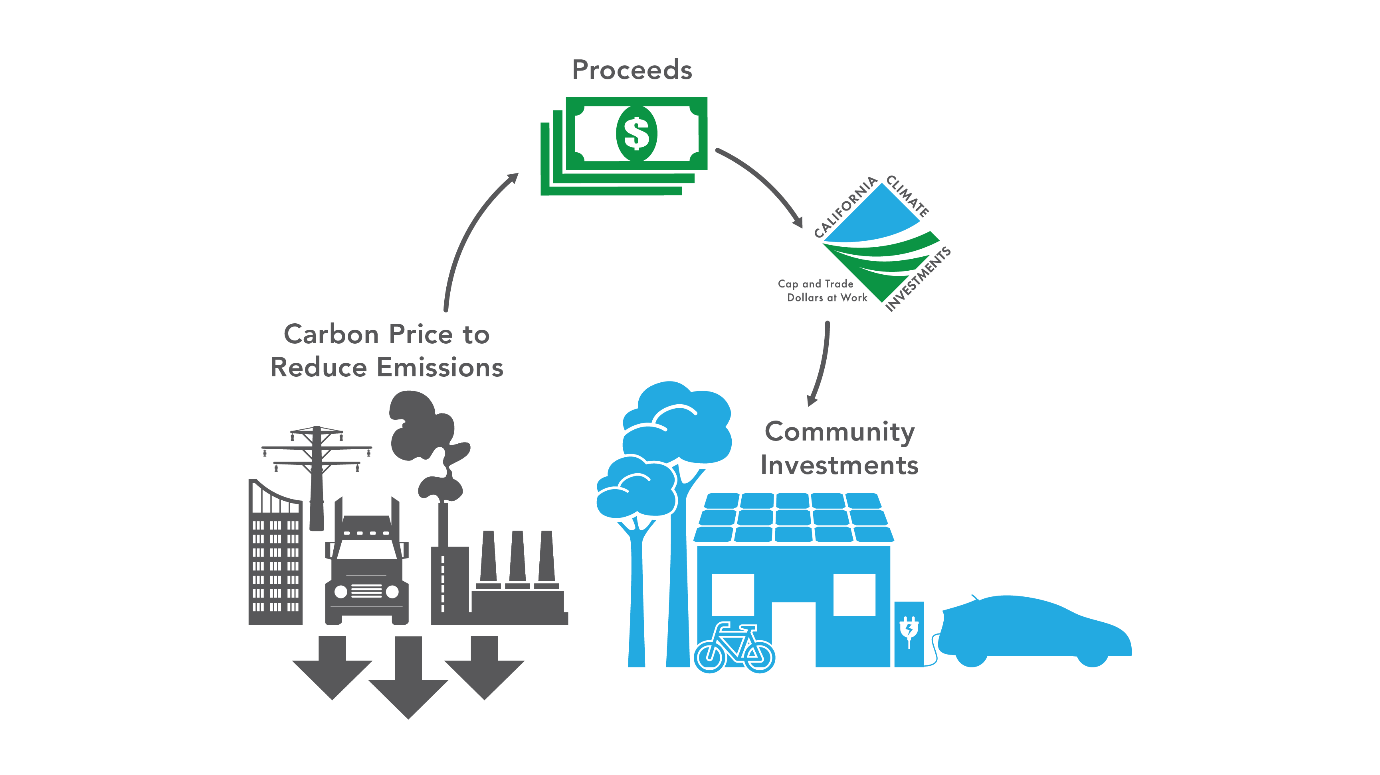
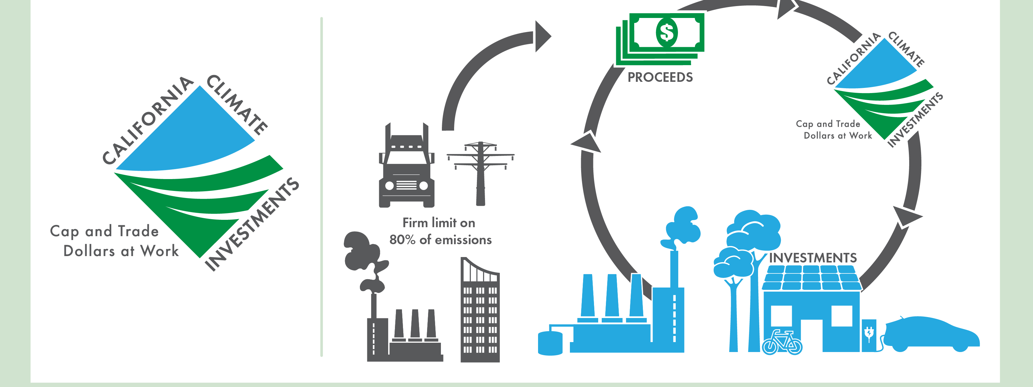
Overview of California Climate Investments using Cap-and-Trade Auction Proceeds
Notes:
[Kristyn] California’s Cap-and-Trade program is one component of a suite of California climate policies to reduce GHG emissions.
Our Cap-and-Trade Program includes an allowance auction mechanism that generates money in the form of auction proceeds. The State's portion of the proceeds from the auction are put into the Greenhouse Gas Reduction Fund, or the GGRF.
That fund has generated over $28 billion * to date and is used for projects collectively known as California Climate Investments.
A collection of state agencies works together to administer programs that provide the fundings to recipients that result in projects on the ground.

Slide 9

















Administering Agencies
Notes:
[Kristyn] Altogether, 24 state agencies administer about 90 different California Climate Investments programs.
CARB, the agency I work for, is the administrator of the GGRF, and plays an important role in overseeing the use of these funds, collecting information about projects, and providing accountability and transparency by publicly releasing information on outcomes. CARB also administers some California Climate Investments programs.
All the agencies you can see on the screen are directing billions of dollars into our state’s transition to a low‑carbon and more equitable future. Each of these administering agencies specializes in a specific sector or set of project types that align with that agency’s focus.
Agencies are administering a broad portfolio of California Climate Investments programs and project types that span virtually all sectors of the economy from transportation and housing to energy efficiency to agriculture, forestry, waste, water, job training and technical assistance.
There is also a growing suite of programs focused on renewable energy generation, electric vehicle charging infrastructure, and building decarbonization.

Slide 10
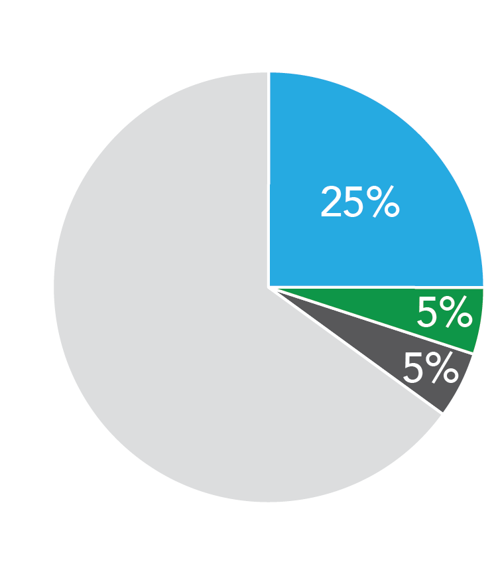
Priority Populations
Assembly Bill 1550
  Disadvantaged communities (25%)
  Low-income communities
  and households (5%)
  Low-income communities and
  households within ½ mile of
  disadvantaged communities (5%)
CARB sets investment targets for programs
Require agencies to evaluate project benefits
California Climate Investments
Notes:
[Kristyn] As part of the legislative requirements for California Climate Investments, 35% of project funding must benefit priority populations.
We refer to populations identified by statute as “priority populations” which include disadvantaged communities, pursuant to Senate Bill (SB) 535, and low‑income communities, and low-income households, pursuant to Assembly Bill (AB) 1550.
CARB develops priority populations investment targets, in consultation with administrating agencies, each fiscal year for programs that receive funding. These targets reflect the ability of each program to target certain priority population categories while encouraging programs to strategize to meet their targets and helping to ensure that California Climate Investments meets its overall statutory minimum requirements.

Slide 11
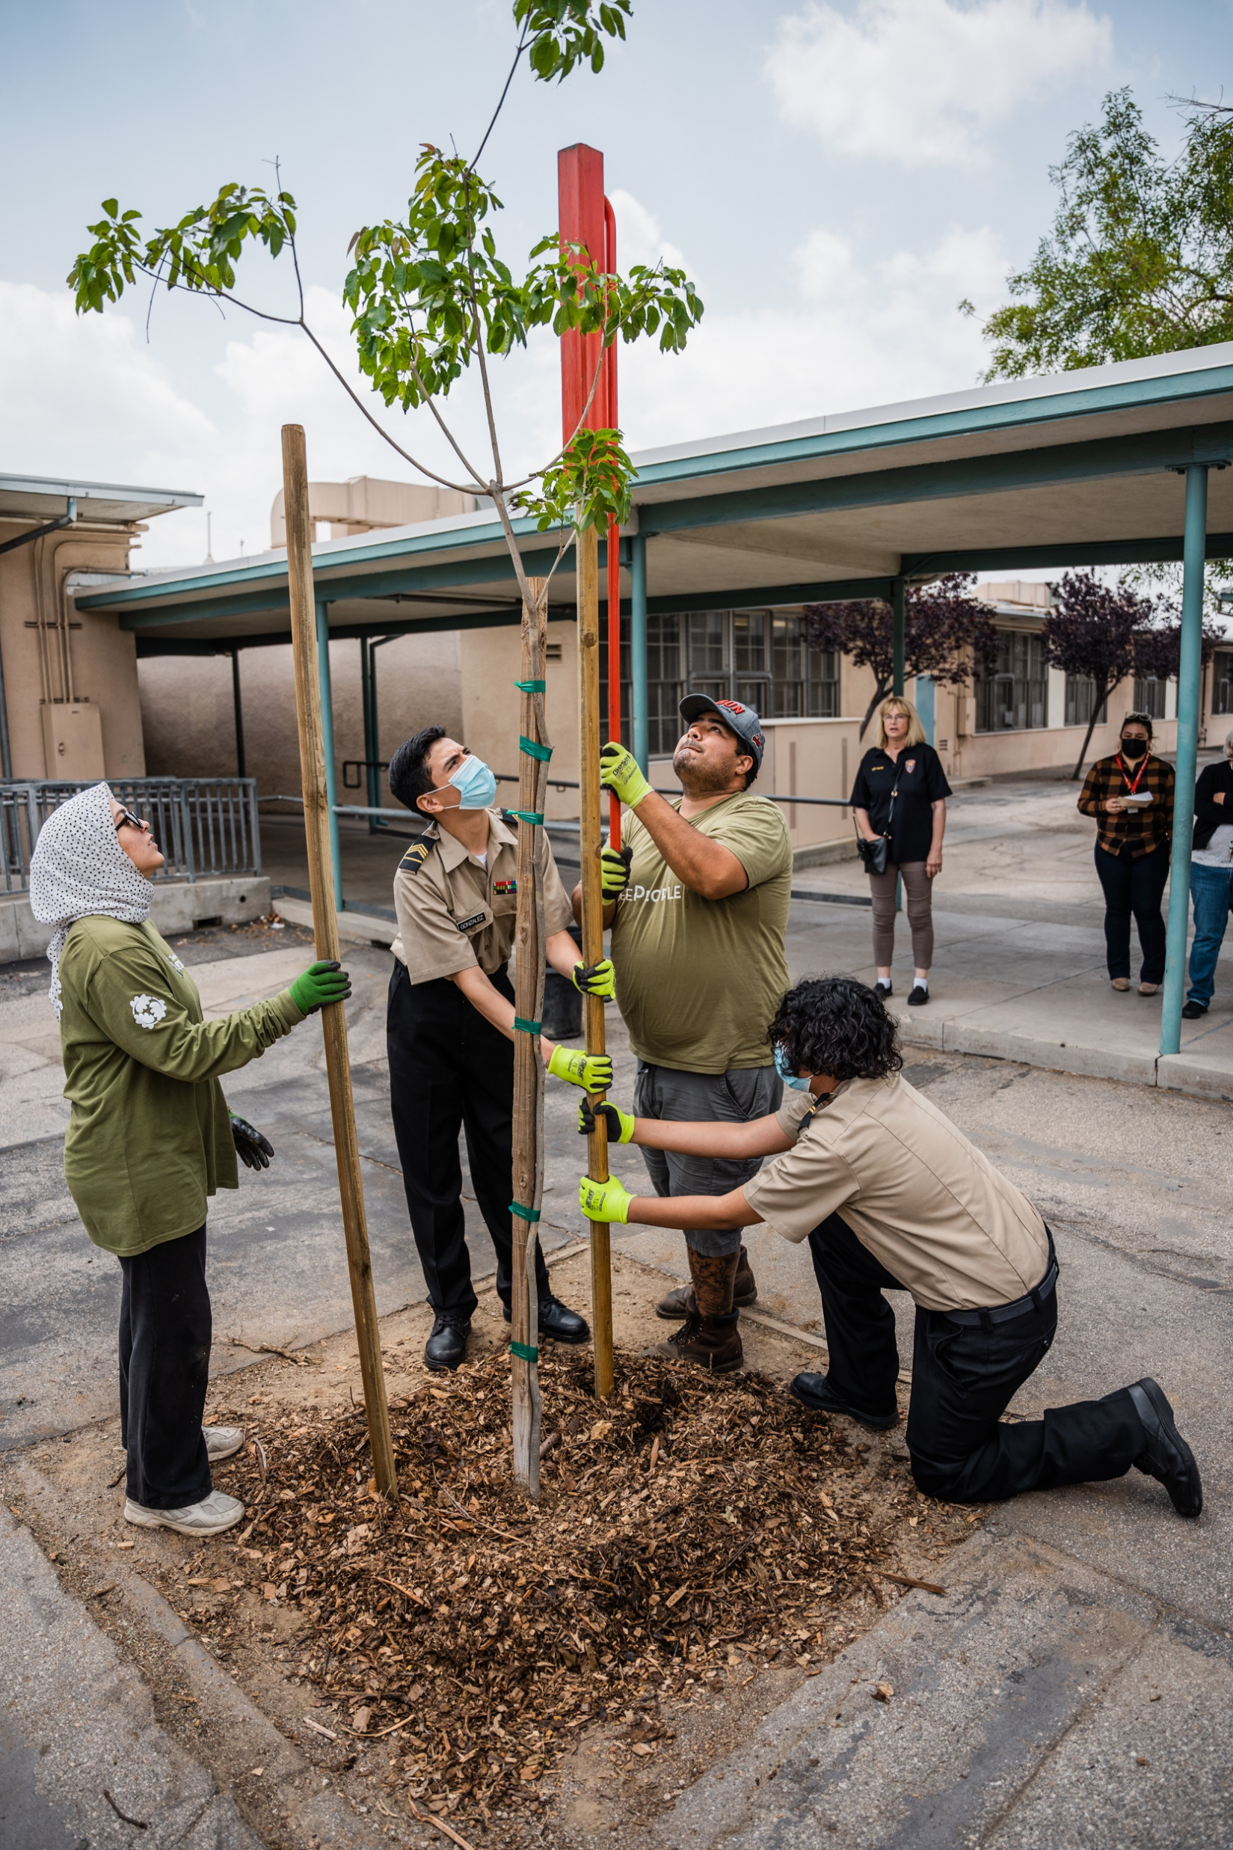
Program Design and Implementation
Legislature and Administration appropriate fund during annual budget process
Agencies responsible for program design
Must adhere to CARB Funding Guidelines
Notes:
[Kristyn] The Administration and Legislature determine which administering agencies will receive funds and how those funds should be used through the annual budget process. The funds an agency receives are known as an appropriation.
Upon receiving an appropriation, each individual agency is responsible for designing programs and selecting projects.
Each agency defines selection criteria and mechanisms to prioritize projects consistent with the objectives of their program, which can range from air quality improvements to water conservation. Funds may be awarded as competitive grants, first-come, first served vouchers, or other funding mechanisms.
All programs must comply with the requirements in the Funding Guidelines which include facilitating GHG emission reductions and maximizing co-benefits and benefits to disadvantaged communities.

Slide 12
Funding Guidelines for Agencies that Administer California Climate Investments
Set guiding principles and investment requirements
  Facilitate GHG emissions reductions
  Benefit priority populations
Used by agencies as they design programs and select projects
Support accountability and transparency
  Annual Report on outcomes
  Interactive project map and downloadable database
Notes:
[Kristyn] CARB developed overarching guidance for all agencies that receive money from the GGRF in 2014 in response to SB 862, and that guidance is embodied by the Funding Guidelines.
The Funding Guidelines set guiding principles and identify statutory requirements, including investments minimums for certain populations.
Administering agencies are responsible for designing and implementing their programs according to CARB’s Funding Guidelines which are designed to meet expenditure requirements and meet the State’s statutory and policy objectives for appropriations from the GGRF.
The Funding Guidelines provide direction for how agencies can target their investments to priority populations, whether it be locating projects within disadvantaged communities, providing job training for local residents, or enhancing cost savings for low-income individuals.
The guidelines also contain requirements for transparency and accountability that include reporting on the status and expected benefits of funded projects.
With the methods and reporting requirements identified in the Funding Guidelines, we have been able to deliver consistent and reliable information to the public and Legislature.

Slide 13
Project Outcomes
Agencies design their programs
  May prioritize applicants serving priority populations
CARB tracks achievements and releases Annual Report in coordination with Department of Finance
As of November 2023, $8.1 billion (76%) of implemented projects benefit priority populations
Notes:
[Kristyn] Since each agency designs their program, they can choose to target certain priority populations. Through individual program guidelines, an agency can give additional scoring points, reduce match requirements, or give priority for first-come, first-serve funding for certain applicants based on location or income.
CARB quantifies and reports on the achievements of programs, so we can understand what benefits programs are providing and how funds are being spent and where.
Once a year around April, CARB, along with our partners in the Department of Finance and the administration, releases an Annual Report to the Legislature. The Annual Report provides information about annual and cumulative achievements, the funding status of programs, estimated greenhouse gas emission reductions, benefits to priority populations, information on estimated co-benefits resulting from projects, and much more.
As of November 2023, 76%, or $8.1+ billion, of implemented California Climate Investments project funding is benefitting priority populations under both SB 535 and AB 1550, greatly exceeding statutory requirements.
This concludes the overview of California Climate Investments. I will now pass the mic over to Sierra for a poll and to transition us over to the Funding Guidelines background.

Slide 14
Poll: What is your level of familiarity with California Climate Investments and the Funding Guidelines?
Very familiar.
Somewhat familiar.
I am familiar with California Climate Investments but not the Funding Guidelines.
Unfamiliar. I attended today to learn more.
Notes:
[Sierra] Thanks, Kristyn! We’d like to know what is your level of familiarity with the Funding Guidelines?
Are you:
Very familiar
Somewhat familiar
I am familiar with California Climate Investments but not the Funding Guidelines
Unfamiliar. I attended today to learn more.
Okay, I will now pass the mic to Raina to go over the updates in the Funding Guidelines draft.

Slide 15
Why are the draft 2024 Funding Guidelines important to me?
Notes:
[Raina] Thanks, Sierra! Some of you may be wondering, why are the draft 2024 Funding Guidelines important to me? The Funding Guidelines, described on slide 12, inform how California Climate Investments programs develop their solicitations and guiding materials. Your input today will help shape the final guidance we publish for the agencies that administer California Climate Investments programs which, ultimately, may impact the experience your community or household has with seeking California Climate Investments dollars.

Slide 16
Timeline for Funding Guidelines Update
Release Draft Funding Guidelines for
public comment
June 2024
First Public Workshop
May 8, 2023
Finalize Funding Guidelines
Fall 2024
Ongoing outreach & engagement
Fall 2022
Public Survey
October 24, 2023
Assembly Bill 680 Workgroup
July 11, 2024
Second Public Workshop
July 1, 2025
Assembly Bill 680 statutory deadline to update Funding Guidelines
Notes:
[Raina] Let’s start with an overview of our process. We kicked-off by launching a public survey in Fall of 2022 to collect input on our planned update to the Funding Guidelines. We hosted our first public workshop on May 8, 2023 to gather additional feedback from the public.
We led an interagency workgroup series over the summer of 2023 to collaborate with agency partners on implementation of the Assembly Bill (AB) 680 workforce standards for certain programs and hosted a public workgroup that Fall to gather public input on workforce development in the Funding Guidelines.
Today, we are hosting a public workshop to discuss the updates made in the Draft 2024 Funding Guidelines to facilitate the current public comment period.
This Summer we will incorporate all feedback we receive from the public and anticipate publishing the final guidance in the Fall.
Before we dive into the key updates, it is also helpful to us to gauge your interest in each topic area. I will pass the mic over to Sierra to lead us through the next poll question.

Slide 17
Poll: Are there specific topic areas you are interested in hearing more about?
Key updates to existing guidance
Resources for program design and implementation
AB 680 workforce standards
Other topics (please type in chat!)
All of the above
Notes:
[Sierra] We would like to know, are there specific areas you are here to learn more about?
This could be:
Key updates to existing guidance
Resources for program design and implementation
AB 680 workforce standards
Other topics (please type in chat!)
All of the above
Okay, thank you all for your responses. There will be time to discuss these and other topics during the question portion at the end of the presentation. I will pass things back to Raina now.

Slide 18
Key Updates
General Improvements
Community Engagement
Expenditure Record Process
Tribal Engagement
Workforce Development
Reporting Timing and Frequency
Program and Project Evaluations
Appendices
  California Carbon Sequestration and Climate Resiliency Project Registry
  Updated Priority Populations Designations
  Reporting for Projects not Funded by GGRF
Notes:
[Raina] Thanks, Sierra! The draft Funding Guidelines contain updates throughout the document that cover several key update areas.
These areas are:
General Improvements
Community Engagement
Expenditure Record Process
Tribal Engagement
Workforce Development
Reporting Timing and Frequency
Program and Project Evaluations; and
8. Inclusion of existing, related guidance as appendices
We will walk through each key update area in this next section.

Slide 19
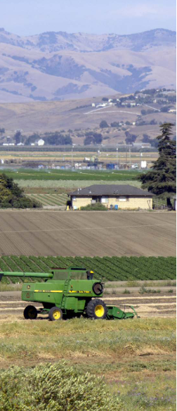
1. General Improvements
Condense and consolidate information
Clarify action items
Addition of appendices
Add new links to the Resource Portal, resources, and materials
Notes:
[Raina] The goal of this first update area was to make general improvements based on feedback we heard from administering agencies and lessons learned in order to make the Funding Guidelines easier to read and use, and easier to update in response to future changes.
In an effort to make the document more user-friendly, we condensed and consolidated information to streamline the reading experience and included weblinks for more detailed information, program specific information, or supporting materials for implementation. We also reframed the document to be more action-oriented by clarifying expectations for administering agencies at each step of the process.
To support all those involved in realizing California Climate Investments projects, we created a Resource Portal. This is a web-based resource that compiles all supporting materials provided in the Funding Guidelines and a wealth of other materials that may support implementation. Later in this workshop, we will provide a virtual tour of the new Resource Portal.

Slide 20
2. Community Engagement
Expand on community engagement to maximize benefits to priority populations
Strengthen guidance for direct and meaningful community engagement
Update language to incorporate best practices
Uplift existing advance payment allowances
Notes:
[Raina] The next update area relates to to community engagement. Throughout the Funding Guidelines, we have elevated direct and meaningful community engagement to a strong recommendation for agencies during both the design and implementation stages of their programs to bolster our commitment to public participation.
In the draft, we:
Expand on the importance of community engagement throughout as a means of ensuring we are maximizing benefits to priority populations. Updates include incorporating guidance from our community engagement best practices document;
Strengthen our recommendations to conduct direct community engagement where possible and ensure community engagement efforts are meaningful;
Provide best practices for community engagement; and
Uplift advance payment allowances in existing law to increase access to funding.

Slide 21
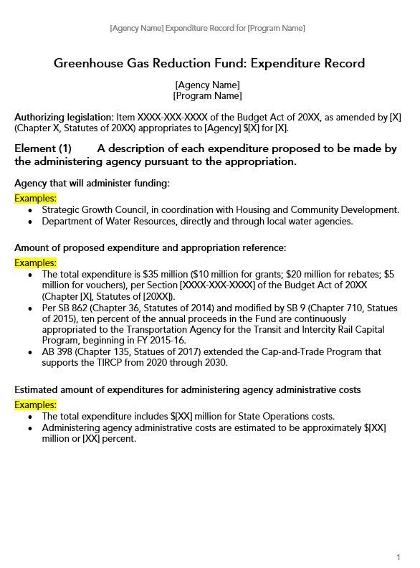
3. Expenditure Record Process
Administering agencies to post on their webpages
CARB will link to expenditure records
Removed attestation memo requirement
Notes:
[Raina] The third update area pertains to our expenditure record process. Administering agencies are required to provide expenditure records by statute. We have updated the expenditure record process to require administering agencies to now host expenditure records on their own websites to ensure the documents are accessible and posted as soon as available. Currently, CARB receives expenditure records from administering agencies and posts them on our website. CARB will still collect and post links to the expenditure records to facilitate access.
Under the current Funding Guidelines, agencies are required to prepare an attestation memo affirming that the expenditure record was prepared according to the GGRF requirements. Unlike the expenditure record, attestation memos are not statutorily required. In an effort to further streamline the expenditure record process we removed the previous attestation memo requirement.

Slide 22
4. Tribal Engagement
Prioritize projects designed for and implemented by Tribes
Navigating Limited Waivers of Sovereign Immunity thoughtfully
Developing proactive relationships with Tribal grantees and applicants
Designing programs with elements to meet needs unique to Tribes
Avoiding undue burden to potential Tribal applicants
Additional resources on the Resource Portal
Notes:
[Raina] The fourth key update area is a new area of focus in the draft 2024 Funding Guidelines. This is our guidance pertaining to tribal engagement. The update provides guidance on maximizing benefits to tribes, including:
Added language throughout to more-meaningfully prioritize projects designed for, implemented by, and directly benefiting Tribes;
Recommendations for navigating Limited Waivers of Sovereign Immunity thoughtfully to foster transparency and trust between administering agencies and Tribes, and to increase participation from Tribes.
Recommendations for developing proactive relationships with Tribal grantees and applicants.
Approaches for designing programs with elements to meet needs unique to Tribes—including dedicated resources, funding, and implementation timelines that are reflective of Tribal needs.
Considerations for avoiding undue burden to potential Tribal applicants.
As part of these guidance updates, staff are also compiling important resources related to program design and implementation to maximize benefits to federally and non-federally recognized Tribes, Tribal nonprofits, Tribal businesses, and individual Tribal members —such as the Tribal Engagement Strategy. These resources are linked through the Funding Guidelines and made publicly available on the Resource Portal.

Slide 23
5. Workforce Development
AB 680 requires CARB to update the Funding Guidelines with six workforce standards:
  1. Fair and responsible employer standards
  2. Inclusive procurement
  3. Prevailing wage for construction work
  4. Community workforce agreements for projects in excess of $1 million
  5. Preference for applicants that demonstrate partnership with an education or training program
  6. Preference for applicants that demonstrate creation of high-quality jobs
Notes:
[Raina] The fifth key update area also contains a new focus. This is a dedicated workforce development section. This section contains the six baseline workforce standards set forth by AB 680 for certain California Climate Investments programs that receive funding on a continuous basis. AB 680 builds on an existing emphasis on workforce policy within California Climate Investments. The initial legislation that established the GGRF included the priority to foster job creation and job training, wherever possible and prior versions of the Funding Guidelines include recommended actions administering agencies can take to accomplish these goals.
The AB 680 workforce standards are:
Fair and responsible employer standards;
Inclusive procurement;
Prevailing wage for construction work;
Community workforce agreements for projects in excess of $1 million;
Preference for applicants that demonstrate partnership with an education or training program; and
Preference for applicants that demonstrate creation of high-quality jobs.
Several of these standards reinforce or back up to existing labor laws. In the draft Funding Guidelines, we outline the intent of each standard, provide avenues to meet the requirements, and highlight the emphasis AB 680 places on priority populations.

Slide 24
5. Workforce Development
Job Quality Principles
Implementation Strategies
Wage & benefit standards
Training pathways
Local & targeted hiring
Supportive organizational culture
Worker voice & representation
Workplace safety
Guidelines, solicitations, grant agreements, contract language
Ranking and scoring
Labor & community agreements
Procurement
Develop & leverage partnerships
Notes:
[Raina] The workforce development section builds on the AB 680 standards to provide recommended guidance to programs that may not have a compliance obligation. We encourage all programs to support robust job quality, training, and other workforce development activities, as applicable.
In the draft Funding Guidelines, we recommend programs incorporate the following California Climate Investments Job Quality Principles to support job quality at the project level:
wages above the median that allow workers to live comfortably in their region and comprehensive benefits packages that support an individual beyond base wages;
local and targeted hiring to ensure projects create jobs for the community they are located in and for those in the community in the most need of economic uplift;
training pathways both to enter into a high-quality job and ongoing training to upskill and achieve career mobility, which is especially important as technology changes;
a supportive organizational culture that prioritizes inclusivity, enforces a no tolerance policy for harassment/discrimination, and meaningfully solicits feedback from workers;
and workplace safety.
The recommended strategies provide administering agencies avenues to elevate job quality and incentivize applicants to retain best-in-class employers. We focus on building job quality into solicitations or guiding materials, grant agreements, other contracts, and the procurement process to encourage administering agencies to support high-quality jobs. We recommend incentivizing or requiring applicants with construction projects to enter into community workforce agreements, which build enhanced equity requirements for workers and the community into a project from the start, and to leverage or develop partnerships with training and other workforce development organizations in order to build capacity that supports job quality in communities.
Currently, we provide workforce development and job quality resources on our Resource Portal to support programs, grantees, and all others involved in making a California Climate Investments project a reality. We plan to build on these resources as we identify needs during program implementation.

Slide 25
6. Reporting Timing and Frequency
Mid-year Data Update Period
May 31
Data Cutoff
Jun/Jul
Submit/Review
Nov 30
Data Cutoff
Dec/Jan
Submit/Review
Annual Report
due in Spring
Current
Proposed
Oct 31
Data Cutoff
Nov/Dec
Submit/Review
April/May
Data corrections only
Once annual reporting for project activities through October 31st
Mid-year Data Update for updates/corrections only
Notes:
[Raina] The sixth key update area pertains to reporting. Administering agencies are periodically required to report project-level data to CARB. In response to agency feedback about the time investment required to complete current reporting, we have updated the reporting requirement from twice annually to once a year.
The current mid-year data update period will be maintained each Spring but reserved for updates or corrections to past data or critical issues identified by staff. For most programs, this will mean only one data reporting period each year.
The new data cutoff will be October 31st, a one month shift from the current November 30th cut off. This allows us a few additional weeks of data review without impacting the Annual Report deadline each Spring.

Slide 26
7. Program and Project Evaluations
Previously Project Outcome Reporting
Administering agencies to engage in in-house and/or third-party program and project evaluation activities
Evaluation reports stored and managed by CARB
Provide new evaluation resources
Notes:
[Raina] The seventh key update area relates to program and project evaluations. This was previously known as project outcome reporting. Evaluating and monitoring programs and projects supports accountability and transparency. Through reporting we can communicate successes in facilitating the achievement of GHG reductions; maximizing economic, environmental, and public health benefits to the State; and prioritizing equity and priority population considerations. In coordination with CARB, administering agencies will be encouraged to engage in in-house and/or third-party program and project evaluation activities, as feasible and appropriate.
For the purposes of program and project evaluations:
The term “Program” evaluation refers to determining how well a given California Climate Investments program is achieving its pre-defined goals to achieve certain outcomes or benefits and examines how the design and implementation processes may impact achievement of those goals.
Similarly, “project” evaluation refers to determining how well a given project(s) is achieving certain results or outputs. These evaluations will look different based on program design, and CARB staff will work with agencies as they plan and implement these evaluations.

Slide 27

8. Appendices
Updated priority populations designations
SB 27 California Carbon Sequestration and Climate Resiliency Project Registry
Reporting non-GGRF projects
Notes:
[Raina] The last update area contains three appendices. Each of these appendices contain information that may require future periodic updates.
The first appendix contains the standalone guidance CARB released in 2022 in response to CalEPA’s updated priority populations designations after the release of CalEnviroScreen 4.0.
The second appendix contains CARB’s finalized guidance for the California Carbon Sequestration and Climate Resiliency Project Registry. SB 27 directed the California Natural Resource Agency to develop an online registry for natural and working lands and direct air capture projects that are in need of funding and required CARB to develop minimum eligibility criteria to be listed on the registry. This guidance was finalized in 2023.
The information contained in these two appendices has been previously reviewed through the public comment process. The final guidance is already published as standalone documents and is being incorporated into the Funding Guidelines.
The last appendix provides new guidance on reporting project data when the program is no longer funded through the GGRF. The Legislature, not CARB or administering agencies, appropriates funding for programs and that funding source may change from year to year. In response to administering agency requests, this added guidance allows for the reporting of non‑GGRF‑funded projects under certain circumstances if they otherwise meet the requirements for GGRF-funded projects.
Those are all the key updates you will see in the draft. Before we move to the next segment of the workshop, I would like to pause here to gauge everyone’s thoughts on the updates. I will pass things to Sierra for another poll.

Slide 28
Poll: What update area would you like to learn more about?
General Improvements
Community Engagement
Expenditure Record Process
Tribal Engagement
Workforce Development
Reporting Timing and Frequency
Program and Project Evaluations
Appendices
I would like to learn more about all the updates.
Notes:
[Sierra] We want to know – which update area would you like to learn more about? We can use this information to direct our open comment later on. Would you like to learn more about:
General Improvements
Community Engagement
Expenditure Record Process
Tribal Engagement
Workforce Development
Reporting Timing and Frequency
Program and Project Evaluations
Appendices
I would like to learn more about all the updates.
It looks like people are interested in learning more about [interact based on responses]. The last segment of the workshop is dedicated to hearing your comments and responding to questions. I will now pass things over to Nicole, who will provide a tour of our new Funding Guidelines web companion tool, the Resource Portal.

Slide 29
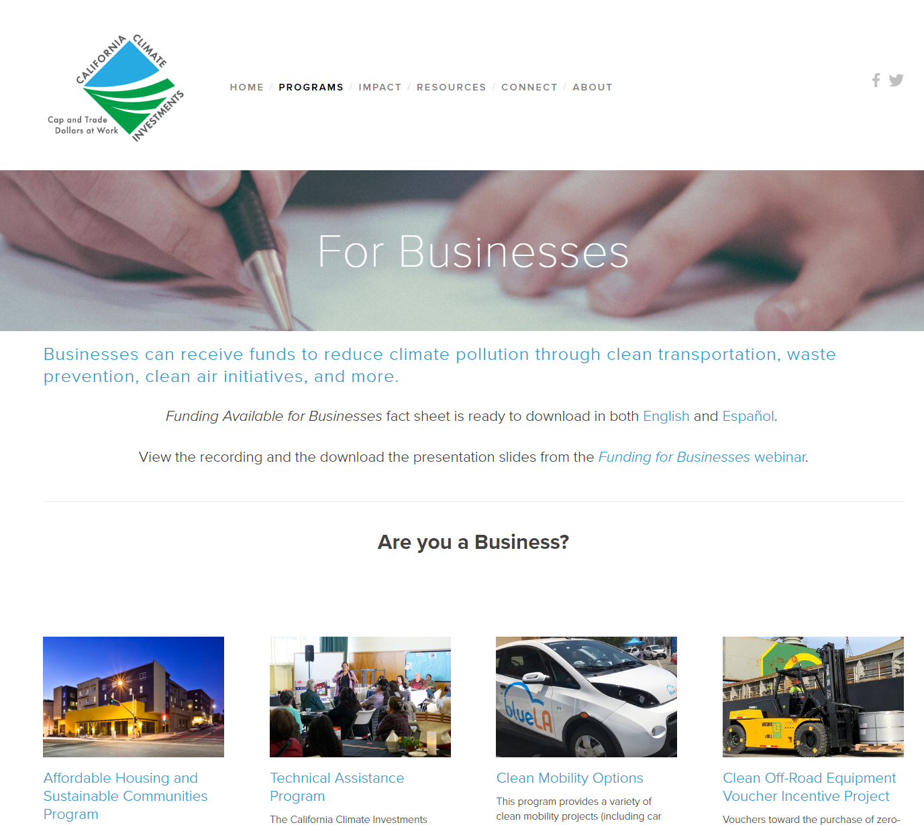
New! Resource Portal
Complement Funding Guidelines
Help climate programs achieve goals
Provide centralized location for relevant State resources
(new and existing)
Notes:
[Nicole] There are lots of additional resources, tools, guidance, or other materials that CARB and the State could provide that build on and even go beyond what’s contained in the Funding Guidelines. We also know that there are lots of great existing State materials out there, but they’re often not centralized in one place. We want to make the Resource Portal an easy-to-use centralized location for key, relevant resources. We’re thinking about many different audiences here, including State administering agencies, but also technical assistance providers, local jurisdictions, and other participants in climate projects.
Our goal is for the Resource Portal to support all organizations involved in making California Climate Investments projects a reality.

Slide 30



Types of Resources
Promising practices, checklists, and “how to” guides
Informational and instructional videos and story maps
Analytical reports and data tools
Notes:
[Nicole] Designed with an array of audiences in mind, the Resource Portal may include promising practices guides or checklists, additional guidance on collecting and reporting project information, supporting materials for project design and implementation, project case studies, and more.
We intend the Resource Portal to be a living resource and we’re also thinking about adding videos or story maps to help highlight real-world examples or provide explanations of program guidelines or tools and analytical reports or data tools to help gain insight into implementation of California Climate Investments and identify areas for improvement.
Now that you have some background, let’s take a tour of the Resource Portal.
[share screen. Nicole to extemporaneously highlight RP features while navigating the site.]

Slide 31
What resources would be most helpful to have on the Resource Portal?
Notes:
[Nicole] Now that you’ve had a chance to tour the Resource Portal, we’d like to hear from you! What resources would be most helpful to you or your organization? Please type in the chat or raise your hand and Sierra will unmute you.
Okay, I will now pass things to Raina for the open comment portion of the workshop.

Slide 32
Participation Reminder
*9
Raise Hand via Zoom Webinar
Select the “Reactions” button, then the Raise Hand option.
The host will be notified that you've raised your hand.
Select Lower Hand to lower it.
Raise Hand via phone:
Dial *9 to raise and lower your hand
Type your comments or questions into the Q&A Box
Notes:
[Raina] Now, we are going to shift gears and open up the floor to you.
If you would like to share a comment verbally, please raise your hand in Zoom. For our participants who are calling in over a phone line, please dial *9 to raise and lower your hand. Sierra will call on you to unmute yourself and ask your question or provide your comment.
In order to allow everyone an opportunity to speak, we ask that speakers limit their question or comment to 3 minutes.
Please also feel free to type your questions into the Q&A, where we may respond either in writing or answer questions live.

Slide 33
Questions?
Notes:
[Raina] Okay, we have about 30 minutes here for questions and comments. We wrap up with next steps after anyone wishing to has had a chance to speak or after 30 minutes have elapsed. Okay, our time for public comment is coming to a close/we don’t have any more comments, so we are going to move to the closing section of the presentation. Thank you all for your participation!

Slide 34
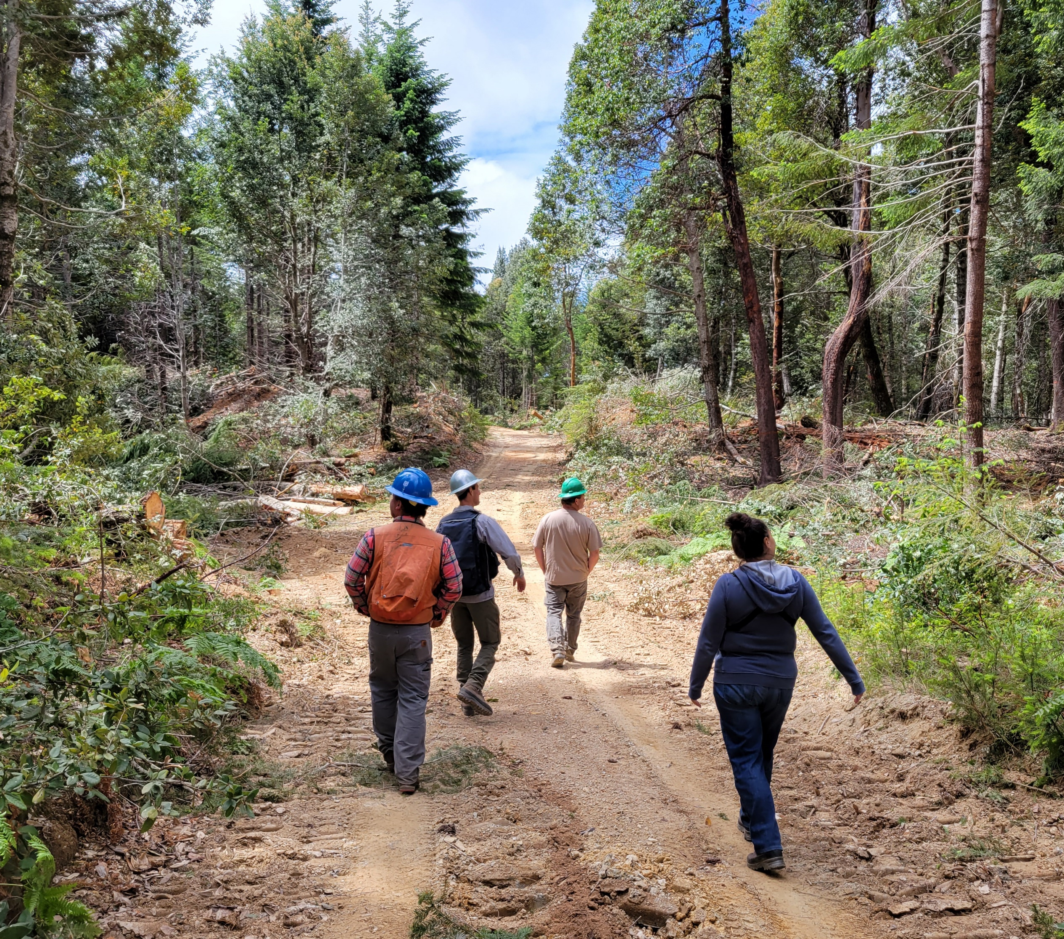
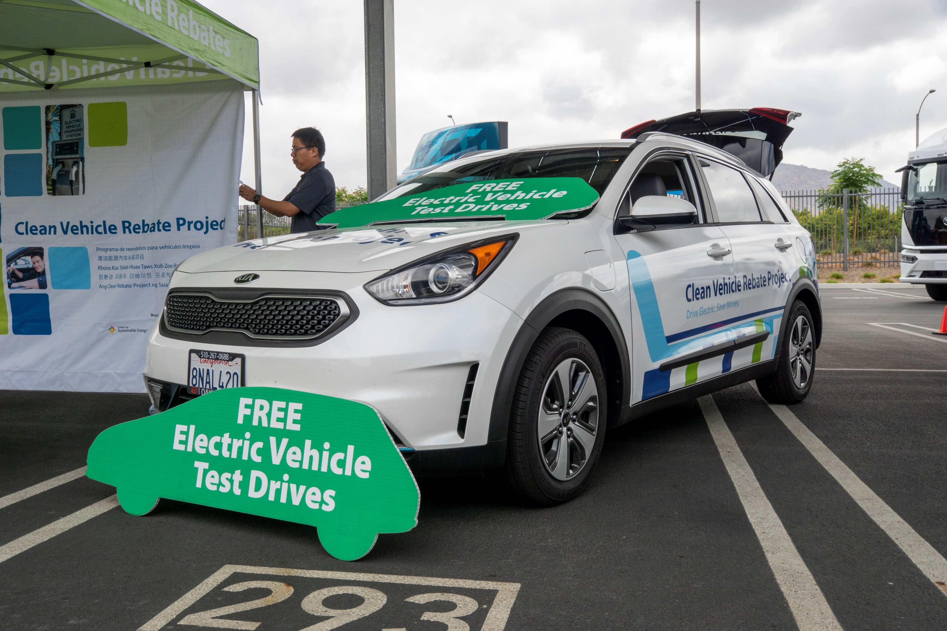
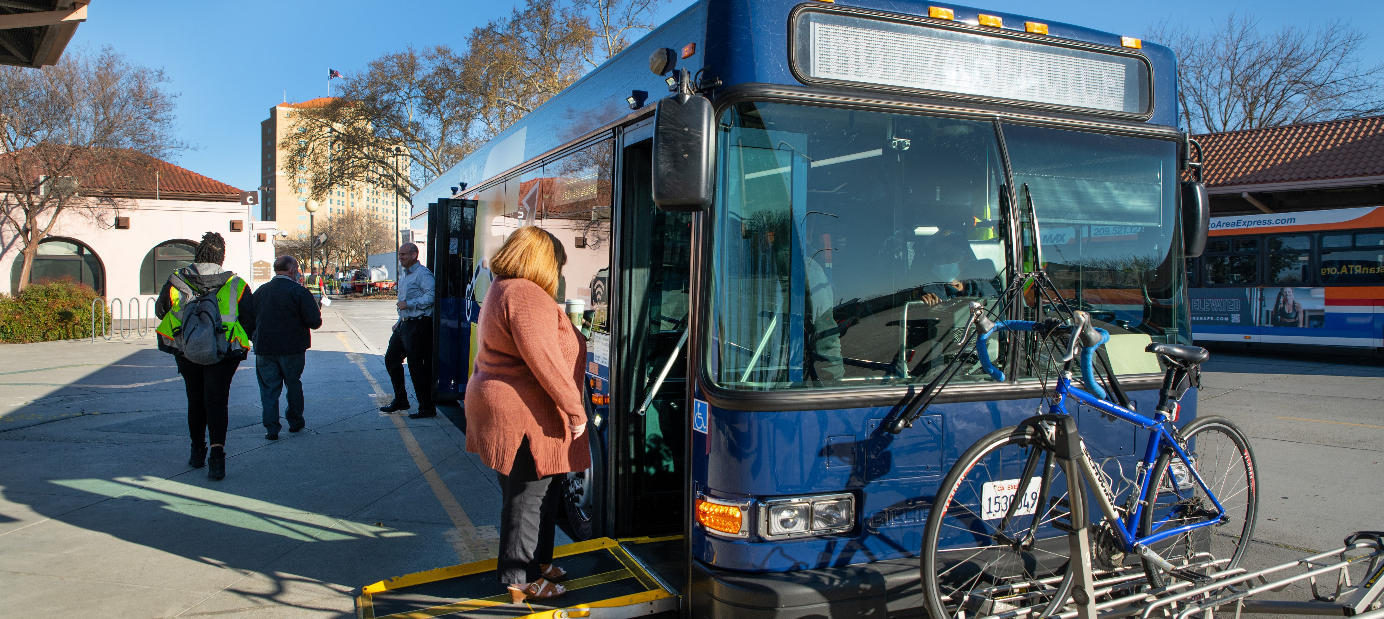
We want to hear from you!
caclimateinvestments.ca.gov
@CAClimateInvest
GGRFProgram@arb.ca.gov
1-800-757-2907 • Hablamos Español
Notes:
[Raina] The draft Funding Guidelines are available on our website for public comment until July 26th. If you have not already, please review the draft and provide your feedback. If you would like to leave additional comments after today’s workshop, please feel free to do that as well via the program email listed above.
We anticipate publishing the final version of the Funding Guidelines this Fall.
We also encourage you to sign up for our listserv to keep up to date on California Climate Investments events.
Our contact information is also on the slide. Feel free to email us with any questions or thoughts.
With that, we’ll conclude the workshop. Thank you once again for your participation today; your input is critical to ensuring California Climate Investments are the best they can be.

