Slide 1
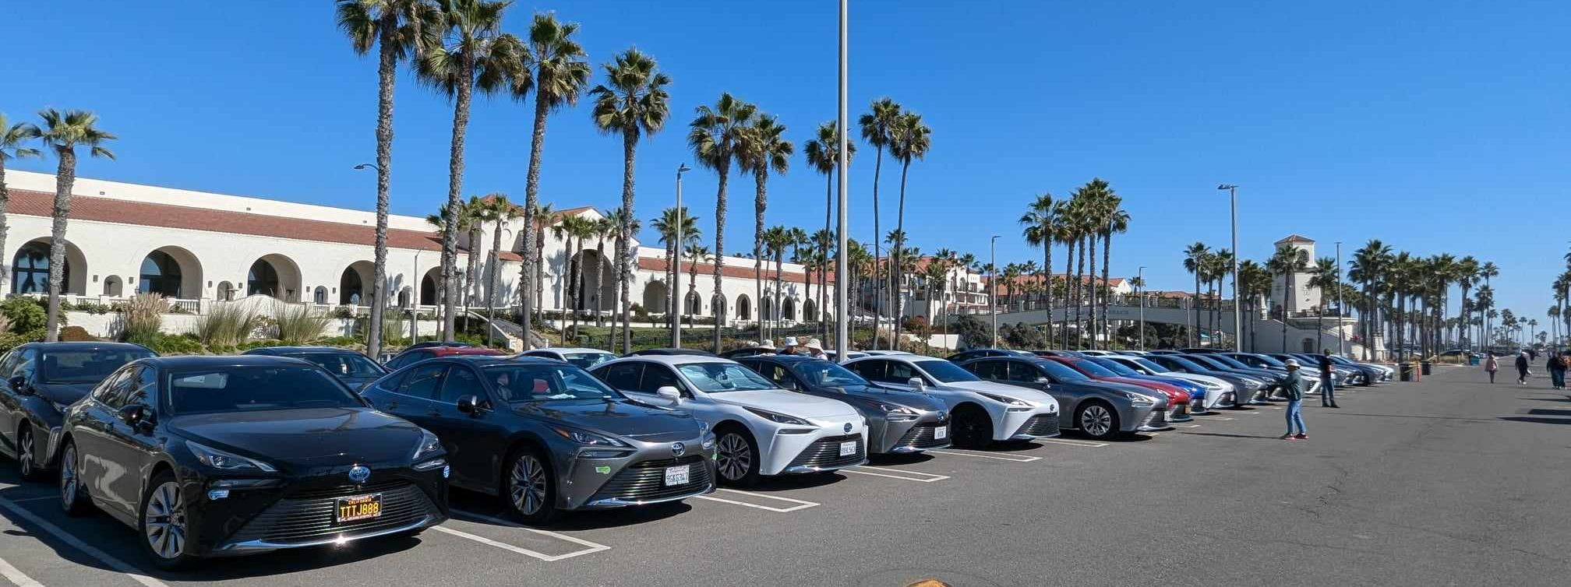
Consumer Comments to the California Air Resources Board regarding the Proposed FY24-25 Funding Plan for Clean Transportation Incentives submitted November 12, 2024
November 9, 2024 Toyota Mirai Owners Customer Appreciation Event, Huntington Beach, California

Slide 2
Nathan Okawa
2708 W. 156th St.
Gardena, California 90249 email: nhokawa@earthlink.net
Toyota Mirai owner in the Greater Los Angeles area since August 2024
Purchased a Mirai FCEV after California was designated a Federal Hydrogen Hub and also
Researched the objectives of the California Air Resources Board and the California Energy Commission, as well as information on the ARCHES website
After experiencing issues with the availability of hydrogen and the reliability of refueling stations, I joined the Facebook groups Toyota Mirai Owners Group, the Hydrogen Car Owners and the California Hydrogen Car Owners Association, to learn more about the state of the supply of hydrogen and transportation in California

Slide 3
California Air Resources Board, Hydrogen Fueling Infrastructure https://ww2.arb.ca.gov/our-work/programs/hydrogen-fueling-infrastructure/about
Hydrogen Fuel Cell Partnership http://www.cafcp.org/
California Energy Commission, Clean Hydrogen Program https://www.energy.ca.gov/programs-and-topics/programs/clean-hydrogen-program
California AB-8, Alternative fuel & vehicle technologies: funding programs https://leginfo.legislature.ca.gov/faces/billNavClient.xhtml?bill_id=201320140AB8
Considerable money and effort was expended by the State of California to build the initial network of hydrogen refueling stations and Toyota started selling the FCEV Mirai in the 2014-2015 timeframe. According to the CARB website, zero-emission FCEVs play a significant role in reducing greenhouse gases in California, and with the H2FCP plans were made for a network of 100 hydrogen refueling stations by 2024; Shell Co. was awarded $40 million to build some of this network, but terminated their plan in September 2023. The $40 was never re-allocated to support the development of the hydrogen and FCEVs.

Slide 4
Assembly Bill 8 (AB 8; Perea, Chapter 401, Statutes of 2013)
AB-8 requires that $20 million be allocated annually until there are at least 100 hydrogen-fueling stations in California. Additional monies for BEVs as well as FVEVs would be available through vehicle and other fees. AB-8 also allows moneys not allocate to station construction can be used to support the deployment of an effective and efficient station network in a way that benefits the public. Lastly, AB-8 requires annual evaluations of FCEV Deployment and Hydrogen Fuel Station Network Development.
The executive summary contained in the 2023 report lists past actions that were funded and/or planned, but never accomplished. The report correct identifies that the development of a large refueling station infrastructure, fuel availability and cost and station reliability as key to consumer decisions to purchase these FCEVs.
The planned expansion of the fuel stations reached a maximum of 66 in 2023, then dwindled to 53 due to continuing supply disruptions and the departure of Shell Co. from the market. In addition, retail hydrogen prices rose from about $15 per kilogram in mid-2022 to $30 and $36, depending upon the vendor, where it remains to this day. This is equivalent to gasoline at $12 per gallon.

Slide 5
Summary
The CARB, CEC and other State entities have failed in their goals of building a robust hydrogen fuel station network.
Lower CARB LCFS credits has contributed to high retail hydrogen prices that are not sustainable. Fuel allowances supplied by manufacturers to encourage FCEV adoption are being exhausted, leaving consumers to pay the equivalent of $12 per gallon of gasoline once their allowance is used up.
The AB-8 report identified that some stations have reliability issues leading to lengthy downtimes. As an example, the former Shell station in Torrance, which has been taken over by Air Products, has been down since September 2024, with no timeline for repair.

Slide 6
Comments:
The 2023 AB-8 report identifies station availability, reliability and affordable prices as critical to current and prospective FCEV owners
The experiences of consumers with the Light Duty fuel stations can have real applications to the rollout of MD and HD hydrogen fuel stations, e.g. wait times between refueling due to the need for compression between fills. This was apparently not considered when funding was initially allocated to build the network, since some stations have only one pump, limiting the number of cars that can be refueled in a given time; I have spoken to owners who have waited two or more hours in a line. The requirement for maintenance, uptime and adequate capacity was apparently not a condition of the initial grants to build these stations.

Slide 7
Comments:
I looked for reports on the AB-8 customer experience and feedback requirement and have not been able to locate it. I urge you to engage current FCEV owners and document their feedback. The reason sales of hydrogen FC vehicles has dropped precipitously is because of the negative public reputation due to the difficulty of locating working stations and the extremely high cost of fuel. Owners can be located through vehicle registrations or on social media. The CARB and CEC needs to first ensure the reliability and availability of fuel at the existing stations before funding additional stations.
Much of the AB-8 report is about additional station funding, geographical coverage and equity. If you don’t solve the fuel issues, you won’t need to worry about any of that because the manufacturers will have stopped selling LD FCEVs in the US due to poor sales.

Slide 8
Comments cont’d:
Fuel prices need to come down immediately. I can’t stress this enough. There are members of the Facebook group selling or turning in their cars each week. The common themes are that their fuel card was exhausted or finding fuel was too troublesome and affecting their ability to get to work or taking time out of their weekend. The CARB and CEC needs to have a sense of urgency with this matter.
I read statements from some State legislators in proceedings dealing with H2 funding saying that more spending on LD FCEVs is a waste of money. If they do not intend to carry out the goals stated on a number of different State websites and in AB-8, then they need to be transparent about it and remove all references to the use of LD FCEVs in meeting zero emissions.

Slide 9
Comments cont’d:
In addition, these same legislators and members of CARB, the CEC, etc. need to contact FCEV owners, thank them for their pioneering adoption of FC vehicles, and inform them that you have decided that LD fuel stations and retail sales will not be supported (despite ARCHES), and that fuel prices will likely remain at current prices.
Honda, Hyundai and Toyota still support FCEVs. In fact, I know someone who just leased a Honda eFCEV CR-V, and Hyundai will display a concept FCEV SUV at the LA Auto Show this month. The manufacturers are doing their part.
Finally, the election of a new administration is a threat to current and future funding. It might be wise to reconsider future funding for Clean

Slide 10
Comments:
Transportation Incentives and delay approving a budget until it becomes clearer how the State of California will be affected.
The picture on the first page is at a Toyota Mirai customer appreciation event on November 9, 2024. There were 40+ Mirais and 150 owners and family in attendance. Though FCEVs make up 1.1% of ZEVs in California, there are people in that number who purchased or leased these vehicles and spend an inordinate time trying to fuel their vehicles. Your decisions affect these people. Billions of dollars have and are continuing to fund EV chargers even though EVs comprise only about 2.5% of registered vehicles in California. I urge you to use the moneys allocated by AB-8 and

Slide 11
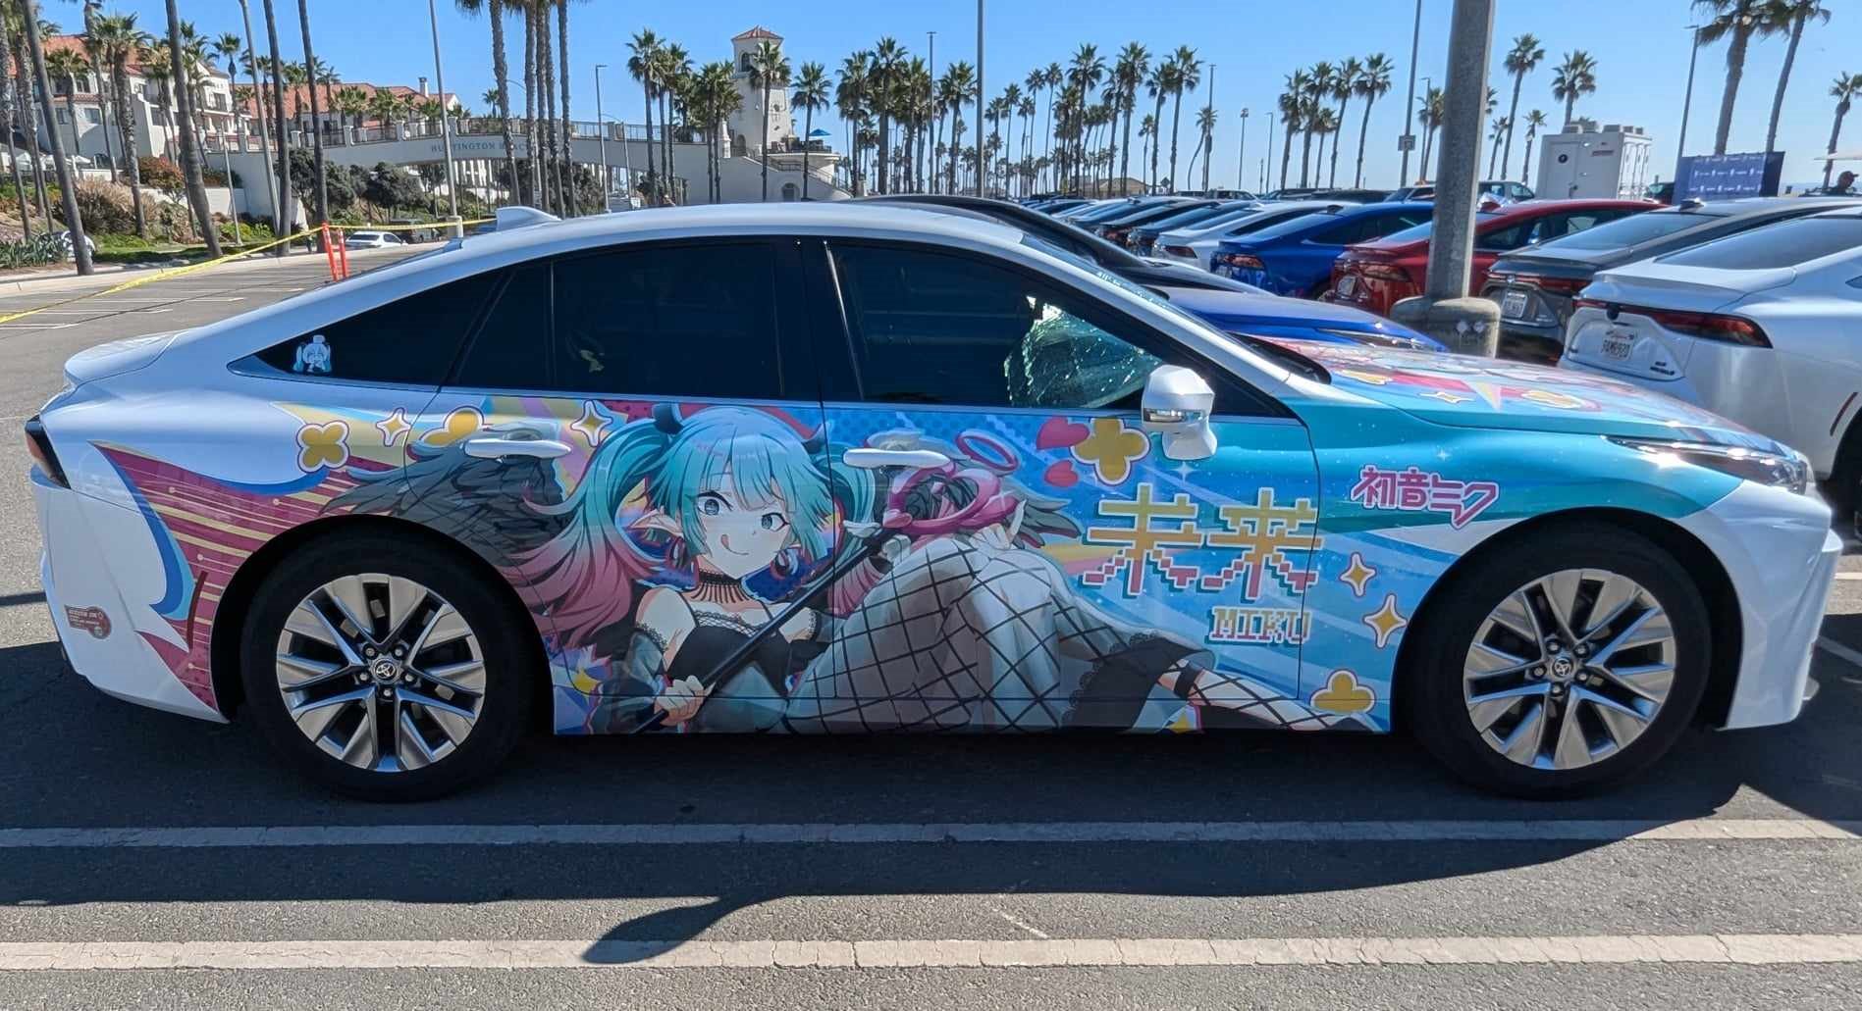
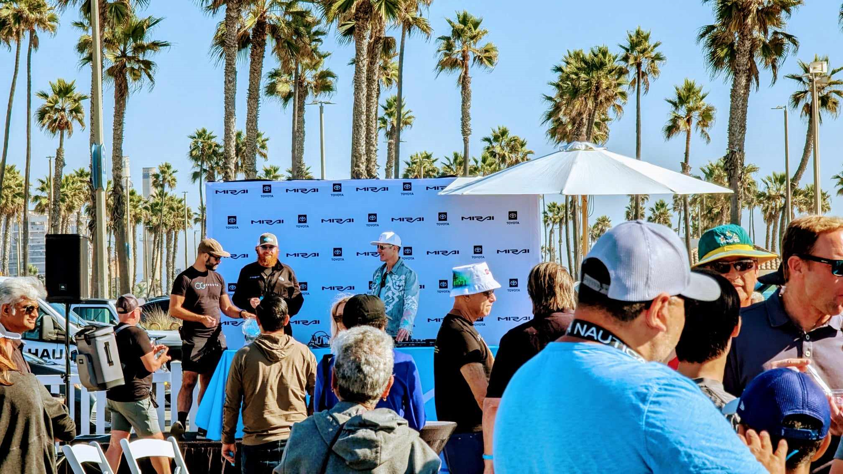
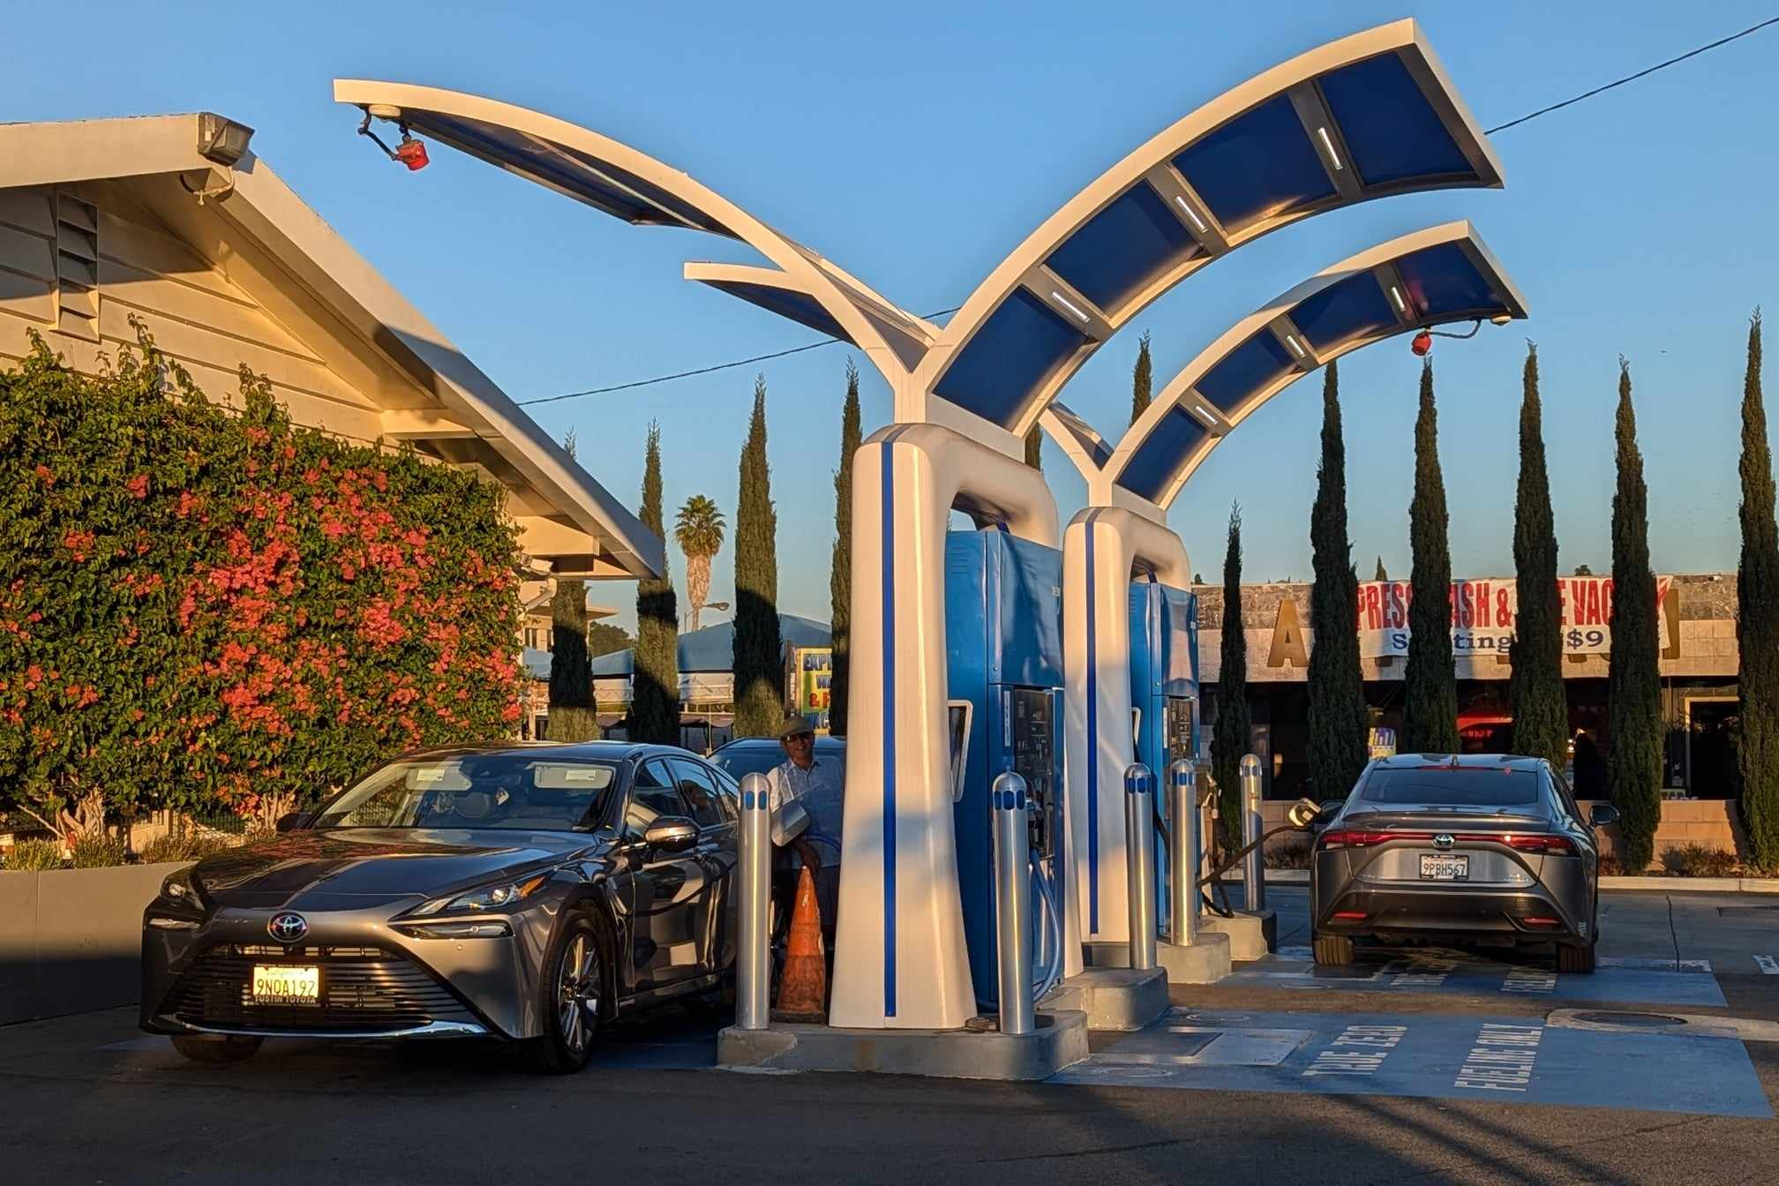
Comments cont’d:
the returned grants from Shell to support owners of FCEVs.
Sincerely,
Nathan Okawa
Gardena, California
nhokawa@earthlink.net

Slide 12
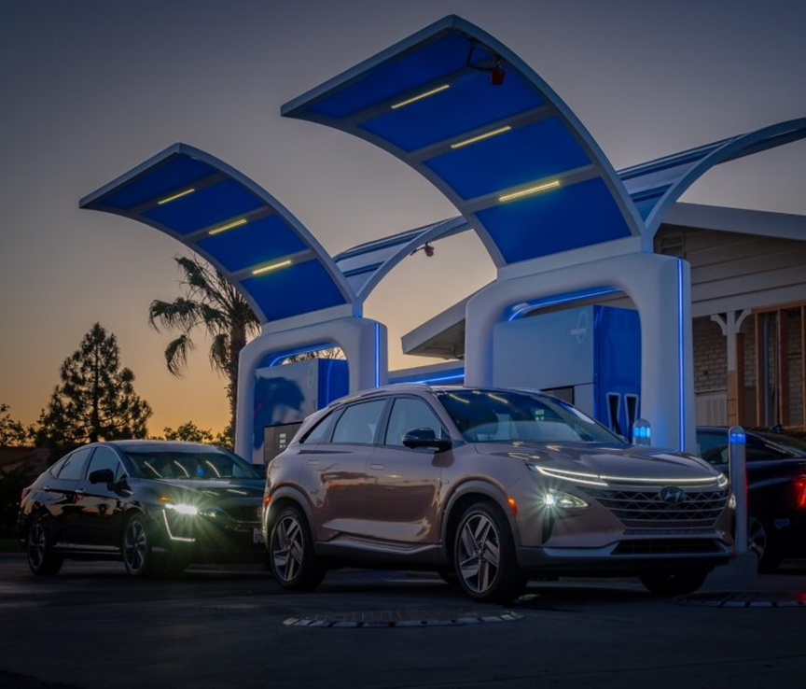
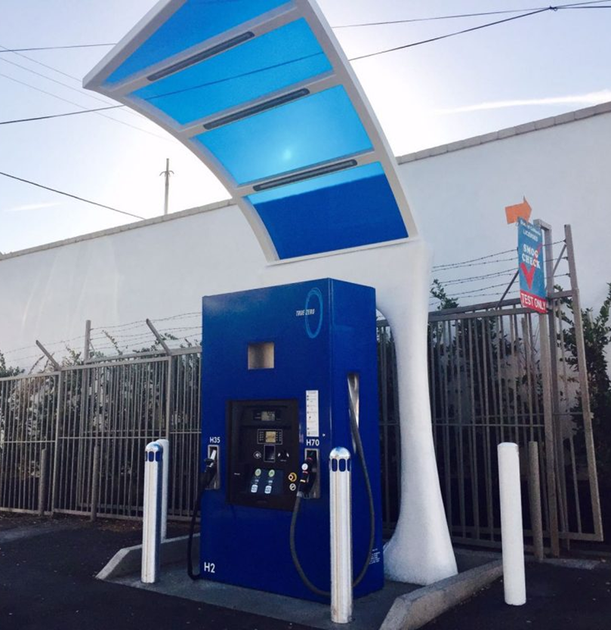
Fuel station with 4 pumps Fuel station with only one pump

Slide 13
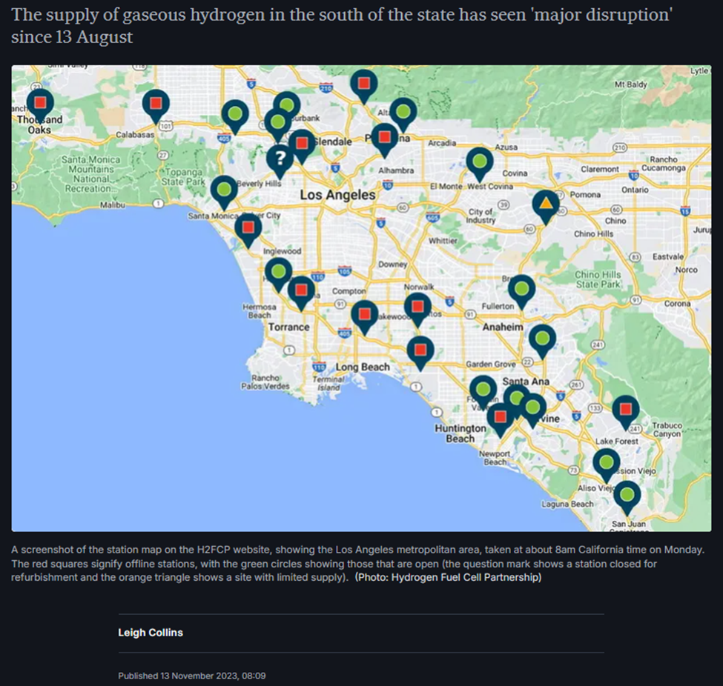
November 13, 2023 Greater Los Angeles H2 station status, red indicates out of service

Slide 14
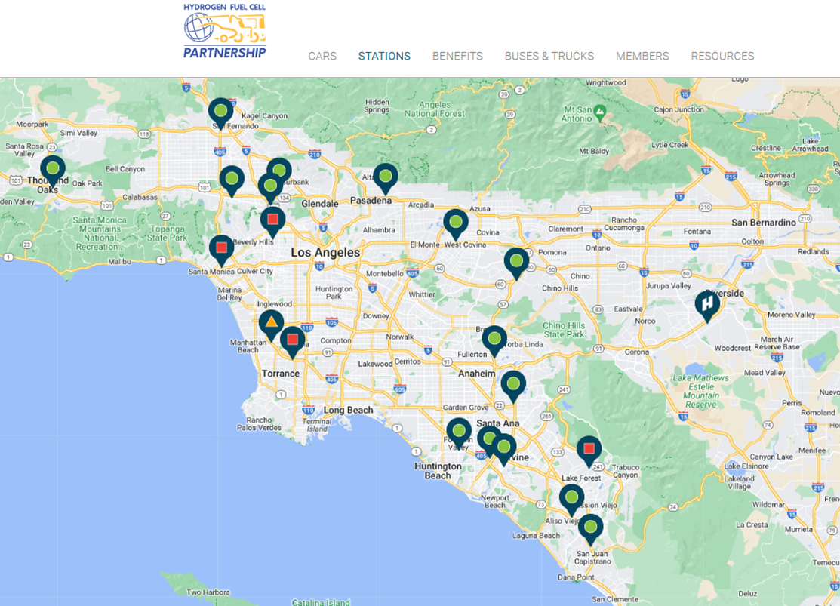
November 10, 2024 H2 station status- one year later from the previous station status snapshot. Red indicates out of service. Note that there are markedly fewer stations in the Greater Los Angeles area than in 2023. I reside north of Torrance. Since there are other out of service stations, there is an approximately 800 plus square mile area of Los Angeles with no station coverage; an owner might have to travel 20-30+ miles to fuel their vehicle. The best times to avoid lines is after midnight or before 5am. This is what FCEV owners experience.

