Slide 1
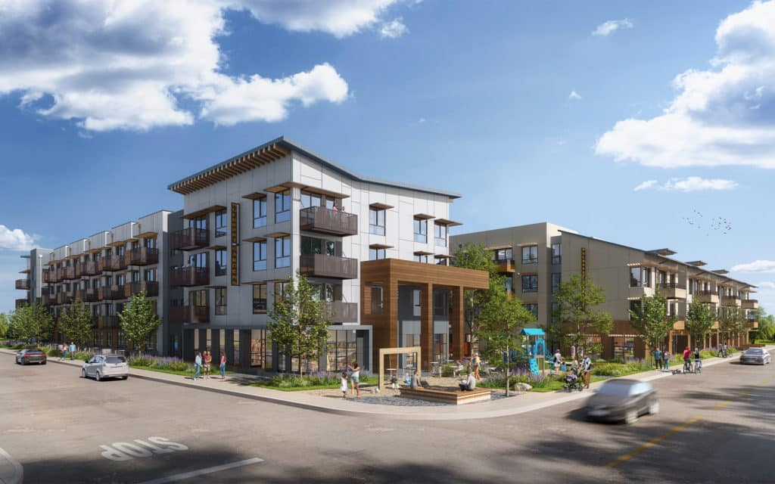

Mulberry Gardens Senior Apartments
Riverside, CA

Slide 2
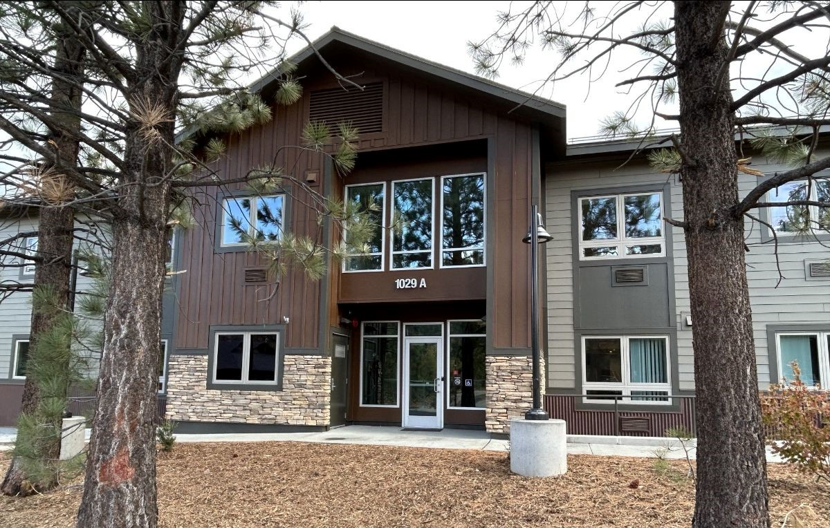
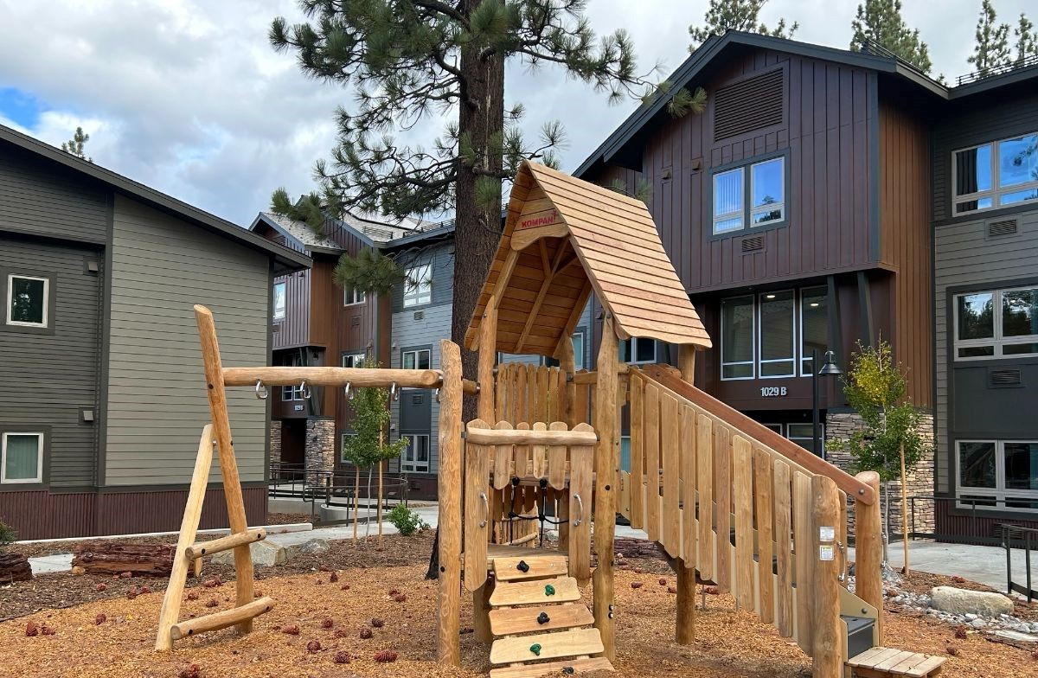
Sugar Pine Village
South Lake Tahoe, CA

Slide 3

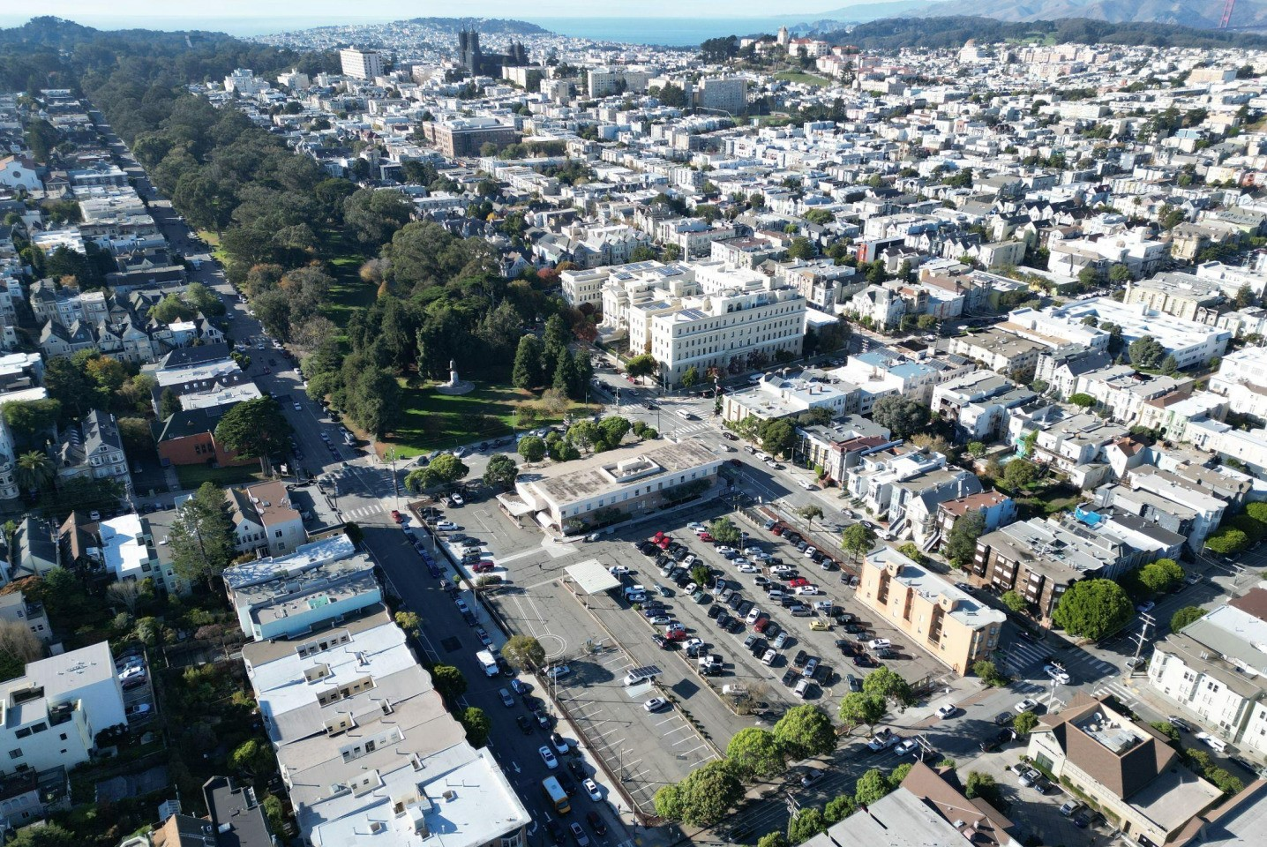
San Francisco Prohousing Designation

