Slide 1
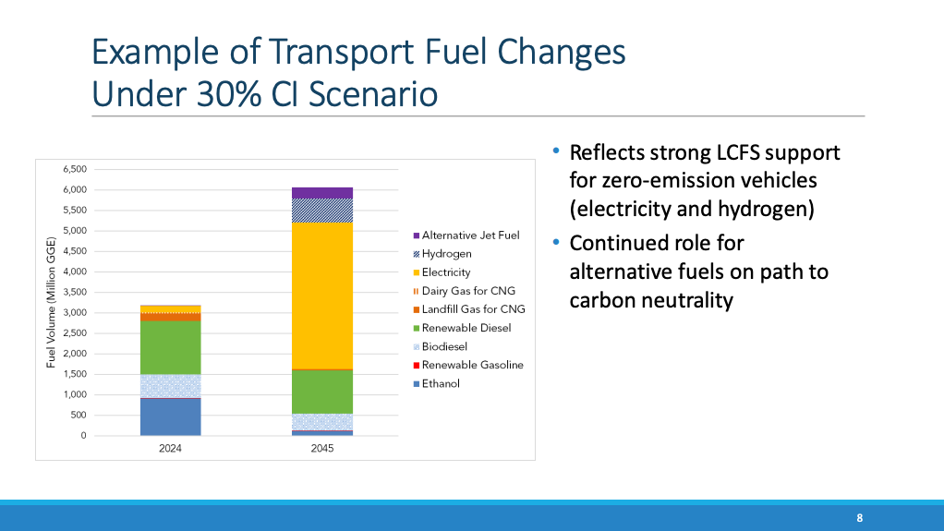
CARB Staff Presentation

Slide 2
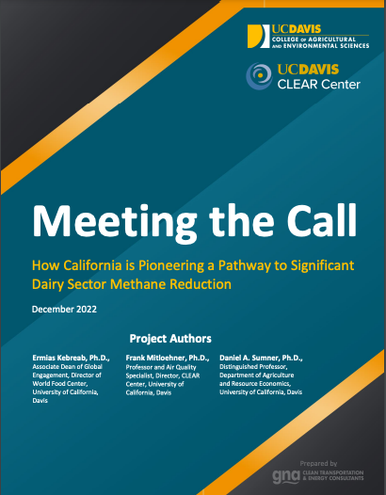
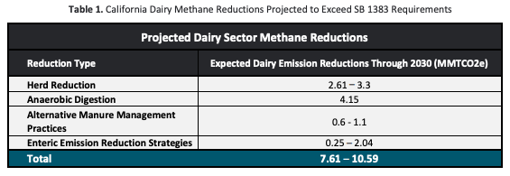
UC Davis Report
“continued implementation and commitment to the incentive-based climate-smart solutions that are currently driving voluntary dairy methane reduction in California should, by 2030, achieve the full 40 percent reduction in dairy methane sought by state regulators without the need for direct regulation.”
3.46 – 6.44

Slide 3
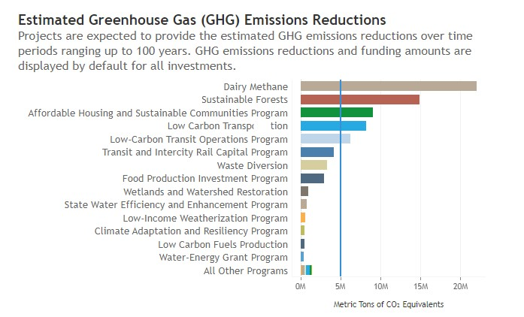
Dairy Digester Effectiveness
More reductions than any other investment, at lowest cost per ton of reduction
DDRDP costs $9/MTCO₂e
(among lowest of any CCI program)
Less than 2% of total GGRF Funds, 20+% of total reductions
Source: 2023 California Climate Investments Annual Report

