Slide 1
Approval of the South Coast Air Basin 2012 PM2.5 and Ozone State Implementation Plans
ARB Board Meeting
(January 25, 2013)
Remarks by Southern California Gas
Notes:
Good morning, my name is Lee Wallace and I am representing Southern California Gas Co.
We want to acknowledge the tremendous work the SCAQMD and CARB staff have done in bringing before you a path to attainment of our clean air goals. For this air basin, some might look at the problem, and conclude it is impossible to solve. However the staff have worked very hard and are presenting to you today a reasonable path forward.
In my remarks today, I want to focus on this larger challenge and in particular the shape of the problem.

Slide 2
CARB VISION for Clean Air – June 2012 All sectors combined emission reduction targets and Projected emission reductions for NOx and CO₂
Carrying Capacity
2008 Ozone Std.
Notes:
This is a very important chart to understand the multi-layered air quality challenges we face here in southern California. I will explain this further, but pay particular attention to the two black dots in the lower left quadrant.
On June 28 of this year, CARB staff presented the “Vision for Clean Air,” a joint effort with the South Coast AQMD and the San Joaquin Valley APCD. The Vision’s objective was to take a broader view of air quality planning from a multi-pollutant perspective. Specifically it sought to integrate planning efforts (1) for SIPs under the Clean Air Act, (2) AB 32 Scoping Plan Updates, e.g. in 2013, and (3) freight transport planning.
This graph shows data from the Vision, and illustrates the problem identified by the Vision. Looking at the red line, the chart shows that it is relatively “easier” to achieve the state’s GHG goals for 2050 [the dashed horizontal line], compared to attainment of ozone standards that must be met in 2023 and 2032. The path laid out by the Vision achieved the necessary GHG emission reductions before 2050.
However now look at the two black dots in the lower left quadrant. The NOx reductions needed were too late by 12 years, in the case of the 2023 target [the first black dot from the left], and over 10 years too late in the case of the 2032 target [the second black dot from the left].
What is needed is a strategy, or path to zero emission transportation options, that not only achieves the state’s GHG goals for 2050, but also achieves significantly more criteria pollutant reductions, much sooner.
The slope of the curves on this chart are driven by the rate of penetration of ultra clean technologies, such as electric vehicles and fuel cell vehicles. To get to the level of emissions needed in 2023 and 2032, there must be more rapid penetration of cleaner transportation technologies. Trying to introduce brand new electric or fuel cell trucks even earlier than the Vision contemplates would be very difficult. Therefore the path must start with, and rely upon existing technologies. We believe natural gas is poised to be a major part of most paths to zero emission transportation options.

Slide 3
SCAQMD Needs More Emission Reductions, and Much Sooner
Notes:
This chart shows what the emission reduction curve will look to achieve the 2023 and 2032 goals. It illustrates the fact that the emission reductions needed here in the SCAQMD are heavily front loaded.
In 2010 the NOx Emissions Planning Inventory is approximately 624 tons per day. [Interpolated value based on 2008 and 2014 numbers from Draft Final 2012 AQMP (November 2012) Appendix II Tables B-1 and B-2.] To reach the carrying capacity for the 1997 8 hour ozone standard of 115 tons per day will require a reduction of 509 tons per day over a decade. SCAQMD has identified about 60% of the needed reductions, but that still leaves almost 200 tons per day to be found.
In order to reach the next ozone standard, the 2008 8 hour standard, the District will have to reduce NOx emissions by a relatively smaller amount of 35 tons per day, over a period of a little less than a decade.
Reliance upon “over the horizon” technologies is ill advised to address a heavily front loaded emission reduction challenge. To introduce new technologies, even though they have tailpipe emissions of zero, will require a rapid build out and deployment of manufacturing, infrastructure, maintenance and other support functions that is unprecedented.
A sounder approach is to build on existing technologies, but starting with even cleaner versions of these existing technologies. Natural gas can meet this challenge to provide even cleaner versions of natural gas vehicles, and become part of a “path” to zero emission transportation options.

Slide 4
South Coast AQMD Definition of Near-Zero Emissions
“The term―near-zero emissions refers to emissions approaching zero and will be delineated for individual source categories through the process of developing the Air Quality Management Plan/State Implementation Plan and subsequent control measures. …. Near-zero emissions technologies can help meet this need, particularly if they support a path toward zero emissions (e.g. electric/fossil fuel hybrids with all-electric range).”
(Emphasis added.)
Source: Revised Draft 2012 Air Quality Management Plan, Page 4-19
Notes:
Developing a range of alternative fuel and electric passenger vehicles that will fulfill consumer needs for all of the various needs we have is difficult enough. But turning to the task of moving freight or other large cargoes, the problem of developing a range of alternative fuel and electric vehicles that fulfill these needs becomes several times more difficult.
The South Coast AQMD must rely heavily upon the introduction of zero and near-zero emission technologies. The staff have recognized the difficulty in fulfilling the demand for the range of vehicles that will be needed in the time frames we have. We support the way that the SCAQMD staff have defined the problem that will allow flexibility to address the many demands on vehicles used to move freight or other large cargoes, and also allow existing technologies to develop or support a path to zero emission transportation options.
Natural gas vehicles in development show that NGVs can be more than a “bridge,” and can readily play a role on the path to zero emission transportation options. I’d like to discuss some examples.

Slide 5
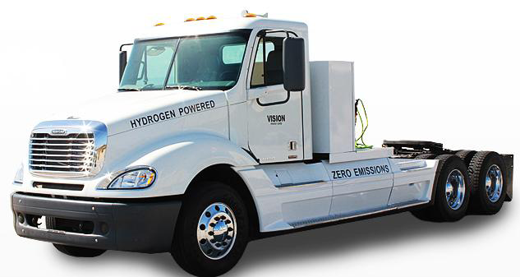
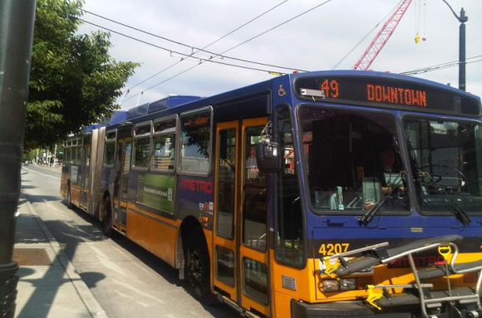
Zero Emission Truck & Electric Catenary Highway (ZETECH)
Technology Description
Hybrid-electric natural gas truck with Catenary capable zero-emission operations and a small battery pack for short distance travel on all-electric power.
Potential Benefit
Unlimited zero-emission range when connected to a Catenary system.
Extensible system that can grow from near-dock facilities to the I-710 corridor and eventually comprise a zero-emission electric container movement system sought by the ports.
Ability to use natural gas in extended off-Catenary operation, completely eliminating diesel emissions
Goals / Targets
Based on existing hybrid technologies and demonstrated system components -- deployment of a Catenary system for near-dock rail yards feasible in the 2016-2020 time frame
Status
Developing funding team and concept
Notes:
The idea here is to take a natural gas truck and outfit it to be able to use a catenary system. This system can grow from near-dock facilities to the I-710 corridor and eventually comprise a zero-emission electric container-movement system sought by the ports. It has the ability to use natural gas in extended off- Catenary operation, completely eliminating diesel emissions wherever it goes.

Slide 6
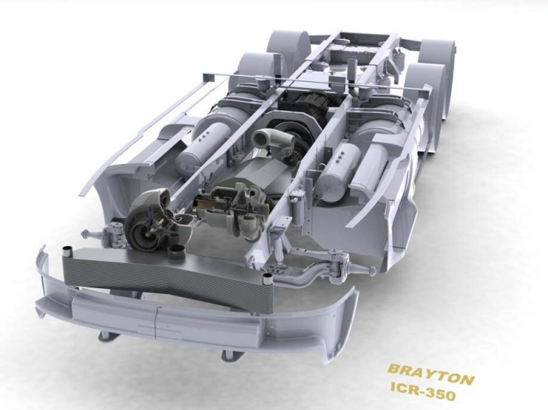
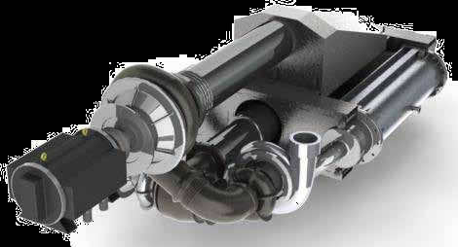
Low Emission Turbine Drive
Project Overview
Demonstrate near-zero emissions dual liquid/natural gas combustor for existing 350 kW gas turbine engine designed for Class-8 trucks with SoCalGas funding
SoCalGas co-funding low-NOx combustor with Brayton Energy
CEC, Kenworth & FedEX -- $1.5 millions to develop a Class 8 MT dual fuel truck for the demonstration
Benefits
Near-zero emissions (75% NOx improvement)
NOx = 0.05 g/bhp/hr, CO = 0.02 g/bhp/hr
Fuel flexibility
Improved efficiency from advanced turbine design
Status and Timing
Testing of turbine in truck chassis is schedule for April 2013
First chassis dynamometer runs expected in July 2013.
FedEX will receive the CNG-only truck (made by Kenworth) in late 2013 and operate in 2014 in CA
Notes:
The purpose of this project is to address the range anxiety of long haul truckers, while still allowing them to reap the economic advantage of using natural gas instead of diesel. The vehicle operator will likely use natural gas because of the significant cost savings, but when the truck is required to travel outside its normal territory or when CNG fueling is not readily available, the engine will seamlessly transition to operate on liquid fuel. This will give truckers and fleet operators the opportunity and confidence to use low-cost natural gas in an expanded territory.

Slide 7
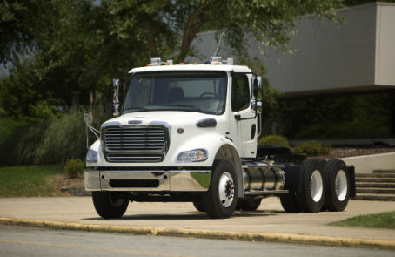
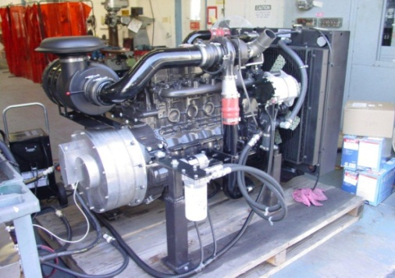
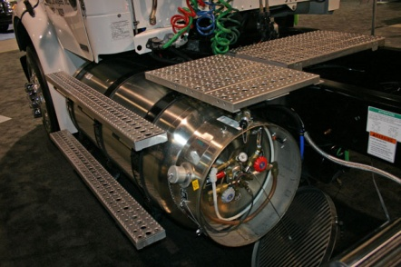
US Hybrid: Plug-in Hybrid Natural Gas Drayage Truck Demonstration
Technology Description
Demo of 80,000 GVWR Nat Gas Plug-in Hybrid Truck
Utilizes ISL-G (8.9 L) CARB certified engine, 100 kWh Li-Ion Battery-Pack, 500 HP Electric Drive Motor, 300 amp converter
Potential Benefits
Eliminates frequent periods of idling typical at Port facilities where drayage trucks often queue for long periods.
Hybrid truck will operate in electric mode (EV mode) around 25% of time (30 miles) in charge depletion mode, then in hybrid mode with sustaining charge.
Overcomes perceived issue of lack of power from CWI 8.9 liter engine currently in use.
No limitation of the range and usage and will have higher number of operating hours than a diesel truck.
Goals & Targets
Target of 30% fuel reduction due to HEV operation
Out-perform strict CARB emission standards
CNG / LNG / biomethane capable
Partners
CEC funding $1.632 Million
GTI is primary for project
US Hybrid, CWI, Calko Transport, Freightliner, UC-Riverside
Potential to use SoCalGas truck platform
Notes:
This purpose of this vehicle is to address the constant idling typical of Port facilities where drayage trucks often queue for long periods. This hybrid truck will operate in electric mode (EV mode) around 25% of time (30 miles), and then, in hybrid mode with charge sustaining. It will overcome the perceived issue of lack of power from CWI 8.9 liter engine currently in use. There is no practical limitation of the range and usage, and it will have higher operating hours than a diesel truck.

Slide 8
Natural Gas Paths to Zero-Emission Options for Transportation
Very Low Emission NGVs |  | Strategies for Zero Emissions |  | Zero Emissions Options
Zero Emission Truck & Electric Catenary Highway (ZETECH) |  | Advanced NG engines
Low Emission Turbine Drive |  | CNG/H2 Infrastructure |  | Zero Emissions Equivalent
US Hybrid: Plug-in Hybrid Natural Gas Drayage Truck Demonstration |  | NG/H2 blends |  | Net Zero
Locomotives |  | Hybridization |  | Zero Emission Miles Travelled
Ocean Going Vessels |  | Biogas
 |  | Innovation
Notes:
These are a few examples of very low emission natural gas heavy duty trucks that can be the starting points for “paths” to achieve zero emission transportation options, as envisioned in the SCAQMD definition discussed earlier. (These examples are in the vertical box on the right along with other relevant examples for freight.)
But what is a path to zero emissions? First we must recognize that there must multiple paths, or choices, to match the variety of work demands and duty cycles, especially for vehicles that haul freight or other large cargoes. To deal with this more complicated problem, regulators are developing new ways of thinking about zero emission options as they consider the demands that the vehicles must satisfy.
Looking at the vertical box on the right, we see what the goals of some of these paths might be.
Zero Emissions Equivalent takes into account associated air emissions. For example if an electric vehicle is the zero emission technology model, air regulators try to calculate the additional emissions associated with generation of the electricity used by the vehicle in its duty cycle to get an equivalent emission rate.
Net Zero is a concept that looks at the generation and use as a system, and considers non-traditional options. For example a CNG hybrid passenger train could be powered by a turbine that emits at the same rate as a base load electric generation plant. For this type of freight transportation that may travel through numerous air basins, the equivalent might the base load generation emission rate that would have supplied the electricity used by an electric locomotive.
Zero Emission Miles Travelled is an interesting concept being considered by the SCAQMD staff in particular. This is based on the idea that a vehicle’s miles traveled at zero emissions are their real objective in certain very important uses, such as drayage trucks.
Now looking at the vertical box in the middle, we see how different strategies might be applied to some of these natural gas truck examples on the right to get to the zero emission option goals on the left.
Advanced NG engines. Natural gas engines are being made with very low emission rates, and manufacturers are investigating strategies to achieve even more impressive emission rates.
CNG/H2 Infrastructure. As noted in the recent EPA rulemaking, the CNG infrastructure can support and even lead to creation of a hydrogen fuel infrastructure.
NG/H2 blends. Engine manufacturers have for a long time known that mixtures of hydrogen and natural gas used in engines can reduce NOx emissions even further.
Hybridization of a low emission natural gas engine can make the overall system even cleaner.
Biogas can contribute significantly to the achievement of the state’s GHG goal.
And most important, these paths leave room for innovation. In any technology development, we know that not everything works out. But utilizing existing technologies will allow manufacturers to learn from mistakes and take advantage of the ingenuity they possess, based on the experience they have with existing technologies, to come up with solutions that we can’t even envision now.
I want to thank the Board for this opportunity to testify.

