Slide 1
Public Workshop:
Senate Bill 1137 – Discussion Draft Performance Standards for
Continuously Operating Emissions Detection Systems
July 16, 2026
Zoom Virtual Workshop
Notes:
Speaking Notes are in a Separate Word Document

Slide 2
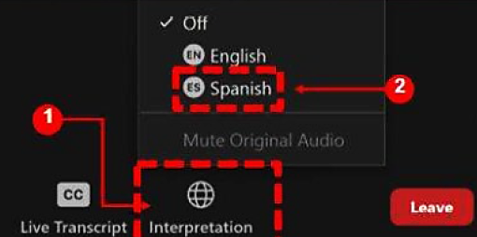

Selecting Language Interpretation
In your meeting controls, click Interpretation. If that option is not visible, click More
Click the language that you would like to hear. Options for this meeting are English and Spanish
To only hear the interpreted language (Spanish), click Mute Original Audio
Notes:
Speaking Notes are in a Separate Word Document

Slide 3
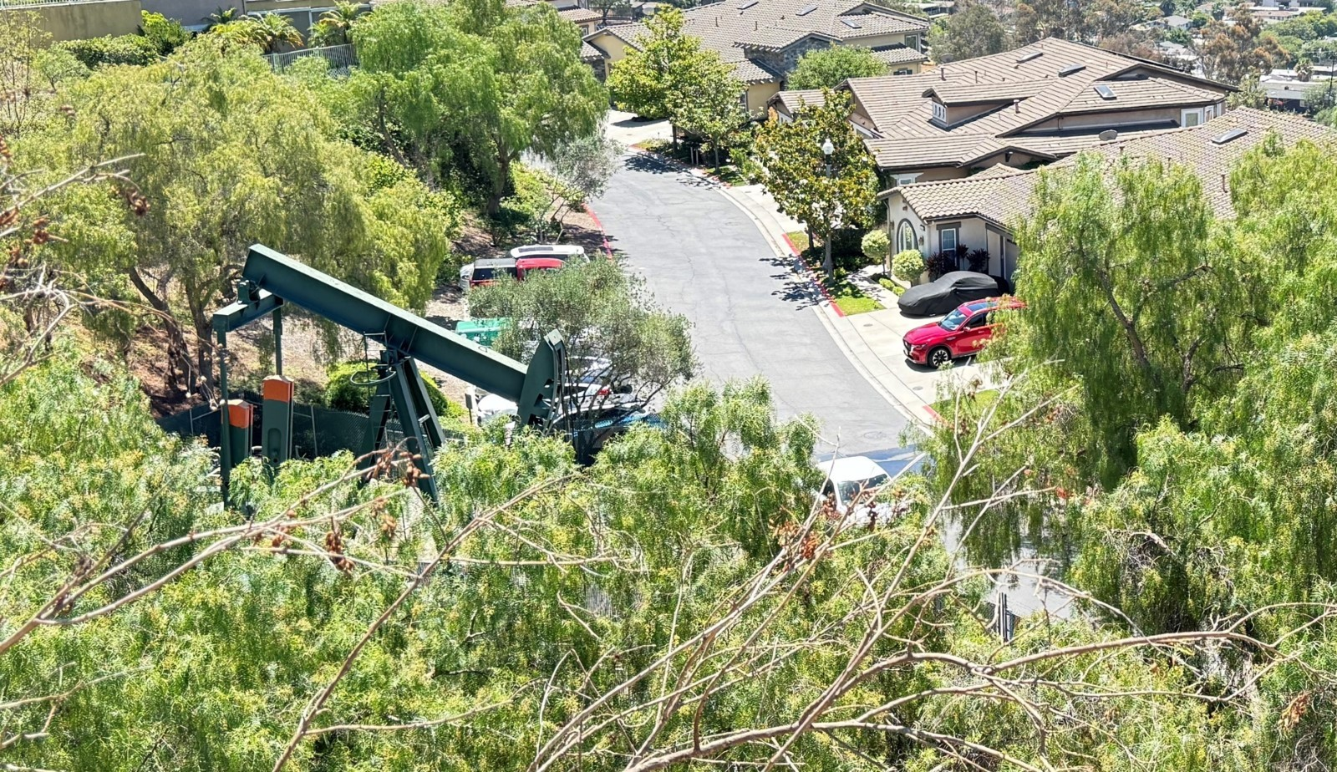
Public Workshop Agenda
Welcome
Introductory remarks
Staff presentation
5-minute break
Questions and discussion
Notes:
Speaking Notes are in a Separate Word Document

Slide 4
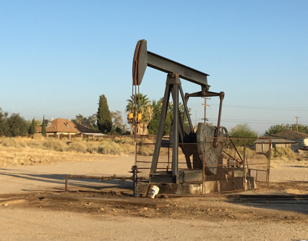
Workshop Topics
1
  Senate Bill 1137
2
  Roles and responsibilities
3
  Draft regulatory concept
4
  Preliminary cost estimate
5
  Request for alternatives
6
  Rulemaking timeline
Notes:
Speaking Notes are in a Separate Word Document

Slide 5

Senate Bill 1137 (SB 1137)
Establishes health protection zones (HPZ) around sensitive receptors located within 3,200 feet of oil and gas production wells and production facilities
Operators of existing wells and production facilities in HPZ must develop leak detection and response plans (LDRP) and install a continuously operating emissions detection system (EDS)
3,200 feet
Notes:
Speaking Notes are in a Separate Word Document

Slide 6

Components of LDRP Required by SB 1137
Alarm system alerts the operator when leaks are detected
Response protocol for identification and repair of leaks
Notify community when leaks cannot be fixed within 48 hours
Chemicals to be detected by the EDS
Continuously operating EDS
Notes:
Speaking Notes are in a Separate Word Document

Slide 7


SB 1137 Concept
Emission Plume
Wind Direction
Oil & Gas Production Facility
Emissions Detection System
Sensitive Receptor
Notes:
Speaking Notes are in a Separate Word Document

Slide 8
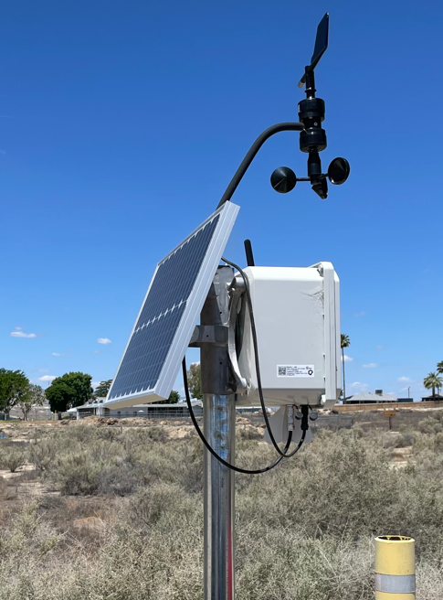
CARB’s Roles Under SB 1137
Adopt regulations to establish performance standards for continuously operating EDS
Identify chemical constituents of concern by region
Concur with California Geologic Energy Management Division (CalGEM) to approve or deny the EDS portion of the leak detection and response plans
Collaborate with CalGEM to develop methods for providing public access to data generated by operators
Averaging Time
Spatial Coverage
Detection Limit
Alert Threshold
Detection Time
Example performance standards
Notes:
Speaking Notes are in a Separate Word Document

Slide 9
Comparison to Existing Air Rules/Regs Impacting Oil & Gas
 | Air District Rules | U.S. EPA New Source Performance Standards | CARB Oil & Gas Regulation | SB 1137
Applicable Sector | Upstream production | Upstream production | Upstream production | Upstream production in HPZ
Pollutant | VOC | VOC, Methane | Methane | Toxic air contaminants, Methane
Frequency of Measurement | Monthly or quarterly | Quarterly or semi-annual | Quarterly* | Continuous
Enforcement Authority | Air Districts | Air Districts | CARB / Air Districts | (CalGEM)
* CARB’s Oil and Gas Regulation contains continuous monitoring requirements for natural gas underground storage facilities, and inspection and repair requirements when operators are notified by CARB of emission plumes detected using approved satellite-based instruments
Notes:
Speaking Notes are in a Separate Word Document

Slide 10
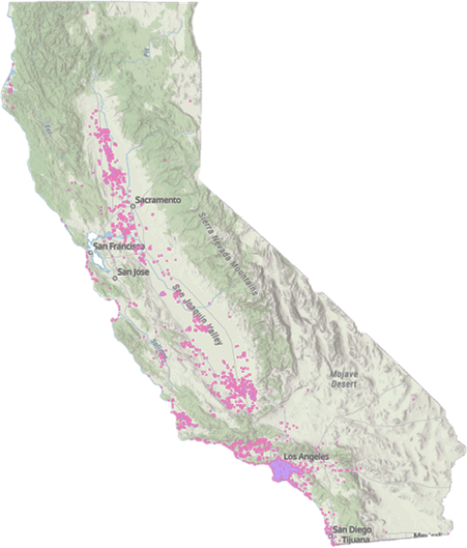
Anticipated Scope of SB 1137 on CA Oil and Gas Production - Preliminary Estimates
Category | Estimate*
Operators to develop LDRPs | 200
Percent of oil production in HPZ | 23%
Percent of natural gas production in HPZ | 7%
Wells in HPZ | 21,000
Tanks in HPZ | 7,300
*Source CalGEM WellSTAR database as of December 2025
HPZ
Notes:
Speaking Notes are in a Separate Word Document

Slide 11
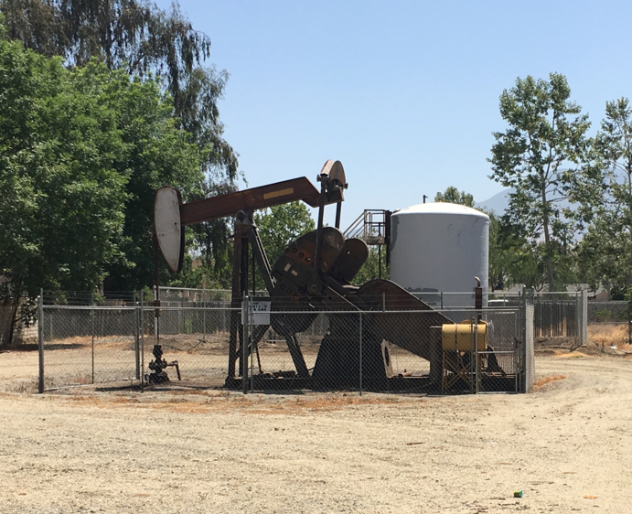
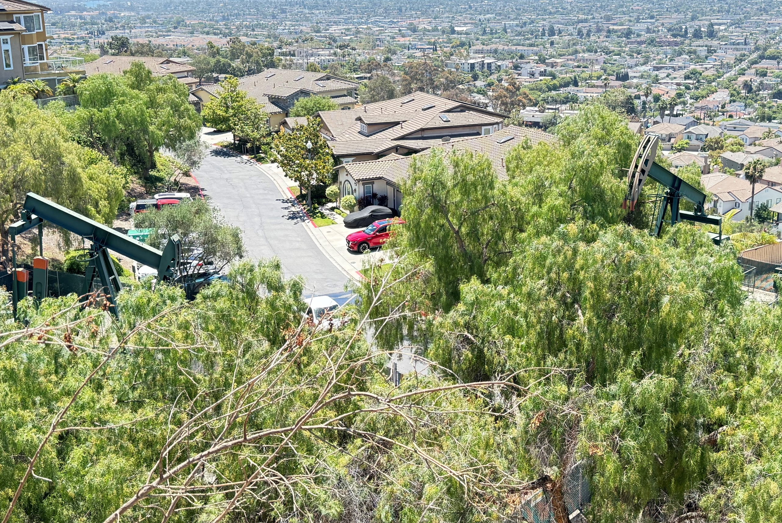
SB 1137 Considerations
California oil and gas production facilities vary widely in configuration, complexity, chemical composition of emissions, meteorology, topography, and distance to sensitive receptor(s)
Notes:
Speaking Notes are in a Separate Word Document

Slide 12
Discussion Draft Documents Available for Review
Topic | Release Date*
Discussion Draft Regulatory Text | 07/01/2026
Review of Commercially Available Continuously Operating Emissions Detection System Technologies Designed for Use at Oil and Gas Production Sites | 07/01/2026
Evaluation of Potential Performance Standards for Continuously Operating Emissions Detection Systems for Upstream Oil and Gas Production Sites in California | 07/01/2026
Evaluation of Methane as a Surrogate to Identify Leaks and Associated Toxic Emissions from Crude Oil and Natural Gas Production Wells and Facilities | 10/31/2025
  *All documents available here: https://ww2.arb.ca.gov/our-work/programs/senate-bill-1137-establishment-health-protection-zones-oil-and-gas-production
Notes:
Speaking Notes are in a Separate Word Document

Slide 13



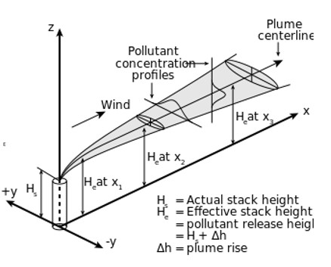
Draft Regulatory Concept: Four Step Process
Characterize facility emissions
Conduct air dispersion modeling
Select & site EDS, set alert threshold
Conduct ongoing quality assurance and reporting
Notes:
Speaking Notes are in a Separate Word Document

Slide 14
Step 1 – Characterize Facility Emissions
Statutory Language:
  LDRPs “shall identify chemical constituents, such as methane and hydrogen sulfide, as well as potential toxics of highest concern....that will be detection targets for the EDS” (PRC § 3283(a)(1))
  “Methane may serve as a surrogate for constituents that cannot be continuously monitored” (PRC § 3283(a)(1))
Framework:
  Staff proposes site-specific source profiles be used to identify toxic of highest concern
  Methane may be used as a surrogate when the ratio of methane to toxic of highest concern is known, and proposed methane EDS meets performance standards
Characterize facility emissions
Select & site EDS, set alert threshold
Conduct ongoing quality assurance and reporting
Conduct air dispersion modeling
Notes:
Speaking Notes are in a Separate Word Document

Slide 15
Step 1 – Characterize Facility Emissions
Proposed Requirements:
  Independent third-party performs compositional source testing and analysis
  Follow procedures outlined in proposed regulation to establish detection target based on:
    Toxic of highest concern
    Methane to toxic of highest concern ratio
Proposed Chemicals to be Analyzed
Benzene
Toluene
o-Xylene
m-Xylene
p-Xylene
n-Hexane
Hydrogen Sulfide
Characterize facility emissions
Select & site EDS, set alert threshold
Conduct ongoing quality assurance and reporting
Conduct air dispersion modeling
Notes:
Speaking Notes are in a Separate Word Document

Slide 16
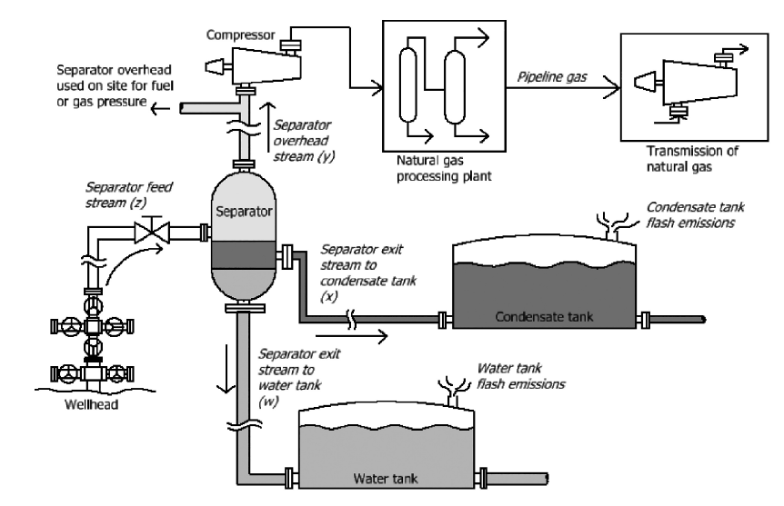
Step 1 – Characterize Facility Emissions
Equipment categories to be source tested:
  Wells
  Processing equipment
  Glycol dehydrators
  Storage equipment
Methods to be used:
  USEPA Method 18
  USEPA Method TO-15A
  API MPMS Chapter 14.1
  ASTM D1945-14
Reprinted with permission from Allen et al., (2017) Environ. Sci. Technol. https://doi.org/10.1021/acs.est.7b02202. Copyright 2017 American Chemical Society.
Characterize facility emissions
Select & site EDS, set alert threshold
Conduct ongoing quality assurance and reporting
Conduct air dispersion modeling
Notes:
Speaking Notes are in a Separate Word Document

Slide 17
Step 2 – Conduct Air Dispersion Modeling
Statutory Language:
  LDRPs must include EDS designed for rapid detection of target chemical constituents to identify leaks "...before emissions impact the surrounding communities” (PRC § 3283(a)(2)(A))
Framework:
  Health-based thresholds to determine community impact
  Office of Environmental Health Hazards Assessment (OEHHA) develops acute Reference Exposure Levels (REL) for many potential toxics
  EDS must detect REL-level leaks, where the ambient concentration of toxic of highest concern exceeds the OEHHA acute REL at a sensitive receptor
Characterize facility emissions
Conduct air dispersion modeling
Select & site EDS, set alert threshold
Conduct ongoing quality assurance and reporting
Notes:
Speaking Notes are in a Separate Word Document

Slide 18
Step 2 – Conduct Air Dispersion Modeling
Proposed Requirements:
  Perform air dispersion modeling for each facility following OEHHA's Air Toxics Hot Spots Program Guidance Manual
  Must use appropriate meteorological data to reflect local conditions
  LDRPs must identify REL-level leak rates from production equipment
  Output should include maps of maximum 1-hr ground level concentrations of detection target throughout HPZ
Characterize facility emissions
Conduct air dispersion modeling
Select & site EDS, set alert threshold
Conduct ongoing quality assurance and reporting
Notes:
Speaking Notes are in a Separate Word Document

Slide 19
Step 3 – Select and Site EDS, Set Alert Threshold
Statutory Language:
  SB 1137 requires EDS to be “continuously operating” and rapidly identify leaks “before emissions impact the surrounding communities” (PRC § 3283(a)(2)(A))
  “Sampling locations and sample inlets shall be consistent with local meteorology and best practices” (PRC § 3283(a)(2)(A))
  EDS “shall include a new or use an existing meteorological system that is appropriately sited….” (PRC § 3283(a)(2)(B))
Framework:
  EDS must be sited and operated to reliably detect REL-level leaks within one hour
  Variety of monitoring tools may be used in EDS provided they are continuously operating and meet the proposed regulation's performance standards
  Allow for a variety of site-specific EDS configurations
Characterize facility emissions
Conduct air dispersion modeling
Select & site EDS, set alert threshold
Conduct ongoing quality assurance and reporting
Notes:
Speaking Notes are in a Separate Word Document

Slide 20
Step 3 – Select and Site EDS, Set Alert Threshold
Proposed Requirements:
  Adhere to CARB-developed performance standards for EDS operation, siting, baseline setting, and alert threshold requirements:
    Annual uptime at least 90%
    Measurement intervals of one hour or less
    Detect REL-level leaks transported towards sensitive receptors within one hour
    Concentration-based alert thresholds using air dispersion modeling and baseline results
  Meteorological station(s) must conform with established USEPA siting guidance where possible
Characterize facility emissions
Conduct air dispersion modeling
Select & site EDS, set alert threshold
Conduct ongoing quality assurance and reporting
Notes:
Speaking Notes are in a Separate Word Document

Slide 21
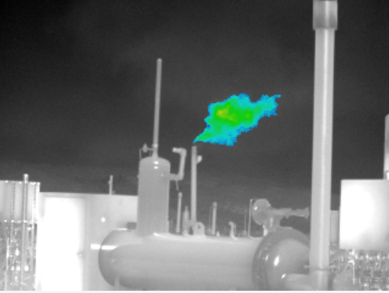
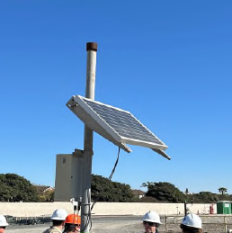
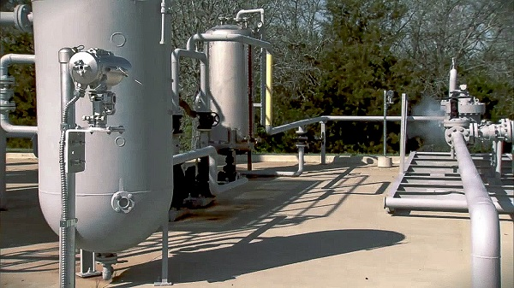
Step 3 – Examples of Commercially Available EDS
KVR. FLIR ADGILE. https://kvrinfrared.com/product/flir-adgile/
ENMET. Emerson’s New Gas Detectors Operate in Extreme Conditions. 2021.https://valvemagazine.com/news/emersons-new-gas-detectors-operate-in-extreme-conditions/
Scanning/Imaging Systems
Point Sensor Networks
Open-Path Systems
Notes:
Speaking notes are in a separate Word Document

Slide 22
Step 4 – Provide Ongoing Quality Assurance
Statutory Language:
  EDS “shall include an alarm system that effectively, immediately, and reliably alert the operators when triggered” (PRC § 3283(a)(2)(B))
Framework:
  Ensure EDS continue to meet performance standards over time
Proposed Requirements:
  Each operator must submit a Quality Assurance Project Plan (QAPP) for each LDRP
  Plans must include data quality objectives, standard operating procedures, quarterly performance tests, maintenance and repair plans
  Independent audits required every 3 years
Characterize facility emissions
Conduct air dispersion modeling
Select & site EDS, set alert threshold
Conduct ongoing quality assurance and reporting
Notes:
Speaking Notes are in a Separate Word Document

Slide 23
Preliminary Total Implementation Costs
(total across 2028-2033)
Characterize facility emissions
Select & site EDS, set alert threshold
Conduct ongoing quality assurance and reporting
Conduct air dispersion modeling
Source testing
Monitoring plan preparation
Equipment cost
Data management
Equipment installation
Routine QA/QC
3rd Party audits
Equipment maintenance
$13 million
$27 million
$56 million
$101 million
(For 5 years)
Notes:
Speaking notes in a separate word document

Slide 24
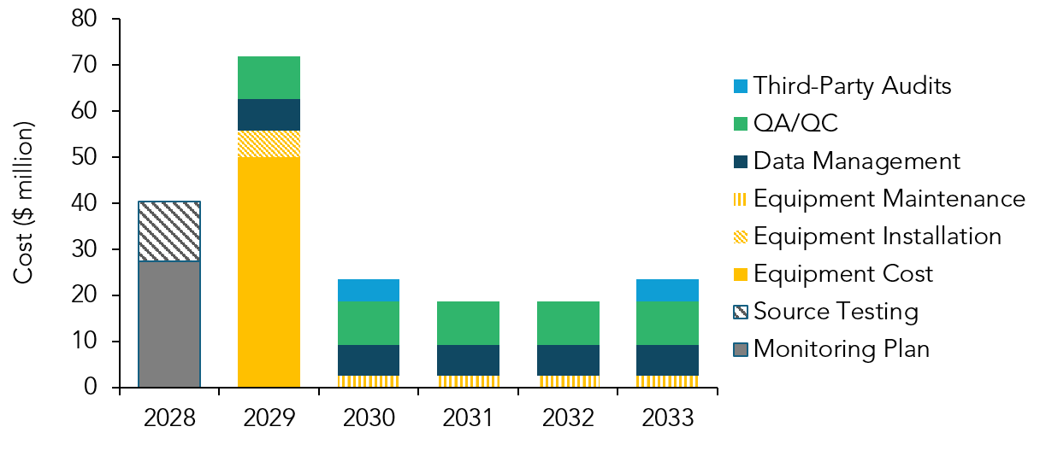
Preliminary Implementation Cost Breakdown
Capital costs
Ongoing costs
Notes:
Speaking notes in a separate word document

Slide 25
Alternatives for Consideration
Alternative 1
One upwind and one downwind sensor
Does not consider sensitive receptor locations
CARB Staff Proposal
Site-specific compositional source testing
Air dispersion modeling
Flexible EDS choices
Acute REL-based alert thresholds
Alternative 2
Sensors directly installed on each piece of equipment and boundaries
Requires identification of all leaks including those below REL-level leak rate
Increases likelihood of missed or delayed detection; Lowers implementation costs
Allows operators more choice in EDS selection; Leaks detected before community impact
Some leak detection benefits with significantly higher implementation costs
Notes:
Speaking Notes are in a Separate Word Document

Slide 26
Request for Alternatives
CARB encourages public input on alternative approaches that:
  May yield the same or greater benefits than those associated with the proposed regulation, or
  May achieve the goals at lower cost
Please ensure the submission:
  Discusses the alternative’s ability to fulfill the purpose of the draft regulatory proposal as CARB has presented it
  Includes the associated cost/benefit information, data sources to enable comparison of economic impacts, and a clear description of the basis for any cost calculations
Notes:
Speaking notes in a separate word document

Slide 27
Request for Alternatives
Submit alternatives relating to economic impacts by
August 17, 2026,
to:
  https://ww2.arb.ca.gov/public-comments/SB-1137-workshop-development-performance-standards-EDS

Slide 28
Rulemaking Timeline
Date | Action
Q2, 2026 | Release discussion draft versions of regulatory text and supporting documents
Q3, 2026 | Second public workshop
Q3, 2026 | Alternatives analysis to Department of Finance (Standardized Regulatory Impact Assessment)
Q1, 2027 | 45-Day public review period, release staff report, and third public workshop
Q1, 2027 | CARB Board Hearing
Q4, 2027 | Final package to Office of Administrative Law
Q2, 2028 | Target effective date of regulation
July 1, 2028 | Oil and gas operators submit LDRPs
July 1, 2029 | CARB and CalGEM approve plans or provide Notice of Deficiencies
July 1, 2030 | Oil and gas operators implement plans and deploy EDS
Pre-Rulemaking Phase
Formal Rulemaking Phase
Implementation Phase
Notes:
Speaking Notes are in a Separate Word Document

Slide 29
5-Minute Break and then
Questions and Discussion
Notes:
Speaking Notes are in a Separate Word Document

Slide 30




How to Participate
Raise Hand via Zoom or Phone
Click on Raise hand in Zoom or dial *9 if calling in by phone
When the host gives you permission, click on Audio in Zoom or dial *6 to unmute your mic. State your name and affiliation before asking a question or providing feedback
Click Lower hand in Zoom or dial *9 after you have delivered your feedback. To mute your mic, click on Audio in Zoom or dial *6
Notes:
Speaking Notes are in a Separate Word Document

Slide 31
More Information
Provide feedback by August 17, 2026, to:
  https://ww2.arb.ca.gov/public-comments/SB-1137-workshop-development-performance-standards-EDS
Please visit our program webpage for more information:
  https://ww2.arb.ca.gov/our-work/programs/senate-bill-1137-establishment-health-protection-zones-oil-and-gas-production
Subscribe to future announcements and feedback opportunities:
  https://public.govdelivery.com/accounts/CARB/subscriber/new?topic_id=sb1137
Contact us via email at: sb1137implementation@arb.ca.gov
Notes:
Speaking Notes are in a Separate Word Document

