Slide 1
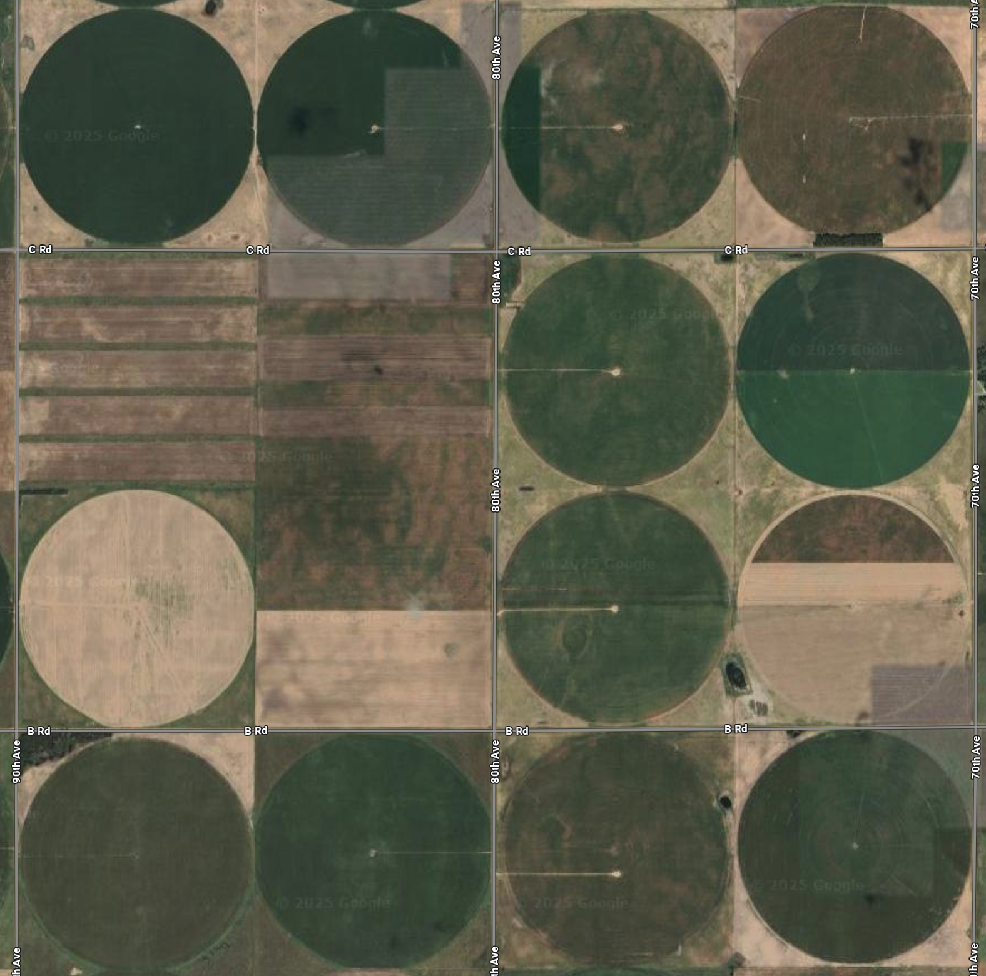
Land Use and Sustainability Changes in South Dakota
David Clay, Deepak Joshi and Nicholas Goeser
David Clay
Distinguished Professor Soil Science
Editor-in-Chief American Society of Agronomy
South Dakota State University
David.clay@sdstate.edu
Support for our research was provided by
USDA-AFRI, Land Use Change Initiative (LUCI), United Soybean Board,
SD Soybean Research and Promotion Council, SD Corn Utilization Council, K-State and SD State University

Slide 2



Supporters of LUCI
Steering Committee
Technical Task Force
Definitions Task Force
Additional supporters
Gevo
Iowa Soybean Association
Kearney
McDonald’s
National Sorghum Producers
The Nature Conservancy
U.S. Soybean Export Council
United Soybean Board
World Wildlife Fund
Accountability Framework Initiative
Arizona State University
CropGrower, LLC
Ducks Unlimited
EPA
FFAR
Gevo
Iowa Soybean Association
Kansas State University
Lone Oak Ventures
McDonald’s
Oak Ridge National Laboratory
South Dakota State University
The Nature Conservancy
University of Wisconsin
University of Wisconsin - Madison
U.S. Soybean Export Council
United Soybean Board
World Wildlife Fund
Arva Intelligence
Clean Fuels Alliance America
Earthworm
Environmental Defense Fund
Individual Farmers
Gevo
JBS
McDonalds
National Cattleman’s Beef Association
National Corn Growers Association
Platform for Ag and Climate Transformation
Individual Ranchers
The Nature Conservancy
U.S. Roundtable for Sustainable Beef
U.S. Soybean Export Council
United Soybean Board
World Wildlife Fund
General Mills
Pheasants Forever

Slide 3
Questions I attempted to answer
How much and where is land use change occurring in SD
  Land surveys were conducted in 2006, 2012, 2014, and 2022
Can we grow the supply of biofuels
  Supply of corn and soybeans
  Changes in erosion and N use
What research questions
  How to continue increasing good and services from existing cropland
  Reduce the barriers to the adoption of conservation practices and 4R nutrient management

Slide 4
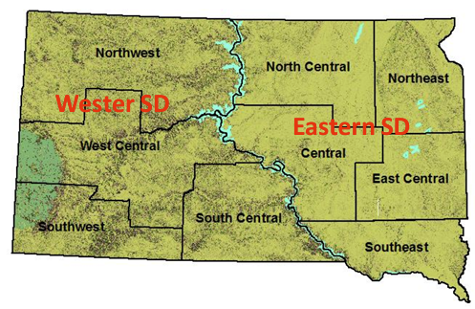
How much and where is land use change occurring in SD
SD was selected as a model system because it on the transition between tall and short grass prairies.
Produces row crops and livestock.
Important habitat for wildlife.

Slide 5
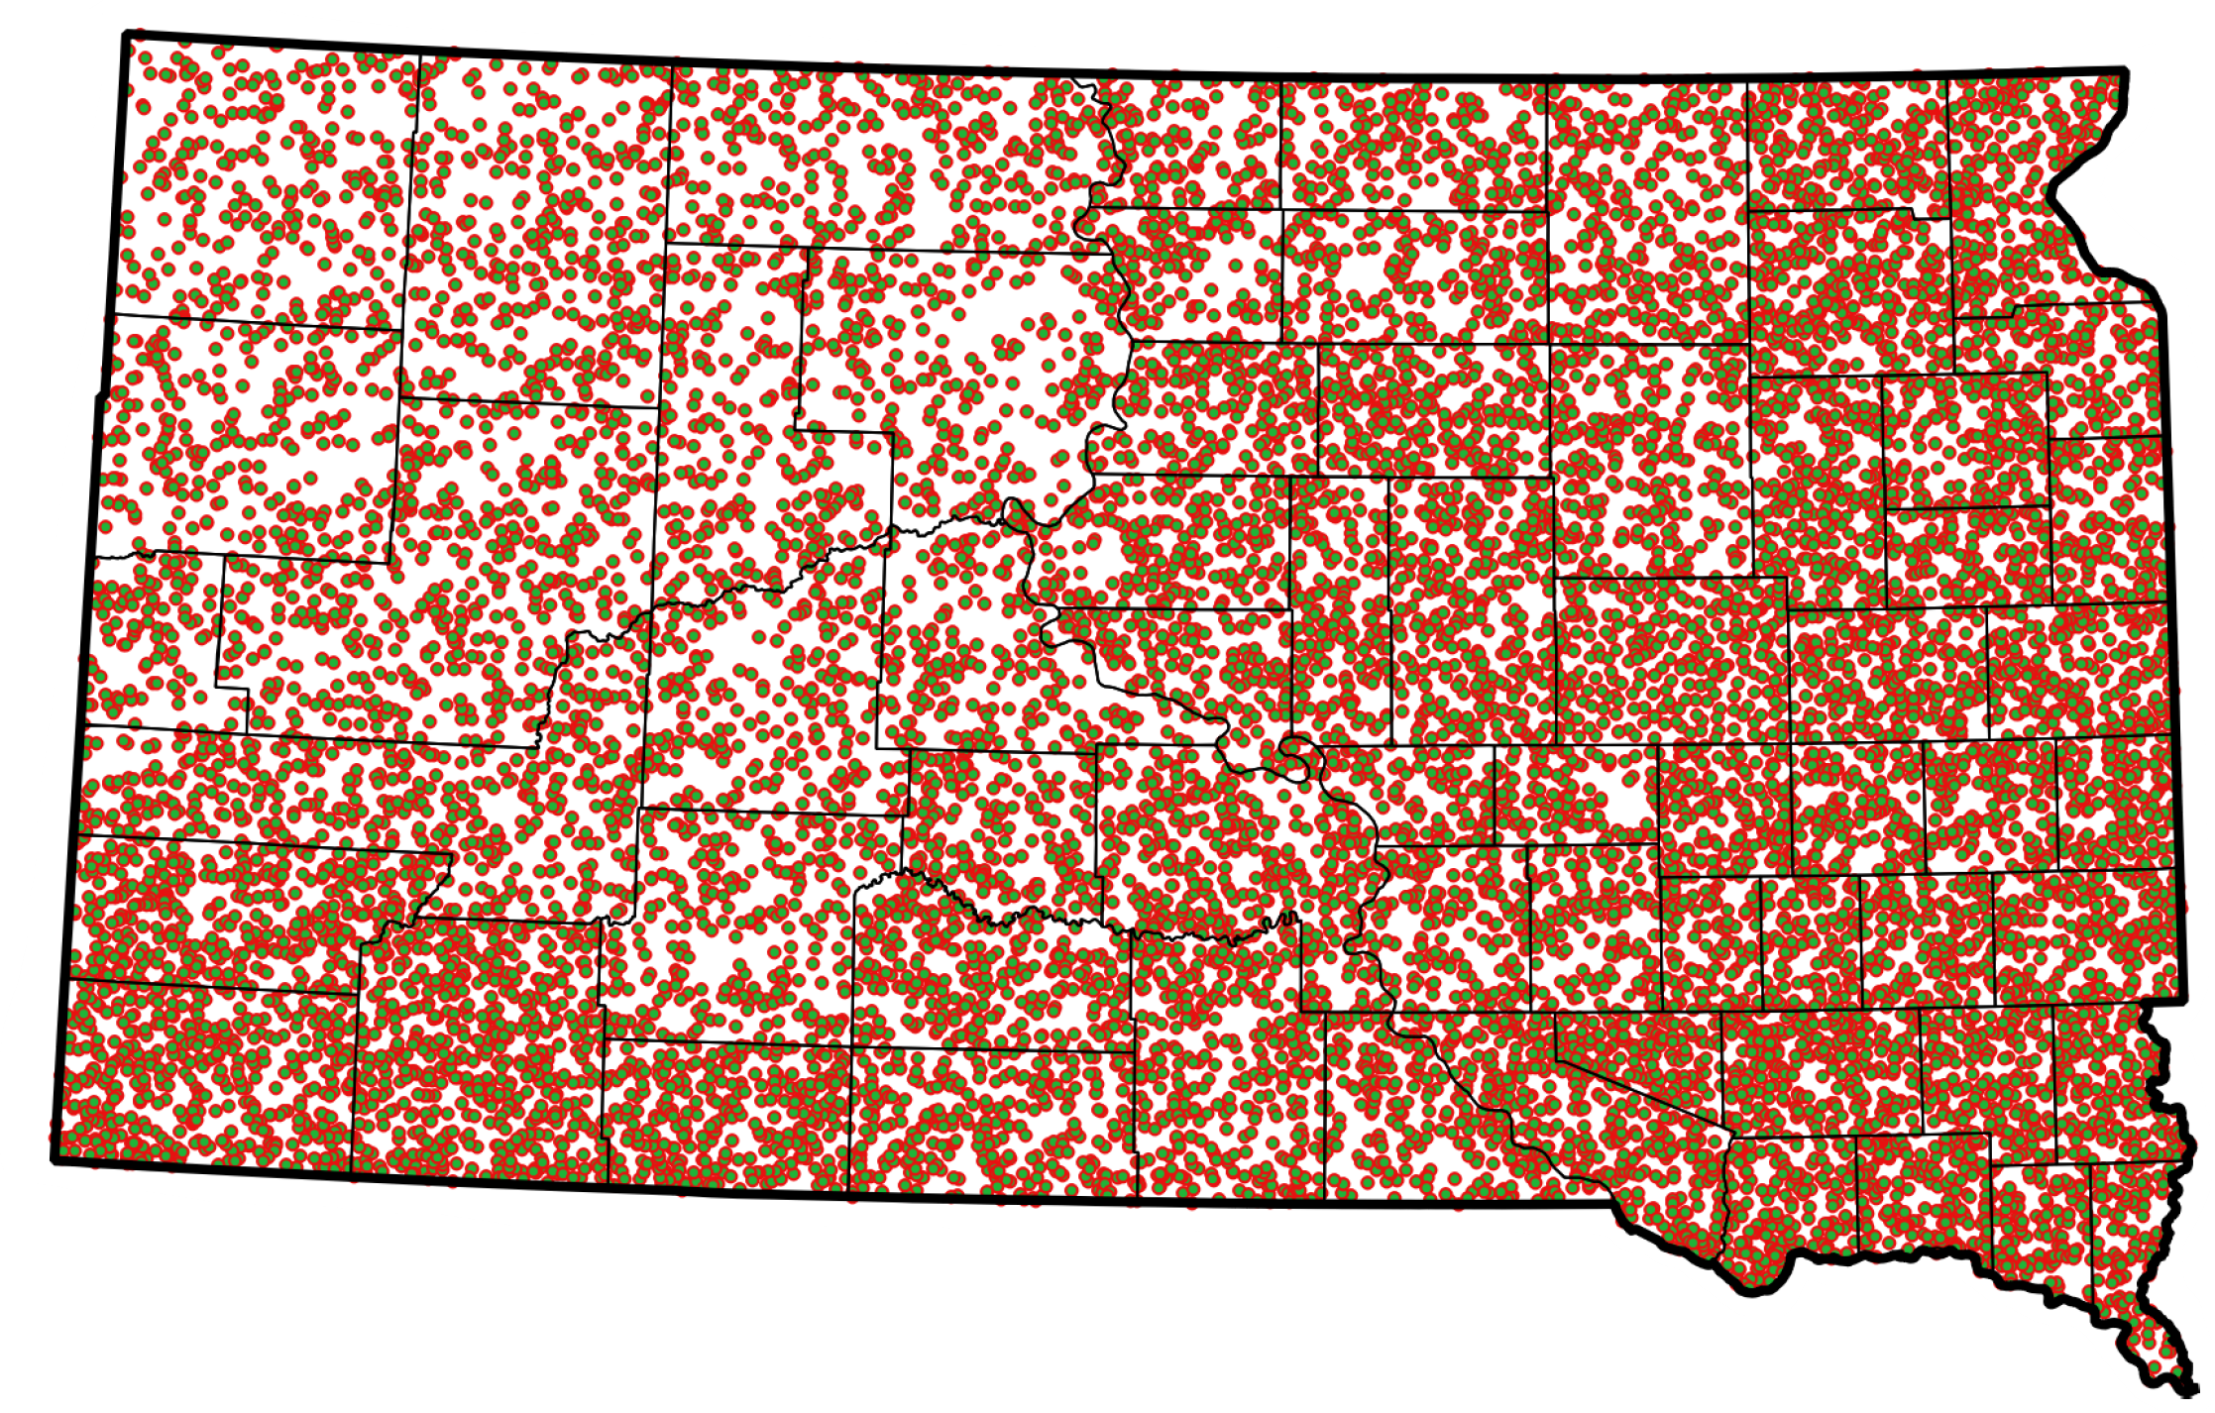
South Dakota Maps with Sampling Points
Over 2006, 2012, 2014 and 2022= 57,600 sampling points
Crop land around 18 million acres
Grassland (pasture and rangeland) and around 24 million acres.

Slide 6
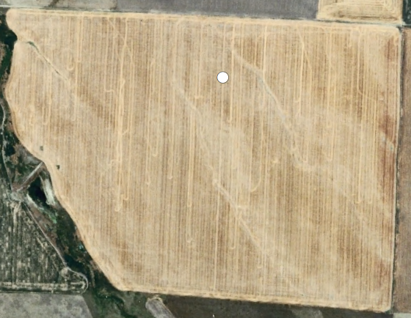
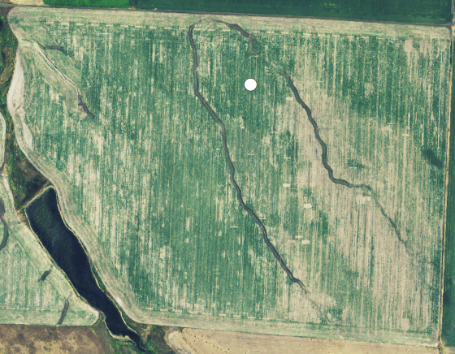
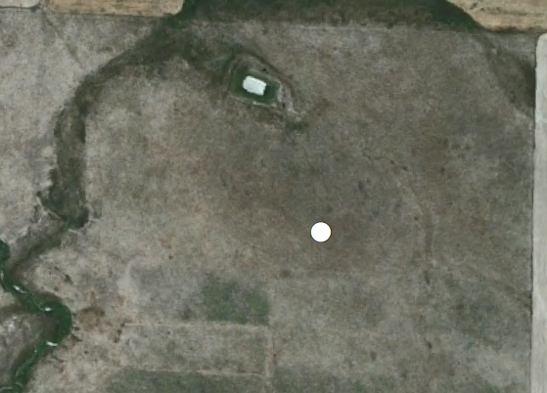
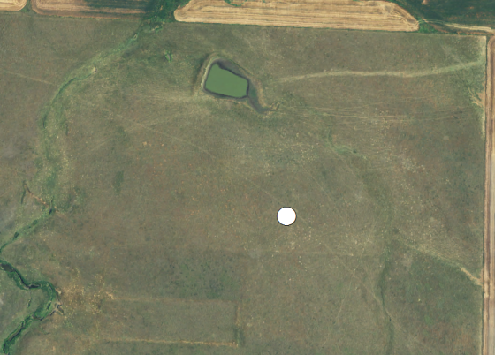
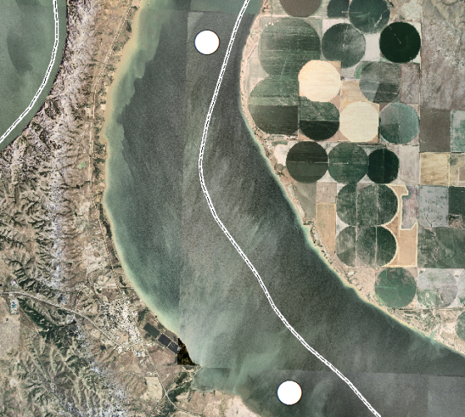
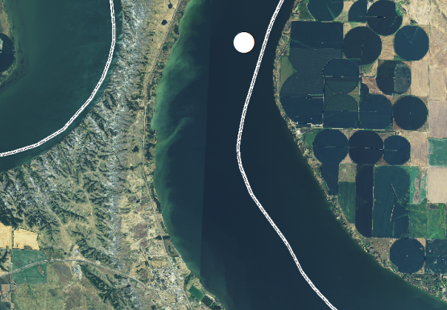
Each point was classified based on visual observation using USDA-NAIP imagery
USDA-NAIP Imagery:
High resolution & collected during the peak growing season
1 m for 2006, 2012, and 2014
0.6 m for 2022
2006
2012
2014
2022
1. Cropland
All cultivated crops
2. Grassland
All Hay
Pasture
Herbaceous Grasslands
3. Other
Open Water
Wetlands
Forested
NonAg

Slide 7
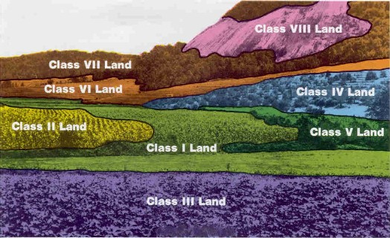
Soil Quality Assessment: Where are land use changes occurring?
Land Capability Class (LCC)
Super imposed on sampling points
LCC I to IV considered suitable for cultivation
LCC V has excess water limitation
LCC VI to VII unsuitable for cultivation
Image reference: http://nesoil.com/ri/capabilityclasses.htm

Slide 8
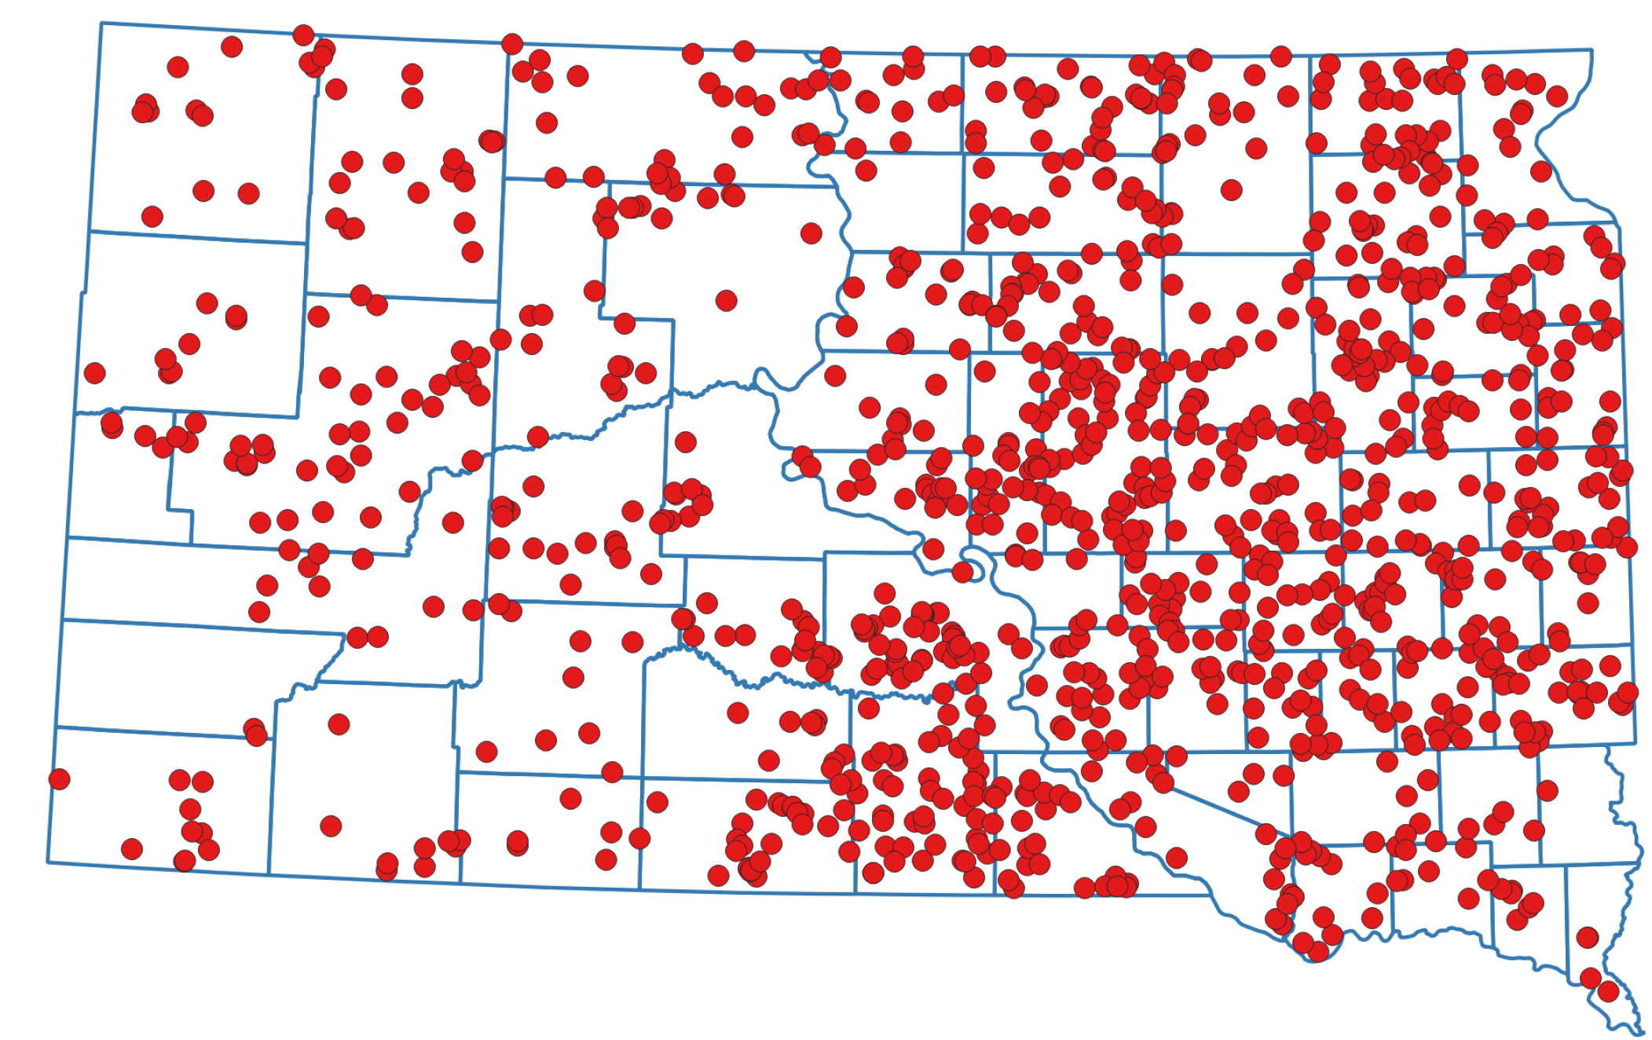
Grassland to Cropland Conversion: East Vs. West
From 2006 to 2022 about 1.5 million ha (3.7 million acres) were converted from grassland to cropland
From 2006 to 2022, about 0.24 million ha (0.6 million acres) were converted from cropland to grassland

Slide 9
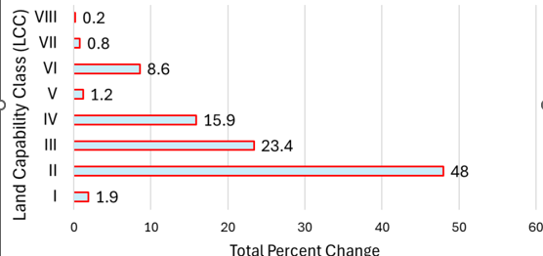
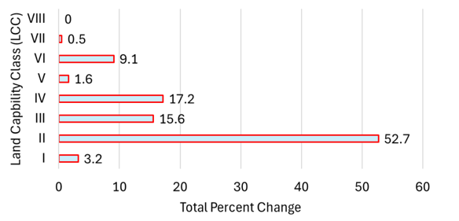
Land capability class of converted land from 2006 to 2022 in South Dakota
Grassland to cropland 2006 to 2022
Cropland to grassland 2006 to 2022
89.2 % of the land converted was suitable for
crop production (LCC I-IV).
88.7% of the land converted to grassland
was suitable for crop production (LCC I-IV).

Slide 10
The expectations are that converting grassland to cropland should
Increased erosion
Reduced stored carbon in the soil
Lower soil health
Increased N requirement
Loss of habitat for wildlife

Slide 11
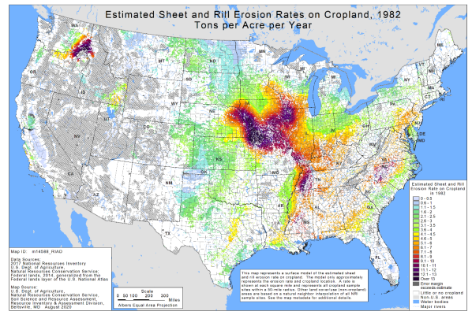
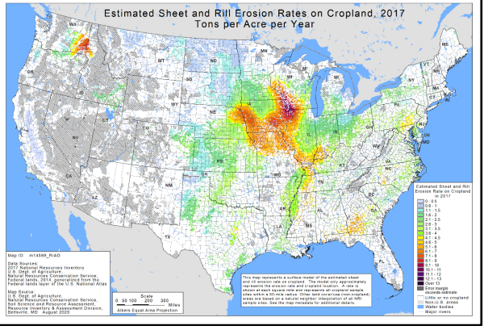
Reduced erosion from 1982 to 2017
These decreases are associated with reduced increased adoption of
conservation practices from near 0 in 1985 to 85%

Slide 12
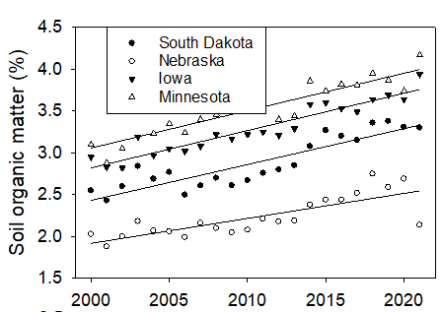
Increases soil organic carbon storage
Midwest Laboratory shored with us data from their testing of farmer soil testing
They analyzed over 12 million soil samples from 2000 to 2022
Conservation practices have increased from near zero in 1985 to over 85% in 2017
SD yields have increased
  Corn 2.76 bu/a year
  Soybean 0.65 bu/a year
From 2000 to 2020, SOC increased 35%

Slide 13
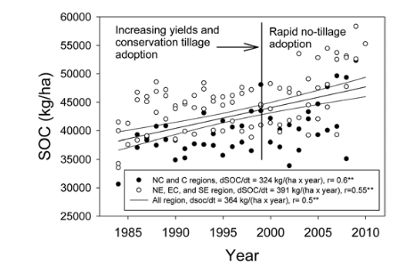
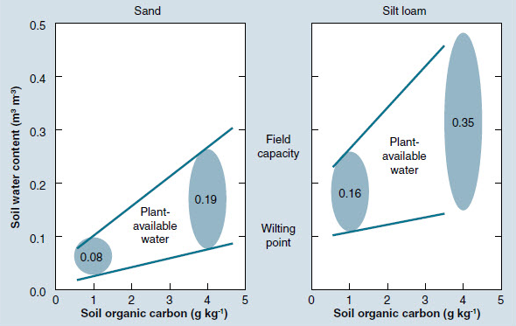
Increased yields even during droughts.
Crop | 1974 (kg/ha) | 2012 (kg/ha)
Wheat | 1230 (18bu/acre) | 3070 (46 bu/acre)
Soybean | 1340 (20 bu/acre) | 2012 (30 bu/acre)
Corn | 2060 (33 bu/acre) | 6321 (100 bu/acre)

Slide 14
Improved soil resilience
Crop | In of water from better health | Acres | WUE | Price | Return due To soil health
 | State | million | Bu/inch | $/bu | $ million
Corn | 1.61 | 5.2 | 8.81 | 7.25 | 534
Soybean | 1.61 | 4.1 | 3.60 | 14.25 | 338
Wheat | 1.61 | 2.43 | 5.85 | 7.83 | 177
Total |  | 11.73 |  |  | 1,050
This results in an annual return of $89.6/acre resulting from soil health

Slide 15
Impact on N recommendations
N rate is linked to nitrate leaching into ground water and nitrous oxide emissions
SD N recommendation = 1.2 (yield goal)–credits+25 lbs N a
to
N recommendation = 1.0 (yield goal) – credits
Where did this N come from?
  Increased SOC and soil water

Slide 16
Can we grow the supply of biofuels annual yield change from 2000 to 2020
State | Corn | Soybeans
 | Bu/(acre×year) | Bu/(acre×year)
SD | 2.76 | 0.65
MN | 2.15 | 0.53
IO | 2.02 | 0.59
NE | 2.48 | 0.84
This yield increase is attributed to improved genetics and increased soil health.
If we can increase these gains, the expectation is that each year in these 4 stated
corn production will increase over 82 million bushels.

Slide 17
Questions
Better understanding on the social aspect of land use change
How do we continue increasing production without converting lands.
Is there a maximum amount of carbon that can be stored in our soil
We need better methods to demonstrate to farmers how soil health improvements have increased their yields and profitability.

Slide 18
Summary: Conservation practices—Water — Yield—Erosion—N use are interconnected
Land is being converted from grassland to croplands.
Most of this land is suitable for row crop production.
Erosion decreased.
The N applied/bu is decreasing.
Yield increases attributed to improved soil health and better genetics.
Improved soil heath and better genetics are growing the amount of corn produced at a rate of 82 million bu of corn per year in SD, MN, IO, and NE.

Slide 19
Thank you for the opportunity to visit with you

