Slide 1

GLOBIOM modelling for biofuel policy support
Stefan Frank, Niklas Hinkel, Petr Havlik…
International Institute for Applied Systems Analysis, Laxenburg, Austria
November | 2025

Slide 2
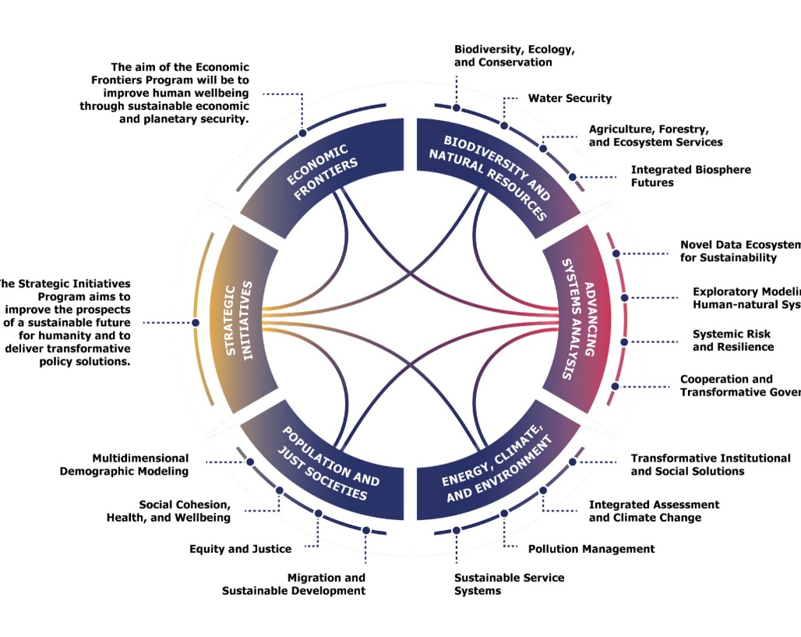
International Institute for Applied Systems Analysis
International research institute established in 1972 near Vienna, Austria
Founded by the US, Soviet Union and 10 other countries to promote East-West scientific cooperation during the Cold War.
Today, 400+ researchers from 50+ countries
The Institute conducts policy-oriented research into issues that are too large or complex to be solved by a single country or academic discipline.
This includes pressing concerns that affect the future of all humanity, such as global warming, energy security, population, aging, or the sustainable development goals

Slide 3
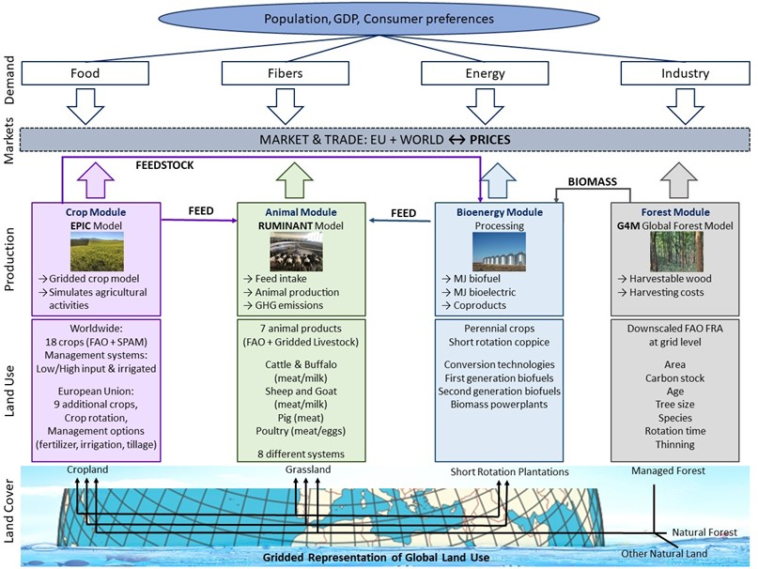
The economic model GLOBIOM simulates land-use change and related emissions of multiple sectors
Bio-economic land use partial equilibrium model integrating global agriculture, bioenergy, and forestry sectors
Bottom-up (spatially explicit land cover, land use, management systems and economic cost information) to the top (regional commodity markets)
Major, globally cultivated crops modelled (ca. 85% of crop-derived calorie supply, ca. 84% of total harvested cropland)
Comprehensive and detailed representation of global livestock sector
Food demand drivers: population, income, response to prices and income, and price changes
Various bioenergy feedstocks represented incl. their co-products (e.g., DDGS)
Recursively dynamic: 10-year time steps (2000 calibration, 2000-2020 validation, up to 2100 projections)

Slide 4
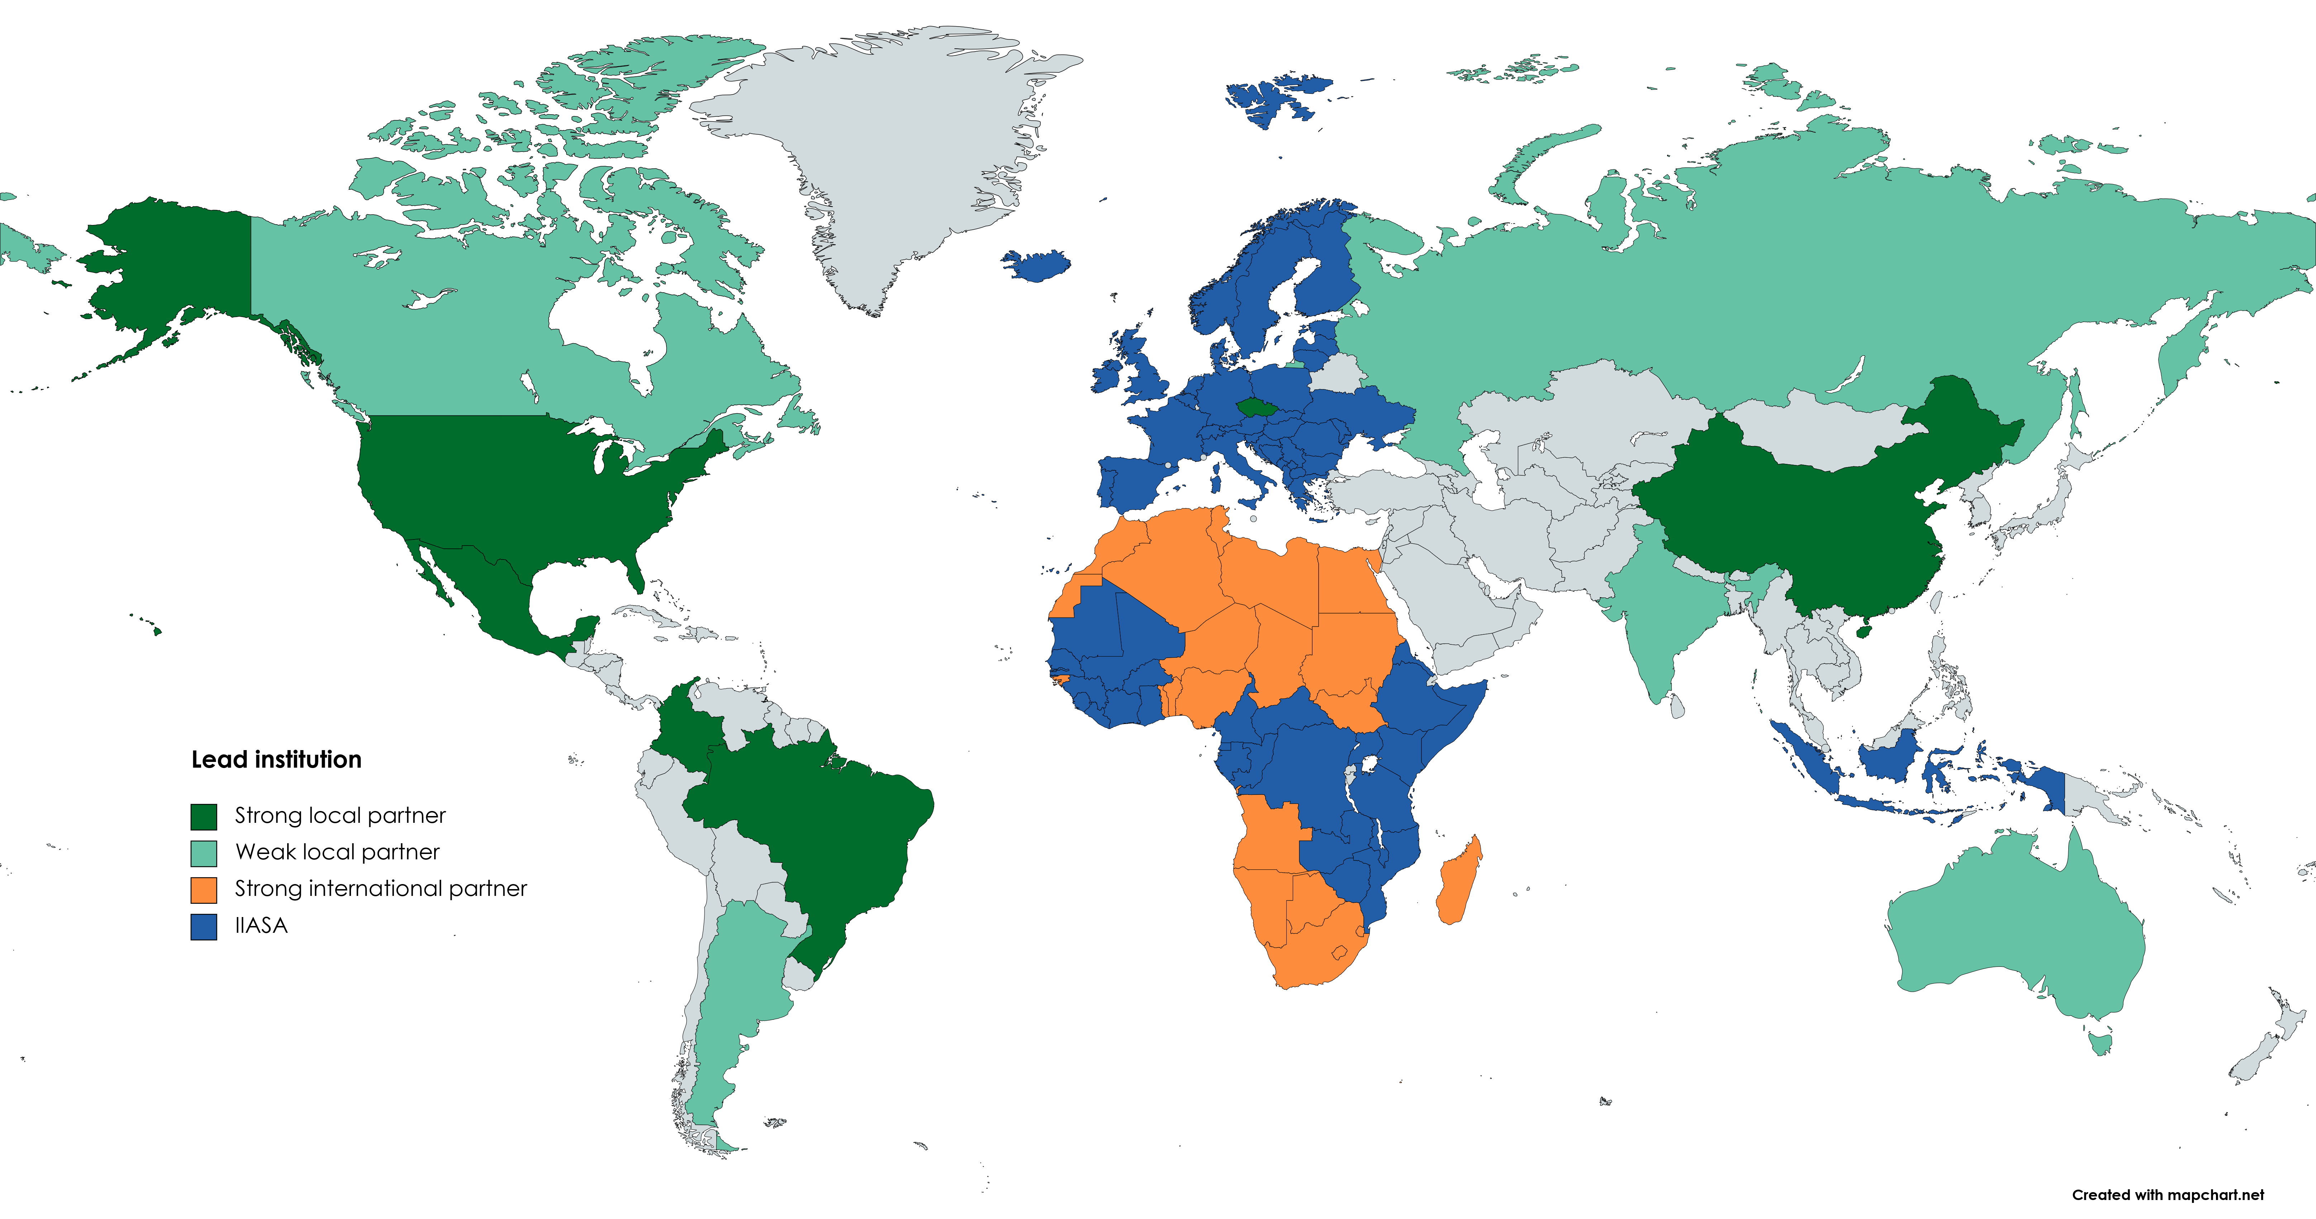

GLOBIOM network - application geography
Collaboration with different research institutions that apply and develop GLOBIOM for their own national / international assessments…
https://globiom.org/

Slide 5
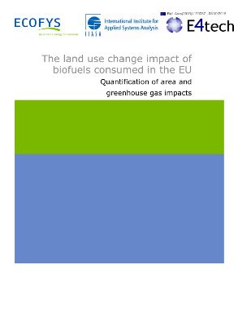

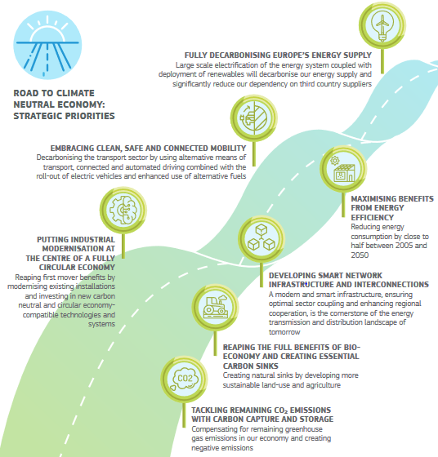
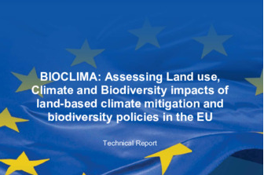
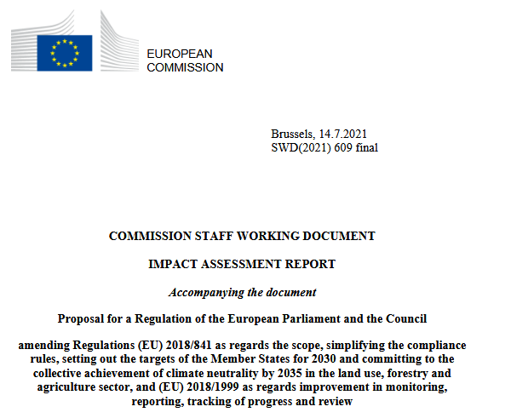
GLOBIOM modelling for policy support
Biofuel assessments
EC – ILUC assessment of 1st and 2nd generation
EPA – ILUC modelling for Renewable Fuel Standard
ICAO – ILUC modelling for CORSIA framework
Climate and energy policies
EC – Land use modelling for EU’s 2030 & 2040 targets, 2050 Long-Term Strategy, Green Deal & Fit for 55 package (EUCLIMIT I – VII)
IPCC – Global Climate stabilization pathways, land-use modelling for 3 global IAMs e.g. MESSAGEix-GLOBIOM
Biodiversity policies
EC – EU Nature Restoration Regulation (BIOCLIMA I-III)
….

Slide 6
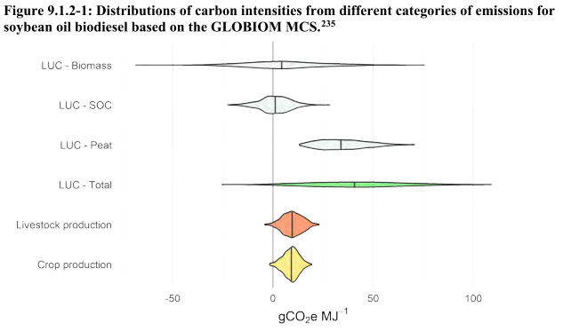
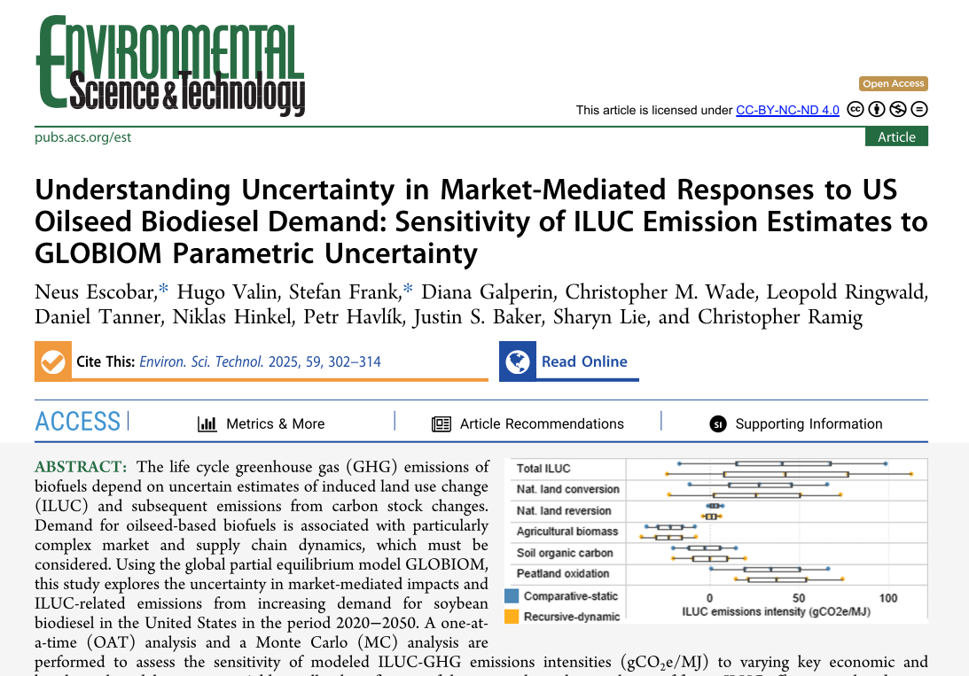
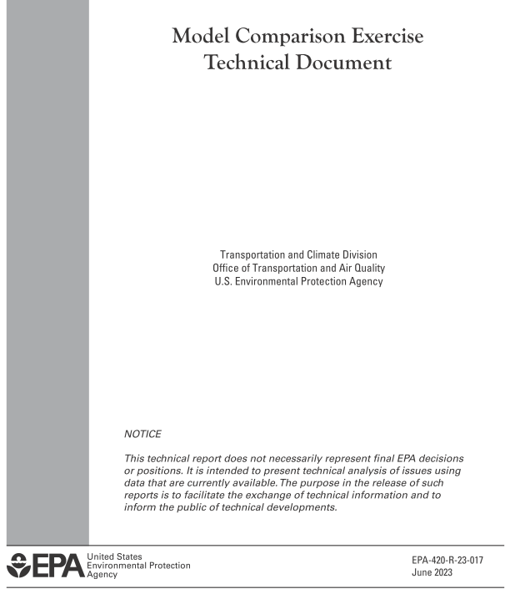
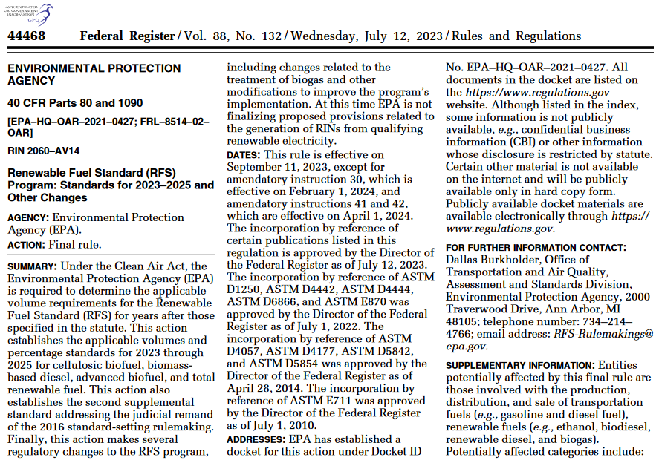
GLOBIOM continues to inform US Renewable Fuel Standards’ biofuel regulations
GLOBIOM ILUC analyses
EPA-IIASA joint publication Dec. 2024
EPA report
RFS ruling
Source: Escobar et al. (2024)

Slide 7
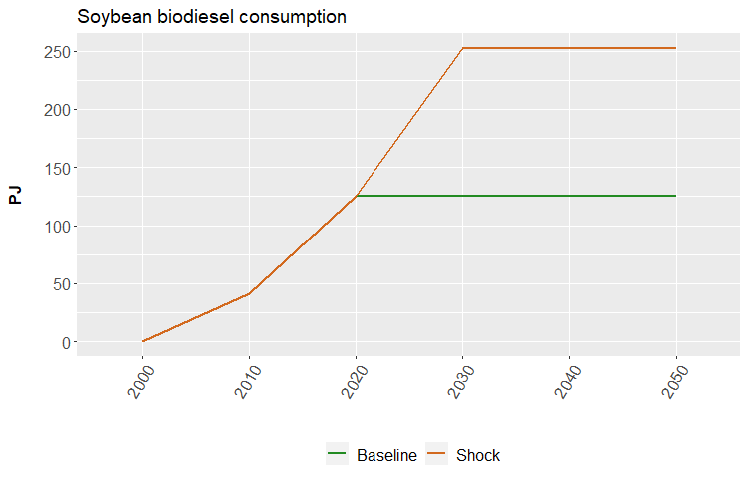
Analyzing ILUC sensitivity with GLOBIOM
Baseline: global biofuel volumes constant at 2020 levels
Shock: increased demand for US soybean biodiesel 2020-2050, reaching total additional demand of 126.9 PJ/year in 2030 (= 1 BGGE ≈ current US consumption)
Source: Escobar et al. (2024)
Assessing influence of varying key model parameters (7 economic, 4 biophysical):
Central Case
model default
central values of varied parameters
One-at-a-time (OAT) sensitivity analysis
individual effects of 11 analyzed parameters
4 values below, 4 above default → 88 combinations
Monte Carlo (MC) simulation
ILUC impact ranges from simultaneous variation (distributions) of analyzed parameters
1000 runs (baseline and shock)

Slide 8
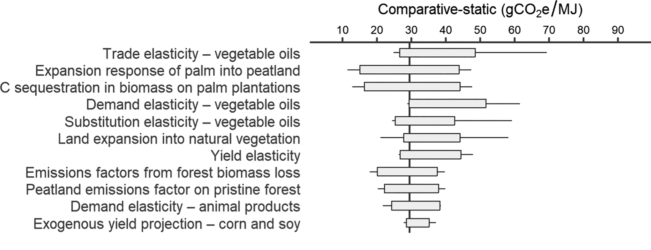
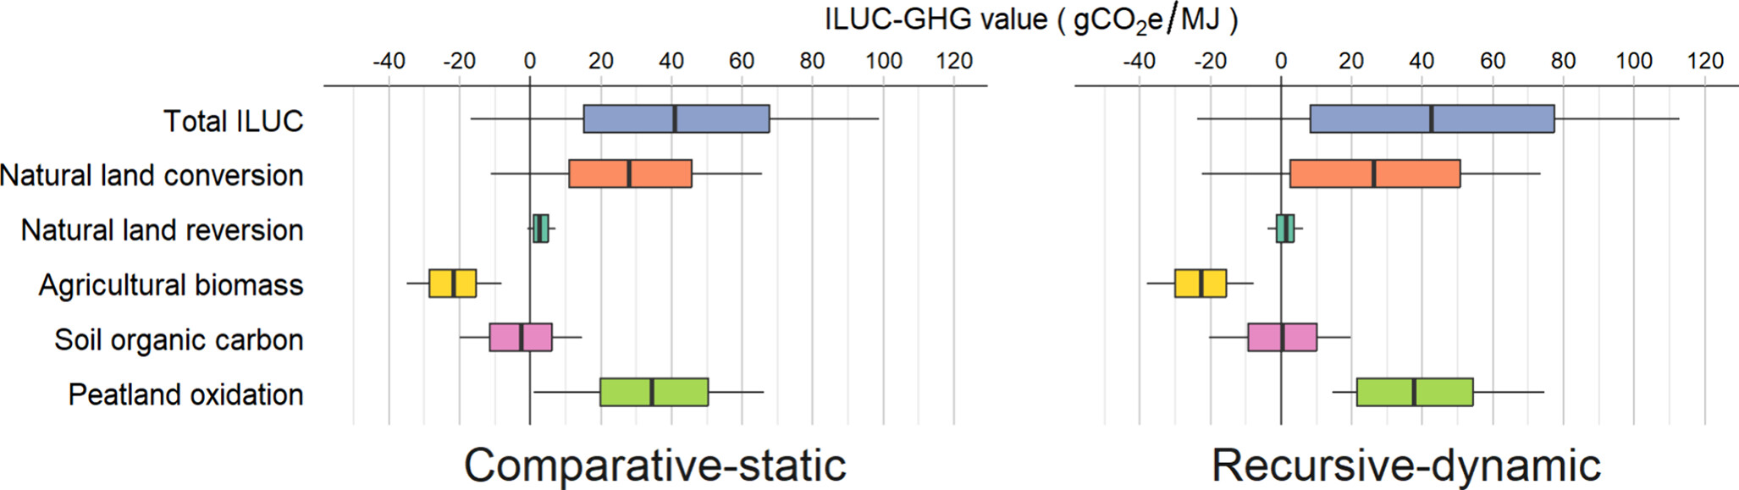
Results & conclusions
One-at-a-time results
ILUC emission values largely vary depending on which vegetable oils replace diverted soybean oil and the carbon content of land converted for agricultural use
A strong driver of results is oil palm expansion in Southeast Asia
Spillovers from US shock to Southeast Asia and South America depend strongly on vegetable oil substitution elasticity and vegetable oil demand elasticity
Market-mediated responses related to vegetable oil markets require systemic analysis of uncertainty when estimating ILUC emissions
Monte-Carlo results
Source: Escobar et al. (2024)

Slide 9
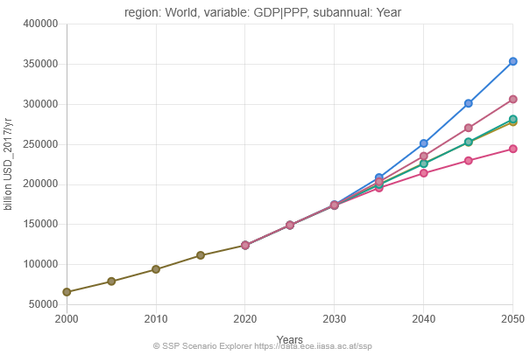
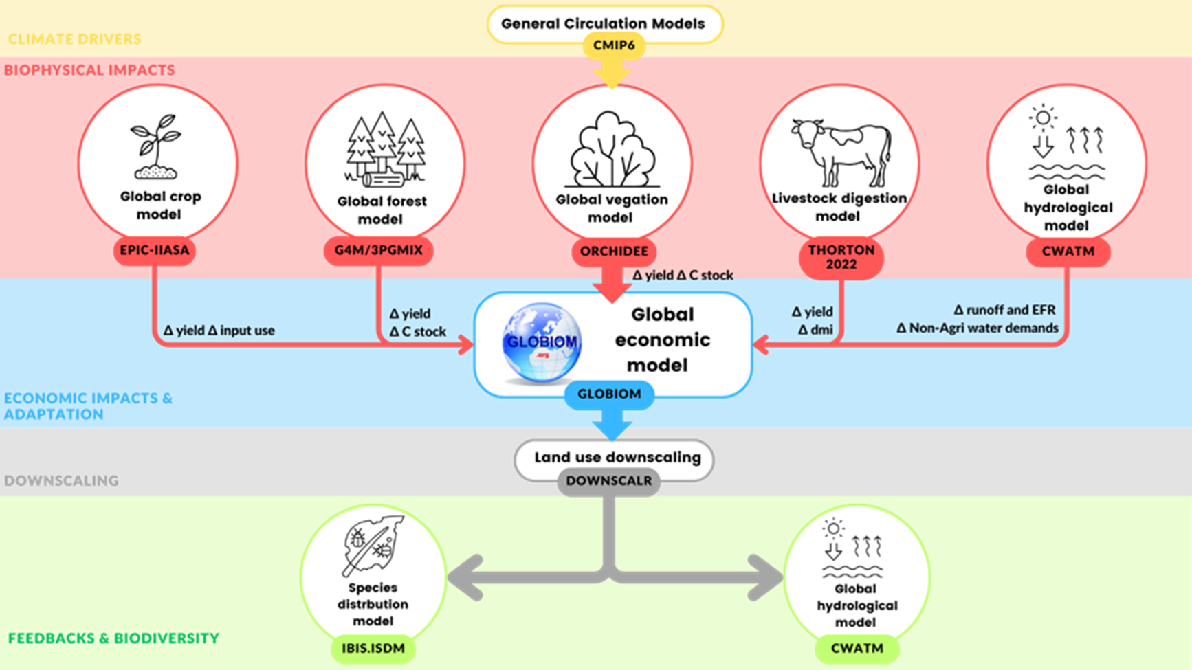
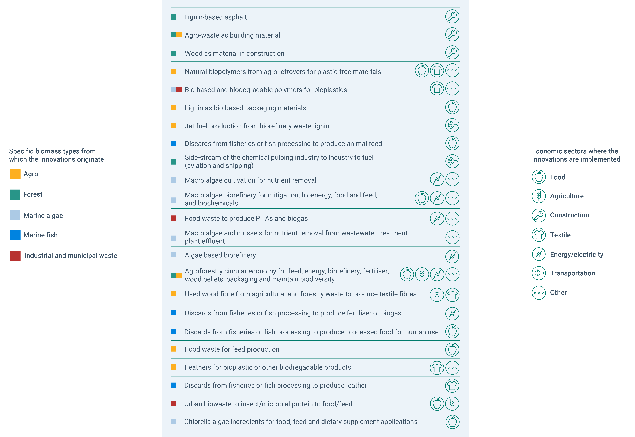
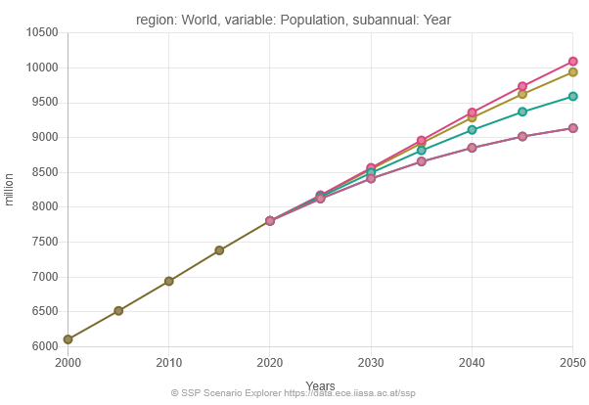
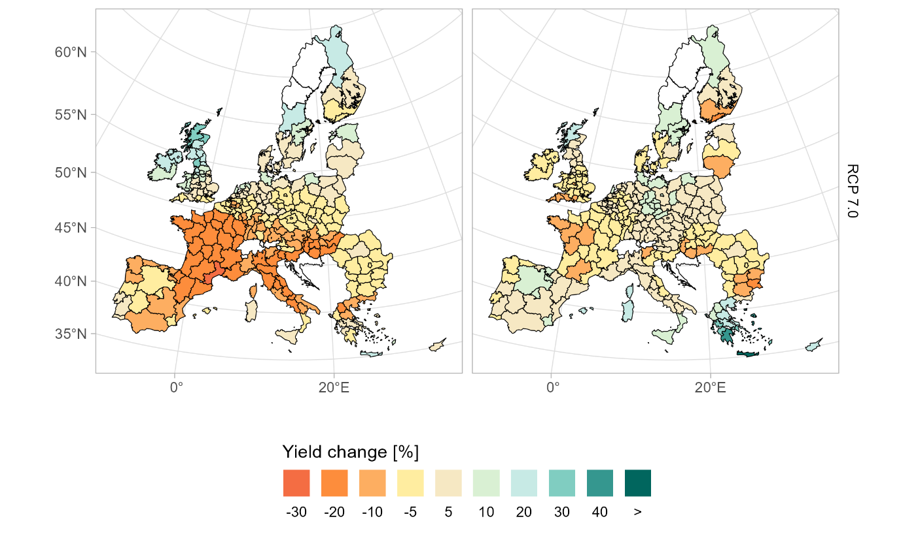
The world is changing...
Uncertainty in baseline drivers
Demand for bio-based materials
Climate impacts & extreme events
OECD GDP projections
Globally, agriculture provided about 80% of biomass supply across uses
Bio-based industry could become a more pronounced driver of land-use
Maize Wheat
IIASA population projections
Source: SSP database, IIASA
Source: EEA, ETC-BE working paper, 2025
Source: Palazzo et al. (forthcoming)

Slide 10
Thank you!
Stefan Frank
Senior Research Scholar

