Slide 1
Intermediate Winter Canola and Challenges with ILUC Assessment Tools
John Sens
LCA & Compliance Reporting Lead
11/06/2025

Slide 2
CAUTIONARY STATEMENTS RELEVANT TO FORWARD-LOOKING INFORMATION FOR THE PURPOSE OF “SAFE HARBOR” PROVISIONS OF THE PRIVATE SECURITIES LITIGATION REFORM ACT OF 1995
This document contains forward-looking statements relating to Chevron’s operations and lower carbon strategy that are based on management’s current expectations, estimates, and projections about the petroleum, chemicals, and other energy-related industries. Words or phrases such as “anticipates,” “expects,” “intends,” “plans,” “targets,” “advances,” “commits,” “drives,” “aims,” “forecasts,” “projects,” “believes,” “approaches,” “seeks,” “schedules,” “estimates,” “positions,” “pursues,” “progress,” “may,” “can,” “could,” “should,” “will,” “budgets,” “outlook,” “trends,” “guidance,” “focus,” “on track,” “goals,” “objectives,” “strategies,” “opportunities,” “poised,” “potential,” “ambitions,” “aspires” and similar expressions, and variations or negatives of these words, are intended to identify such forward-looking statements, but not all forward-looking statements include such words. These statements are not guarantees of future performance and are subject to numerous risks, uncertainties and other factors, many of which are beyond the company’s control and are difficult to predict. Therefore, actual outcomes and results may differ materially from what is expressed or forecasted in such forward-looking statements. The reader should not place undue reliance on these forward-looking statements, which speak only as of the date of this report. Unless legally required, Chevron undertakes no obligation to update publicly any forward-looking statements, whether as a result of new information, future events or otherwise.
Among the important factors that could cause actual results to differ materially from those in the forward-looking statements are: changing crude oil and natural gas prices and demand for the company’s products, and production curtailments due to market conditions; crude oil production quotas or other actions that might be imposed by the Organization of Petroleum Exporting Countries and other producing countries; technological advancements; changes to government policies in the countries in which the company operates; public health crises, such as pandemics and epidemics, and any related government policies and actions; disruptions in the company’s global supply chain, including supply chain constraints and escalation of the cost of goods and services; changing economic, regulatory and political environments in the various countries in which the company operates; general domestic and international economic, market and political conditions, including the military conflict between Russia and Ukraine, the conflict in Israel and the global response to these hostilities; changing refining, marketing and chemicals margins; the company’s ability to realize anticipated cost savings and efficiencies associated with enterprise structural cost reduction initiatives; the potential for gains and losses from asset dispositions or impairments; the possibility that future charges related to enterprise structural cost reduction initiatives, impairments and other obligations may be greater or different than anticipated, including as a result of unexpected or changed facts, circumstances and assumptions; actions of competitors or regulators; timing of exploration expenses; timing of crude oil liftings; the competitiveness of alternate-energy sources or product substitutes; development of large carbon capture and offset markets; the results of operations and financial condition of the company’s suppliers, vendors, partners and equity affiliates; the inability or failure of the company’s joint-venture partners to fund their share of operations and development activities; the potential failure to achieve expected net production from existing and future crude oil and natural gas development projects; potential delays in the development, construction or start-up of planned projects; the potential disruption or interruption of the company’s operations due to war, accidents, political events, civil unrest, severe weather, cyber threats, terrorist acts, or other natural or human causes beyond the company’s control; the potential liability for remedial actions or assessments under existing or future environmental regulations and litigation; significant operational, investment or product changes undertaken or required by existing or future environmental statutes and regulations, including international agreements and national or regional legislation and regulatory measures related to greenhouse gas emissions and climate change; the potential liability resulting from pending or future litigation; the risk that regulatory approvals and clearances related to the Hess Corporation (Hess) transaction are not obtained or are obtained subject to conditions that are not anticipated by the company and Hess; potential delays in consummating the Hess transaction, including as a result of the ongoing arbitration proceedings regarding preemptive rights in the Stabroek Block joint operating agreement; risks that such ongoing arbitration is not satisfactorily resolved and the potential transaction fails to be consummated; uncertainties as to whether the potential transaction, if consummated, will achieve its anticipated economic benefits, including as a result of risks associated with third party contracts containing material consent, anti-assignment, transfer or other provisions that may be related to the potential transaction that are not waived or otherwise satisfactorily resolved; the company’s ability to integrate Hess’ operations in a successful manner and in the expected time period; the possibility that any of the anticipated benefits and projected synergies of the potential transaction will not be realized or will not be realized within the expected time period; the company’s future acquisitions or dispositions of assets or shares or the delay or failure of such transactions to close based on required closing conditions; government mandated sales, divestitures, recapitalizations, taxes and tax audits, tariffs, sanctions, changes in fiscal terms or restrictions on scope of company operations; foreign currency movements compared with the U.S. dollar; higher inflation and related impacts; material reductions in corporate liquidity and access to debt markets; changes to the company’s capital allocation strategies; the effects of changed accounting rules under generally accepted accounting principles promulgated by rule-setting bodies; the company’s ability to identify and mitigate the risks and hazards inherent in operating in the global energy industry; and the factors set forth under the heading “Risk Factors” on pages 20 through 26 of the company’s 2023 Annual Report on Form 10-K and in subsequent filings with the U.S. Securities and Exchange Commission. Other unpredictable or unknown factors not discussed in this report could also have material adverse effects on forward-looking statements.

Slide 3
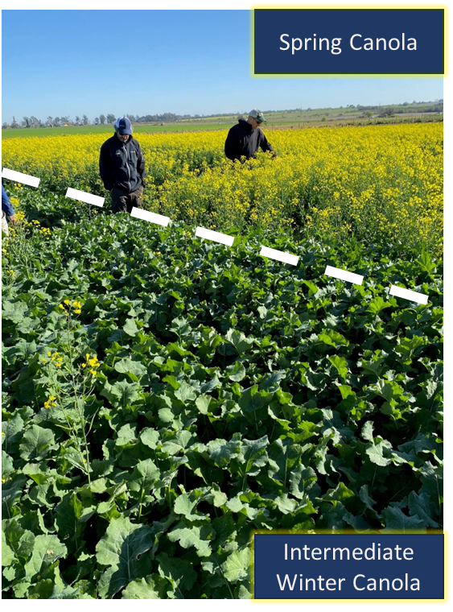
What is Intermediate Winter Canola?
  Intermediate winter canola is a cover crop that is planted in the fall, harvested in the spring.
  Meal and oil are very similar to spring canola
  Oil can be used as feedstock to produce biofuels such as renewable diesel, biodiesel, and SAF
  Intermediate winter canola requires a cold period (vernalization) and is genetically different than spring canola
  Farmers are incentivized to plant it:
  Improves soil through plant diversity and water filtration
  Maximizes productivity through multi-year crop rotation
  Diversification of products and net increase of production from existing farmland
  Increased total farm profitability with access to federal crop insurance for qualified participants
  Winter canola is additive to existing farmland production
Trial above shows intermediate winter canola does not produce seeds without vernalization

Slide 4
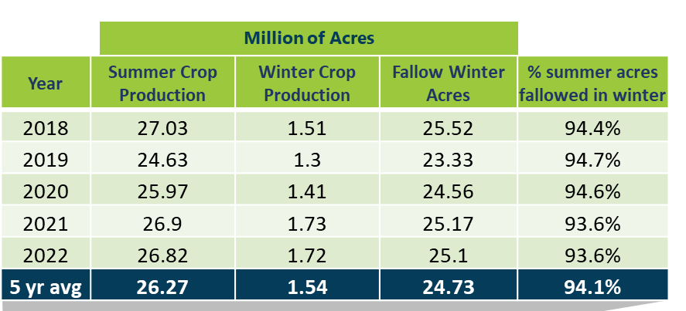
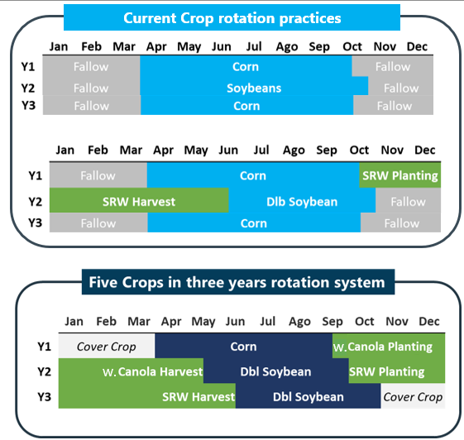
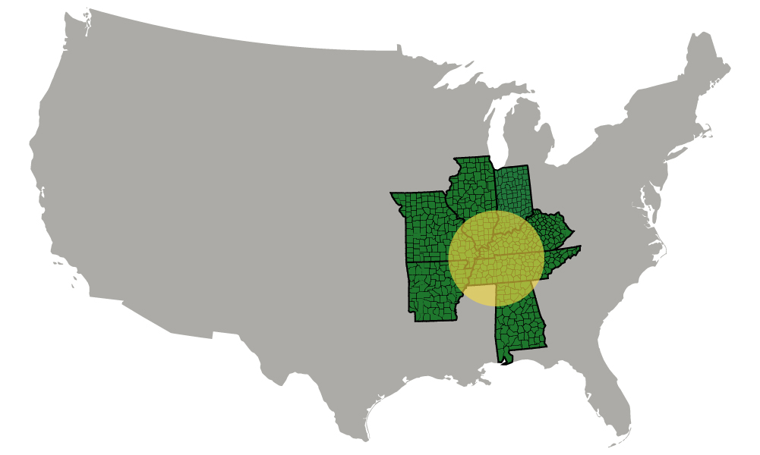
Intermediate Winter Canola fits into Primary Crop Rotation
Source: USDA Cropland Database CroplandCROS (usda.gov)
Dbl
Intermediate Winter Canola Growing Region
Source: https://www.bungeag.com/locations/?type=wintercanola
*SRW – Soft Red Wheat

Slide 5
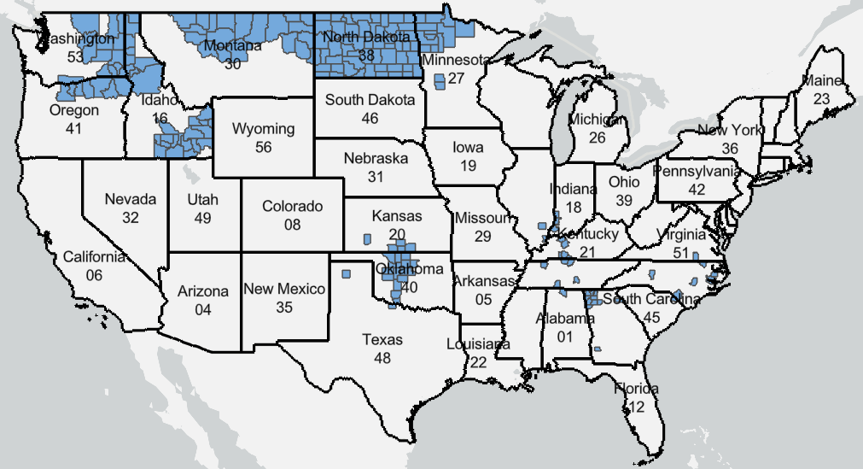
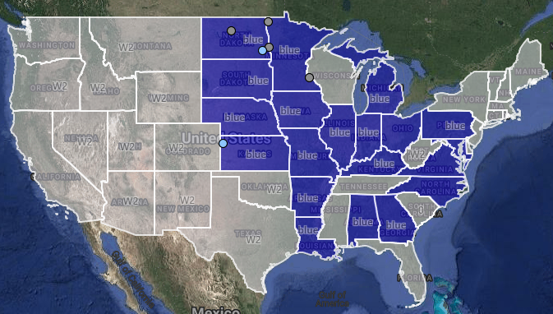
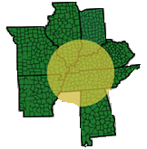
Intermediate Winter Canola scaling up new supply chain to support LCFS
2024 Insured Canola Acres¹
US Softseed Crushing Locations³
~95% of US Spring Canola, ~2.2 MM acres²
Existing Plants
Less than ~80k acres of winter canola²
New Capacity under Construction
Sources:
1 - https://public-rma.fpac.usda.gov/apps/mapviewer/commodity
2 - https://www.uscanola.com/crop-production/spring-and-winter-canola
3 - https://www.nopa.org/about-us/nopa-plant-locations/

Slide 6
Various Biofuels Programs and Research Show Intermediate Winter Crops have a Neutral or Negative ILUC
Study | ILUC for Novel Crop Oils | Reference
CA LCFS Camelina Feedstock Only Pathway under CA-GREET 2.0 | Camelina 0 gCO2e/MJ | https://ww2.arb.ca.gov/sites/default/files/classic/fuels/lcfs/2a2b/apps/so-camelina-oil-sum-110714.pdf
Argonne National Labs 45ZCF-GREET Manual | Camelina, CoverCress, Carinata “Not considered to have significant I[ndirect]-Effects” | https://www.energy.gov/sites/default/files/2025-01/45zcf-greet_user-manual.pdf
Research supporting programs Lui et. al study on intermediate oilseeds | Camelina -15.3 gCO2e/MJ Carinata -12.9 gCO2e/MJ Pennycress -18.3 gCO2e/MJ | https://pubs.acs.org/doi/10.1021/acssuschemeng.4c06429
USCA Study on isolation winter canola production | Isolated Market for Winter Canola -6.77 | Taheripour, F.; Sajedinia, Induced Land Use Change: Case of Winter Rapeseed Biodiesel, May 2024, Department of Agricultural Economics, Perdue University
CORSIA Listing | Global Camelina -13.4 USA Carinata -21.4 | https://www2023.icao.int/environmental-protection/CORSIA/Documents/CORSIA_Eligible_Fuels/ICAO%20document%2006%20-%20Default%20Life%20Cycle%20Emissions%20-%20October%202024.pdf

Slide 7
ILUC Modeling Challenges for Assessing Intermediate Crops
GTAP is an economic model, not an agricultural model
  Multiple models required, numerous assumptions, and few experts that can complete the calculation leads to extreme difficulty for fuel pathway applicants
  Models are not set up to handle agricultural systems that recognize an additive benefit, it can only take resources from the equilibrium system
  Use of existing land and equipment, growing in a limited region and selling exclusively in the US are not options that exist in the model
ILUC calculations can negatively impact implementation of beneficial new crops
  Numerous qualitative benefits that lead to financial benefits or savings are not considered
ILUC uncertainty makes investment decisions difficult because of the outsized impact of ILUC on biofuel CI scores
  Lack of method to apply for improved ILUC under LCFS

Slide 8
Recommended Path Forward
Establish a 0 ILUC base line for intermediate winter canola and the opportunity to reduce in the future
  Intermediate crops should be exempt from the cap on crop-based biofuels because they are additive and therefore do not contribute to land conversion, deforestation, or food insecurity¹
  Could be applied across all intermediate feedstocks to give industry certainty for planning
Clear steps to obtain an ILUC not found in Table 6 are needed
  A clear process is needed for applicants, verifiers, consultants, and CARB to follow for ILUC assessment if it is required to establish new fuel pathways
Consider regional feedstock production to limit scope of indirect effects
  Intermediate crops, like intermediate winter canola, have limited areas where they can be grown due to genetic crop differences
Act urgently on pathway applications to resolve ILUC questions and give clarity
  Not acting delays emission reductions and slows beneficial implementation
1. CARB final statement of reason: 11/8/2024 https://ww2.arb.ca.gov/sites/default/files/barcu/regact/2024/lcfs2024/fsor_appb.pdf

