Slide 1
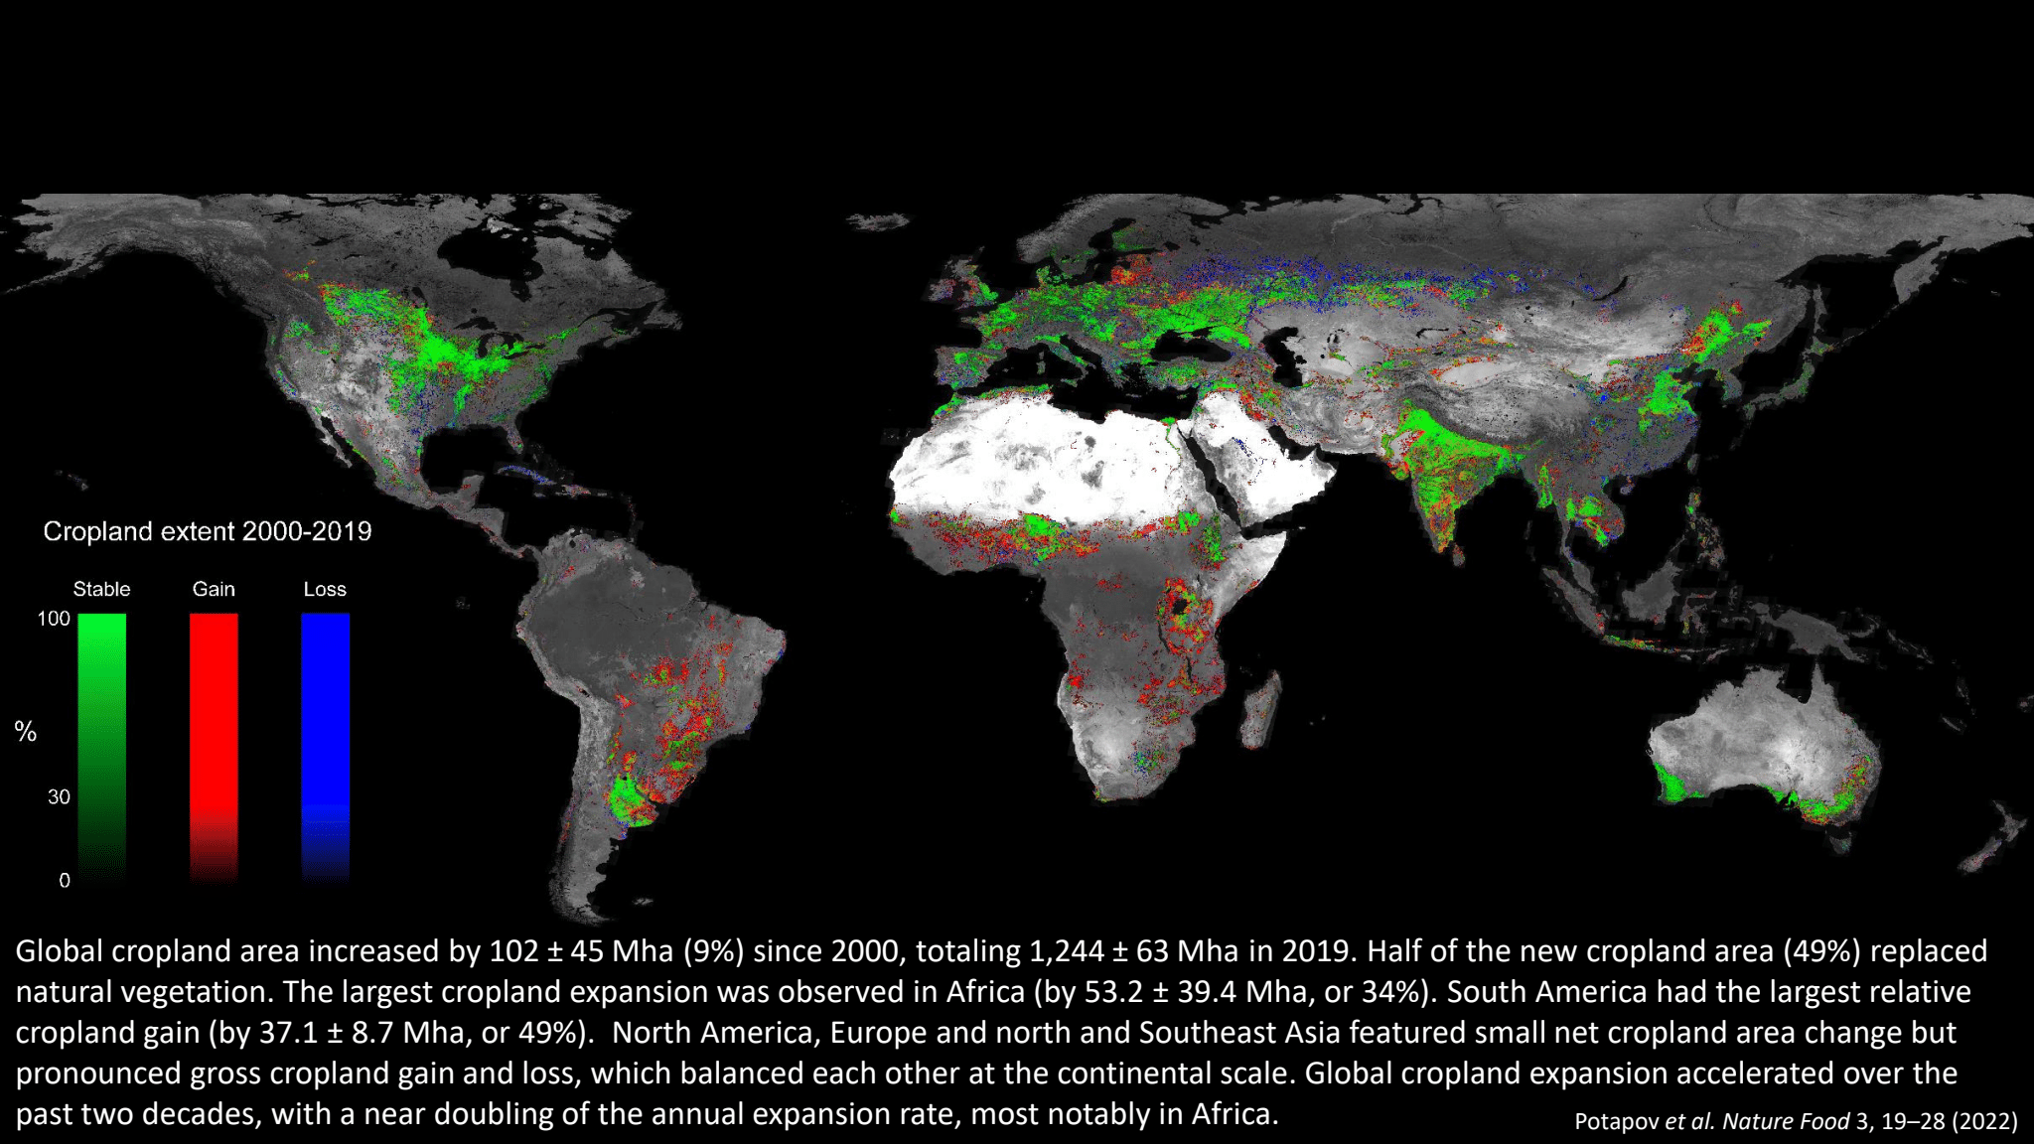
Global cropland is expanding at net 25 million acres per year – size of India in 30 years
2010-2050:
~50 more crop calories
~70% more livestock products
~50% more wood
~100 million hectares of urban land
Potapov et al., Nature Food (2022)– 10 MHA net arable expansion
+ FAO – probably 1 Mha permanent cropland
CROPS
+ PASTURE
Notes:
Driving cropland expansion is a relentless increase in demand for food. The figures shown are estimates from 2010-2050. And the effects on global land use are also exacerbated by rising demand for wood and urban land in this time frame.. (These figures can be found in WRI, The Global Land Squeeze (2023), and are reasonable summaries of numerous studies.) This need for land is exclusive of expansion of bioenergy.

Slide 2
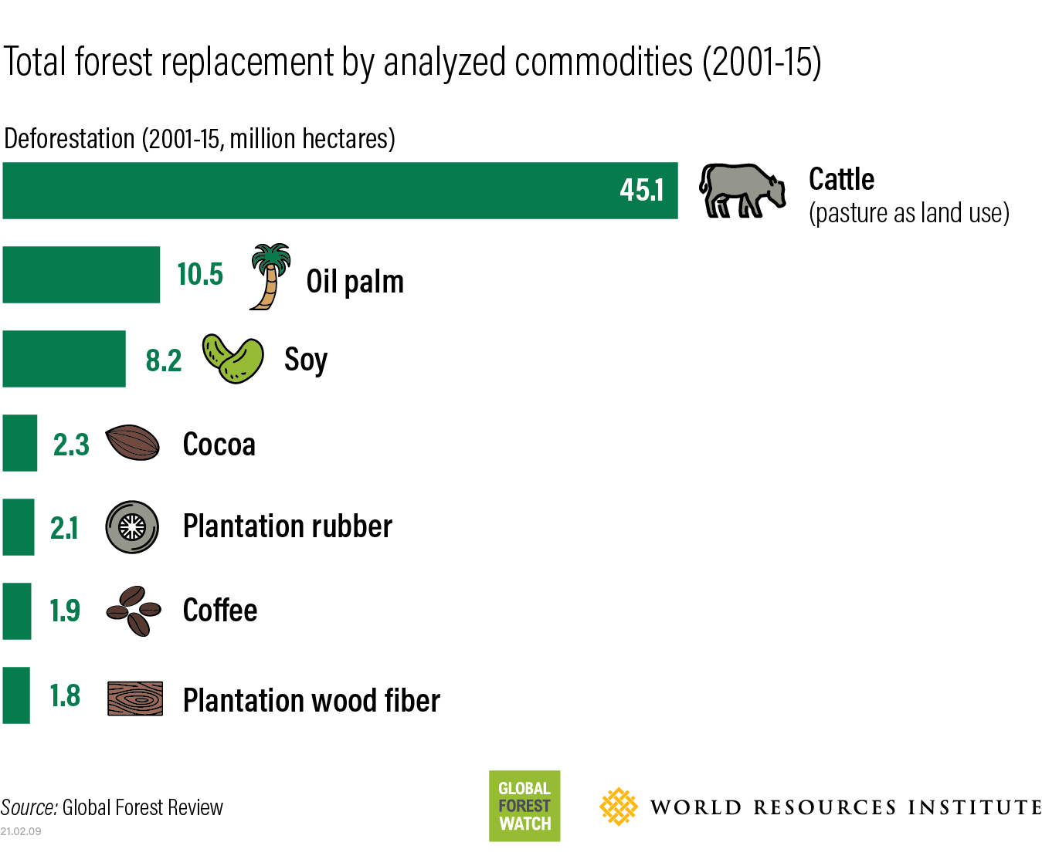

Even more pasture than crop expansion into forest

Slide 3
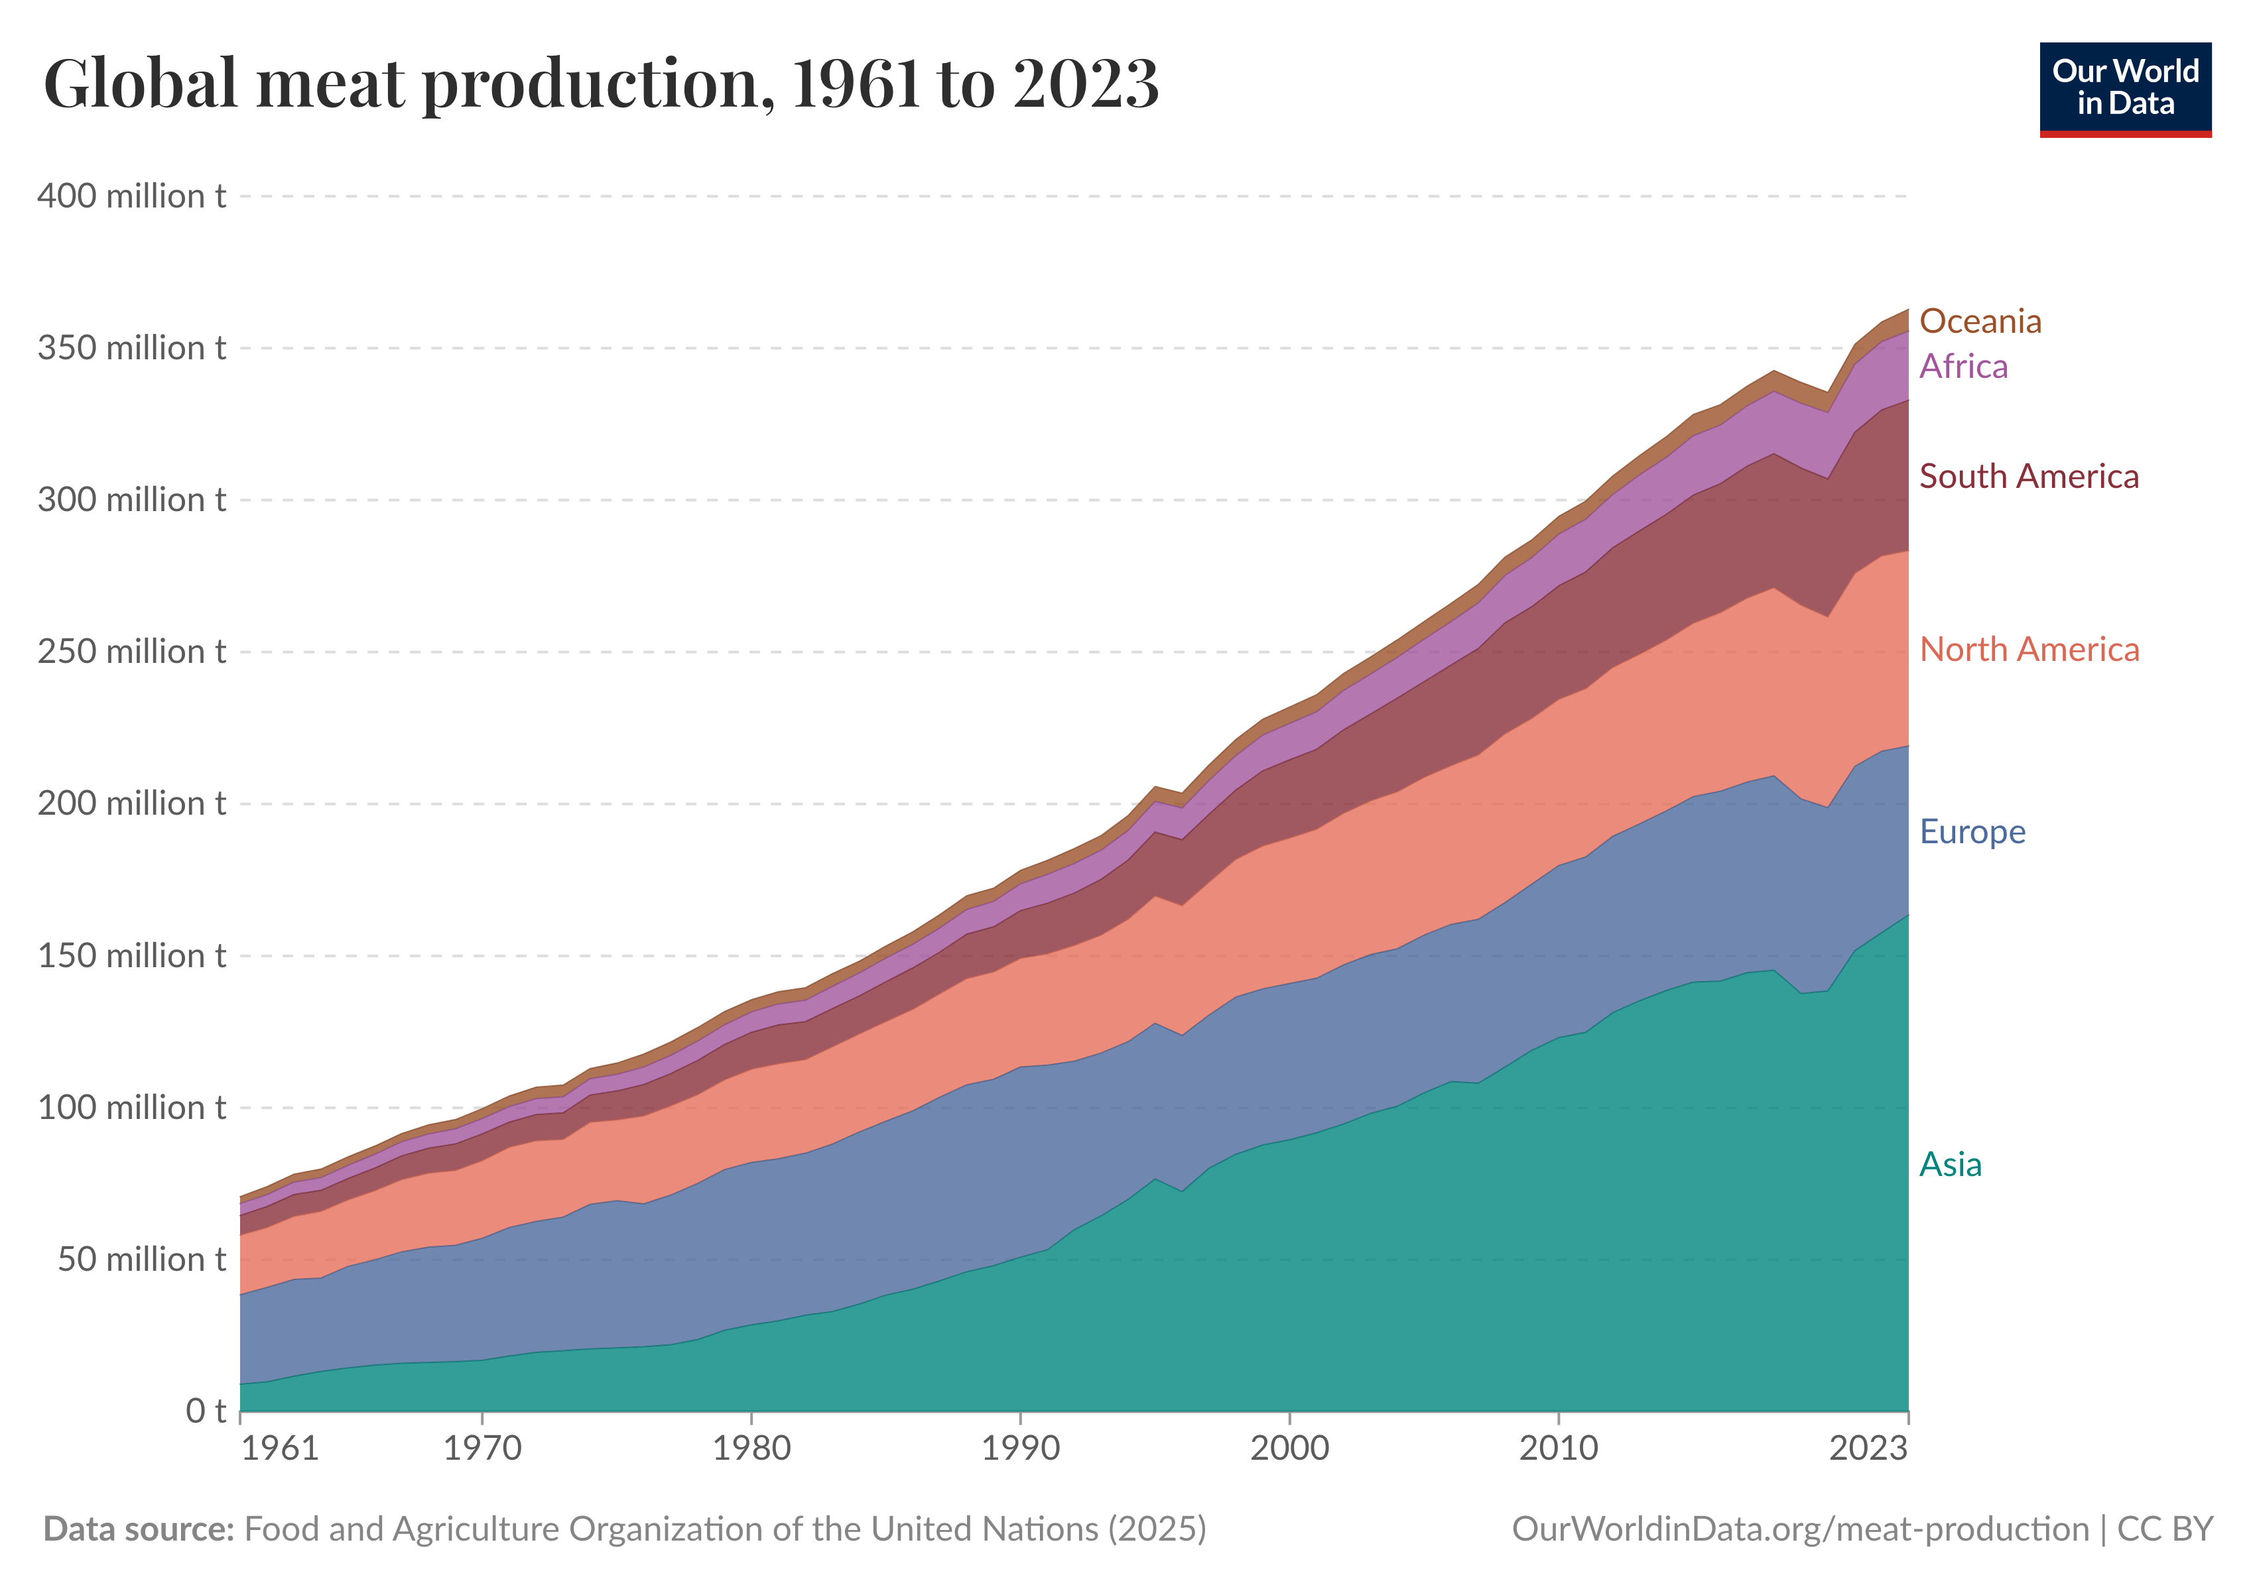
Huge global growth in demand for meat & milk

Slide 4
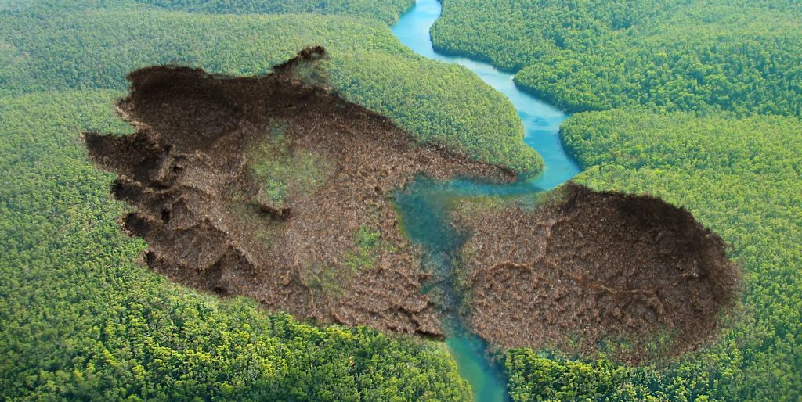
More efficient use of land
Land is valuable stuff for climate!
Need More Food & More Carbon Storage
Fixed Land Area
Minimize the land carbon footprint and
Don’t make the problem worse

Slide 5

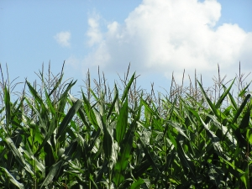
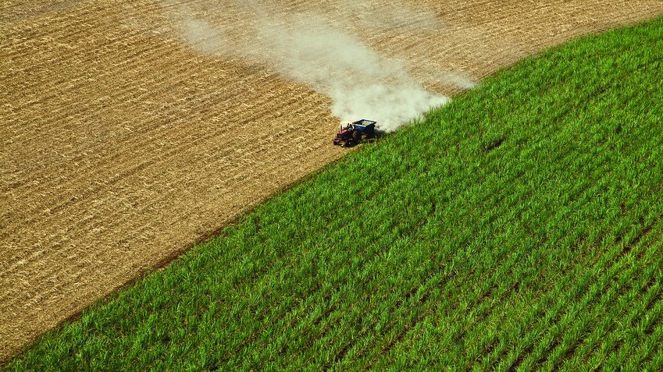

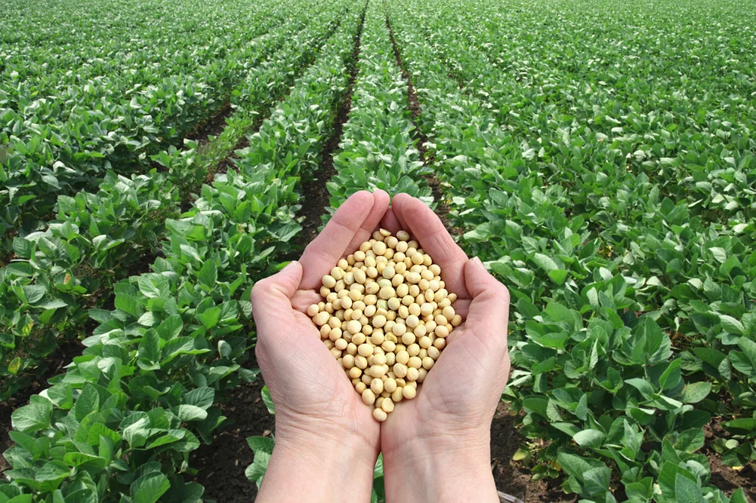
Solar conversion efficiencies (net)
Iowa corn ethanol
1.3 (0.13%)
1000 joules
Brazil sugarcane
ethanol 2 (0.2%)
jet fuel 1.1 (0.11%)
In electric car, 300x more miles per acre
Brazilian & U.S. soybean biodiesel ~1 (0.1%)
PV: >110 (>11%)

Slide 6
COP proposed 4-fold increase in sustainable fuels
If biofuels, this would require ~375 million more acres cropland – equivalent to all U.S. cropland

Slide 7

Making just 25% of Global Aviation Fuel in 2050 from Vegetable Oil?
20-40% of global cropland
Requires 1 to 2 more Indias
All crops could provide 15% of global primary energy and far less final energy

Slide 8
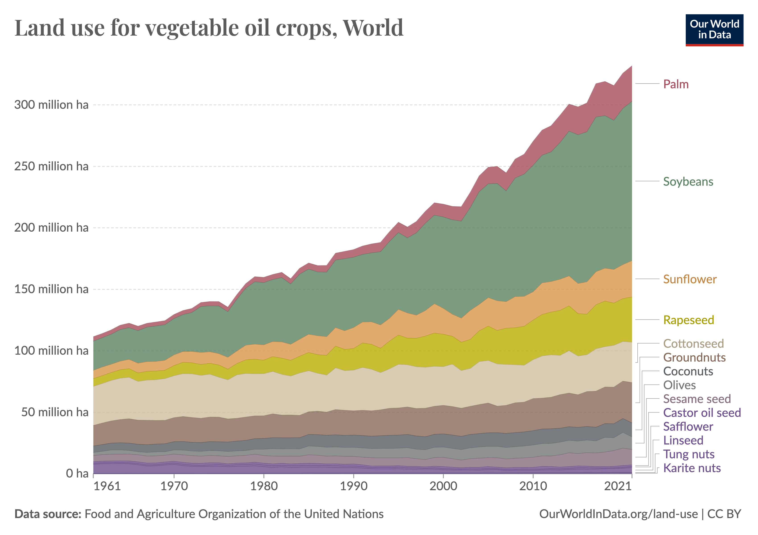
Oil seeds expanded ~250 million acres over 20 years
40% growth in vegetable oil due to biomass-based diesel

Slide 9
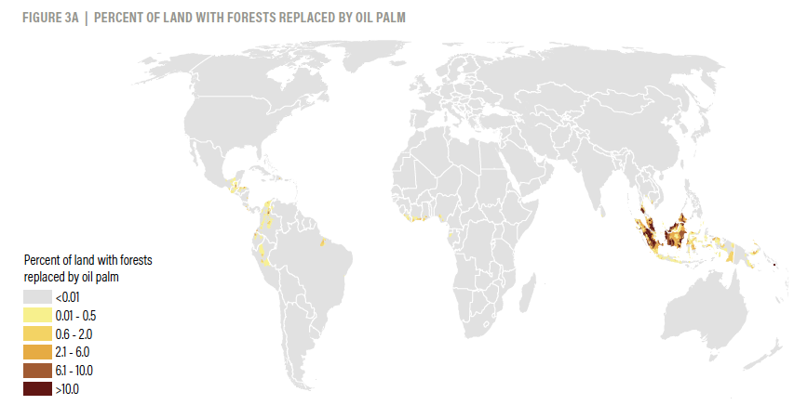
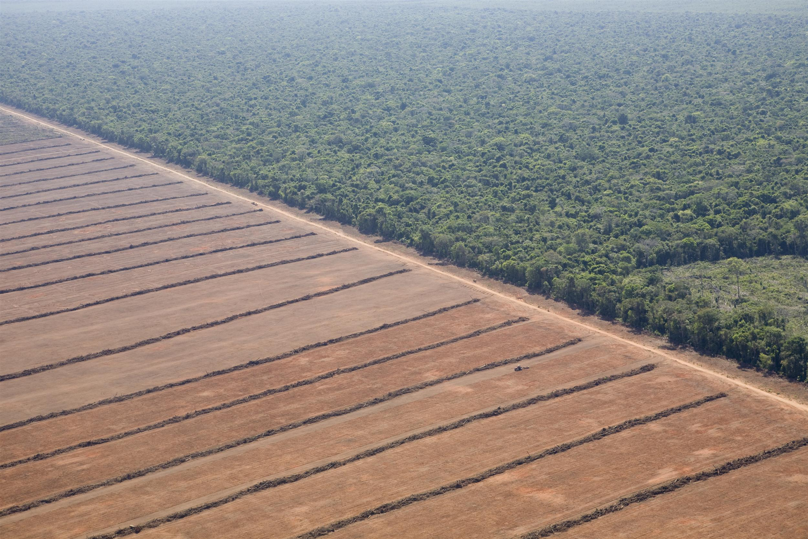
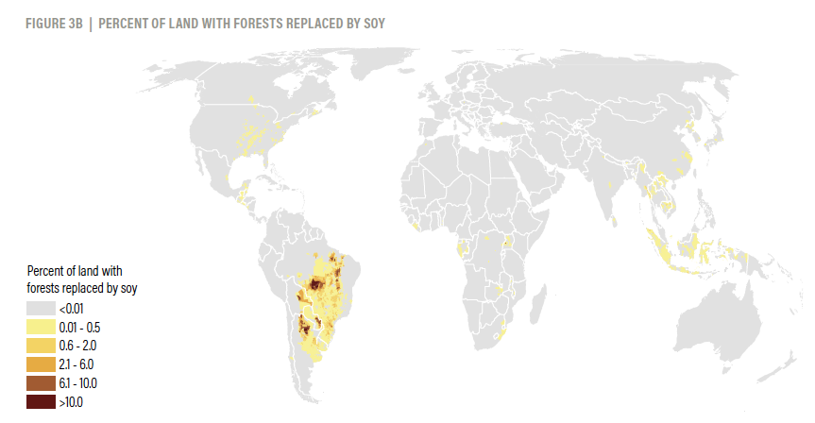
Oil Palm
Direct Deforestation
Soy
Sources: WRI, https://research.wri.org/gfr/forest-extent-indicators/deforestation-agriculture & own calculations from FAO data (assembled World in Data, Statista data biodiesel & various sources contribution of vegetable oil

Slide 10
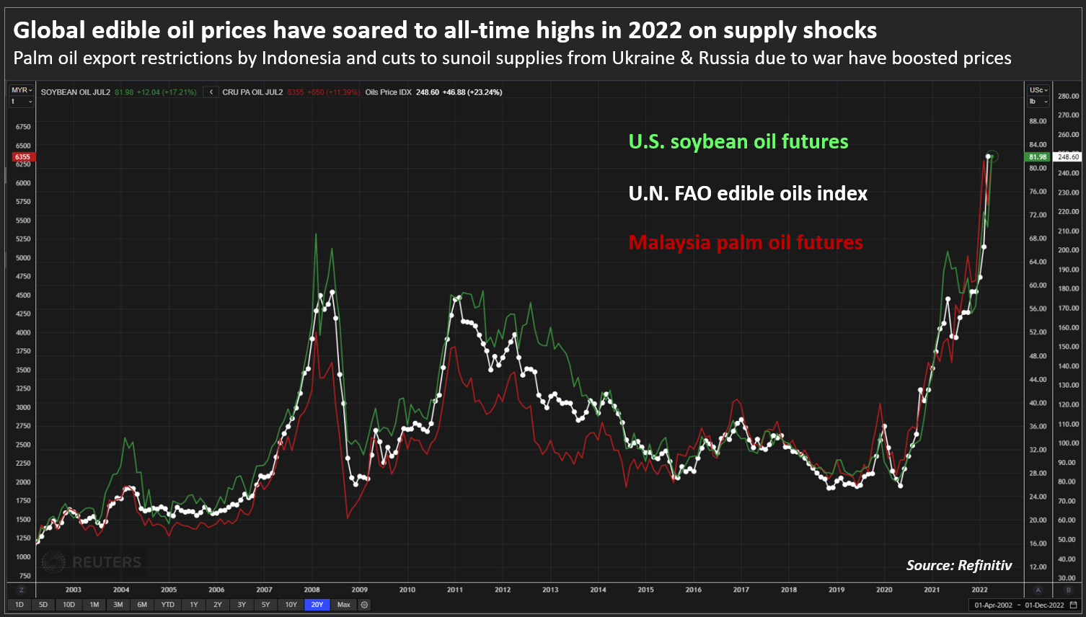
Change in crop prices in one location causes similar changes elsewhere (Roberts & Schlenker 2013) (Chen, Sexton, Smith in review) even including different vegetable oils in different countries
Notes:
Both cursory observation and rigorous studies find that the prices of both vegetable oils and grains are highly correlated both with each other and from one country to another. To be highly correlated, there just needs to be enough substitution “at the margin,” so this means that for many uses, the different vegetable oils can substitute enough for each other to keep prices correlated. The fact that price changes are quickly, in fact instantaneously, transmitted across the world should not be a surprise since there are global traders that seek the cheapest sources of crops anywhere in the world day by day and practice “arbitrage.” This is critically important. It means that increases in global demand anywhere in the world translate into increased prices everywhere and cause cropland to expand wherever it is cheapest, mostly the Tropics. There are also rigorous studies showing that cropland expansion is causally correlated with crop (and beef) prices. So increased demand in the U.S., which drives up prices, helps to drive cropland expansion in the Tropics.

Slide 11
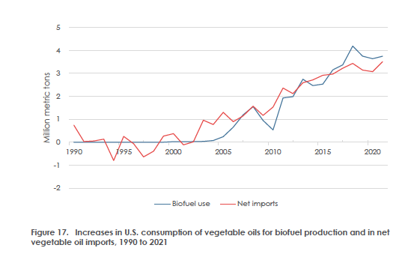
U.S. biomass-based diesel perfectly correlated with increases in vegetable oil imports
Malins (Cerulogy for ICCT 2022) from OECD/FAO data
Notes:
If the above evidence weren’t enough, U.S. increases in use of vegetable oil for biofuels are closely correlated with increased vegetable oil imports even though the U.S. is mostly using home-grown soybean oil for biofuels.

Slide 12
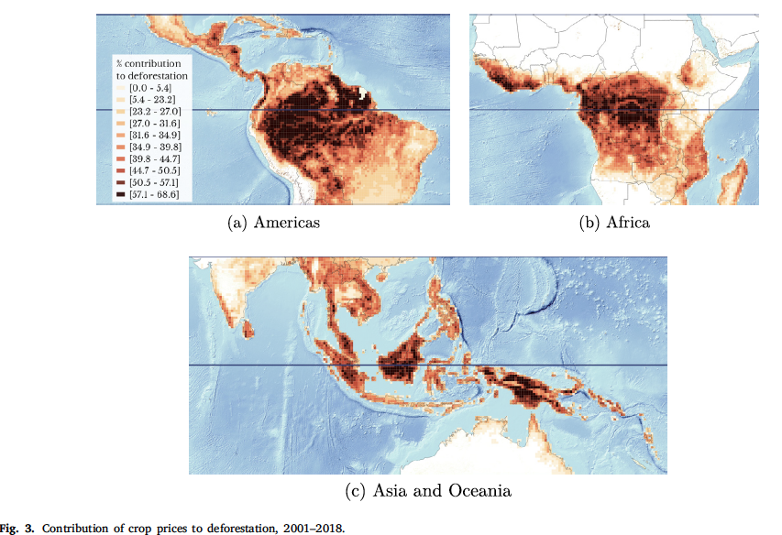
Many papers find global crop prices cause deforestation
Brazil too:
Araujo, Rafael, Francisco Costa, and Marcelo Sant’ Anna. 2020.
10% increase in long-term beef price leads to 16% loss of unprotected Amazon forest and 7 gigatons CO₂ emissions
Berman et al., J. Env.Econ. & Management (2023)

Slide 13
Claims to carbon advantages of biofuels treat land as free.
Source of fuel* | Feedstock + refining + transport | Tailpipe | Fermentation | Total GHGs & % Increase for Biofuel Without Plant Credit | Credit for Plant Growth | Total GHGs & % Savings for Biofuel
Gasoline | +27.72 | +73.8 | - | +101.5 | - | +101.5
Corn ethanol | 50 | +73.8 | +36.9 |  | 109.5 | 59.2 (-32%)
160.7
Greenhouse gas emissions and sinks (CO₂ eqv.) per mega joule of fuel

Slide 14


Slide 15
Biofuels use land to grow crops to replace fossil fuels (the benefit).
The cost is not using that land for other purposes.
How should we evaluate that cost?

Slide 16

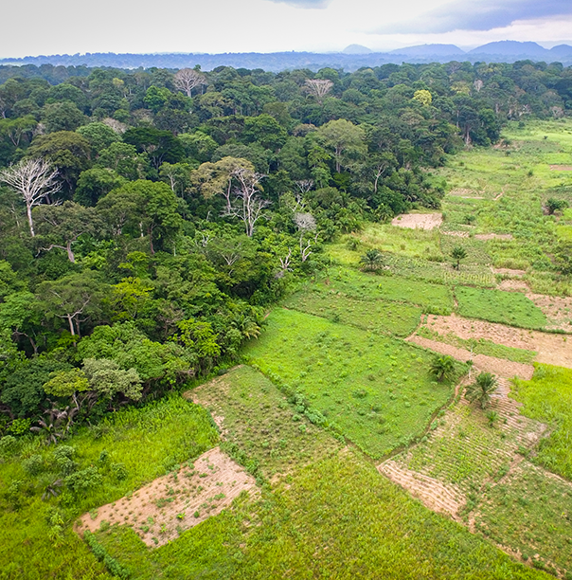
Agricultural land should be counted like any other fixed input.
Making cars requires making car factory
Making crops requires making cropland

Slide 17

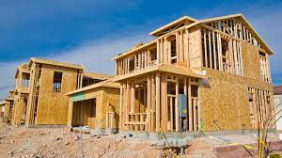
How to measure value of an existing asset?
The price/value of an old house is the cost of building a new house (adjusted for quality)

Slide 18
Carbon Opportunity Cost
Global corn for ethanol: 200 gCO2/MJ – 3x tailpipe emissions of gasoline; 166 gCO2/MJ
Global Soybean-Based Diesel: 330 gCO2/MJ - >4x tailpipe emissions of diesel; 211 gCO2/MJ
North America ethanol: 86 gCO2/MJ
U.S. soybean oil 159 gCO2/MJ
Searchinger et al. Nature (2018_
Wirsenius et al. (in review)

Slide 19


Tallow has higher carbon opportunity cost than vegetable oil

Slide 20
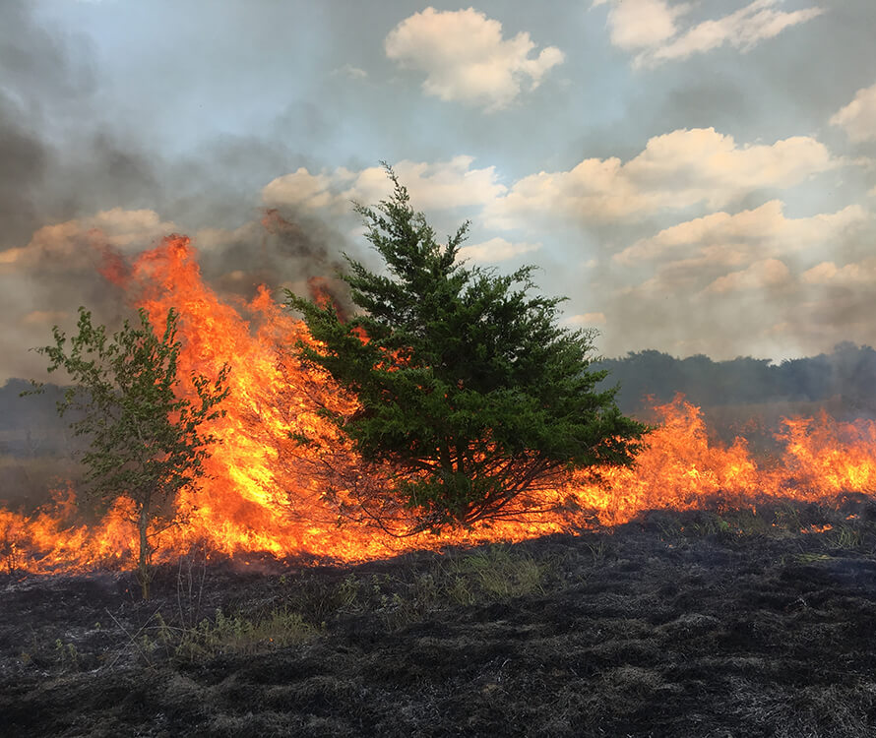
COCs (and all ILUC) significantly underestimate carbon costs: each 1 acre of additional cropland in forests results in 1.5 to 2 acres of deforestation
Pendrill et al., Science (2022)

Slide 21
Q: In a world that badly needs more food per acre, does it make sense: (a) to divert the world’s best farmland away from food?
ILUCs of 27 for soybean oil & 20 for corn ethanol?
(b) to value that farmland at 10% the average carbon cost of replacing the crops?
(c ) or half the carbon sequestration value of a lawn?

Slide 22
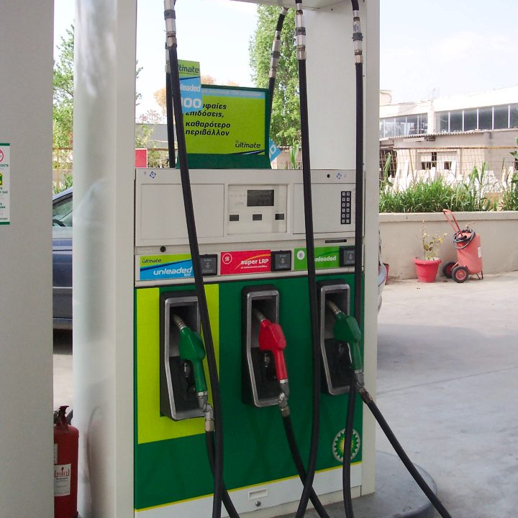
Why ILUC?
If biofuels use one more acre of land, the world will use one more acre unless someone else uses less.
Why should biofuels be credited if someone else uses less land?

Slide 23
Best ILUC calculations
Best:
Chen, Sexton & Smith (U Cal. Berkely, in review): 83 gCO2/MJ for any biodiesel from oil palm expansion in Indonesia/Malaysia alone.
Lark et al. PNAS (2022): U.S. expansion alone more than cancels out climate benefits of corn ethanol.
OF MODELS WITH HUNDREDS TO THOUSANDS OF PARAMETERS
Merfort et al. Nature Climate Change (2023) – 92 gCO2/MJ - high yield energy crops

Slide 24
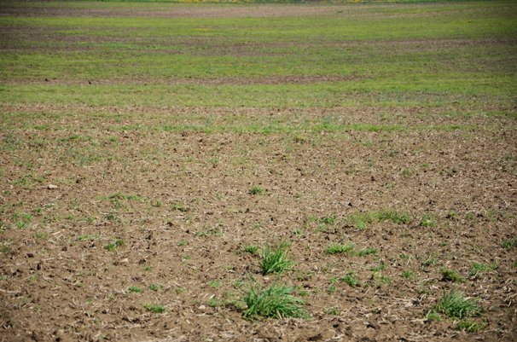


Low ILUC values world’s best farmland as very, very, very cheap!
ILUC 27 for soybeans means 0.5 tonnes carbon cost per hectare per year
ILUC 20 for corn means 0.4 to 0.7 tC/ha/y
>1 tonne/ha/y
3 t/ha/y

Slide 25
Why model claims higher prices cause economic feedbacks that lower carbon cost
Bizarre stuff, such as wildly physically impossible GTAP results
Or: Other people use less land
Reduced food consumption
Increased yields by other farmers around the world
Claims new low carbon but high yield cropland

Slide 26
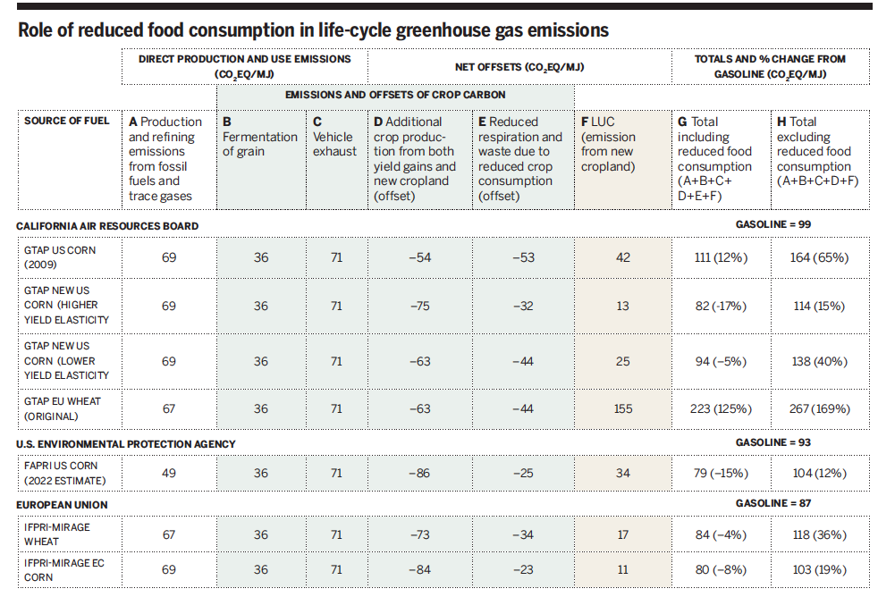
CARB GTAP Model Climate Benefits Flow from Reduced Food Consumption – 50% of Calories Not Replaced
Searchinger, Edwards et al., Do Biofuel Policies Seek to
Cut Emissions by Cutting Food, Science (2015)
Notes:
First, reduced food consumption. The GTAP model run used in California for corn ethanol estimates that half of the crop calories diverted to ethanol are not replaced because higher food prices cause people to consume less food. (This calculation fully accounts for the fact that ethanol by-products remain in the feed supply). This was shown in a paper in Science in 2015 but was essentially also shown in the paper published by GTAP authors on the California modeling in 2010 (Hertel et al. Biosicence 2010). The Science paper also showed that this food reduction was the source of greenhouse gas reductions by CARB; i.e., without this reduction, corn ethanol would increase emissions. This can be understood simply as the fact that because half of the food diverted to biofuels is not replaced, there is less land use change. But physically, it is even more disturbing. The greenhouse gas reduction attributed to ethanol occurs literally because people and livestock who eat fewer crops breathe out less carbon dioxide, and this reduction in emissions through the model is credited to biofuels. Although no one literally intended this, the de facto policy of the State of California is to achieve GHG reductions by increasing the demand for crops so that people eat less food and as a result they and their livestock respire less carbon. And unfortunately, when prices rise, it is the global poor who consume less.

Slide 27
Good news
GTAP has no basis at all for estimated food reduction
No econometrically estimated demand elasticities
No estimated cross-price elasticities
Mostly invented and otherwise misused supply elasticities

Slide 28
But bad news: less food reduction, more ILUC, and

Slide 29
Worse:
1% increase in global crop prices generates >0.6% increase in global mortality for children under age 5
Usman et al., Economics Perspectives and Policy
47:745-773 (2024).

Slide 30
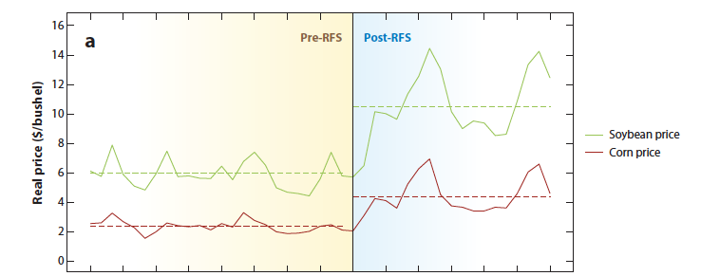
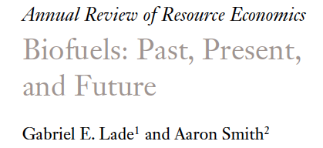
Crop prices roughly doubled post U.S. renewable fuel standard

Slide 31
If biofuels increase global crop prices by 20%, they cause increased child mortality by 600,000 per year.

Slide 32
ILUC asks the wrong question:
Wrong question:
What if we devote land and money for climate mitigation in one way and one way only, e.g., biofuels?
Right question:
What is the most climate beneficial way to devote the same land and the same money?

Slide 33
Summary
Biomass-based diesel charging $2 more per gallon
Extremely inefficient use of land
Increasing global emissions
Vast biodiversity effects
Depends on reduced global food consumption
Probably causing at least hundreds of thousands of increased child mortalities
If expanded will reconfigure the earth

Slide 34
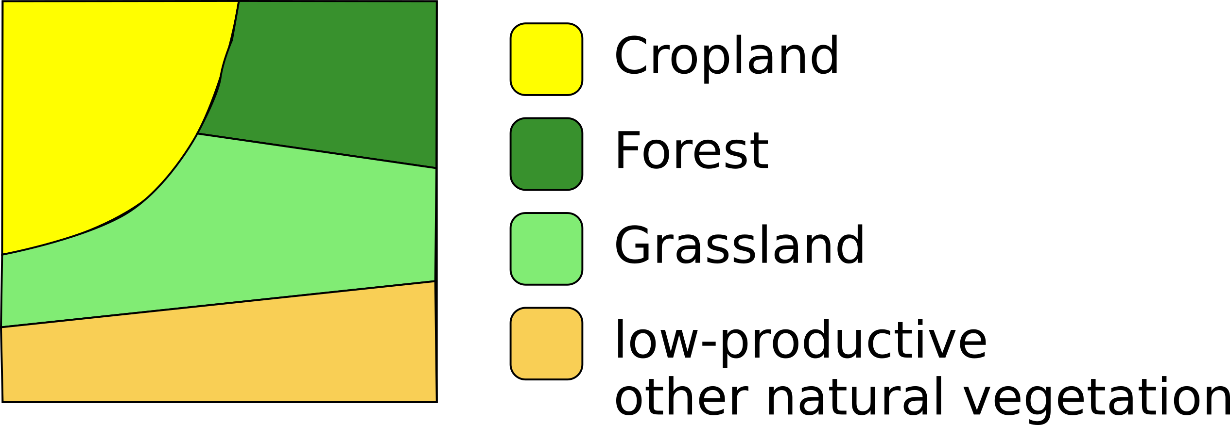
Why Globiom Produces Low ILUC for Ethanol
New cropland in low-productive lands assumed to achieve the same yields as existing cropland.

Slide 35
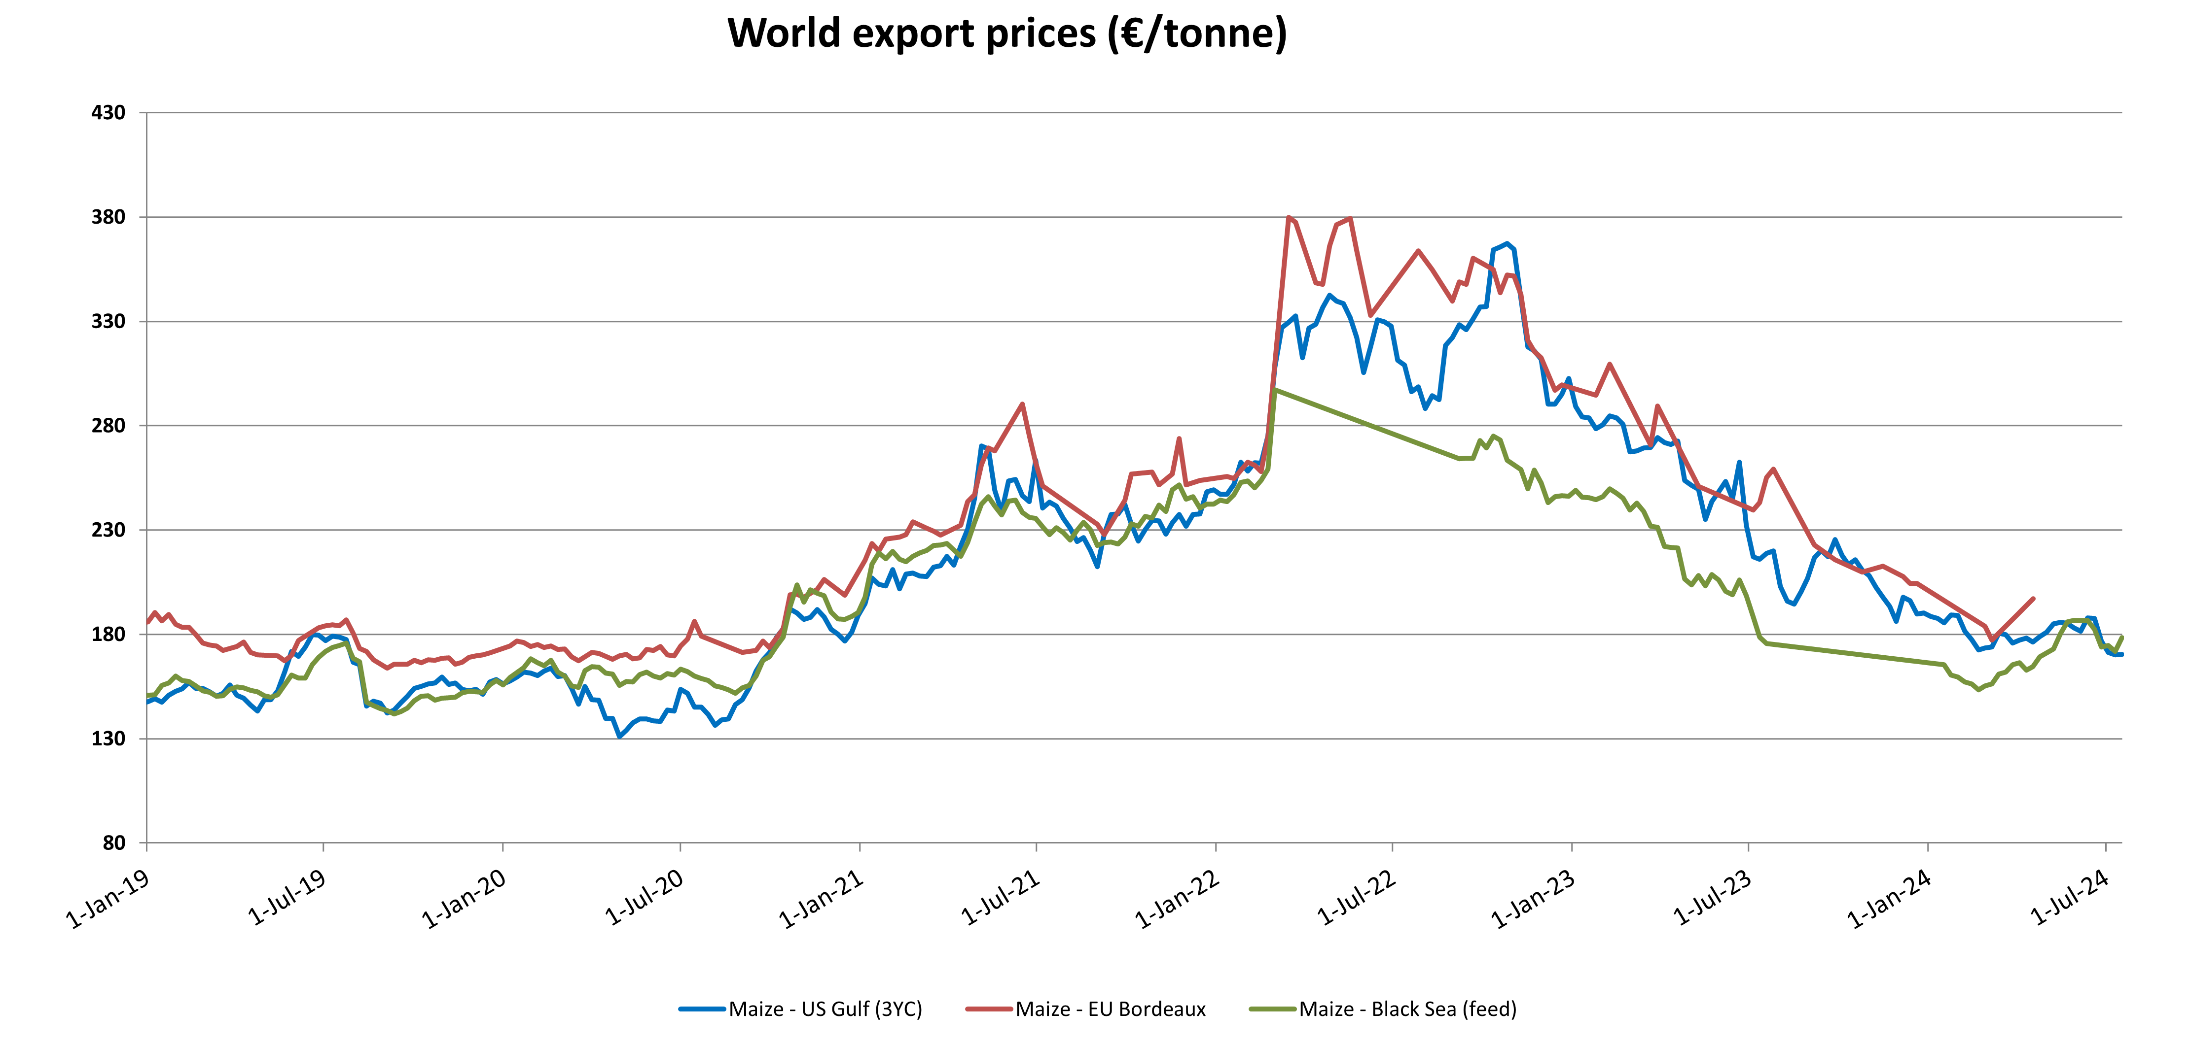
Global corn & sugar prices also track
Rumanikova et al., The Interrelationship Between Sugar Prices at the Main World Sugar Commodities Markets, Sugar Tech (2019): “The hypotheses about the strong relationship among the price of sugar on key sugar markets and their common trend have been proven.”
Notes:
The GTAP result is provably wrong. For example, for corn ethanol, the model projects that U.S. corn ethanol results in a permanent 16% increase in the price of U.S. corn but only a 1% rise in the EU corn price. In fact, the prices move in harmony. (The short-term decline in prices shown for “black sea” corn (maize) reflects the short-term effect of the Ukraine war when Ukrainian grains was unable to get out of the Black Sea.) There are rigorous studies showing this common movement of prices, which are obvious to global grain traders and those who play in commodity markets.

Slide 36
Wildly differential ILUCs for different vegetable oils cannot be true
 | Soy biodiesel | Palm oil Biodiesel | Canola Oil
GTAP – California | 27 | 71 | 13
Globiom (EU) | 100 | 230 | 43
Grams CO₂ Per Megajoule of Biofuel

Slide 37
