Slide 1
Model-based Land Use Change Emissions Estimation
Page Kyle
Pacific Northwest National Laboratory
Notes:
Stock image of cloud formations

Slide 2
Background
Estimation of the land use change (LUC) emissions footprint of biofuel production and use is inherently complex and uncertain
First-order supply chain uncertainty (land cleared and its characteristics)
Biophysical uncertainty (soil carbon responses over time)
Market-mediated effects (trade, feed/food substitution, demand levels)
Indirect (i.e., not related to fuel supply chain) LUC emissions appear especially significant here
A variety of different modeling approaches have been used; this is documented in detail by the US EPA in a 2023 technical report: https://nepis.epa.gov/Exe/ZyPDF.cgi?Dockey=P1017P9B.pdf
Supply chain life cycle analysis models (GREET) evaluate the upstream GHG emissions from a specific method of supplying biofuels
Economic models (ADAGE, GCAM, GLOBIOM, and GTAP) evaluate the net GHG impacts of a marginal change in biofuel production, considering market-mediated effects

Slide 3
LUC complexity and inter-model heterogeneity (US soybean biodiesel example)
Each billion gallons of soybean biodiesel is produced from about 20 Mt of soybeans
If US soybean biodiesel production increases, soybean exports will likely decrease
The response of soybean importers (e.g. China) will be important for the net LUC signal
An Armington-based bilateral trade model will tend to backfill China’s imports from Brazil (i.e. tropical deforestation)
A Heckscher-Ohlin trade model will backfill according to marginal cost of production (and shipping)
Flow | Mt
US soybean exports | 69.4
China soybean imports | 96.9
from USA | 27.3
from Brazil | 60.5
from other | 9.1

Slide 4
Supply chain modeling approach (GREET)
Purpose: evaluate all GHGs associated with a specific fuel supply chain, taking into account all relevant associated emissions
Method: detailed analysis of all stages of the supply chain
LUC emissions do not lend themselves to this sort of approach
As such, direct and indirect LUC emissions in GREET are estimated from GTAP model runs, parameterized with biofuel shocks, summarized by CCLUB
The standard bottom-up and detailed approach for estimating life-cycle emissions in GREET is not applied to LUC emissions, whether direct or indirect

Slide 5
Economic modeling approach (GCAM et al)
Purpose: to evaluate the system-wide response to a marginal increase in biofuel production
Method: for each fuel analyzed, pair-wise scenarios are run, with a prescribed “baseline” and “shock” level of production and/or consumption
Timeframe is typically 25-40 years
All (shock – baseline) emissions from all parts of the economy (including LUC), domestically and internationally, are attributed to the marginal increase in fuel production
LUC CO₂ emissions are estimated from LUC using a simple carbon cycle model
This approach incorporates many economic equilibrium impacts
E.g., forcing in a higher-price fuel can reduce demand which reduces emissions

Slide 6
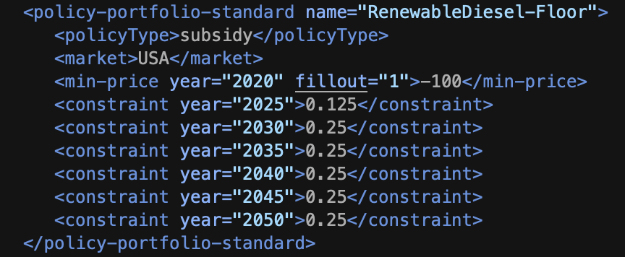
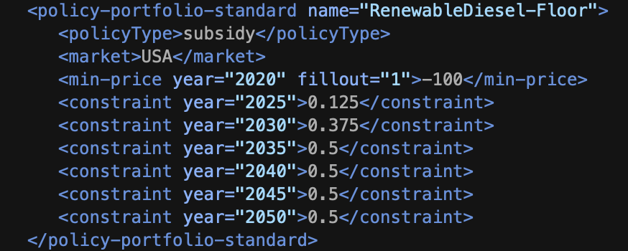
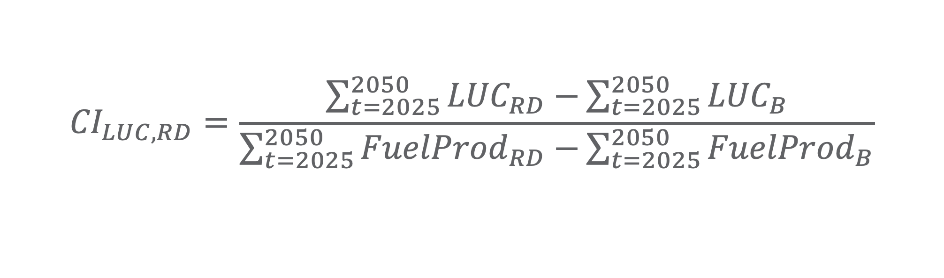
Implementation in GCAM
Baseline (B)
Shock (RD)
$${CI}_{LUC,RD}=\frac{\sum_{t=2025}^{2050}{{LUC}_{RD}−}\sum_{t=2025}^{2050}{{LUC}_{B}}}{\sum_{t=2025}^{2050}{{FuelProd}_{RD}−}\sum_{t=2025}^{2050}{{FuelProd}_{B}}}$$
Note: the unit above is EJ/yr; 1 billion gallons of diesel is about 0.135 EJ

Slide 7
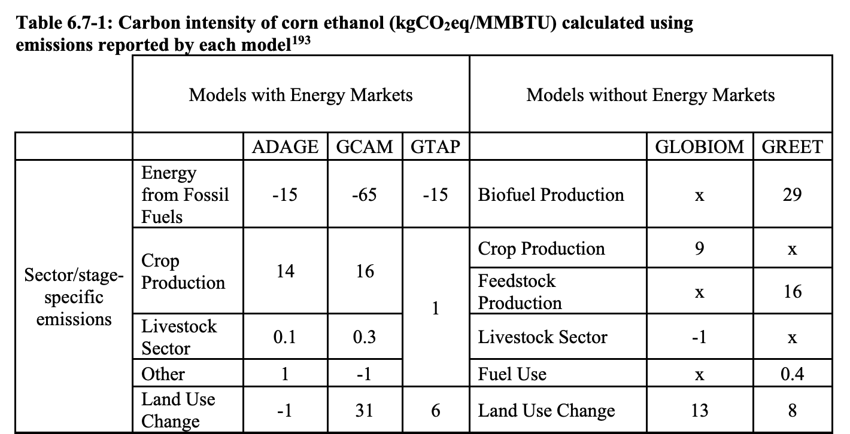
Past published results (corn ethanol)
Source: p86 in https://nepis.epa.gov/Exe/ZyPDF.cgi?Dockey=P1017P9B.pdf
Note: one reason for inter-model divergence on the LUC signal is exogenous land conversion
constraints. GCAM applied none in this study, but can replicate others’ results when constraints
are applied; see https://doi.org/10.1142/S2010007822500087

Slide 8
Summary
CI_LUC from GCAM can be indicated by region, or by groups of regions (e.g., USA and all other countries), but not by individual land use types
GCAM can be used to estimate CI_LUC of any fuels whose input-output relationships are known
The implementation example was for a fuel that is not typically in GCAM
The CI_LUC values estimated consider many economic equilibrium impacts of a biofuel policy, such as impacts on trade, prices, and overseas land use choices
CI_LUC results are downstream of any impacts of a biofuel shock on retail fuel prices and therefore consumption

