Slide 1

Camelina Scalable, Low CI Feedstocks Without Impacting Food or Feed
2025 Land Use Change Expert Workgroup

Slide 2
Who We Are Seed to Farm and Farm to Fuel: Two Decades in Camelina
We Are…
Seed
A camelina-focused platform with two decades of experience bringing seed, services, and markets together around intermediate crops
We develop and supply camelina varieties tailored to idle and fallow windows, matching maturity and performance to local rotations
Services
Farmer
We wrap seed with agronomy, data, and sustainability services—from planting plans and in-season advice to full value chain traceability
We design programs around farmer reality: closed loop contracts, guaranteed offtake, and systems that protect main crops while adding new revenue

Slide 3
Productive Land Cover Intermediate Crops 101
Idle Windows
Camelina thrives during idle windows, enhancing land productivity without disruption and provides broad regenerative ag benefits to the farming system
Resilient crop
An additive crop that makes oil + protein in months when the field would otherwise be idle and bare
Farmers like camelina because: Quick maturity; modest inputs; compatible with no/low till; same equipment; added revenue in idle windows

Slide 4

Regenerative Ag Carbon Accumulation in Soil
Harvested grain is removed: roots & straw stay in field
SOIL HORIZONS
High biological activity, fresh roots & residues
Aggregation mineral-associated organic matter
Slow-turnover carbon & parent material
Root system feeds microbes
Fine-root turnover = organic matter
Soil aggregation protects carbon
Stable soil organic carbon (SOC) increases
Residue and roots contribute to soil carbon accumulation; approximately 70% of above-ground residue stays while 100% of roots systems remain in the field

Slide 5
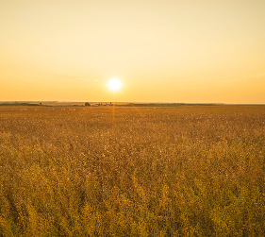
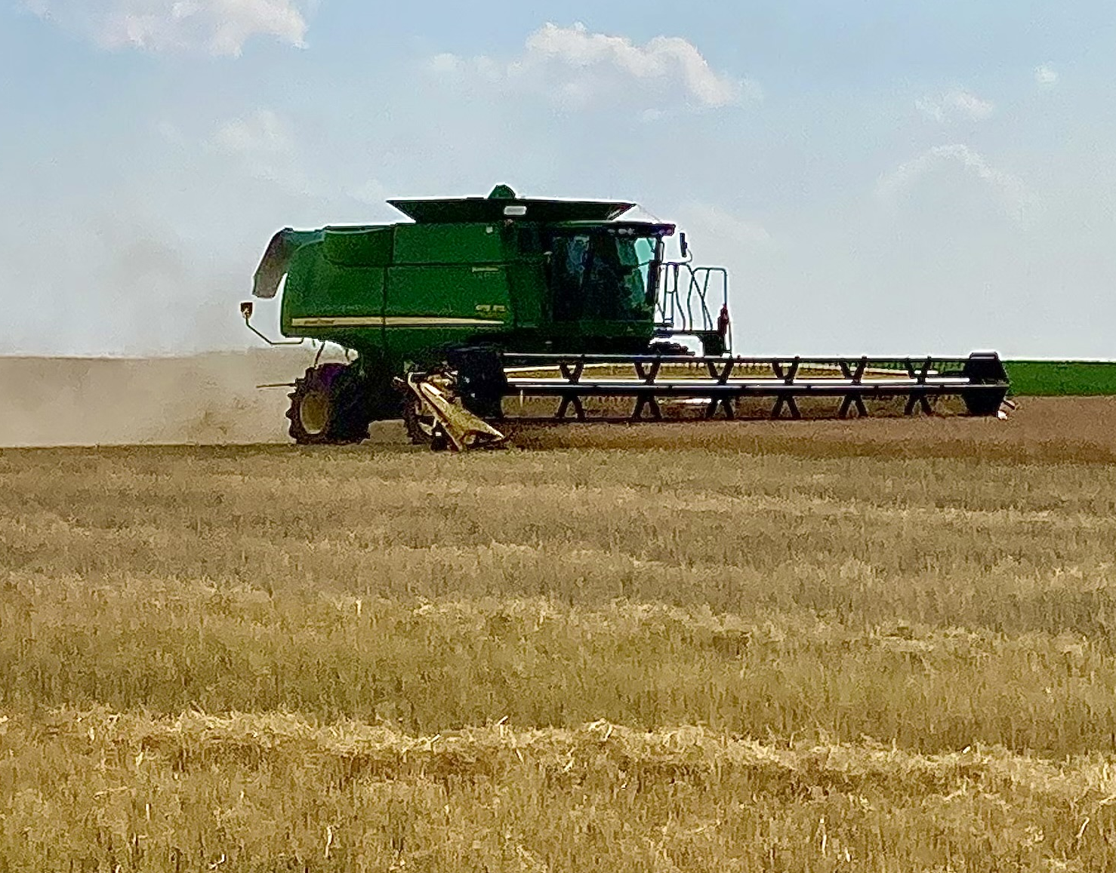
Where Camelina Fits
Winter
Camelina seeds can be sown in October and November, maximizing winter productivity
An additive crop that makes oil + protein in months when fields would otherwise be idle and bare
Spring
Early spring sowing allows for optimal growth and summer harvests, enhancing overall yield potential

Slide 6
Variety Release Window
Scale-Up
Target Definition
Crosses & Early Selections
Pre-Yield Plot Trials
Multi-location Yield & Quality Trials
Variety Release Decision
Certified/Commercial Seed Multiplication
Commercial Launch & Marketing
Year 0 | 1 |  | 2 |  | 3 |  | 4 |  | 5 |  | 6 |  | 7 |  | 8
0 – 1
Cycle Time Pathway to Scale
1 – 2
2 – 3
3 – 4
4 – 6
5 – 7
Crop Innovation Pipeline at a Glance
6 – 8

Slide 7
Over Two Decades of Camelina
On the Ground
We’ve learned how to fit camelina into real rotations without interrupting farmers’ main crops, and how to design agronomy and logistics around that reality
We’ve learned how to make it work field-by-field, farmer-by-farmer
At scale
Success depends on respecting the land-use boundary, keeping systems robust for growers, and building data flows that make additionality visible to regulators

Slide 8
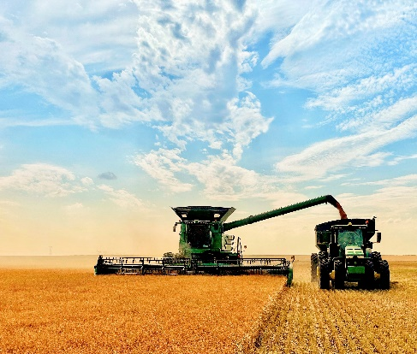
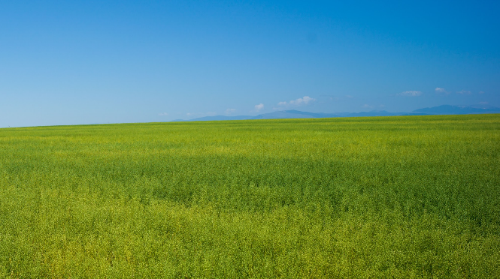
Mind the Boundary Missed SCA gains + positive meal displacement can lead to systematic undercounting unless boundaries match how Intermediate Crops and residues work
Don’t Underestimate Camelina
Attributional
Direct Carbon Intensity reflects immediate emissions impacts of a process
Consequential
Indirect Land Use Change effects consider broader environmental impacts over time

Slide 9
Policy Alignment Today, intermediate crops are less than 1% of production but represent an enormous opportunity
LCFS
Small But Mighty
Camelina supports CARB’s decarbonization and energy transition goals, contributes to in-state energy stability, sustainable livestock feed, and aligns with global policy frameworks in the European Union
Camelina Is: Scalable, Additional, and Aligned with global sustainability frameworks that recognize harvestable cover crops.
Camelina Needs:
Establish a clear intermediate-crop definition
Allow soil-carbon improvements from land management and reflect meal displacement to count
Use a prioritized pathways review to help accelerate adoption of these systems

