Slide 1

Uncertainty and Risk in ILUC Modeling
6 November 2025
2025 CARB ILUC Workshop
Colin Murphy Ph.D.
Co-Director - Energy Futures Research Group
Co-Director - Low Carbon Fuel Policy Research Initiative
Director – Biofuel Land Use Change Research Program
Julie Witcover Ph.D.
Co-Director - Low Carbon Fuel Policy Research Initiative
Deputy Director – Biofuel Land Use Change Research Program

Slide 2



Who We Are Biofuel Land Use Change (BLU-C) Program Team
ITS-Davis is the largest sustainable transportation focused university research group in the U.S.
Founded in 1992
150+ researchers, students, faculty and staff
$20+ million annual budget
Multiple topic-focused centers, including Global South Clean Transportation Center
ITS-Davis founding Director Dan Sperling is the co-creator of the Low Carbon Fuel Standard
ITS researchers have published dozens of papers on clean transportation and alternative fuels
Biofuel Land Use Change (BLU-C) program founded in 2025, with multi-year funding to investigate ILUC issues, especially related to novel feedstocks in emerging markets in Global South
Colin Murphy Ph.D.
Director – BLU-C Program
Co-Director – Energy Futures Program
Co-Director – Low Carbon Fuel Policy Research Initiative
Julie Witcover Ph.D.
Deputy Director – BLU-C Program
Co-Director – Low Carbon Fuel Policy Research Initiative
Assoc. Project Scientist – ITS-Davis
Lucas Salgado
Ph.D. Student Trans. Tech. & Policy

Slide 3
Why is ILUC Modeling Important?
Alternative fuels are needed to decarbonize transportation
EVs can’t satisfy all transportation needs and EV transition will take decades
Policy support is needed to bring alternative fuels into the market
Biofuels are the only lower-carbon alternative fuel that has emerged to date
Alternative fuel carbon intensity is variable & not all alternative fuels are lower-carbon than petroleum
Good alternative fuel policy makes incentive proportional to GHG benefit
LCFS is designed to do this, but accurate GHG assessment is an ongoing challenge
ILUC can have a major impact on the GHG emissions from biofuels

Slide 4
ILUC – What is being modeled?
Biofuel feedstock competes for land
indirect=market-mediated
Prices change (ag, energy)
New demand level
New supply level
Higher food prices → poverty/hunger?
More land → LUC emissions?
Higher yield →
ag practice emissions?
No global carbon policy → land users don't consider GHG emissions
How to manage LUC risk for 21st c. given other policy objectives?
Source: Witcover et al. (2011)
Notes:
ILUC is triggered when biofuel feedstock competes for land, displacing or diverting another commodity

Slide 5
ILUC models – A few high-level factors to keep in mind
Model timeframe –
Timing of land use emissions vs. alt fuel GHG impacts.
Annual modeling can yield different results than modeling start/end periods or before/after policy shock.
Agricultural supply response –
Assumptions about yield and area responsiveness (and their interplay) are key.
Must distinguish between changes in response to policy and unrelated trends.
Trade –
Assumptions regarding feasibility and response time strongly impact how trade impacts ILUC models.
Geopolitical factors can quickly upend well established trade patterns.
Treatment of Land –
Land can be modeled in physical or economic terms, with a tie back to physical land.
Number of land categories constrains models’ representation of potential conversion pathways.
Scope –
Partial vs. general equilibrium & sectoral coverage
Treatment of land tenure, land use policy, etc. can exert big influence on results.
Inter-model alignment –
ILUC assessment often requires multiple models, and interactions with other models for regulatory purposes (e.g. GREET). Are data/results interoperable? Are model assumptions compatible?

Slide 6
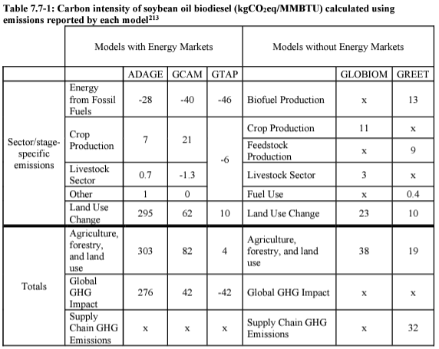
High Uncertainty in ILUC Modeling
EPA compared 5 models that nominally could assess ILUC risk for high-volume biofuels consumed under RFS
Upper bound of uncertainty range for soybean oil biodiesel almost 30x greater than lower bound
Upper bound of ILUC impact is almost 3x life cycle GHG impact of petroleum diesel
Uncertainty around ILUC risk of lipid-based fuels, e.g., soy oil biodiesel, much greater than corn ethanol
“x” means not reported by that model.
Source: EPA ILUC Inter-Model Comparison

Slide 7
What Drives ILUC Model Uncertainty?
Structural & methodological choice – there is no single “correct” approach.
Parameter uncertainty – Uncertain quantitative correlation or causation among factors.
E.g., What is the supply elasticity of a given commodity?
Inadequate data – Limited coverage of some commodities or markets, (esp. lipids & emerging markets), confidential business information, inconsistent reporting, data lag
Historical data doesn’t include impact of climate change, which will affect agriculture
Other confounding factors – Impact of social, economic, or geopolitical factors obscures critical causal relationships that inform models
Subjective assumptions – Some elements of ILUC models must be assumed, and there is no objectively “correct” choice.
E.g., Allocation of costs or impacts in multi-product systems?

Slide 8
Understaning How ILUC Risk Impacts Biofuel Policy
Policy Support for Biofuel, per unit of fuel
More
Less
Lower ILUC Assessment
Higher ILUC Assessment
Theoretically Optimal Amount:
Maximize Net Emission Benefit
Risk From Biofuel Overconsumption
Carbon loss (vs. slow accumulation)
Biodiversity impacts & species loss
Stranded asset risk
Tech lock-in / policy delegitimization
Risk From Biofuel Underconsumption
Lost opportunities to decarbonize
Less technological development
Foregone economic/employment growth
Asymmetric Risks

Slide 9
Policy Guidance
Additional research is needed to develop better ILUC risk assessment and mitigation tools for policymakers
ILUC assessment will always be uncertain, and dependent on subjective assumptions.
Policy must account for indeterminacy of ILUC estimates, especially where novel feedstocks or markets are involved.
Current LCFS ILUC adjustment factors are outdated
Models & data have improved
Supply shock on lipids far smaller than actual industry development
Regular updates will always be needed
Given the risk dynamics in global land use, a risk-averse approach re: ILUC best achieves the stated goals of California’s climate policy
Better assessment tools could allow higher risk tolerance
Quantitative ILUC modeling will always be part of assessment, but there may be approaches to ILUC risk mitigation in which modeling plays a secondary role
May be crop- or geography- specific

Slide 10
Questions and discussion welcome!
Additional Resources
Lowcarbonfuel.ucdavis.edu (UCD LCFS Research Group site)
LCFS Web Data Explorer
Driving California’s Transportation Emissions to Zero by 2045
Fuel Policy Scenario Modeling (FPSM) of Low Carbon Fuel Standard Targets for 2030 and Beyond
Updated Fuel Portfolio Scenario Modeling to Inform 2024 Low Carbon Fuel Standard Rulemaking
Technology and Fuel Transition Scenarios to Low Greenhouse Gas Futures for Cars and Trucks in California to 2050
Comparative Assessment of the EU and US Policy Frameworks to Promote Low-Carbon Fuels in Aviation and Shipping
Multijurisdictional Status Review of Low Carbon Fuel Standards, 2010–2020 Q2; California, Oregon, and British Columbia
Improving Credit Quantification Under the LCFS: The Case for a Fractional Displacement Approach
Modeling expected air quality impacts of Oregon's proposed expanded clean fuels program - ScienceDirect
Current Methods for Life Cycle Analyses of Low-Carbon Transportation Fuels in the United States (National Academies report)
Making Policy in the Absence of Certainty: Risk-Aware Consideration of Indirect Land Use Change (ILUC) Estimates for Biofuels
Colin Murphy Ph.D.
cwmurphy@ucdavis.edu
lowcarbonfuel.ucdavis.edu
Bluesky: persuasivescience@bsky.social
To receive updates regarding the Institute of Transportation Studies research, policy briefs and related work, sign up on our listserv via this link: its.ucdavis.edu/join-our-mailing-list/.

