Slide 1
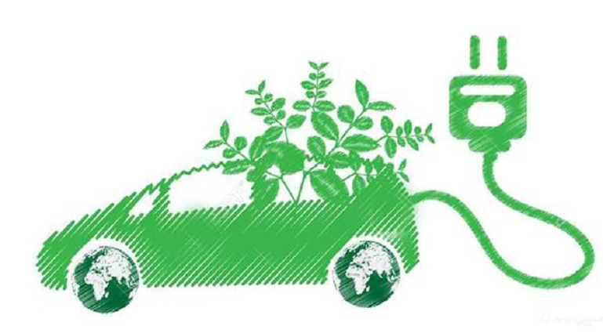
Uncertainty and Risk in ILUC Modeling
6 November 2025
2025 CARB ILUC Workshop
Colin Murphy Ph.D.
Co-Director - Energy Futures Research Group
Co-Director - Low Carbon Fuel Policy Research Initiative
Director – Biofuel Land Use Change Research Program
Julie Witcover Ph.D.
Co-Director - Low Carbon Fuel Policy Research Initiative
Deputy Director – Biofuel Land Use Change Research Program

Slide 2
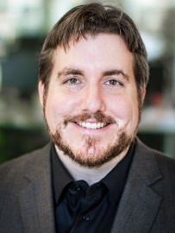

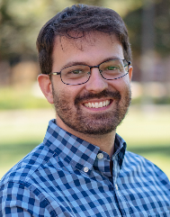
Who We Are Biofuel Land Use Change (BLU-C) Program Team
ITS-Davis is the largest sustainable transportation focused university research group in the U.S.
Founded in 1992
150+ researchers, students, faculty and staff
$20+ million annual budget
Multiple topic-focused centers, including Global South Clean Transportation Center
ITS-Davis founding Director Dan Sperling is the co-creator of the Low Carbon Fuel Standard
ITS researchers have published dozens of papers on clean transportation and alternative fuels
Biofuel Land Use Change (BLU-C) program founded in 2025, with multi-year funding to investigate ILUC issues, especially related to novel feedstocks in emerging markets in Global South
Colin Murphy Ph.D.
Director – BLU-C Program
Co-Director – Energy Futures Program
Co-Director – Low Carbon Fuel Policy
Research Initiative
Julie Witcover Ph.D.
Deputy Director – BLU-C Program
Co-Director – Low Carbon Fuel Policy Research Initiative
Assoc. Project Scientist – ITS-Davis
Lucas Salgado
Ph.D. Student Trans. Tech. & Policy

Slide 3
Biofuel Land Use Change (BLU-C) Research Program
Biofuels are an important and growing element of transportation fuel portfolios and GHG reduction plans in many jurisdictions.
Land use change, especially ILUC is an important but highly uncertain part of biofuel GHG assessment.
Existing tools produce uncertain results & have limited coverage of some geographies and crop types, especially novel crops in the global south.
Most regulatory programs require quantification of ILUC GHG impacts.
Uncertain if model-free approaches (e.g. sustainability certification, co-production) can adequately mitigate ILUC risk, and under what conditions
ILUC model development is a complex process, requiring extensive expertise, data resources, and development time.
Developing acceptance within research & regulatory community is also time consuming.

Slide 4
Biofuel Land Use Change (BLU-C) Research Program
6-year program funded by unrestricted gift from Acelen Renewables to evaluate & develop ILUC research and modeling approaches, especially for novel crops in the Global South.
First project will be to assess ILUC risk from large-scale macaúba cultivation on degraded cattle pasture in Brazil
Definitions and assessment of “degraded” to be determined analysis
Two-pronged approach –
How can we improve regulatory approaches to ILUC risk assessment and mitigation? This will likely focus on existing analytic frameworks.
Is there a better way to assess and mitigate ILUC risk within the regulatory environment? This will look to assess and develop new analytic frameworks.
BLU-C is envisioned as a research effort & forum to advance regulatory ILUC risk assessment & mitigation broadly, not limited to just the first project.

Slide 5
BLU-C’s First Steps
Literature review & assessment of ILUC modeling methods
Forming advisory committee to offer guidance & help socialize results. Working to ensure broad representation of many voices, including communities and land use experts from the Global South.
Will be recruiting a postdoc very soon.
Conference planned Spring/Summer 2026, likely co-hosted with Prof. Aaron Smith from UC Berkeley
If you are interested in collaborating, joining the conference, recommending members of the advisory panel, etc. Please email me: cwmurphy@ucdavis.edu

Slide 6
Questions and discussion welcome!
Additional Resources
Lowcarbonfuel.ucdavis.edu (UCD LCFS Research Group site)
LCFS Web Data Explorer
Driving California’s Transportation Emissions to Zero by 2045
Fuel Policy Scenario Modeling (FPSM) of Low Carbon Fuel Standard Targets for 2030 and Beyond
Updated Fuel Portfolio Scenario Modeling to Inform 2024 Low Carbon Fuel Standard Rulemaking
Technology and Fuel Transition Scenarios to Low Greenhouse Gas Futures for Cars and Trucks in California to 2050
Comparative Assessment of the EU and US Policy Frameworks to Promote Low-Carbon Fuels in Aviation and Shipping
Multijurisdictional Status Review of Low Carbon Fuel Standards, 2010–2020 Q2; California, Oregon, and British Columbia
Improving Credit Quantification Under the LCFS: The Case for a Fractional Displacement Approach
Modeling expected air quality impacts of Oregon's proposed expanded clean fuels program - ScienceDirect
Current Methods for Life Cycle Analyses of Low-Carbon Transportation Fuels in the United States (National Academies report)
Making Policy in the Absence of Certainty: Risk-Aware Consideration of Indirect Land Use Change (ILUC) Estimates for Biofuels
Colin Murphy Ph.D.
cwmurphy@ucdavis.edu
lowcarbonfuel.ucdavis.edu
Bluesky: persuasivescience@bsky.social
To receive updates regarding the Institute of Transportation Studies research, policy briefs and related work, sign up on our listserv via this link: its.ucdavis.edu/join-our-mailing-list/.

