Slide 1
Land Use Changes Related to California’s LCFS
State of Tocantins

Slide 2

Total Area: 27 million ha
TOCATNINS
Population: 1.5 million inhabitants
Sustainability: 60% of the territory is conserved→
15% por UC.
Biomes: Amazon → 9%
Cerrado savanna → 91%
Economia: 37,6% of GDP is agribusiness
MATOPIBA:
Last Agricultural Frontier.

Slide 3
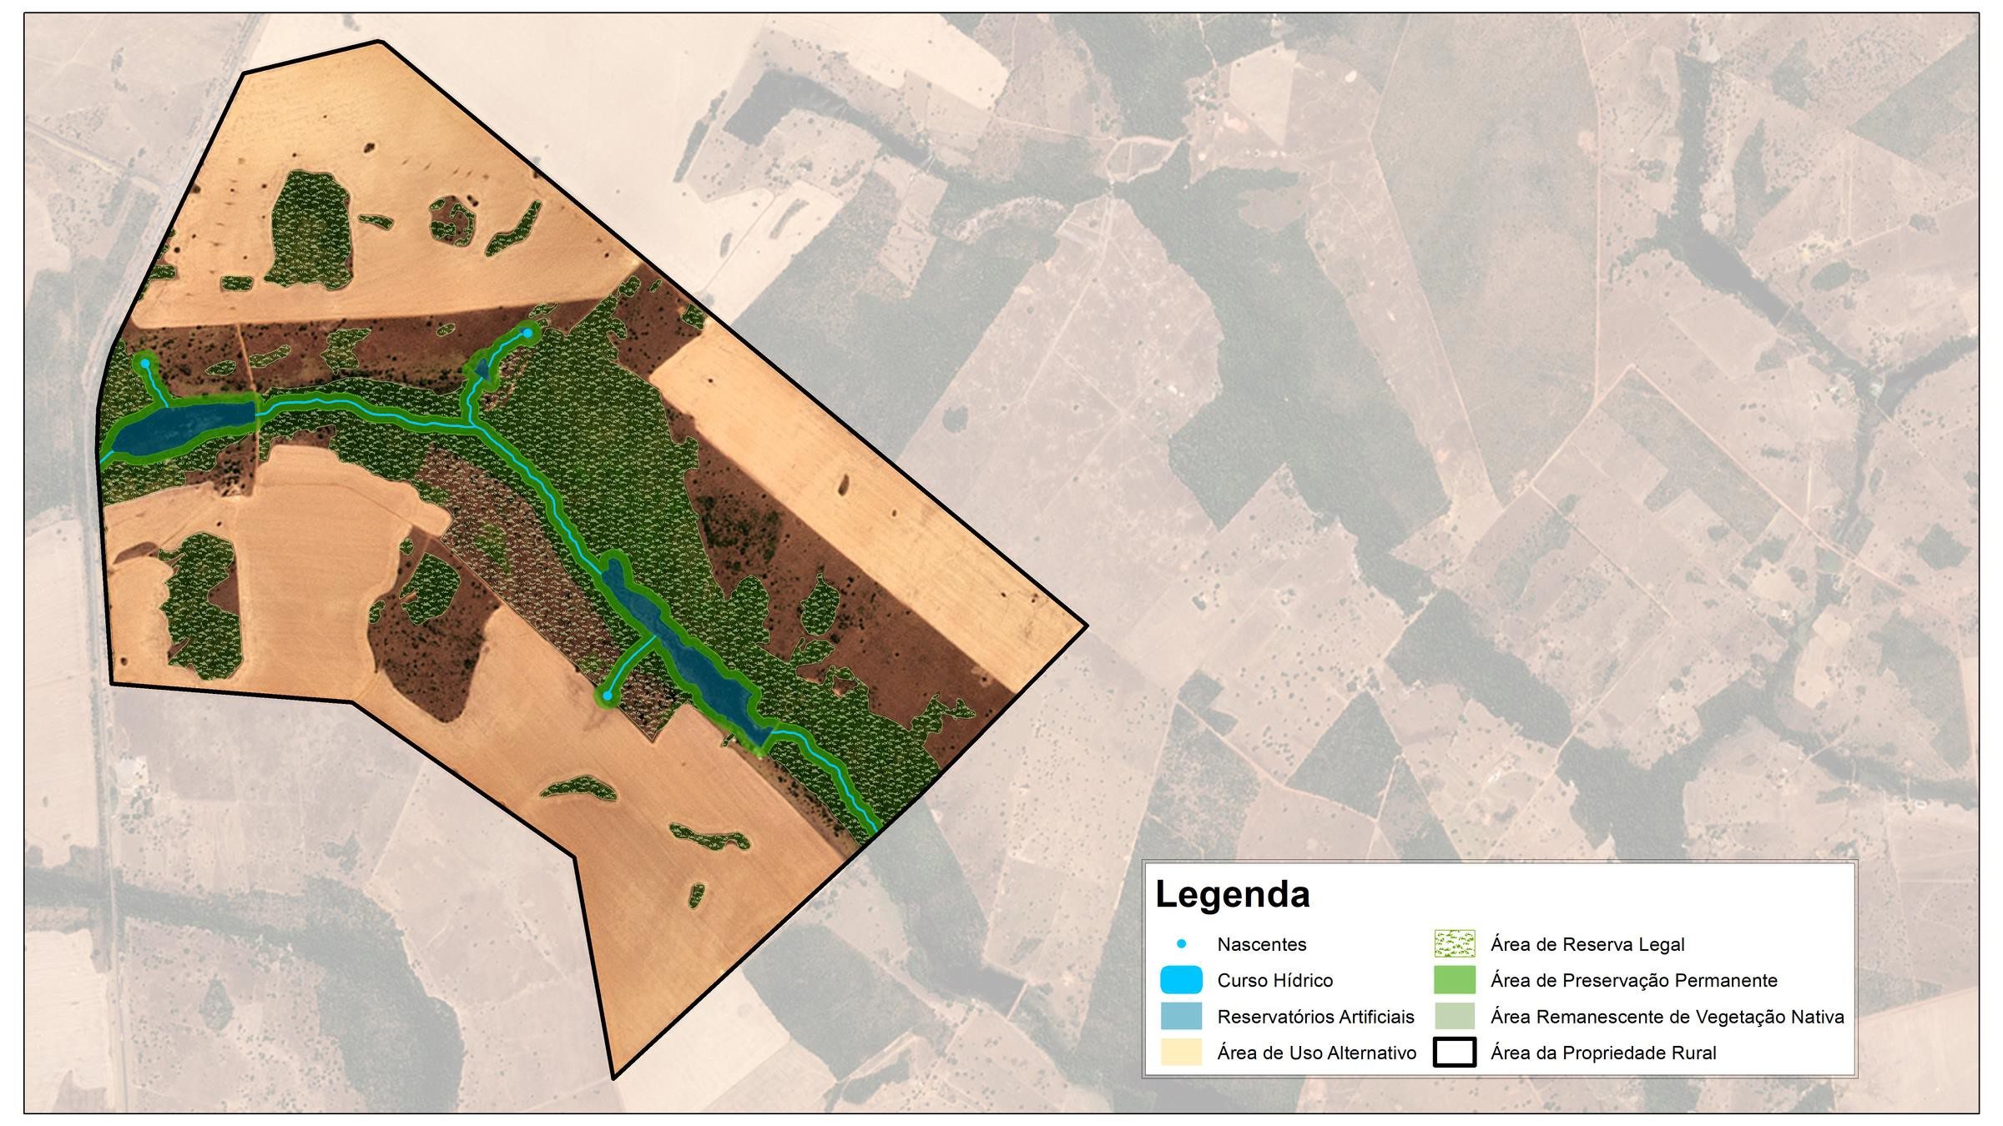


LEGAL OBLIGATION
Rural Producer Partnering with Conservation
What does the forest code say?
Legal Reserve in the Amazon
80%
Areas situated in forests
35%
Areas situated in cerrado
The Alternative Use Area is only legally authorized after the APP and RL guarantees are in place.
Example of a property declared in the CAR (Rural Environmental Registry), With preserved APP (Permanent Preservation Area) and RL (Legal Reserve) forming an ecological corridor

Slide 4
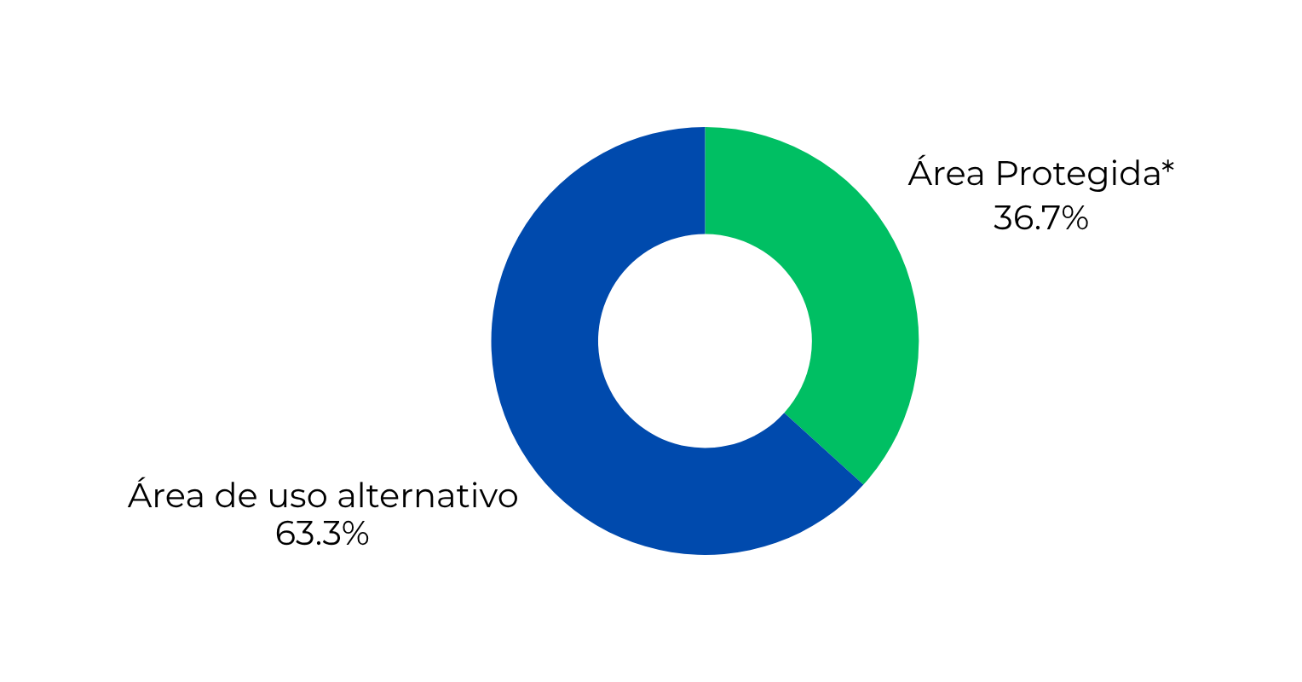
PROPERTY CONSERVATION
More than a third of property is protected in Tocantins.
*Average protected area within rural properties in Tocantins. Data declared in the CAR.

Slide 5
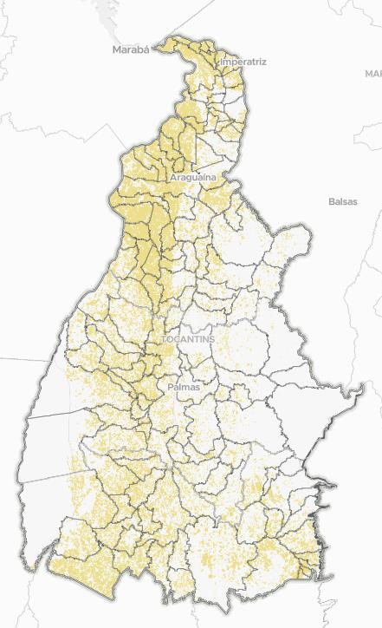
SUSTAINABLE GROWTH
Agriculture in consolidated areas
Total pastureland: 7.56 million hectares
Challenge: to restore ~ 5 mi ha of degraded pastures
Alternative: Incentivize the expansion of agriculture in these areas for renovation and restoration, guided by the principles of Low Carbon Agriculture.
Restoring the productive potential of pasture areas is an alternative to
Minimize the opening of new agricultural frontiers.

Slide 6
Objective
Reduce GHG emissions in agriculture;
PLAN ABC+
Sustainability Policy since 2010
How?
Recover degraded areas
Increase productivity
Diversify production
Integrate Crop-Livestock-Forest systems
State Commitment- 2010 to 2020
Recover 1.2 million ha of degraded pastures*
Achievement:
87,17 %* of the goal met
Tocantins is revising its ABC+ state plan and updating goals for the next 5 years based on the National ABC+ Plan
New Goal (2020–2030):
Recover 1 million ha of degraded pastures
*Source: ABC Tocantins Management Group

Slide 7
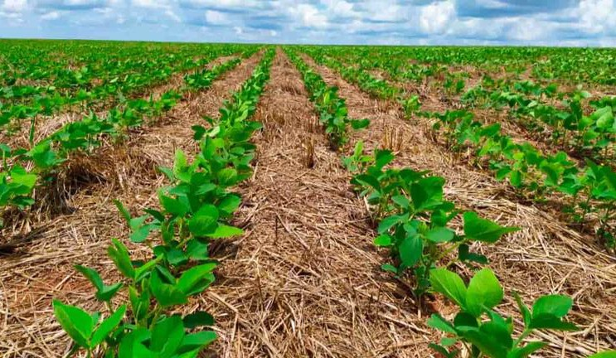
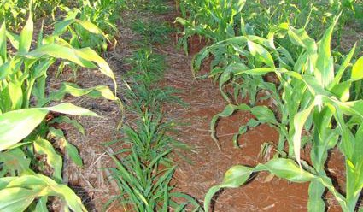
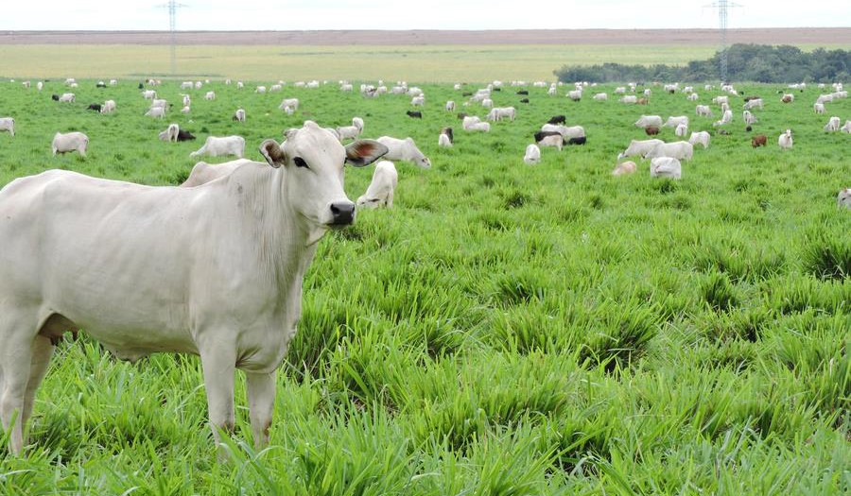
SOY, CORN, AND CATTLE Crescimento em produtividade e diversidade
Potential for 3 harvests per year
Technique:- ILP/ILPF (Crop-Livestock-Forest Integration)- with year-round soil cover.
Main Crop: Soy Second Crop: Corn Off-season: Cattle
By adopting Low Carbon Agriculture practices, we are transforming agriculture into a tool for carbon capture and natural resource conservation

Slide 8
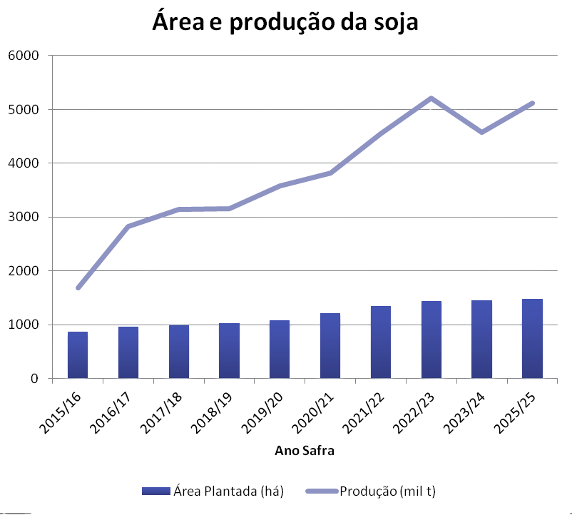

SOY PRODUCTION
The Strength of Technology in the Field
In the last 10 years:
Planted Areas: + 41%
Production: + 67%
Productivity growth (kg/ha): + 44%
5122
1687
1483
871
We are on the path to intensive growth utilizing ABC technology to obtain 3454 kg/ha of soybeans, meeting efficiency and low carbon emission targets.
Source: SEAGRO/2025

Slide 9
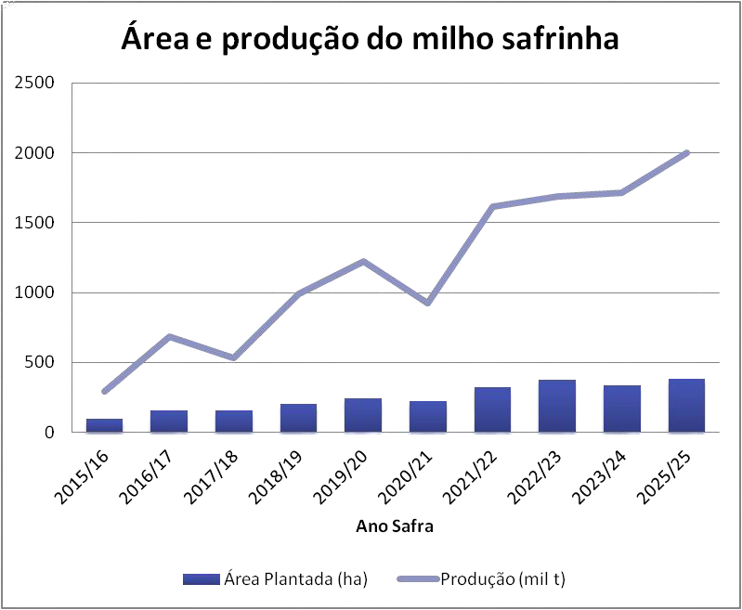
SECOND CROP CORN PRODUCTION
Production Exceeds Expansion
Over the last 10 years:
Planted area: + 299% Production: + 583% Productivity (kg/ha): + 71%
2000
293
381
95,6
Production strength lies in technology,
not land expansion.
Source: SEAGRO/2025

Slide 10
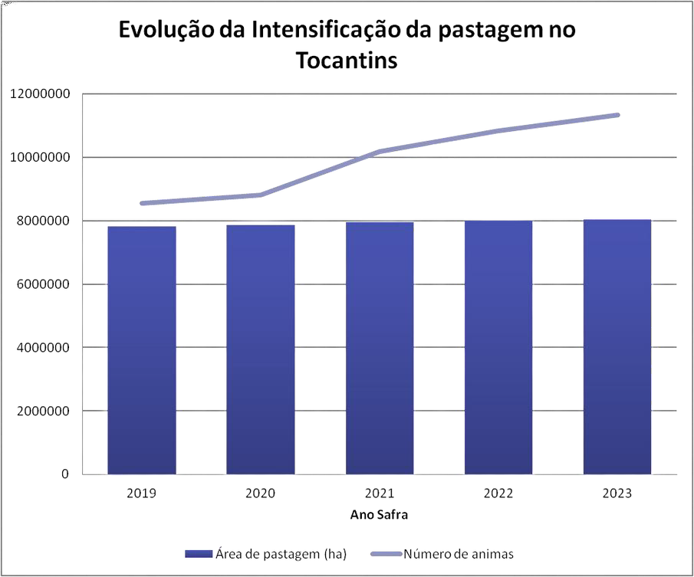
LIVESTOCK PRODUCTION Intensifying Efficient Production
Between 2019 and 2023:
Pasture area: + 3%
Number of animals: + 25% Stocking rate (head/ha): + 23%
Intensification of livestock not only increases meat production, but also frees degraded areas for agriculture
Fonte: SEAGRO/2025

Slide 11




















TRACEABILITY AND GOVERNANCE
Combating Illegality
PLANNING
AUTHORIZATION
MONITORING
OVERSIGHT
Registration in the CAR: The producer declares and commits to the RL and APP
All ASVs are authorized by the State, in accordance with the Forest Code and resolutions
The CIGMA/ SIGCAR platform cross-references deforestation alerts with authorizations (AEF)
Inspections by NATURATINS, IBAMA< and the MPTO (Public Prosecutor’s Office of Tocantins are cracking down on unauthorized deforestation

Slide 12
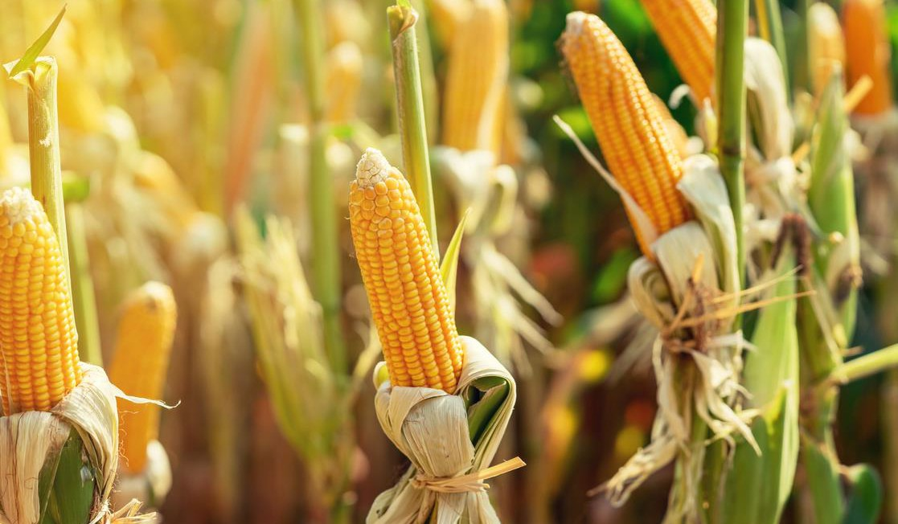
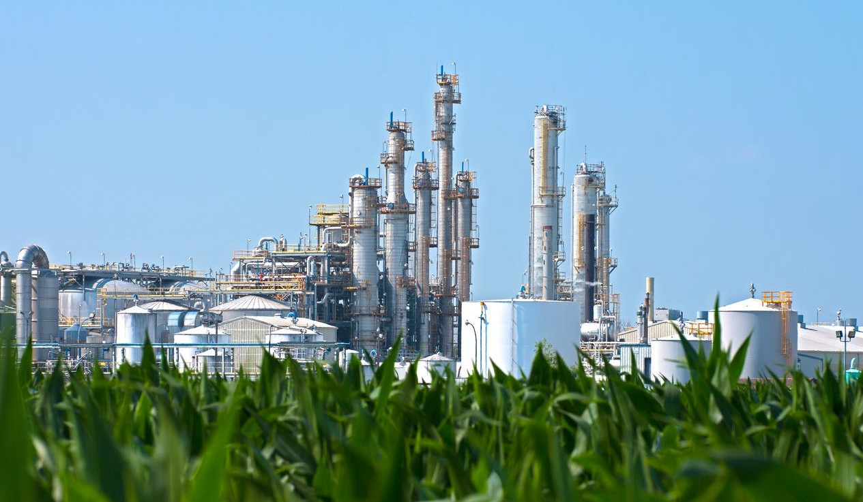
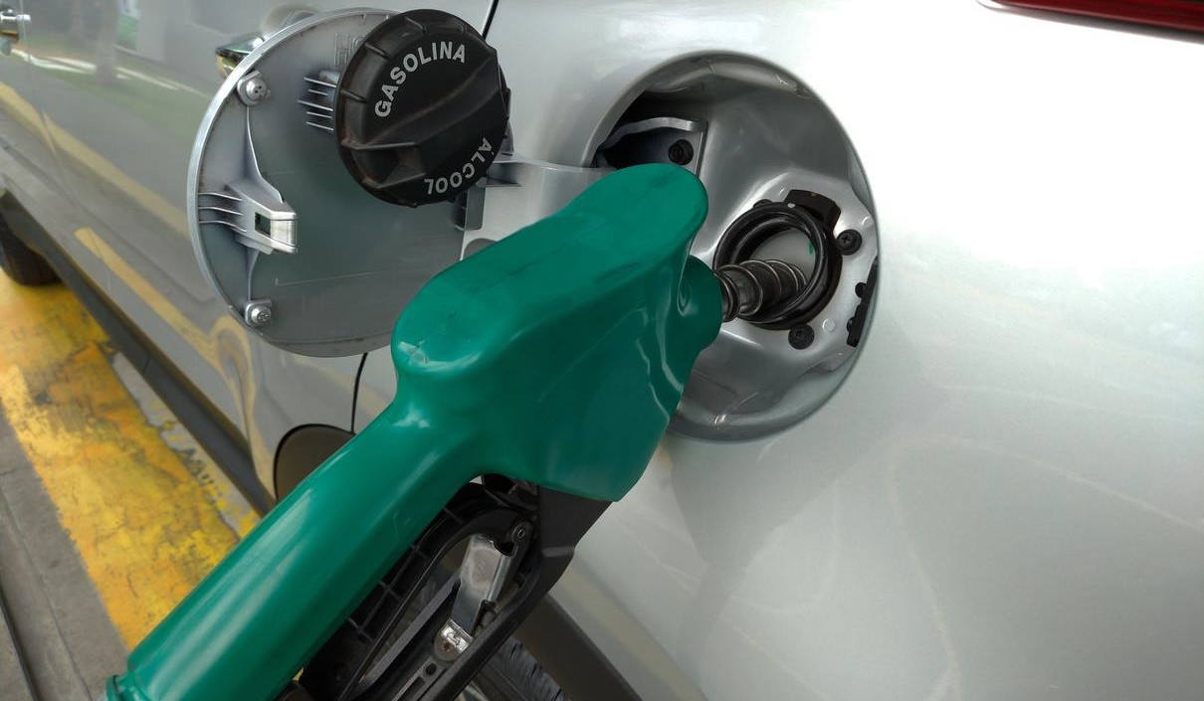
ENERGY TRANSITION
Licensing of the Ethanol Agroindustry
Tocantins has a State Agroenergy Plan
That guides the industrialization of biofuels.
COEMA RESOLUTION135/2025
Regulates licensing of ethanol plants from starchy grains and tubers;
Establishes strict impact criteria and ensures traceability and transparency;
This ensures traceability and transparency of the industrial process, from the field to the biofuel.

Slide 13















ADDED VALUE OF CORN ETHANOL
Benefits of Corn Ethanol Agroindustry:
ECONOMIA CIRCULAR
SOCIOECONÔMICO
Combined with cogeneration of energy (biomass/biogas), it strengthens the state’s clean and renewable energy matrix.
Total Waste Utilization: utilizes 100% of the corn, transforming waste into protein-rich food and biogas.
Agro-industrialization vertically integrates the production chain, retaining value and generating employment and income
SUSTENTABILIDADE

Slide 14

FINAL CONSIDERATIONS
Low Carbon Growth is Our Value Proposition
We Prioritize
Sustainable Growth: Agricultural expansion in degraded pasture areas;
Efficiency: Corn production and livestock farming grew in productivity and stocking rate, exceeding expectations for the area;
Governance and Transparency: We guarantee legality from the farm to the factory.

Slide 15

Obrigada/Thank you
Cristiane Peres cristiane.silva@semarh.to.gov.br

