Slide 1
California Cap-and-Trade Program: Examples of Data Uses & Overview of Publicly Available Information
Updated SEPTEMBER 2020
Notes:
In this presentation, we will discuss examples of data from California’s Cap-and-Trade Program and how it can be used, and we’ll also provide an overview of all the information that is made publicly available related to this Program.
The purpose of the presentation is to ensure that market participants and other interested parties understand the types of data that CARB publishes related to the Cap-and-Trade Program, where this information can be found, and how it can be used to better understand the linked California and Québec carbon market.
We start by responding to several general questions about the Program, market data, and underlying greenhouse gas emissions data. Then we’ll take a closer look at the Program and provide a general overview of each major aspect of the operations of the Program from allocation, to auctions, to offset issuance, and compliance.

Slide 2
Publicly Available Information
Published information ranges from reported emissions data to compliance status
Supports operation of the Cap-and-Trade Program
Enables Program transparency
Ensures efficient market operation
Published information reflects strict confidentiality and market sensitivity procedures
Avoid data asymmetry
Protect confidential business, market sensitive and personally identifiable information
CARB does not comment on third-party analysis or opine on market activities
Program information and development updates available on the Cap-and-Trade Program webpage
Notes:
CARB provides a wide range of information to the public on every aspect of the Cap-and-Trade Program. Publication of this data supports the operation of the program and ensures transparency. Regular posting of program data also supports efficiency in the market.
CARB policies require that programs comply with all state and federal regulations that address the maintenance, security and disclosure of personal and confidential business information, and the protection of privacy. CARB provides many reports on a regular schedule to ensure all market participants have access to the same information at the same time, in order to avoid data asymmetry. Information about the program that is not published on a regular schedule is released with advance notice to market participants. In cases where such information includes market-related information with Québec, our linked partner jurisdiction, the notice of information and publication release date and time are closely coordinated to avoid data asymmetry. CARB Program staff adheres to strict procedures concerning confidentiality and market sensitivity. CARB does not comment on third-party analyses or opine on market activities, nor does CARB disclose confidential business or personally identifiable information that is protected pursuant to the California Public Records Act and the Information Practices Act.
Further, CARB has extensive policies on data release because of the market design of the Program, and identifies and handles market-sensitive data in a uniform and transparent format. The advance notifications mentioned previously identify specific posting dates and times to ensure simultaneous and equal access to all market participants and the public. For instance, advance notices are provided for auction supply, requirements for participation, auction results and proceeds. Slides 23 and 24 of this presentation will provide a detailed schedule for the release of market information and reports.

Slide 3
Outline and Video Modules
Using Publicly Available Data (Examples of Data Use)
Mandatory Reporting Regulation (MRR) – Greenhouse Gas (GHG) Emissions Data Reports
Compliance Instrument Tracking System Service (CITSS) Registrants Report
Understanding Compliance Obligations [Video Module 1]
Allowance Budget and Disposition
Compliance Instrument Report [Video Module 2]
Understanding Industrial Allocation [Video Module 3]
Estimating Value for the Compliance Offset Program
Overview of Publicly Available Data
Western Climate Initiative (WCI) Carbon Allowance Price Data and Other Available Price Information
Allowance Allocation
Auction Data [Video Module 4]
Compliance Offset Program
Compliance Summary Reports and Enforcement
Notes:
This slide provides the outline of the presentation, which is divided into two major sections and includes links to four video modules that will be played during this recorded presentation. The video modules can also be accessed separately and independent of this presentation on the Cap-and-Trade Program Data webpage. Links and contact information are also provided at the end of this presentation on the Resources Slide.
The first section of this presentation focuses on how publicly available program data can be used to understand major Cap-and-Trade Program concepts from calculating compliance obligations, tracking allowance disposition over time, understanding industrial allocation and covered emissions, and estimating the value of the Compliance Offset Program. This first section addresses commonly asked questions about the Cap-and-Trade Program. It assumes that the viewer has a basic understanding of the Cap-and-Trade Program requirements and provisions.
The second section of this presentation provides a general overview of the Cap-and-Trade Program. This part of the presentation introduces available price data sources, and allowance allocation for industrial sectors, electrical distribution utilities, and natural gas suppliers. It provides a walkthrough of auction data reports and how to find past auction results and statistics, an overview of the Compliance Offset Program, and finally a summary of program compliance and enforcement information that is publicly available.

Slide 4
Using Publicly Available Data
Notes:
This is the first section of the presentation: “Using Publicly Available Data.” In this section, we will explain specific examples of how the Cap-and-Trade Program data can be used to answer commonly asked questions about the Program. The whole presentation is approximately two hours long, with four video modules included. Video Module 1 is “Understanding Compliance Obligations.” Video Module 2 is the “Compliance Instrument Report.” Video Module 3 is “Understanding Industrial Allocation.” Finally, Video Module 4 is “Auction Data.”
For those viewers who would like a general overview of the program and an introduction to the various program requirements and provisions before discussing specific examples, please watch Section 2 of the presentation first, and then return to Section 1 later.

Slide 5
Examples of Data Use
Understanding Compliance Obligations
Tracking Allowance Disposition over Time
Understanding Industrial Allocation
Estimating Value of the Compliance Offset Program
Notes:
This presentation will cover four particular examples that respond to common questions CARB staff receive. The four examples are listed here: 1. Understanding Compliance Obligations, 2. Tracking Allowance Disposition over Time, 3. Understanding Industrial Allocation, and 4. Estimating Value of the Compliance Offset Program.
These examples are discussed in detail with the assumption the viewer has an understanding of the program topic and requirements. As mentioned on the previous slide, if it would be helpful to review an overview of the program requirements and provisions first, skip to Section 2, beginning with Slide 22.

Slide 6
Annual Greenhouse Gas (GHG) Emissions Data (1 of 2)
California’s Regulation for the Mandatory Reporting of Greenhouse Gas Emissions (MRR) requires industrial sources, fuel suppliers, and electricity importers to report their annual GHG emissions to CARB
In general, emissions must be reported if they exceed 10,000 metric tons of carbon dioxide equivalent (MTCO₂e) per year
If a facility or fuel supplier exceeds the 25,000 MTCO₂e per year and an electric power entity reports any covered emissions above zero, the reported data must also be verified by a CARB-accredited, third-party verification body
The facility, fuel supplier, or electric power entity is also subject to the Cap-and-Trade Regulation, and is required to submit compliance instruments to match its annual, verified GHG emissions
Notes:
Pursuant to the California Global Warming Solutions Act of 2006, CARB developed an annual greenhouse gas (GHG) reporting regulation, which was approved in 2007. This Mandatory Reporting Regulation, or MRR, collects data from the largest GHG emitters and supports several other CARB programs, including the Cap-and-Trade Program, the AB32 Cost of Implementation Fee Regulation, and the statewide GHG Emissions Inventory.
In general, MRR requires industrial sources, fuel suppliers, and electricity importers to report their annual GHG Emissions. In addition to mandatory reporting of emissions data, MRR requires reporting of product data, the independent verification of emissions data reports, and CARB accreditation and oversight of verification bodies consistent with international best practices. Only CARB-accredited verification bodies may provide verification services to reporting entities.
The MRR program requires annual reporting of GHGs from industrial sources that emit more than 10,000 metric tons of carbon dioxide equivalent, or CO₂e, from transportation and natural gas fuel suppliers, and from imported electricity. If the GHG emissions for a facility or fuel supplier exceed 25,000 metric tons of CO₂e per year, or an electric power entity reports any covered emissions above zero, the reported data must also be verified by a CARB-accredited, third-party verification body. Since 2010, reporting entities have been required to have their GHG emissions data reports verified each year by a CARB-accredited verification body. Beginning with 2017 data verified in 2018, the verification deadline is August 10th.

Slide 7
Annual GHG Emissions Data (2 of 2)
Mandatory Greenhouse Gas Emissions Data Reports: include annual entity and facility-specific GHG emissions data, including verification status if required
A walkthrough of MRR emission data reports is available in Video Module 1: Understanding Compliance Obligations
CARB Pollution Mapping Tool: allows users to choose individual sources and facilities on a map using Google Earth, including presenting facility images in ‘Satellite’ mode. CARB Pollution Mapping Tool presents criteria pollutant, toxic air contaminant, and GHG emissions data for large facilities in the State
GHG Verification Information Webpage: provides information on Third-Party Verification of reported emissions. Information on Accreditation of Verifiers, CARB-accredited verification bodies and individuals is available on the CARB verification webpage
California's annual statewide GHG emissions inventory is an important tool for establishing historical emission trends and tracking California's progress in reducing GHGs. Statewide emission estimates rely on facility-specific emission reports submitted pursuant to MRR
Notes:
This slide provides links to useful tools and data reports. The annual data collected by MRR is provided in a summary spreadsheet that is typically released in the beginning of November. This summary spreadsheet, which is called the Annual MRR GHG Facility and Entity Emissions Report or GHG Emissions Data Report, for short, includes the results of the third-party verification for emissions data and for product data, which are referred to as the verification statement. Because of regulation changes that became effective after January 1, 2012, reports for 2011 data and onward will have differences from the historical 2008-2010 data because of changes in the reporting requirements.
Entity-specific product data that is required to be reported for specific industrial sectors is not made publicly available in the annual MRR report because it contains confidential business information that cannot be publicly released. However, the verification statement for the product data is included in the report to indicate if the submitted product data were complete and accurate. Finally, the data summarized in the annual MRR GHG Facility and Entity Emissions Report reflects all facilities and entities subject to MRR, and does not include all California GHG emissions sources, such as emissions from land use change, agriculture, or certain other sources. A full list of sources that are required to report pursuant to MRR is available in the MRR Regulation.
The CARB Pollution Mapping Tool is an interactive map that allows users to locate and view emissions of greenhouse gases (GHG) and criteria pollutants from large facilities in California. The map includes emissions data for toxic air pollutants along with criteria pollutants and greenhouse gases from large facilities in California. Users can select facilities by a number of attributes such as name, location, or industrial sector using Google Earth and “Satellite” mode imaging. Users can also view their reported emissions using maps, charts and tabular formats, and download data for later use. CARB’s Pollution Mapping Tool was updated on June 18, 2019, and is typically updated each year to reflect the prior year’s verified GHG emissions data.
The next resource link for the MRR Program is CARB’s Verification Webpage. Two primary components of the MRR verification requirements are an accreditation program for GHG verification bodies and individual verifiers, and a verifier performance oversight program. Only CARB-accredited verifiers can provide verification services for reporting entities subject to mandatory reporting. Verifiers are subject to specific requirements that include prescreening for education and professional experience, CARB developed training, and the successful passage of a CARB verification exam. Once these steps are met, CARB issues an Executive Order for CARB accredited verifiers that is valid for a period of three years, whereby the applicant may reapply for accreditation. A list of accredited verifiers and Executive Order copies may be found on the CARB Verification Webpage.
Finally, note that the MRR data is a subset of the statewide GHG emission sources, capturing approximately 80% of the GHG emissions included in the State’s GHG Emissions Inventory. The statewide GHG Emissions Inventory is a different and separate program from MRR that establishes historical emission trends and is an important tool for tracking California’s progress in reducing GHGs.

Slide 8
CITSS Registrants Report
Quarterly report that reflects all active, registered entity accounts in the Compliance Instrument Tracking System Service (CITSS) and all active facilities with covered emissions
Identifies active covered and voluntarily associated entities (General Market Participant – Organization and Individuals) in the Cap-and-Trade Program
Mandatory Reporting GHG ID is the same as “ARB ID” assigned by the California Electronic Greenhouse Gas Reporting Tool (Cal-eGGRT)
ID number is a unique identifier to track verified greenhouse gas emissions to a facility or covered emissions source published in MRR’s annual data reports. An entity may have multiple GHG IDs listed
Two entities in the June 28, 2019 CITSS Registrant Report are provided here for reference:
Entity Legal Name | Entity ID | Entity Type | Mandatory Reporting Greenhouse Gas IDs
ACT Commodities, Inc. | CA1827 | General Market Participant - Organization | NA
AES Alamitos, LLC | CA1248 | Covered Entity, Covered Source, or Opt-in Entity | 100194, 100257, 101321
Notes:
CARB also publishes a report of all entities that are registered in the Cap-and-Trade Program online registry and instrument tracking system, called the Compliance Instrument Tracking System Service, or CITSS. Entities involved in the Cap-and-Trade Program must register for accounts within the CITSS system. These CITSS accounts allow an entity to manage and track their account balance of compliance instruments, coordinate with corporate associated entities on the division of purchase and holding limit shares, and apply for quarterly joint auctions. Market participants must register through CITSS in order to hold, trade, and retire compliance instruments.
The most current CITSS Registrant Report is accessible from the publicly available market information section of the Cap-and-Trade Program webpage.
The CITSS Registrant Report is updated on the last business day of each calendar quarter based on data pulled from CITSS at Noon on the business day prior to the release of the report. For the June 2019 report, the report was released June 28th, 2019, and reflects any CITSS account changes as of Noon on June 27th, 2019. Note that account changes may still be in progress, such as facility retirements from changes of facility ownership and entities converting to a voluntary participation status or exiting the Cap-and-Trade Program. Any changes reflected in the CITSS Registrant Report must have been processed in CITSS by the time the data is pulled to generate the quarterly registrant report.
CITSS accounts for registered entities are displayed in the CITSS Registrants Report in numerical and then alphabetical order with the first entity listed in the June 2019 report as 3 Phases Renewables, Inc. (CA1763), and the last entity in that report listed as Zuber Farms, LLC (CA2034). The ID number in the second column will all start with “CA” for those entities registered in California.
In the third column, the report includes the entity type, which helps to identify those entities that likely have an upcoming compliance obligation and an interest in acquiring compliance instruments. There are a total of four entity types in CITSS: 1. Covered Entity, Covered Source, or Opt-in Entity, 2. General Market Participant – Previously Covered, 3. General Market Participant – Organization, and 4. General Market Participant – Individual. These are referred to in the Regulation as a covered entity, an opt-in entity, and a voluntarily associated entity (see Subarticle 3 of the Regulation for complete requirements).
The fourth and final columns of the report identifies the Mandatory Reporting GHG ID, and multiple IDs assigned to an entity with one or more covered emission sources that are subject to the Cap-and-Trade Program. For the entity type, “Covered Entity, Covered Source, or Opt-in Entity,” a GHG ID will be identified. For entities that do not have a compliance obligation, and are voluntarily associated entities in the Program, these can be observed with a “NA” or not applicable noted in the column. As of June 2019’s CITSS Registrant Report, there were approximately 700 registered entities with almost half of these registered with an entity type of: “Covered entity, covered source, or opt-in entity.”
This report is a useful resource that provides market transparency on the level of participation at the industry, company, and individual level. The report can be used to track market participation – from the total number of covered entities, their covered emissions reported to the Mandatory Reporting Regulation (MRR), and the obligation requirements due to Cap-and-Trade to the total number of voluntary market participants that include offset project operators, consultants, brokers, traders, investment firms, and individuals.

Slide 9
Understanding Compliance Obligations
Understanding compliance obligations requires an understanding of total covered emissions, compliance obligation calculations, and compliance instruments surrendered
Annual GHG Emissions Data Reports and Compliance Reports
The first compliance period (CP1) included the total 2013 and 2014 covered emissions subject to a compliance obligation. There were two compliance deadlines in CP1
Nov. 3, 2014 annual compliance obligation deadline: 30% of 2013 covered emissions
Nov. 2, 2015 full compliance period compliance obligation deadline: 70% of 2013 covered emissions and 100% of 2014 covered emissions
Difference between total covered emissions and total compliance obligations: late or non-compliance, changes of ownership, late entrants, underreported emissions
Notes:
In order to calculate what an entity’s compliance obligation is under the Cap-and-Trade Program, as well as the number of compliance instruments the entity must acquire and surrender to CARB based on its reported and verified covered emissions, it is helpful to understand the following concepts: total covered emissions, compliance requirements – the difference between an annual or full compliance period compliance obligation deadline—, and the total compliance instruments surrendered by the entity to date.
The first compliance period included the total covered emissions from 2013 and 2014 subject to a compliance obligation. There were two separate compliance deadlines in this first compliance period, which is also referred to as CP1. Pursuant to the Cap-and-Trade Regulation, the compliance deadline is the first business day of November. For CP1, the deadlines were November 3, 2014 – an annual compliance obligation deadline, which required entities to surrender compliance instruments equal to 30% of 2013 covered emissions— and November 2, 2015 – the full compliance obligation deadline of this compliance period where entities were required to surrender compliance instruments equal to the remaining 70% of 2013 covered emissions and 100% of 2014 covered emissions. For both of these compliance events, CARB has published Compliance Summary Reports that show each entity’s compliance status and the total number and type of compliance instruments surrendered for that compliance event. For the first annual compliance obligation deadline, entities surrendered 100% of their obligation due, and for the full compliance period compliance obligation due on November 2, 2015, for CP1, entities surrendered 99.99% of their total 2013-2014 triennial surrender obligation.
Any differences between total covered emissions and total compliance obligations can be associated to late compliance or non-compliance, changes of ownership, late entrants that are eligible to defer their obligation to the next compliance period, or underreported emissions.
The next slide will discuss the second compliance period and include a video module of how to track an entity’s covered emissions and their estimated compliance obligation. The video will also illustrate an example of how to use multiple emissions data reports to understand an entity’s compliance obligation.

Slide 10
Understanding Compliance Obligations: Facility Emissions Example
The second compliance period (CP2) included the total of 2015, 2016, and 2017 covered emissions subject to a compliance obligation. Some entities that deferred their 2014 covered emissions per Section 95853(d) had larger obligations
There were three compliance deadlines in CP2
Nov. 1, 2016 annual compliance obligation deadline: 30% of 2015 covered emissions
November 1, 2017 annual compliance obligation deadline: 30% of 2016 covered emissions
November 1, 2018 full compliance period compliance obligation deadline: 70% of 2015 covered emissions, 70% of 2016 covered emissions, and 100% of 2017 covered emissions
Example: calculating the compliance obligation of a covered entity with two facilities Video Module 1: Understanding Compliance Obligations
Entity ID | ARB GHG ID | 2015-2017 Obligation | Total Instruments Surrendered | Obligation Status
CA1019 | 101701, 101749 | 4,258,874 | 4,258,874 | Fulfilled
Notes:
The second compliance period included covered emissions from 2015, 2016, and 2017. Covered emissions, as explained previously, are those emissions that are subject to a compliance obligation under the Cap-and-Trade Program. Additionally, some entities that were new entrants to the Cap-and-Trade Program per section 95853(d) of the Regulation may have deferred their 2014 covered emissions to the second compliance period. This means some entities had larger compliance obligations to surrender on November 1, 2018 that included 100% of their 2014 covered emissions, on top of the 2015 to 2017 remaining emissions obligations due.
The three deadlines in this second compliance period were: November 1, 2016, annual compliance obligation deadline where an entity was required to surrender compliance instruments equal to 30% of its total 2015 covered emissions. November 1, 2017, annual compliance obligation deadline where an entity was required to surrender compliance instruments equal to 30% of its total 2016 covered emissions. And, finally, the November 1, 2018 full compliance period compliance obligation deadline where an entity surrendered compliance instruments equal to its remaining 70% of 2015 covered emissions, 70% of 2016 covered emissions, and 100% of 2017 covered emissions. Video Module 1: Understanding Compliance Obligations will now walkthrough an example calculation for a covered entity with two facilities.

Slide 11
Tracking Allowance Budget and Disposition
Allowance Budgets: California and Joint Market
California Regulation specifies California-issued allowances
Linkage with Québec and inclusion of Québec allowances (total allowance supply)
Reserve allowances designated from within each jurisdiction’s allowances budgets
Allowance Disposition within the California Budget: Data Sources
Cap-and-Trade Regulation
California GHG Allowance Budgets in Tables 6-1 and 6-2
§95870 and §95871 on disposition of allowances to the Allowance Price Containment Reserve (APCR), Advance Auction, and Voluntary Renewable Electricity Reserve Account
Electrical Distribution Utility Allocation Tables
Estimated State Auction Budget
Notes:
Now that we have covered how to determine an entity’s compliance obligation, let’s look at allowance supply. The California Cap-and-Trade Program issues a fixed number of allowances that entities are given through the allocation process or that CARB auctions. We will discuss allowance allocation and auctions later in this presentation.
The Program is designed with decreasing annual caps, or allowance budgets, so the total quantity of allowances available decreases over time. The decreasing annual budgets help to ensure that the State will meet its mandated greenhouse emission targets—reducing emissions to 1990 levels by 2020 and achieving a 40% reduction below 1990 levels by 2030, while ensuring progress to longer term goals of 80% below 1990 levels by 2050 and carbon neutrality.
California’s Cap-and-Trade Program linked with Québec’s Cap-and-Trade System on January 1, 2014. Linkage allows for the use of compliance instruments from Québec’s Cap-and-Trade System. Therefore, the California allowance budget and Québec allowance budget together establish the total allowance supply in the joint carbon market.
Each jurisdiction designated a small percentage of allowances from their budgets to be placed in price containment reserves. A covered entity may purchase allowances for compliance from its jurisdiction’s reserve account at a predefined price. Cost containment is needed to minimize price volatility, and provide market stability in the case of strong surges in short term demand to meet immediate compliance needs. Reserve sales are only held if an entity indicates they want one. To date, that has not happened. The allowances placed into the APCR are not in the general market and are only accessible for direct compliance by covered entities.
Tables 6-1 and 6-2 in Subarticle 6 of the Regulation define the California annual allowance budgets. Subarticle 8 of the Regulation covers disposition of allowances within the budget – that is, how allowances are allotted to various uses and distributed to the market.

Slide 12
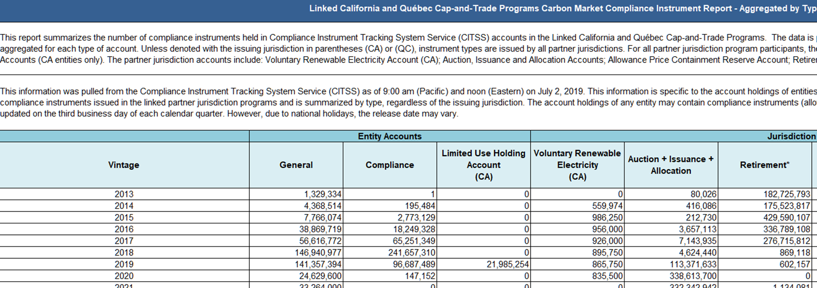
Compliance Instrument Report (1 of 2)
Screenshot of the 2019 Quarter 2 tab from the Joint California and Québec Compliance Instrument Report
Notes:
This slide shows a screenshot of the 2019 Quarter 2 Tab from the Joint California and Québec Compliance Instrument Report. As explained further in Slide 13 and Video Module 2, this is a joint report produced by California and Québec, and the data is pulled from CITSS, typically by the 3rd business day of each calendar quarter. This report shows the number of instruments aggregated by instrument type, account type, and vintage. The report identifies the total amount of allowances and offset credits held by entities and the amount held by all participating jurisdictions, which currently are California and Québec. Video Module 2 provides a closer look at this report.

Slide 13
Compliance Instrument Report (2 of 2)
Entities acquire compliance instruments through allocation, auctions, and private transactions for compliance use
Compliance Instrument Report: snapshot of compliance instruments in CITSS accounts
Joint California and Québec report that is posted quarterly
Accounting of all allowances and offsets issued in the linked market
Aggregated data ensures confidential business information is protected
Allowances in private and jurisdiction accounts by account type
Retirement of allowances, reduced supply over time
Designated use allowances: California voluntary renewable electricity account, Québec environmental integrity account
Video Module 2: Compliance Instrument Report
Notes:
Throughout a compliance period, entities accumulate allowances for compliance through several means, including through auctions, transfers between entities, and some entities receiving free allocation. Offset credits are acquired through private transactions between registered market participants bilaterally or on what is typically referred to as the secondary market. CARB, in coordination with Québec, publishes a quarterly Compliance Instrument Report that provides a snapshot of where all compliance instruments – allowances and offset credits – are within CITSS. This joint report provides an accounting of all allowances and offset credits issued to date in the linked market. The aggregated data reveals allowance holdings in private entity and jurisdiction accounts by account type. It is important to recognize that the Compliance Instrument Report shows combined data from both California and Québec’s entity and jurisdiction accounts in the linked carbon market. The aggregated data ensures that confidential business information such as entity and sector based product data, compliance strategies, or market-sensitive information remains protected. The Compliance Instrument Report provides a high-level overview and transparency on the compliance instruments currently in market circulation, while still ensuring proper handling and safeguarding of the market-sensitive data.
Video Module 2 includes a brief walkthrough of this quarterly Compliance Instrument Report, and identifies the different accounts in CITSS by entity and by jurisdiction. In the video, we will discuss the retirement of allowances and the changes one can see in the disposition of holdings and supply over time. Most notably, entity account balances drop significantly at the end of a compliance period when entities must surrender allowances from their CITSS accounts into jurisdiction retirement accounts. The video will cover each entity and jurisdiction account as well as the designated use allowances in the California Voluntary Renewable Electricity Reserve Account and in Québec’s Environmental Integrity Jurisdiction Account. Finally, the video and the next few slides will explain how the data in the Compliance Instrument Report can be used to understand and track the quantity of compliance instruments in circulation, among other market trends.

Slide 14
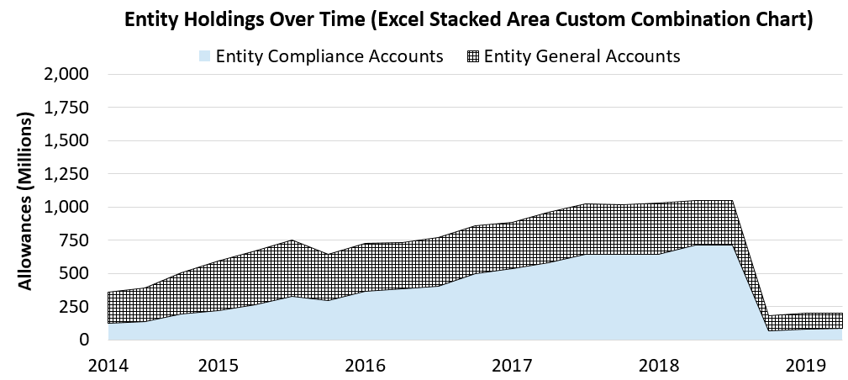
Changes in Allowance Disposition over Time
Allowance totals in the chart are those eligible to satisfy CP1 and CP2 compliance obligations.
These include vintages 2013 to 2017 allowances, and 2018 and 2019 industrial true up allowances.
Notes:
The Compliance Instrument Report provides one snapshot of allowance holdings per calendar quarter. Video module two describes holdings in the Compliance Instrument Report’s tab for the 2nd quarter of 2019. The report available on CARB’s website will contain one tab per quarter from the second quarter of 2014 to the most recent quarter. By comparing allowance holdings across quarters, or report tabs, it is possible to create visualizations of changes in allowance disposition over time.
This excel stacked area custom combination chart shows changes in allowance disposition in entity accounts over time. For a given point in time, or location on the bottom “Time” axis, the height of the chart’s grid pattern area equals the total allowance holdings in entity general accounts. The blue shaded color area of the chart shows total allowance holdings in entity compliance accounts.
The chart was created using information from quarterly Compliance Instrument Reports from quarter two 2014 through quarter two 2019. As discussed in the second video module, the Compliance Instrument Report gives allowance totals by account type for the joint California and Québec market. This means allowances shown in this chart are the totals for Québec and California entities, rather than just California entities. Allowance totals in the chart are limited to the allowances eligible to satisfy 2013 through 2017 compliance obligations.
Let’s take an example point in time to better understand the chart. In the third quarter of 2015, the top of the grid pattern reaches 750 million allowances. We see that entity compliance accounts, the blue shaded area, held around 330 million allowances. In the third quarter of 2015, we also see that entity general accounts held another 420 million allowances, or the difference between the top and the bottom of the grid pattern. The sum of entity compliance and general holdings for the third quarter of 2015 is approximately 750 million allowances.
Understanding that the compliance instrument report reflects all compliance instruments in the joint California-Québec market helps to compare holdings immediately prior to linkage between California and Québec on November 1 2014, and immediately after linkage. This linkage is part of the reason for a jump in the 4th Quarter 2014 entity holdings as compared to the 3rd Quarter 2014 entity holdings.
In the third quarter of 2014, only California allowances were eligible for compliance in the California market, and so only California allowance totals were included in the Compliance Instrument Report. Starting with the fourth quarter of 2014, California and Québec’s allowances are included in the Compliance Instrument Report: both jurisdictions’ allowances became eligible for compliance use in either jurisdiction’s cap-and-trade program. While Ontario briefly joined the joint market in Q4 of 2017 and Q1 of 2018, their estimated private entity account holdings were excluded from the chart on this slide for those two quarters, although a small number of Ontario allowances held by California and Québec entities are included in the chart’s allowance totals from Q2 of 2018 to the end of the time period. Those allowances were fully accounted for when California and Québec retired an equivalent number of allowances in mid-2019.
Beginning in 2015, transportation fuel and natural gas suppliers were subject to the Cap-and-Trade Regulation. This nearly doubled the size of the program and is reflected in the slide by an increased rate of accumulated allowances in entity accounts from the beginning of 2015 through the third quarter of the year, as the market expanded to include these sectors. Now look to the end of 2015. We can see the first drop in holdings between 2015 Q3 and 2015 Q4 when the November 1st compliance event occurred. A total of 278,408,105 allowances were surrendered and placed in California and Québec’s Jurisdiction Retirement Accounts for 2013 and 2014 covered emissions obligations due to CARB and Québec.
The full compliance period compliance event at the end of a compliance period is when the majority of emissions are accounted for. Once fuel suppliers and natural gas suppliers were subject to the Cap-and-Trade Regulation, the next full compliance period compliance event occurred on November 1, 2018. Following linkage with Québec in 2014, we see a steady increase in compliance holdings from 2015 to the first half of 2018 in anticipation of the full compliance period compliance obligation for 2015 to 2017 emissions. During this time, California entities were required to surrender allowances equal to 30% of 2015 emissions on November 1st, 2016, and 30% of 2016 emissions on November 1st, 2017.
For Compliance Period 2, the full compliance period compliance obligation deadline took place on November 1st, 2018. This event is visible in the chart as the 981,442,093 allowances moved out of private entity accounts into California and Québec’s retirement accounts. The private holdings tracked in this chart dropped from over 1 billion allowances to less than 200 million allowances. California entities were required to surrender compliance instruments for the remainder of 2015 and 2016 emissions, and 100% of 2017 covered emissions. Québec entities surrendered allowances on November 1st, 2018 for 100% of their 2015, 2016, and 2017 emissions.

Slide 15
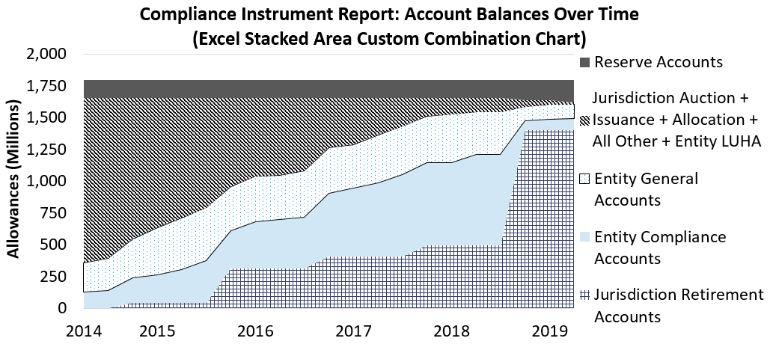
Allowances in Entity and Jurisdiction Accounts over Time – Actual Data from Compliance Periods 1 and 2
Allowance totals in jurisdiction and entity accounts are those eligible to satisfy CP1 and CP2 compliance obligations.
The graph also shows allowance balances in the reserve and VRE accounts (from vintages 2013 to 2020 budgets).
Notes:
Now we’ll look at how compliance period 1 and compliance period 2 eligible allowances moved between different accounts from 2014 to 2019. As with the prior slide’s entity-only chart, this excel stacked area custom combination chart uses the information in the quarterly Compliance Instrument Report. In addition to the prior slide’s visualization of private entity holdings over time, the chart visualizes California and Québec jurisdiction accounts as well.
Allowances for 2013 to 2020 budget years were created before the start of the 2014 Compliance Instrument Reports used for this graph. This is why the total number of Compliance Period 1 and Compliance Period 2 eligible allowances—the graph’s height of 1.8 billion allowances—remains constant as the chart’s X-axis moves from 2014 to 2019. The chart does make adjustments to remove the temporary expansion of allowances from Ontario linked accounts in Q4 of 2017 and Q1 of 2018.
Let’s take the chart categories one by one, from top to bottom at one point in time. We’ll start with a look above the last point in 2015 right before the jump in the bottom account volume.
At the top of the chart, we see 141 million allowances in the allowance price containment reserve or APCR for short, in dark grey. Video module 2 discusses how the APCR was created from within the 2013 to 2020 caps, and does not represent an expansion of the number of allowances in the market.
The next account group, in dark grey and white lines, combines California and Québec’s auction, issuance, and allocation accounts, the California VRE, and California limited use holding accounts. The allowances are grouped together because the majority of these accounts’ allowances are either auctioned during the quarterly auctions, or transferred from California and Québec to compliance entities for allocation purposes. Video module 2 describes the VRE. Video module 3 describes a feature of industrial allocation called true-up that results in a small number of vintage 2018 and 2019 allowances to be displayed in this chart.
The blue polka dot and light blue shaded areas are the private entity general account and compliance account volumes that we saw in the prior slide. As with the prior slide, we see the same 750 million allowances in the third quarter of 2015. This is the distance between the bottom of the light blue area to the top of the blue polka dot area.
The bottom dark grey hashed area shows the allowances held in Québec and California’s retirement accounts.
Now let’s move from 2014 to 2019: left to right in the graph. The APCR has never been accessed, so it remained constant in volume from 2014 to 2018. California has a self-ratcheting mechanism that removes unsold allowances from the market during periods of low demand for allowances. This self-ratcheting mechanism is meant to ensure low demand for allowances does not mute the carbon price signal. The first time this mechanism was utilized was after undersubscribed auctions in 2016 and 2017, where the State did not fully sell all available California allowances. Allowances that remained unsold after 24 months were moved into the APCR pursuant to the self-ratcheting mechanism. Ultimately, the mechanism has moved 37 million allowances as of August 2019 into the APCR. The Auction Summary Report for 2016 and 2017 auctions provides detailed information on the total allowances sold and the remaining unsold vintage year 2016 and 2017 allowances.
We see the grouped set of jurisdiction accounts gradually shrinking over time. This makes sense. Many of these allowances gradually entered private circulation through auctions and allocation, with some moving to the APCR as a result of California’s self-ratcheting mechanism. By the middle of 2019, only a small number of the allowances shown in this graph remain in these grouped accounts: the jurisdiction auction, issuance, allocation, and VRE accounts; and private entity limited use holding accounts.
The number of allowances in entity accounts expands over time in preparation for the November 2015 and 2018 multi-year compliance events. Movement of allowances into these accounts was described in greater detail on the prior slide. Finally, there is an incremental expansion in the number of allowances held in the jurisdiction retirement accounts during California’s partial compliance events in November of 2014, 2016, and 2017. This is a direct flow of allowances and offsets from California compliance entity accounts to the retirement account. The number of allowances grows substantially during the 2015 and 2018 multi-year compliance events.

Slide 16
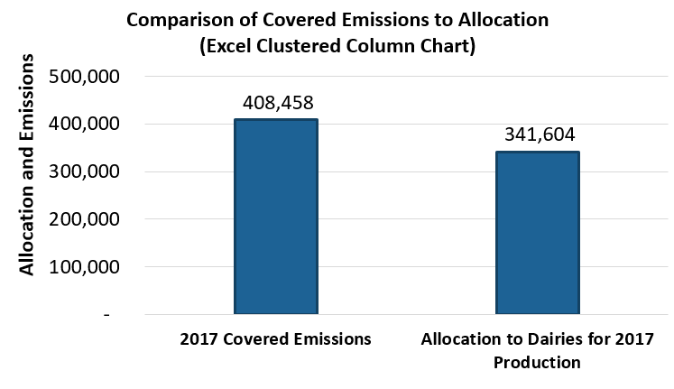
Understanding Allocation – Example: California Dairies
“Dairies” 2017 Covered Emissions = 2017 MRR GHG Data for Corresponding Dairy emissions = 408,458 mtCO₂e
“Dairies” 2017 allocation = (2017 “Total Allocation”) – (2017 “Total True Up Value”) + (2019 Total True Up Value) = 341,604
Video Module 3: Allocation
Notes:
In a moment, video module 3 on allowance allocation to industrial entities will start. The video module is also available to watch on CARB’s Cap-and-Trade website at ww2.arb.ca.gov/cap-and-trade-program-data. The module will walk through why CARB allocates to industrial covered entities, and examples of allocation and emissions for two covered sectors using public information.
First, we’ll compare allowance allocation and covered emissions for the Dairy sector. Then, we’ll compare allowance allocation and covered emissions for the Petroleum Refining and Hydrogen Production sector.

Slide 17
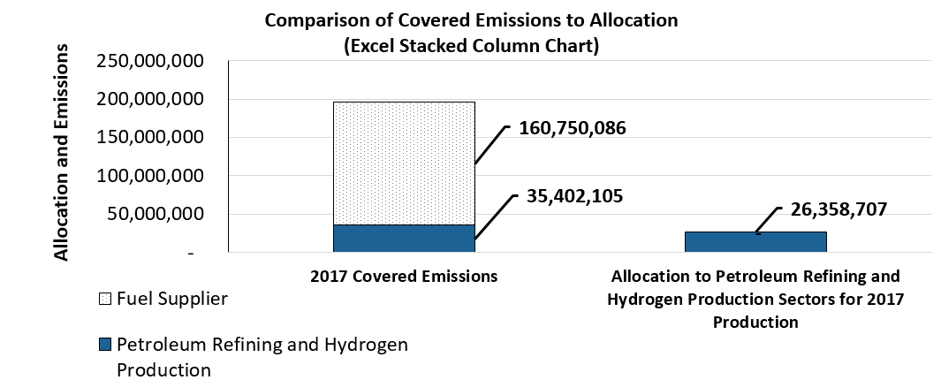
Understanding Allocation – Example: California Petroleum Refining and Hydrogen Production (1 of 3)
Refinery and Fuel Suppliers – see next slide for covered emissions categories from MRR
Notes:
Video Module 3 on allowance allocation to industrial entities provides a more detailed discussion of this chart.
On this slide, the chart shows that covered entities in the petroleum refining and hydrogen production sector had a 2017 compliance obligation of 35,402,105 metric tons of CO₂e. Allowance allocation to the same sector was 26,358,707 allowances. In addition, fuel suppliers, that sell the refining sectors’ product, had a 2017 compliance obligation of 160,750,086 metric tons of CO₂e. Fuel suppliers do not receive any allowance allocation. Taken together, allowance allocation covers about 13% of these emissions.

Slide 18
Understanding Allocation – Example: California Petroleum Refining and Hydrogen Production (2 of 3)
2017 MRR Emissions connected to Fuel Supplier covered emissions in Excel Stacked Column Chart
U.S. EPA/ARB Subpart (2017 MRR Data "2017 GHG Data" Tab Column AC) | 2017 Covered Emissions Chart Category (corresponding rows’ 2017 MRR Data "2017 GHG Data" Tab Column R)
MM | Fuel Supplier
MM,NN | Fuel Supplier
Notes:
This table helps find California fuel suppliers’ 2017 emissions covered by the Cap-and-Trade Program. Fuel suppliers sell the products of covered entities in the petroleum refining and hydrogen production sector. Fuel suppliers’ 2017 emissions are displayed in the grey dotted pattern section of slide 17’s left hand column. Fuel suppliers’ 2017 emissions were 160,750,086 metric tons of CO₂e. We recommend watching video module 3 on allowance allocation to learn how this table can help calculate the emission total for fuel suppliers on slide 17.

Slide 19
Understanding Allocation – Example: California Petroleum Refining and Hydrogen Production (3 of 3)
2017 MRR Emissions Categories connected to Covered Emissions in Excel Stacked Column Chart
North American Industry Classification System (NAICS) Code and Description (2017 MRR Data "2017 GHG Data" Tab Column AB) | U.S. EPA/ARB Subpart (2017 MRR Data "2017 GHG Data" Tab Column AC) | 2017 Covered Emissions Chart Category (corresponding rows’ 2017 MRR Data "2017 GHG Data" Tab Column R)
324110 - Petroleum Refineries | Include C, P, PP, and Y | Petroleum Refining and Hydrogen Production
324199 - All Other Petroleum and Coal Products Manufacturing | All | Petroleum Refining and Hydrogen Production
325120 - Industrial Gas Manufacturing | All | Petroleum Refining and Hydrogen Production
Notes:
This table helps find 2017 emissions for the petroleum refining and hydrogen production sector. The sector’s 2017 emissions are displayed in the dark blue section of slide 18’s left hand column. The sector’s 2017 emissions were 35,402,105 metric tons CO₂e. We recommend watching the allowance allocation video module to understand this table in the context of how to recreate the overall allowance allocation chart to the petroleum refining and hydrogen production sectors on slide 17.

Slide 20
Estimating Value of the Compliance Offset Program (1 of 2)
Historical price data is available in the Market Transfers Summary Reports. The average price has steadily increased each year, relative to increasing allowance prices
An estimated value of the offset credit program can be derived using the weighted average prices, total quantity of offset credits issued, and an auction reserve price to determine an offset premium. This value increases annually
Based on the 2017 Market Transfers Summary Report data, the weighted average prices of offsets and allowances were $11.89 and $14.33 respectively. Offset cost is then estimated at 83% of an allowance: a discount of 17%. Using the auction reserve price of $15.62 for allowances, this gives an approximate value of 2019 prices of $12.96 per offset credit
Offset credits that are not eligible for trading (e.g., the forest buffer account, invalidated offsets) are subtracted out from estimating the total value of the Compliance Offset Program
Using this estimation approach, the value today would be approximately $1.7B. This value reflects all offsets issued to date (including retired offsets)
Notes:
CARB releases annual summary reports that provide average price statistics for allowances and offset values based on CITSS transfer data. Using the most recent Market Transfers Summary Report, it is possible to determine a rough estimate of the total financial value for California’s Compliance Offset Program, or what we can call an “offset premium,” using the weighted average prices provided in the report, the total quantity of offset credits issued which is provided in the publicly available Offset Issuance Table updated twice a month or as provided in the quarterly Compliance Instrument Report, and the auction reserve price from the last auction.
Based on the 2017 Market Transfers Summary Report data, the weighted average prices of offsets and allowances were $11.89 and $14.33 respectively. This means that offsets were available at approximately 83% of the price of an allowance, a discount of 17%. Applying this discount to the 2019 auction reserve price of $15.62 for allowances gives an approximate offset price of $12.96 for 2019. Based on the 2019 Quarter 2 Compliance Instrument Report, the total quantity of California offset credits issued – not accounting for the forest buffer– is roughly 136 million offset credits, an investment value of $1.7 billion dollars towards non-covered sectors. This value is expected to increase as allowance price increases at an annual rate of 5% plus inflation, and we issue more credits for offset projects that meet stringent project requirements, and reduce emissions or achieve increased carbon sequestration. This aspect of the program is just one part of the larger climate efforts to reduce greenhouse gas emissions.
It should be noted that offsets trade at a lower amount than the allowances we sell at auction because of the risk involved with project reversals. ARB has created a forest buffer pool to account for the risk attributed to forest offset projects where carbon is not permanently sequestered. Some forest offset credits are placed into this insurance buffer pool, to compensate for potential reversals due to forest fires, pest infestations, and other unintentional events. The size of this buffer pool is currently at 20 million forest project offset credits based on the 2019 Q2 Compliance Instrument Report – a value of $259 million.

Slide 21
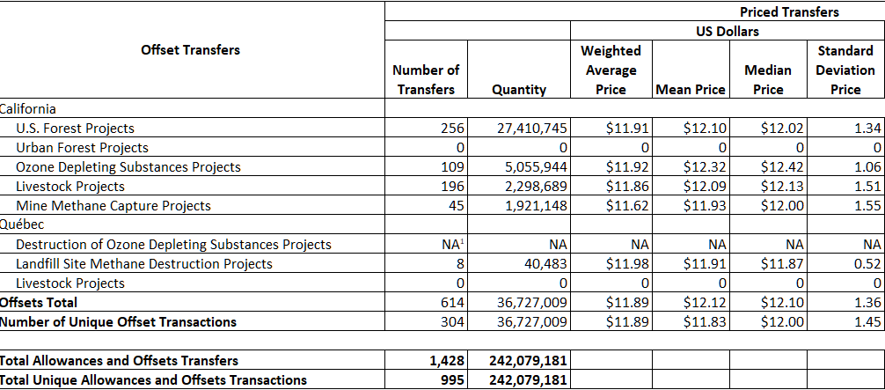
Estimating Value of the Compliance Offset Program (2 of 2)
The screenshot below is from the 2017 Market Transfers Summary Reports.
Notes:
This is a screenshot of the 2017 Market Transfers Summary Report. To determine an estimated value for the Compliance Offset Program, take the weighted average price from this report, and refer to the most recent auction reserve price, and either the Offset Issuance Table or Compliance Instrument Report as described on the previous slide. The weighted average price for total offsets is shown in this report as the 3rd column in the “priced transfers” category.

Slide 22
Overview of Publicly Available Data
Notes:
This is the second section of the presentation: “Overview of Publicly Available Data,” where general information is provided on the full range of information released about the Cap-and-Trade Program. This section explains resources on available compliance instrument prices, a detailed description for the allocation process to industrial sectors, electric distribution utilities, and natural gas suppliers. This section is roughly 30 minutes long, with one video module, Video Module 4. Video Module 4 covers Auction Data, and demonstrates where to access auction notices, results and statistics, and a summary of auction proceeds generated to date.
There are some general slides on the Compliance Offset Program that explain the issuance of offset credits and information on offset project third-party verification bodies. The final slides include an overview of program compliance and enforcement, and a final summary of resources and webpages referenced throughout this presentation.

Slide 23
Summary and Timing of Information Release (1 of 2)
Topic | Reports | Release Timeframe
Greenhouse Gas (GHG) Reporting Data | GHG Facility and Entity Emissions | Every November (following the compliance deadline)
California GHG Emission Inventory | Full GHG inventory, summaries, and trends (2018 edition covers 2000-2016 GHG Emissions) | Annually
Allowance Allocation | Allowance Allocation Summaries | Every December
Compliance Offsets | Offsets Issuance Table | Every other Wednesday
Auction Data | Auction Notices | Quarterly, 60 days before auction
 | Summary Results Reports | Quarterly, 1 week after auction
 | Proceeds Reports | Quarterly, 4 weeks after auction
 | Annual Auction Reserve Price Notice | Every December, first business day
 | Annual Allowance Price Containment Reserve Notice | Every December, first business day
Notes:
This table summarizes the Cap-and-Trade Program reports and related reports by topic, and provides the release timeframe for each report. Links to these reports are provided throughout the presentation and on the last slide.
The annual GHG Facility and Entity Emissions report summarizes greenhouse gas emissions reported pursuant to the Regulation for the Mandatory Reporting of Greenhouse Gas Emissions, or MRR for short. CARB publishes this report in November for GHG emissions from the previous year. Video Module 1 earlier in this presentation provides an overview of GHG Facility and Entity Emissions reports in the context of understanding Cap-and-Trade Program compliance obligations.
CARB publishes the California Greenhouse Gas Emission Inventory annually. Each edition of the inventory covers statewide greenhouse gas emissions from the year 2000 through the year two years prior to publication. For example, the 2019 edition of the inventory covers 2000 to 2017 greenhouse gas emissions. CARB prepares the inventory using data reported pursuant to MRR, data from other CARB programs, and data from other State and Federal agencies.
For the Cap-and-Trade Program, CARB publishes annual allowance allocation summaries every December. Video Module 3 earlier in this presentation illustrates the use of allowance allocation summaries in the context of understanding allocation to specific sectors.
CARB publishes a list of all offset projects that have been issued offset credits, and updates the offsets issuance table every other Wednesday. This report lists all offset projects that have been issued ARB offset credits, their invalidation status, and provides links to the relevant listing and other project-related materials that are required to be made public pursuant to the Cap-and-Trade Regulation.
CARB releases auction reports on a quarterly schedule corresponding to the quarterly auction dates: auction notices are published 60 days prior to each auction, summary results reports are published one week after each auction, and post joint auction public proceeds reports are published approximately four weeks after each auction. In addition, CARB publishes an Annual Auction Reserve Price Notice and an Annual Allowance Price Containment Reserve Notice every December. We will discuss the content of auction reports later in this presentation and in Video Module 4.

Slide 24
Summary and Timing of Information Release (2 of 2)
Topic | Reports | Release Timeframe
Market Data | CITSS Registrant Report | Quarterly, last day of calendar quarter
 | Compliance Instrument Report | Quarterly, start of calendar quarter
 | Summary of Market Transfers | Every December
 | Compliance Reports | Every December
Enforcement Actions | Case Settlement Summaries | Monthly
Auction Proceeds Expenditures | Annual Report | Annually
Notes:
CARB publishes the CITSS Registrant Report and Compliance Instrument Report quarterly and the Summary of Market Transfers and Compliance Report every December. These reports were discussed earlier in the presentation and in Video Modules 1 and 2.
CARB enforces rules to protect the integrity of the carbon market. Information on cases settled in lieu of litigation and those resolved by civil or criminal litigation is available through CARB’s Enforcement Case Settlements webpage, which is updated monthly.
CARB’s California Climate Investments Program publishes an annual report on the expenditure of auction proceeds.
The Resources slide at the end of this presentation provides links to the webpages where all of these reports can be accessed.

Slide 25
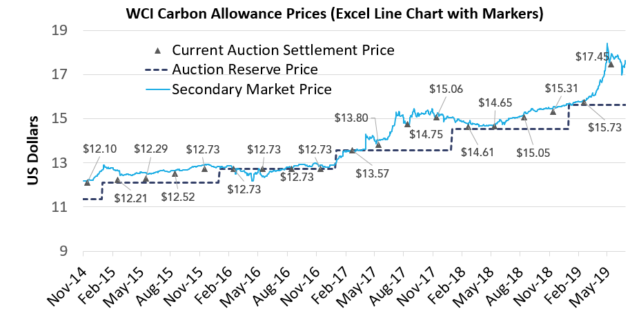
Joint CA-QC Carbon Market Allowance Price Data: Auction and Secondary Markets
Source of secondary
market price: ARGUS
Notes:
CARB is continually assessing, in conjunction with our linked partner Québec, additional ways of showing program data to aid the public and market participants in better understanding the program and the market data. By way of example, this chart was published in July 2019 and displays historical carbon allowance prices from auctions and secondary markets of carbon allowances. Auction prices shown on this chart include the Current Auction Settlement Price and Auction Reserve Price. The Auction Reserve Price for each Current Auction is depicted on the chart with a dark blue line, starting on November 2014 with the first joint California and Québec auction held on November 25th, 2014. The Auction Reserve Price increases each calendar year by 5 percent plus the rate of inflation as measured by the most recently available 12 months of the Consumer Price Index for All Urban Consumers. The current 2019 Auction Reserve Price is $15.62.
The joint November 2014 auction included a Current Auction of 2014 vintage allowances and an Advance Auction of 2017 vintage allowances. The reserve, which is commonly referred to as the minimum price at which allowances offered in the Current Auction could be sold, was set at $11.34. The final settlement price for the Current Auction was $12.10 since the total qualified bids to purchase current vintage 2014 allowances exceeded the total allowances available for sale. The Current Auction Settlement Price is shown as dark blue triangles on this chart. The May 2019 Auction Settlement Price was $17.45, the highest settlement price compared to past auction results and in line with secondary market prices. The reserve prices and the settlement prices displayed in this chart come from publicly available reports discussed on Slide 25 and later in this presentation.
The secondary market price reflects transactions that occur outside of the jurisdiction joint auctions. Secondary market prices are shown as a blue line. These prices reflect the cost of purchasing allowances from private parties, rather than from the jurisdiction joint auction. This historical price chart illustrates that prices in the secondary market track closely with auction settlement prices, and that over the last five years, the value of carbon allowances increased over time in both the primary auction and secondary markets as the carbon market continues to mature.

Slide 26
Other Available Price Information
CARB Cap-and-Trade Program Data Webpage: auction reserve price, prices of APCR allowances, and ceiling price set by Regulation as cost-containment features
Market Transfers Summary Report: summary of priced and unpriced CITSS allowance and offset transactions
Intercontinental Exchange (ICE) and Nodal Exchange: exchange platforms offering participants ability to conduct trades of future contracts and options associated with compliance instruments in the joint California and Québec Cap-and-Trade Programs
U.S. Commodities Futures Trading Commission: releases weekly Commitments of Traders reports on certain open interest positions
Notes:
Containment Reserve allowances for each reserve tier, and the ceiling price as set forth by the Cap-and-Trade Regulation’s cost-containment features. Advance notice for auction and reserve sales is provided on CARB’s webpage by the date and time specified in the Regulation. There is also the Market Transfers Summary Report that is released each year that provides an annual summary of priced and unpriced CITSS allowance and offset transactions. The summary tables provides weighted average prices, unweighted mean and median prices, and unweighted standard deviations in both US dollars and Canadian dollars.
For certain offset types with fewer than three transfers where it may be possible to identify the price and counterparties to transactions, those transactions are placed in an “unpriced” category. In addition, transaction agreements that are between corporate associates or that bundle compliance instruments with other products are categorized as unpriced. Previously on Slides 20 and 21, we reviewed an example of how the Market Transfers Summary Report can be used to estimate a total program value for the Compliance Offset Program. Listed on this slide are a few of the many resources that offer market participants the ability to track prices of futures contracts and options in the secondary carbon market of compliance instruments. In addition to exchange platforms, there are also subscription services for pricing data, and free materials published by the U.S. Commodities Futures Trading Commission, California Energy Commission, and others.

Slide 27
Overall Allowance Allocation (1 of 2)
CARB primarily allocates allowances to three sectors for specific purposes
Industrial Entities: Transition assistance and emissions leakage prevention
Electrical Distribution Utilities (EDU): Ratepayer benefit
Natural Gas Suppliers (NGS): Ratepayer benefit
Allowance Allocation Data Sources
Allowance Allocation Summaries
Electrical Distribution Utility Allocation Tables
Summary of 2013-2017 Electrical Distribution Utility Allocated Allowance Value Usage
Notes:
CARB primarily allocates allowances to three sectors for specific purposes. These three sectors are industrial entities, electrical distribution utilities, and natural gas suppliers. CARB allocates allowances to electrical distribution utilities and natural gas suppliers to protect ratepayers from the cost burden of compliance with the Program in accordance with the goals of AB 32. CARB allocates allowances to industrial entities for two reasons: transition assistance – as the economy adapts to a carbon price – and leakage prevention.
CARB publishes allocation information in annual summaries and in the Electrical Distribution Utilities Allocation Tables posted on the Cap-and-Trade Program Data webpage. The annual allowance allocation summaries provide allocation information by allocation methodology. In these reports, industrial allocation data are disaggregated by general industrial activity. The Electrical Distribution Utility Allocation Tables provide the allocation amount for each electrical distribution utility.
The Summary of 2013-2017 Electrical Distribution Utility Allocated Allowance Value Usage report covers how electrical distribution utilities have used the value of allowances allocated to them, which we will discuss further on slide 32.

Slide 28
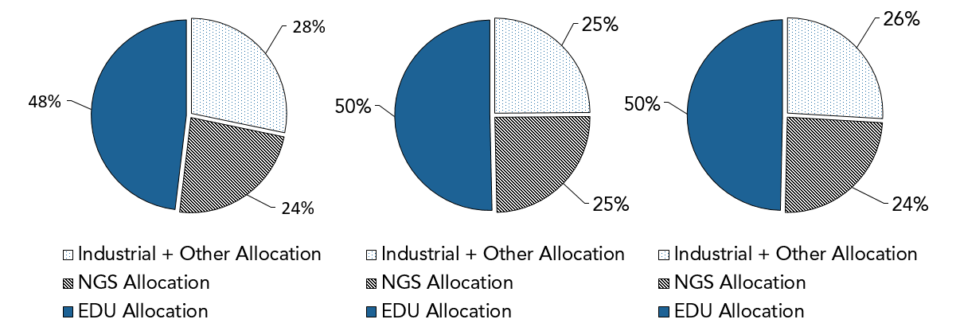
Overall Allowance Allocation (2 of 2)
2017 Allocation
2018 Allocation
2019 Allocation
Notes:
For vintage 2017, vintage 2018, and vintage 2019 allowance allocation, industrial allocation accounted for approximately one quarter of total allocation to entities; natural gas supplier allocation accounted for another quarter; and electrical distribution utility allocation for half of total allocation to entities. The industrial allocation quarter includes “other allocation,” which refers to allocation for legacy contracts, universities and public service facilities, waste-to-energy facilities, and public wholesale water agencies.

Slide 29
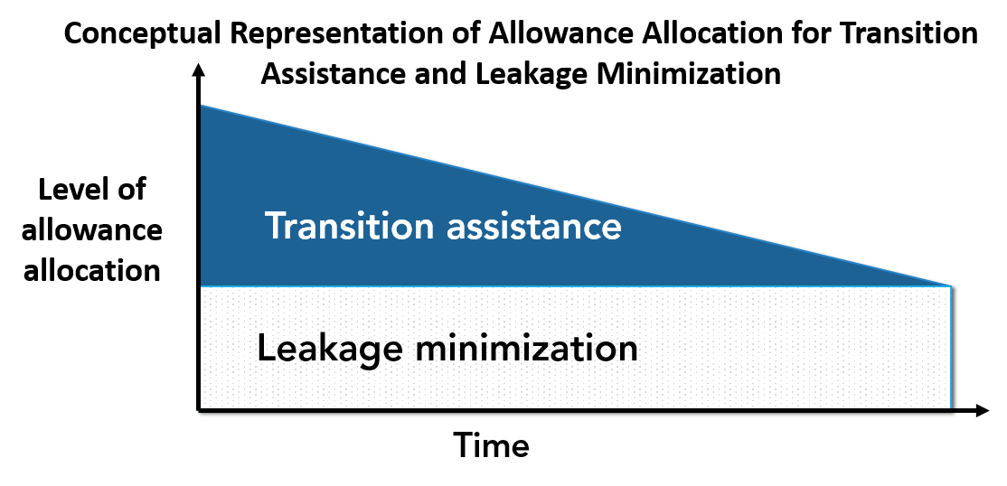
Allocation to Industry (1 of 2)
CARB provides industrial allowance allocation for:
Transition assistance to smooth the change to an economy with GHG costs
Industrial leakage prevention. AB 32 requires CARB to minimize emissions leakage, where a facility might cease operations in California and move those emissions to another state
Notes:
CARB allocates allowances to industrial entities to provide transition assistance and to prevent emissions leakage. Industrial allocation smooths the change to an economy with greenhouse gas emissions costs by giving industry time to identify and invest in cost-effective emission reductions. It also minimizes the risk that facilities will cease operations in California and move operations and associated emissions elsewhere.
The level of industrial allocation was initially scheduled to decline over time as industry adjusts to a greenhouse gas price and adopts energy-saving and greenhouse gas emissions-reducing strategies. The figure on this slide illustrates this concept, in which transition assistance in the early years of the Program alleviates short-term economic impacts and helps promote a smooth transition to a low-carbon economy. And it also illustrates that free allocation to minimize leakage will be maintained until adoption of similar greenhouse gas emission-pricing policies by other jurisdictions, such that free allocation will not be needed to shield entities from leakage risk.

Slide 30
Allocation to Industry (2 of 2)
Product-based methodology:
Level of allocation is based on actual facility production each year
CARB’s preferred approach
Energy-based methodology:
Applied only when product-based method is not feasible
Level of allocation is based on a fixed average historical energy use, which does not change each year
Notes:
The Regulation specifies two methodologies for calculating an industrial facility’s allowance allocation for a given year: the product-based methodology and the energy-based methodology. For the product-based methodology, the level of allocation is based on facility production and product-specific benchmarks. A benchmark is an emissions intensity metric, in units of metric tons of carbon dioxide equivalent per unit of product, based on sector-wide activity in baseline years. The allocation examples earlier in this presentation walked through the calculation of product-based allocation for dairies and refineries.
When the product-based methodology is not feasible because of facilities with complex processes or multiple products, or because needed data are not available, CARB uses the energy-based methodology to calculate allowance allocation. For the energy-based methodology, allocation is based on a fixed average historical energy use.

Slide 31
Allowance Allocation – Electrical Distribution Utilities (1 of 2)
Allocation to EDUs is based on annual estimated emissions from resources needed to serve electricity demand
EDU allocation is specified in the Regulation for each year from 2013 through 2030
Allocated allowance value must be used for the primary benefit of retail ratepayers
Majority of allowances must be consigned to auction
Majority of value is returned to ratepayers in the form of biannual climate credits
Other uses include: energy efficiency, renewable energy, building and transportation electrification
Notes:
Allocation to electrical distribution utilities is based on annual estimated emissions from resources needed to serve electricity demand. The Regulation specifies the level of allocation for each electrical distribution utility for the years 2013 to 2030, and CARB provides this information in Excel format on the Cap-and-Trade Program Data webpage in the 2013-2020 Electrical Distribution Utility Allocation Table and the Post-2020 Electrical Distribution Utility Allocation Table.
CARB has different rules for how different types of utilities can use their allowances.
Investor-owned electric utilities are required to consign all allowances to auction and provide the majority of the proceeds to ratepayers in the form of climate credits to residential ratepayers on their bills.
Publicly-owned electric utilities may use their allowances for compliance or to invest in GHG reducing activities such as energy efficiency, renewable energy, and building and transportation electrification. For more information on use of allowance value, see the Summary of 2013-2017 Electrical Distribution Utility Allocated Allowance Value Usage report on the Cap-and-Trade Program Data webpage.

Slide 32
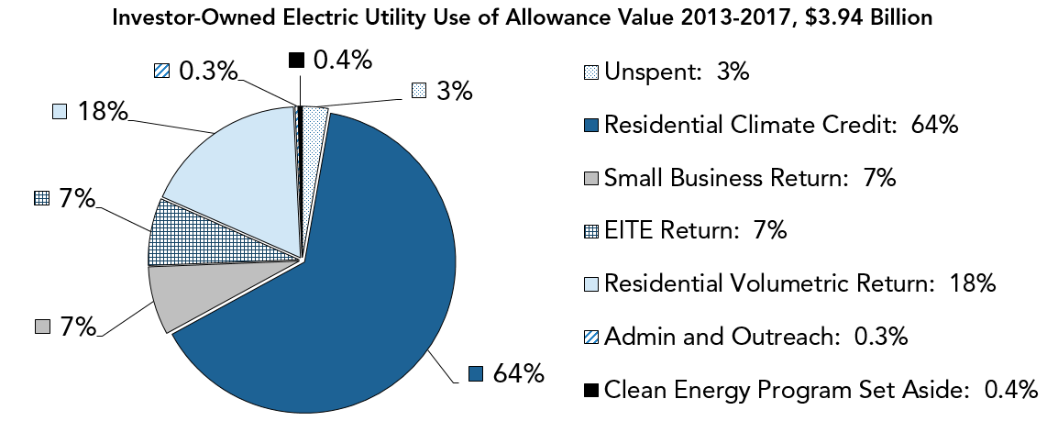
Allowance Allocation – Electrical Distribution Utilities (2 of 2)
Notes:
The example here shows a breakdown on the past use of those allowance proceeds by investor-owned utilities. For context, investor-owned utilities serve three-quarters of the state and receive two-thirds of the allowances allocated to electrical distribution utilities. Between the Residential Climate Credit and Residential Volumetric Return, 82% of the allowance value used from 2013 to 2017 was returned to residential customers. Seven percent was returned to small businesses and another 7% was returned to energy-intensive, trade-exposed (or EITE) industrial facilities.

Slide 33
Allowance Allocation – Natural Gas Suppliers
Allowances allocated to retail natural gas suppliers (NGS), for purpose of benefitting ratepayers
NGS Allocation = 2011 NGS Emissions x Cap Adjustment Factor
2019 NGS Sector total allocation = 48,047,665 MTCO₂e x 0.869 ≈ 41.8 Million Allowances
Past allocation to sector is shown on page 13 of the allowance allocation summary reports
NGS must consign an increasing portion of their allocated allowances to auction by 5% per year, so that 100% of allocated allowances must be consigned in 2030
Use of allowance value will largely be for residential California Climate Credits and building decarbonization programs
Notes:
CARB also allocates allowances to natural gas suppliers for the purpose of benefitting ratepayers. Allocation to natural gas suppliers is based on the emissions from the amount of gas they sold in 2011 times the allocation year’s cap adjustment factor, which represents the annual declining cap pursuant to the Regulation. The annual allowance allocation summaries posted on the Cap-and-Trade Program Data webpage provide the level of allocation to the sector for past years. The natural gas supplier information is in the last few pages of the report, following the industrial allocation table.
Natural gas suppliers are allowed to deposit a portion of their allowances for compliance. They must consign the remainder to auction and use the proceeds to benefit ratepayers. The portion of allocated allowances that natural gas suppliers must consign to auction increases 5% per year such that 100% must be consigned in 2030. Similarly to electrical distribution utilities, the majority of proceeds from the sale of allowances by natural gas suppliers is returned as a biannual climate credit to residential ratepayers. A portion of the proceeds is used for building decarbonization programs.

Slide 34
Auction Data (1 of 2)
Quarterly Auction Reports
Auction Notices: includes a summary of key auction dates and total allowances offered for sale (e.g., May 2019 Joint Auction Notice)
Summary Results Reports: summarizes allowances offered and sold, settlement prices, bid statistics, qualified bidders (e.g., May 2019 Joint Auction Summary Results Report)
Proceeds Reports – auction proceeds for State of California and investor owned and publicly owned utilities (e.g., California Post Joint Auction Public Proceeds Report for May 2019 Joint Auction)
Other Auction Reports
Auction Settlement Prices and Results Summary: summary providing allowances offered and sold, and settlement prices for each auction
Auction Proceeds Summary: a summary of auction proceeds to California and investor owned and publicly owned utilities for each fiscal year from the start of the Program
Annual Auction Reserve Price Notice: identifies the total number of allowances offered for sale and the California and Québec annual auction reserve prices
Notes:
Now let’s move on to a discussion of auction-related information. CARB provides auction data in three reports published for each quarterly auction, in running summary reports, and in an Annual Auction Reserve Price Notice. You can find these reports on the Cap-and-Trade Program Data and Auction Notices and Reports webpages. This slide provides links to the Auction Notices and Reports webpage (select the hyperlinked “Quarterly Auction Reports” heading) and to each report or recent example of the report. The auction data video module 4 provided on the next slide will walk through each of these reports and where to find them on the Cap-and-Trade Program webpage.
For each auction, CARB publishes an Auction Notice, a Summary Results Report, and a Proceeds Report. CARB publishes an Auction Notice 60 days prior to each auction. The Notice includes a summary of key auction dates and the number of allowances by vintage that will be offered at the auction.
CARB publishes a Summary Results Report five business days after each auction. Summary Results Reports provide the number of allowances offered and sold by vintage and by jurisdiction, settlement prices for the Current Auction and Advance Auction, qualified bid summary statistics, and a list of qualified bidders in the auction. Auction Notice and Summary Results Reports are jointly published by CARB and linked partner jurisdictions – so for current reports, you will see they are published by CARB and Québec.
CARB publishes a California Post Joint Auction Public Proceeds Report approximately four weeks after each auction. The Proceeds Report provides information about auction proceeds to the State of California and to investor-owned utilities and publicly owned utilities who consign allowances to auction.
The Auction Settlement Prices and Results Summary provides the number of allowances offered and sold and settlement prices for each auction. CARB updates this report quarterly when posting the Summary Results Report. Similarly, CARB updates the Auction Proceeds Summary quarterly when posting the California Post Joint Auction Public Proceeds Report. The Auction Proceeds Summary provides a summary of auction proceeds to the State of California and to investor-owned utilities and publicly owned utilities who consign allowances to auction by fiscal year.
The Annual Auction Reserve Price Notice, published each December, provides California and Québec’s annual auction reserve prices and allowances to be offered for sale in the upcoming year.

Slide 35
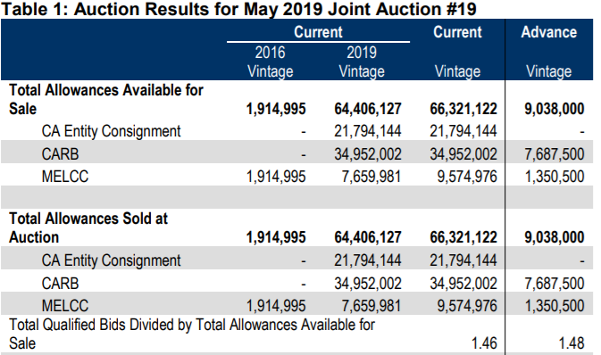
Auction Data (2 of 2)
Data published on Cap-and-Trade Program Data and Auction Notices and Reports webpages
The screenshot below is of a table from the Auction Summary Results Report for the May 2019 Joint Auction
Video Module 4: Auction Data
Notes:
CARB publishes auction data on the Cap-and-Trade Program Data webpage and on the Auction Notices and Reports webpage. Select the Video Module 4: Auction Data link to watch a 10-minute overview of auction reports. The figure on this slide shows the auction results table from the Summary Results Report for the May 2019 Joint Auction, which is discussed further in the auction data video module.

Slide 36
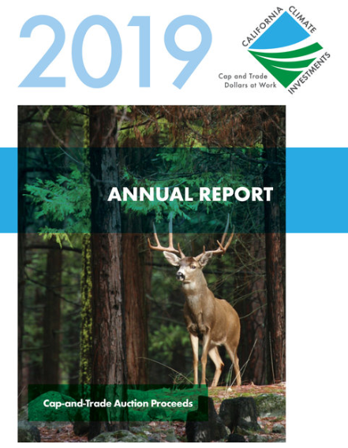
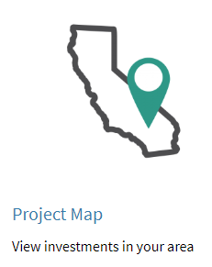
Auction Proceeds
Proceeds to California from the sale of State-owned allowances are deposited into the Greenhouse Gas Reduction Fund (GGRF)
The Legislature appropriates money from the GGRF to State agencies that administer California Climate Investments programs
$11.1 billion deposited to GGRF to date
$9.3 billion appropriated by legislature
$7.4 billion selected and awarded
California Climate Investments webpage
Summary of Auction Proceeds
Notes:
Auction proceeds from the sale of California State-owned allowances are deposited into the Greenhouse Gas Reduction Fund. The Legislature then appropriates money from this fund to State agencies that administer California Climate Investments programs. As of the May 2019 Joint Auction, approximately $11.1 billion have been deposited to the Greenhouse Gas Reduction Fund, as shown in the Auction Proceeds Summary report discussed previously and linked at the bottom of this slide.
The California Climate Investments program prepares annual reports that describe the status of funded programs and list the projects funded. The annual reports also estimate the greenhouse gas reductions expected from project investments and provide key statistics on benefits to disadvantaged communities, demand for funding, and leveraging, fiscal data, and program accomplishments.
As of the 2019 Annual Report released in March 2019, the Legislature has appropriated $9.3 billion to administering agencies and $7.4 billion have been selected and awarded to funding recipients.
This slide provides links to the California Climate Investments webpage, the 2019 Annual Report, and an interactive California Climate Investments Project Map.

Slide 37
Compliance Offset Program (1 of 4)
An ARB offset credit is a tradable compliance instrument issued by CARB that represents a GHG reduction or GHG removal enhancement of one metric ton of CO₂e
CARB issues offset credits to projects that meet stringent eligibility and quantification requirements specified in the Regulation and in approved Compliance Offset Protocols:
Livestock Projects
Mine Methane Capture Projects
Ozone Depleting Substances Projects
Rice Cultivation Projects
U.S. Forest Projects
Urban Forest Projects
Notes:
In addition to allowances, CARB issues offset credits for projects that meet stringent eligibility and quantification requirements. An “ARB Offset Credit” is a tradable compliance instrument issued by CARB that represents a GHG reduction or GHG removal enhancement of one metric ton of CO₂e. The GHG reduction or GHG removal enhancement must be real, additional, quantifiable, permanent, verifiable, and enforceable.
Offset credits represent real emission reductions that occur outside of covered sectors. All compliance offset projects must be developed according to CARB-approved Compliance Offset Protocols. CARB has adopted the following Compliance Offset Protocols: Livestock Projects, Mine Methane Capture Projects, Ozone Depleting Substance Projects, Rice Cultivation Projects, U.S. Forest Projects, and Urban Forest Projects.

Slide 38
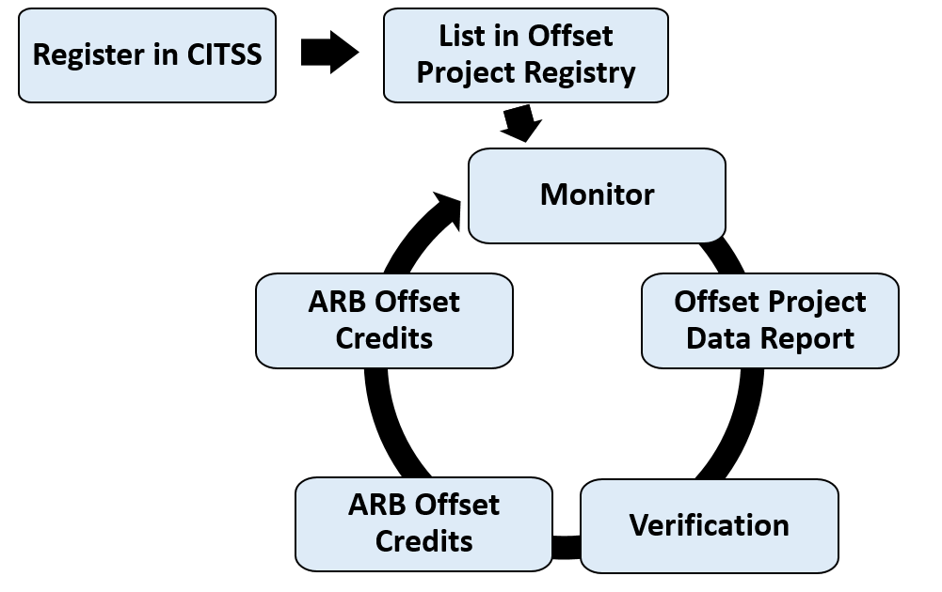
Compliance Offset Program (2 of 4)
ARB offset credits issuance process:
Notes:
The ARB offset credits issuance timeline is depicted here.
First, the Offset Project Operator – or OPO – registers in CITSS, which is necessary in order to possess offset credits.
Next, the OPO lists the project on an approved Offset Project Registry. To do so, they submit basic project information required by the Regulation and relevant Compliance Offset Protocol.
The OPO must then monitor project specific data as required by the Compliance Offset Protocol for the duration of a reporting period.
The OPO then develops and submits an Offset Project Data Report which provides detailed project information as required by the offset protocol.
An approved third-party verification body performs a detailed review and assessment of the Offset Project Data Report’s accuracy and conformance with the protocol requirements.
After verification, the OPO submits the project to the Offset Project Registry for Registry Offset Credit issuance. The Offset Project Registry reviews the Offset Project Data Report and the verification to ensure accuracy and conformance with protocol requirements before issuing the Registry Offset Credits.
The OPO then submits the project to CARB for ARB Offset Credits. CARB reviews the Offset Project Data Report and the verification to ensure accuracy and conformance with protocol requirements, and then issues ARB Offset Credits.
Compliance Offset Protocols require the OPO to monitor and report for every year. Verification is required to be issued credits, but the OPO may verify multiple reporting periods together to reduce costs.
CARB retains all decision making authority to issue compliance offsets and nothing related to policy or oversight of the program is delegated to the OPRs.
Entities may use offset credits to meet up to 8% of their covered emissions for 2013-2020. Per AB 398, the offset usage limit will decrease to 4% for 2021-2025 emissions, and then increase to 6% for 2026-2030 emissions. Starting with 2021 emissions, no more than one-half of the quantitative offset usage limit may be sourced from projects that do not provide direct environmental benefits in California.

Slide 39
Compliance Offset Program (3 of 4)
Offset Project Registries review project listing, reporting, and verification documentation using the Compliance Offset Protocols, and issue registry offset credits
Registry offset credits must be converted to CARB offset credits to be eligible for use in the Cap-and-Trade Program
Approved Offset Project Registries may also evaluate projects and propose offset protocols in the voluntary market. These activities are separate and distinct from CARB’s Compliance Offset Program
See the approved Offset Project Registry websites for information on listed compliance offset projects: Climate Action Reserve, American Carbon Registry, Verra
Notes:
There are three approved Offset Project Registries: the Climate Action Reserve, American Carbon Registry, and Verra. See these registry websites for information on listed compliance offset projects. Note that the registries may also evaluate projects and propose offset protocols in the voluntary market. These activities are separate and distinct from CARB’s Compliance Offset Program.

Slide 40
Compliance Offset Program (4 of 4)
CARB provides the total offset credits issued, project information, links to project documentation, and full project transparency from project location, project listing, issuance, and invalidation timeframes
Offset credits issuance data is updated every other Wednesday. A screenshot of the second tab (“Summary by Type”) of the ARB Offset Credit Issuance Table (an Excel file) as of September 9, 2020 is included below, showing the total number of credits issued:
The fourth tab (“ARB Offset Credit Issuance”) includes data for all issuances, including information identifying the project, its reporting period, its operator and verification body, its location and direct environmental benefits status (DEBS), and any credit retirements or invalidations.
Project Type | ODS | Livestock | U.S. Forest | Urban Forest | MMC | Rice Cultivation
Compliance | 16,174,507 | 5,364,267 | 142,792,709 | - - | 4,477,130 | - -
Early Action | 6,336,710 | 1,695,029 | 13,276,494 | - - | 2,879,684 | - -
Notes:
CARB releases a detailed report that includes a list of all offset projects that have been issued ARB offset credits. This table is updated at 12:00 p.m. (Noon) Pacific Time on the second and fourth business Wednesdays of every month. Information on the vintages and quantities of offset credits issued can be found by selecting the ”ARB Offset Credit Issuance” worksheet within the Excel file. Other worksheets within the Excel file explain the file’s contents and highlight recent updates. The main table includes over 25 columns providing a wealth of information about each issuance and links to project documentation.

Slide 41
Compliance Reports and Enforcement
Following each compliance event, a report is released summarizing the total compliance instruments surrendered by each entity with a compliance obligation
Report provides allowance totals by vintage and offset credits by project ID and quantity
Check the compliance status for facilities and entities registered in CITSS
For example, what can you do with the 2015-2017 Compliance Report?
Track the ARB GHG ID assigned to every covered facility or source to MRR annual data reports to calculate the total covered emissions for an entity
An entity may have one or multiple facilities registered to it; the total obligation is the sum of total covered emissions at the registered entity-level
An entity’s total instruments surrendered may be different from its reported emissions due to changes in facility ownership, deferred emissions, bankruptcy, or noncompliance
Enforcement: CARB continues to enforce rules to protect the integrity of the carbon market. Additional details on cases settled are available on the CARB Enforcement Webpage
Notes:
As mentioned earlier, CARB takes compliance with the requirements of the Cap-and-Trade Program very seriously. CARB posts a compliance report each year, reflecting the annual (or multi-year) emissions for each covered entity, and the types and quantities of compliance instruments surrendered by each entity for compliance. All entities that were required to surrender compliance instruments for the second compliance period met their obligations.
The summary report shows the breakdown of compliance instruments surrendered by each entity with a compliance obligation. The report includes details on the allowance totals by vintage and offset credits by project ID and quantity.
We often get the question: “What can you do with the Compliance Report?”
First, you can track an entity’s obligation back to its emissions. There is an ARB GHG ID assigned to every covered facility or source, which can be used to calculate the total covered emissions for an entity based on MRR’s annual data reports. An entity may have one or multiple facilities registered to it; the total obligation is assessed at the registered entity-level.
Second, for most entities, the total emissions generated during a compliance period will equate to the total compliance instruments surrendered. However, changes to facility ownership, deferred emissions, bankruptcy, or noncompliance may result in a difference between the verified aggregated entity-level emissions (i.e., an entity’s total calculated obligation), and the total instruments surrendered.
Finally, CARB continues to enforce rules to protect the integrity of the carbon market. Additional details on cases settled in lieu of litigation and those resolved by civil or criminal litigation are available on CARB’s Enforcement Settlements Webpage: https://ww2.arb.ca.gov/our-work/programs/enforcement-policy-reports/enforcement-case-settlements.

Slide 42
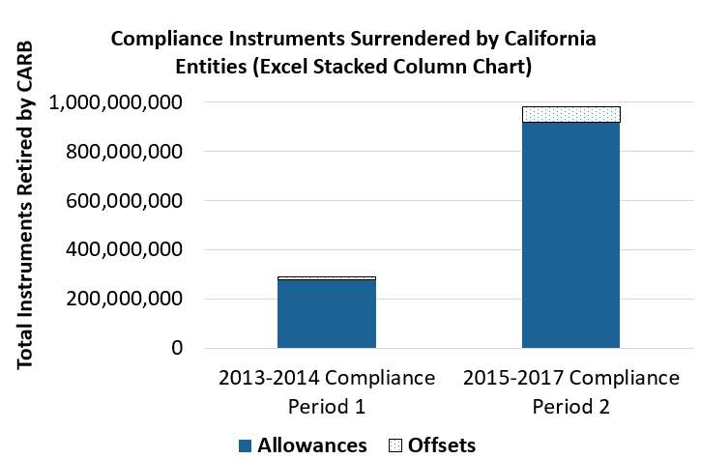
Compliance Instruments by Type Surrendered by CA Entities (CP1 and CP2)
Entities could use offset credits to meet up to 8% of their total compliance obligation
Offsets credits surrendered were 4.39% and 6.36% of the total obligation for Compliance Periods 1 and 2, respectively
Reductions from Compliance Offset Program are additional to in-state reductions expected under complementary climate programs. These reductions are not subtracted from the state inventory
Notes:
The Compliance Summary Reports available for each compliance event provide a detailed breakdown by entity on the number of compliance instruments and type used for compliance surrender. This information is useful as it can provide information on market interest for allowances and offset credits.
Entities are currently able to meet up to 8% of their total compliance obligation using offset credits. For Compliance Period 1, entities surrendered 12,773,097 offset credits, which calculates to 4.39% of the total compliance instruments surrendered. For Compliance Period 2, entities surrendered a total of 62,717,868 offset credits, which calculates to 6.36% of the total compliance instruments surrendered.
For Compliance Period 1 and Compliance Period 2, entities used a total of 75,490,965 offset credits, a small fraction compared to the 1,197,132,330 allowances surrendered by entities for compliance. This allowance total does not include those allowances used to meet the compliance obligation for the California Independent System Operator, or CAISO’s, Energy Imbalance Market or (EIM) outstanding emissions to EIM First Purchasers. This accounts for an additional 1,191,506 allowances that CARB retired. For additional information on the California’s Jurisdiction Retirement Account, refer to Video Module 1 or Slide 10 that provides a detailed explanation of each jurisdiction or entity account and the aggregated balances as reflected in the Compliance Instrument Report.
It is important to note that once issued by CARB, offset credits may be used for compliance with the Cap-and-Trade Program. However, they are not subtracted from the state inventory. For further information, refer to the California GHG Emission Inventory webpage on the next slide.

Slide 43
Links to Resources
Cap-and-Trade Program – Cap-and-Trade Program main page
Cap-and-Trade Program Data – all data reports published by the Cap-and-Trade Program
Overview of Public Data – four-page publication describing publicly available information
California GHG Emission Inventory – Program page for the California GHG Emissions Inventory
Mandatory Greenhouse Gas Emissions Reporting – Program page for Mandatory GHG Emissions Reporting
California Climate Investments – Program page for the California Climate Investments (reporting on use of auction proceeds)
Video Module 1: Understanding Compliance Obligations, Video Module 2: Compliance Instrument Report, Video Module 3: Understanding Industrial Allocation, Video Module 4: Auction Data
General Cap-and-Trade Contact Information: (916) 322-2037 or CACITSSRegistrar@arb.ca.gov
Notes:
The Cap-and-Trade Program home page was updated July 2019 to improve user interface and navigation. The new Cap-and-Trade Program Data webpage provides links to all data reports published by the Program, as well as links to data from related programs. The “Overview of Public Data” is a four-page document describing the Program’s publicly available information. The California GHG Emission Inventory, Mandatory Greenhouse Gas Emissions Reporting, and California Climate Investments links provide access to program pages with data related to the Cap-and-Trade Program. This slide also provides links to the four video modules shown in this presentation.
If there are any questions regarding this presentation material, you can call the Cap-and-Trade hotline (916) 322-2037 or email CACITSSRegistrar@arb.ca.gov. Thank you for watching this Cap-and-Trade Program presentation. We hope that this presentation has been helpful in explaining the types of data that CARB publishes related to the Program, where this information can be found, and how it can be used to better understand the linked California and Québec carbon market.

