Slide 1
Michelin’s GreenerFleets’ Comment to
The State of California’s Draft Priority Climate Action Plan
Created under
The U.S. Environmental Protection Agency’s Climate Pollution Reduction Grants Program
Feb 11, 2024
This document contains confidential or proprietary business information; not for public circulation

Slide 2
Table of Contents
Michelin’s GreenerFleets Overview
Fleet Survey
Transportation Emissions Reduction Roadmap
Proposed Transportation Measures: -
Proposal 1: Fleet Emissions Assessment
Proposal 2: Rebate Program to Upgrade Vehicle Equipment
Proposed Waste Measure: -
Proposal 3: Tire and Re-Tread Material Recycling Projects
Michelin’s GreenerFleets Contact Information, Next Step and Proposal
This document contains confidential or proprietary business information; not for public circulation

Slide 3
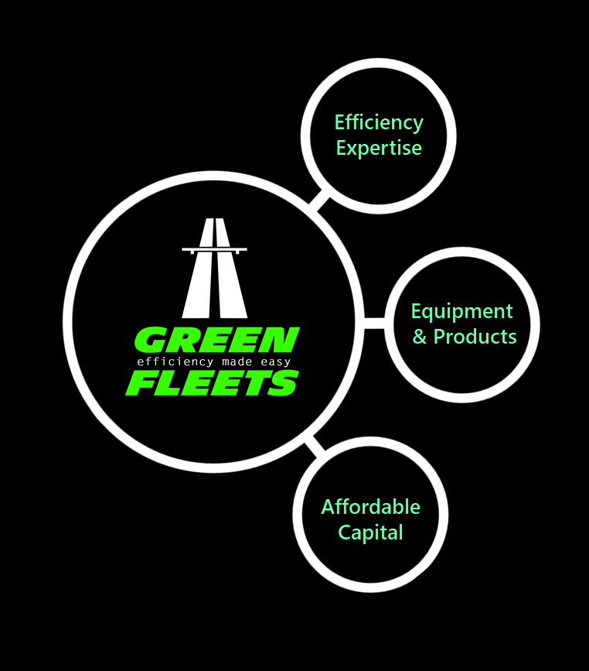
GreenerFleets: the expert in improving fuel efficiency by connecting fleets with expertise and green capital

Slide 4
5 Year Emission Reduction Roadmap
Fleets Survey
GreenerFleets has recently conducted a comprehensive North America survey with transportation fleets in North America:
to have a representative understanding of their current status and current activities in planning or executing their sustainability goals;
to understand the obstacles today’s fleets are facing in meeting their sustainability obligations;
to understand their needs and areas where the fleets would like to see support.
Some highlighted findings are below:
Profitability and financial viability are prioritized before sustainability
Challenges specific to transitioning fleets to zero emission include: 1) existing infrastructure conditions; 2) equipment costs, 3) lack of time and knowledge.
Desired training on 1) calculating environmental footprints 2) implementing infrastructure changes, and 3) understanding best practices for fuel efficiency and tire wear
Many fleets lack familiarity with specific programs like the DERA Act and California HVIP and hence the non-utilization of incentives is attributed to perceived non-applicability or lack of awareness.
Seek government assistance to support and fuel infrastructure advances. They express a clear need for comprehensive information, including detailed plans, estimated costs, and ROI insights for smoother fleet conversion.
To support the small and medium sized fleet which have the least resources for sustainability effort, GreenerFleets is proposing a holistic and phased Transportation Emissions Reduction Plan described in this comment package. GreenFleets would like to request an opportunity to discuss the proposed 3 measures and explain further in detail in one-on-one meeting.
This document contains confidential or proprietary business information; not for public circulation

Slide 5
Tranportation Emissions Reduction Roadmap
5 Year Emission Reduction Roadmap
Michelin’s GreenerFleets proposes a roadmap approach of programs for statewide emission reduction targeting to benefit Small/Medium Fleets and Fleets in Rural Areas.
- Each measure works independently yet synergistically as a holistic Transportation Emissions Reduction Roadmap
YEAR
YEAR
YEAR
YEAR
YEAR
1
2
3
4
5
Fleet Emissions Assessment
Fleet Emissions Assessment
Rebate to Upgrade Vehicle Equipment
Tire and Re-Tread Material Recycling to Reduce Landfill
This document contains confidential or proprietary business information; not for public circulation

Slide 6
Proposal 1: Fleet Emissions Assessments
Fleet Survey Data : Survey data shows fleets have identified lack of knowledge and time to understand or execute sustainability practices including fleet decarbonization and would like help in calculating their emissions footprint
Proposed Solution: Provide fleets a detailed assessment of their fleets using their real operation and route data and provide decarbonization and fleet conversion ideas and roadmap to reduce CO2 emissions. The assessment needs to be sufficiently comprehensive and credible in order to enable fleets operators to make confident decisions in fleet conversion and to meet their ROI targets.
Benefits: 1) Instill confidence in fleet operators in fleets decarbonization by understanding their current fleet emissions footprint, fleet upgrade options and conversion roadmap to reduce emissions overtime, technologies that works with their real operation, and getting the support in seeking private financing from banks and private capitals. 2) Create a realistic real world emission inventory for fleets that can be used by government agencies in planning policies and regulations, financing companies in providing vehicle loans, by technology suppliers in vehicle and infrastructure planning
Emission Impact : Long term emissions reduction comes from fleet conversion, approx. 118,172 tonnes of CO2 emissions can be potentially avoided per year by every 1,000 class 8 trucks converted from diesel to fully electric*.
Implementation Time/Project Duration : 1.5 Years
Estimated Budget for Implementation: Approx. $5 million for every 1000 fleets
Direct Social Benefits: Emissions reduction, job creations, stimulate private financing for zero emission heavy duty vehicles, fleet economic and technology stimulation
*According to the Environmental Protection Agency, there are 10,084 grams of CO2 emissions per gallon of diesel. On average, 1,000 Class 8 EV trucks will eliminate approximately 118,172 tonnes of CO2 emissions per year assuming 100% zero carbon energy source, truck operation profile of 300 miles per day, 5 days per week, 50 weeks per year, 75,000 miles annually and 6.4 mpg diesel fuel consumption rate. https://www.nrc.gov/docs/ML1204/ML120440122.pdf and **https://nacfe.org/research/run-on-less-2017/, average fuel economy , national average 6.4 mpg for average gross weight of 55,498 lbs
This document contains confidential or proprietary business information; not for public circulation

Slide 7
Proposal 2: Rebate Program To Upgrade Vehicle Equipment
Fleet Survey Data : Fleets interviewed have expressed that they put profitability and return of investment before sustainability. They would like help with equipment cost to maintain acceptable profitability while improving carbon footprint
Proposed Solution: Provide subsidy to fleets to upgrade existing vehicle equipment that improves fuel efficiency such as aero dynamics equipment, low rolling resistance tires, anti-Idling devices, advance telematics, driver behavior monitoring to reduce CO2 emissions for ICE vehicles. This solution is particularly helpful to fleets that are in hard-to-reach regions or rural areas where electric or hydrogen fueling infrastructure is not available.
Benefit : Immediate emission reduction impacts. Upgrading a fleet's existing equipment represents one of the most effective ways to achieve fast, scalable, and cost-effective CO2 reduction during the transition period to zero emissions.
Emission Impact : Approx. 10% reduction in a fleets total CO2 emissions. As a datapoint referencing the Canada’s Green Freight Program 2023 implementation data, 1,600 metric tonnes of C02 emissions avoidance identified per year at full implementation for an average fleet size of 143 vehicles
Implementation Time/Project Duration : 1 – 2 Year
Estimated Budget for Implementation : $20M+, 50% subsidy of eligible equipment up to a total cap per fleet based on the equipment type proposed in the fleet assessment.
Direct Social Benefits: Support rural area or hard-to-reach areas fleets with no zero emissions vehicles or near-term fleet conversion ability or lack electric charging or hydrogen fueling infrastructure support; immediate emissions reduction, fossil fuels consumption reduction
Reference : Similar program implemented by Natural Resources Canada - Canada’s Green Freight Program has helped hundreds of fleets make a real carbon footprint impact. Green Freight Program Applicant’s Guide: Stream 1 (canada.ca)
This document contains confidential or proprietary business information; not for public circulation

Slide 8
Example of one fleets potential savings
Equipped with baseline tires,
this fleet generates:
47,870
Fewer Tons
Of CO2
(847,696 Tons of CO2)
Simple changes to existing tires fleets can have major impacts to C02
895,566
Tons of CO2
This is the CO2 reduction equivalent of removing
from the road.
449 Trucks
*The fuel and mileage savings calculations shown are estimates for comparison purposes only. Rolling resistance numbers are determined using drum tests according to ISO 28580 procedures. Actual fuel consumption and mileage performance will vary due to factors such as air pressure maintenance, vehicle components, driver techniques, climate and road conditions and aerodynamics.
This is in reference to steer and drive wheel positions only
Notes:
Specify the tires we are comparing
Based on annual mileage of 90,000 and 8,400 tractors
Baseline MPG – 8.5
Load – 70,000
Speed – GEM 55mph 22%, GEM 65mph 54%
6x4 tractor
Based on Michelin ISO28580 internal rolling resistance testing

Slide 9
Proposal 3: Tire and Re-Tread Material Recycling Projects
Opportunity to Reduce Waste and Recycle Material: Supporting tire retread facilities represents a unique opportunity for a truly circular economy. Retreading a tire and recycling the retread materials have significant positive environmental benefits by minimizing landfills. Especially for tires that do not meet safety requirements will need to be scrapped, by providing retreading facilities with equipment to shred and recycle these tires would be environmentally and economically beneficial. Retread facilities are good funding target entities as they are the aggregator for the used tire stream.
Proposed Scope: Provide equipment acquisition subsidy or grant funding to allow tire retreading facilities to acquire technologies, equipment or know-how to grind and process tries that cannot be retreaded and to process retread material into reusable material. This is a very scalable emission and waste reduction project that can be easily and efficiently duplicated to all states.
Benefits:
Minimize waste and landfills and significant emissions reduction.
Enhance circular economy for tire materials.
Encourage job creation for an untapped segment of the tie recycling industry. Encourage used tired collection from rural areas and potentially adding new business opportunities for remote tire processing facilities.
Emission Impact : 87 to 341 kg CO2e per ton of tire material recycled *
Implementation Time : 1 - 3 Year
Estimated Budget for Implementation : $500K to 1M per project location
* https://www.google.com/url?sa=t&rct=j&q=&esrc=s&source=web&cd=&cad=rja&uact=8&ved=2ahUKEwiPgPKOtJyEAxXtSDABHRlvAt4QFnoECCQQAQ&url=https%3A%2F%2Fcmshredders.com%2Fwp-content%2Fuploads%2F2017%2F03%2FFinalRubberTireRecyclingCarbonFootprint.pdf&usg=AOvVaw159TH6G8D5HF6ArDb09DZK&opi=89978449
This document contains confidential or proprietary business information; not for public circulation

Slide 10
Contacts Information, Next Step and Proposal
Contact Information:
Raymond Cotton
Director, GreenerFleets
Raymond.Cotton@Michelin.com
Next Step and Proposal:
GreenerFleet would like to request a one-on-one meeting to discuss all proposed measures in this comment package in further details, and also urge the possibilities to include the proposed 3 measures in the priority climate action plan for the benefits of the small and medium fleets communities, rural area community as well as beneficiaries of the recycling industry.
This document contains confidential or proprietary business information; not for public circulation

